Slide 1
Data Structures Project
Chess Implementation Using Graphs.
Made By-
Waris K R
Tushar Dixit

Slide 2
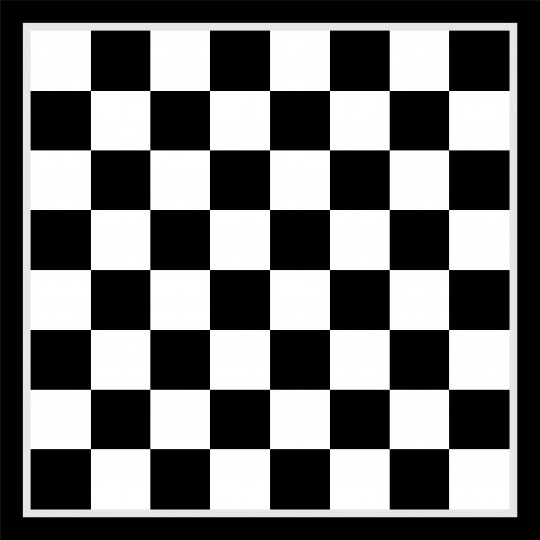
a
b
c
d
e
f
g
h
White
(Computer)
1
2
3
4
5
6
4
3
2
3
2
1
1
1
1
1
1
1
1
1
3
4
5
6
7
7
7
7
7
7
7
7
7
(Player)
Black
8
8
9
10
11
12
10
9
8
Initial Board Positions

Slide 3
Graph for some Initial Board Positions
2a
(Pawn)
1b
(Knight)
0
0
0
0
3a
3c
4a
3b
0
2b
0
2c
0
4b

Slide 4
How a white piece moves
Once The Graph is formed, We search for the highest weight in the graph and prefer a move which gets us closer to the Black King and store it’s position.
2a
(Pawn)
1b
(Knight)
0
0
0
0
4a
3a
3c
3b
0
2b
0
2c
4b
0

Slide 5
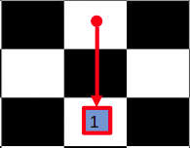
What Happens after a White Piece Moves?
After we move a piece the previous position gets empty and the new position gets filled, so to make correction to the graph we find the first white piece in all directions for both positions and make changes to the graph according to it.

Slide 6
a
b
c
d
e
f
g
h
1
2
3
4
5
6
4
3
2
3
2
1
1
1
1
3
4
1
5
6
7
7
7
7
7
7
7
7
7
8
8
9
10
11
12
10
9
8

Slide 7
a
b
c
d
e
f
g
h
1
2
3
4
5
6
4
3
2
3
2
1
1
1
1
3
4
1
5
6
7
7
7
7
7
7
7
7
7
8
8
9
10
11
12
10
9
8

Slide 8
a
b
c
d
e
f
g
h
1
2
3
4
5
6
4
3
2
3
2
1
1
1
1
3
4
1
5
6
7
7
7
7
7
7
7
7
7
8
8
9
10
11
12
10
9
8

Slide 9
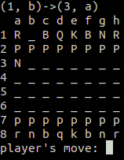
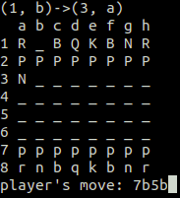
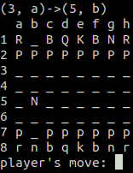
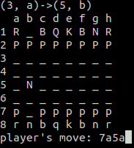
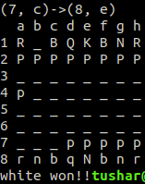
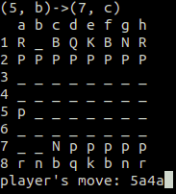
Demonstration

Slide 10
Data Structure used
We have used graph data structure and it has been represented in adjacency matrix form. Since each node of the graph has two numbers, we used to a 4d array to represent the graph. Example:
matrix[previous x coordinate][previous y coordinate][next x coordinate][next y coordinate]

Slide 11
Algorithm Used:
We have used linear search to find the highest weight in the graph for the best move of the computer. The complexity of the search never changes because the size of the graph is always same I.e. it contains 8x8x8x8 elements in the graph as adjacency matrix. So the time complexity is constant. i.e. O(1).

