Slide 1
QueueBo
Smart Traffic Optimization in the New Capital
Team 4
Notes:
Youssef

Slide 2
Who Are We?
Team 4:
Omar Ayoub
Bassel Ahmed
Mohamed Ahmed
Hassan Khalifa
Youssef Kamel
Mentors:
James Austin Myer (Mentor)
Ahmed Saad El Fiky (Mentor)
Notes:
Youssef

Slide 3
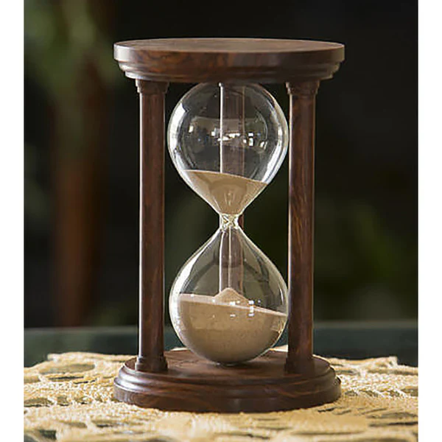
Every Second Counts
Survival to 30 days is 19.5% when EMS arrives within 0–6 minutes, but drops to 9.4% when arrival is 10 minutes or later
Each minute of delay in CPR reduces neurologically favorable 1-month survival by approximately 6.4%¹
And a lot other cases …
¹varying by rhythm type (e.g., 8.3% for VF/pVT)
Notes:
Youssef

Slide 4
Table of Contents
“Why does it matter?” & problem statement
Cost Matrix
Classical Approach
Quantum Approach
via paper
via subsets
Quantum vs. Classical
Future Directions
Notes:
Youssef

Slide 5
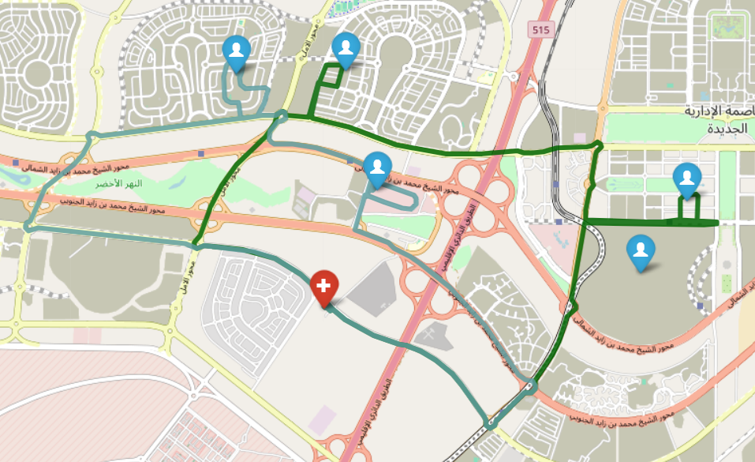
Problem Statement
Emergency Patient Transportation Challenge Scenario: 5 patients need urgent transport to a hospital . You have 1 ambulance.
Constraints:
Each ambulance can make multiple trips
Maximum 3 stops per trip (3 patient per stop)
All patients must reach the hospital
Objective:
Find the optimal routes that minimize total travel distance.
Notes:
Youssef

Slide 6
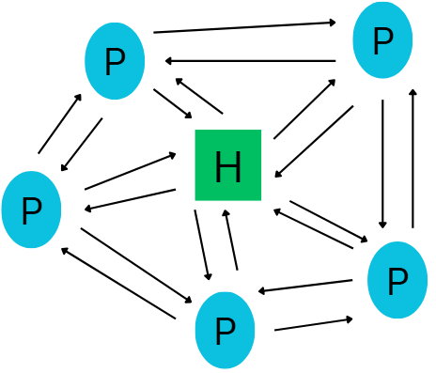
Preprocessing & Mathematical Setup
Mathematically: discover a shortest path on a
directed weighted graph where
the location of each patient is a vertex, and
the 1st vertex is reserved for the location of the hospital
Notes:
Bassel

Slide 7
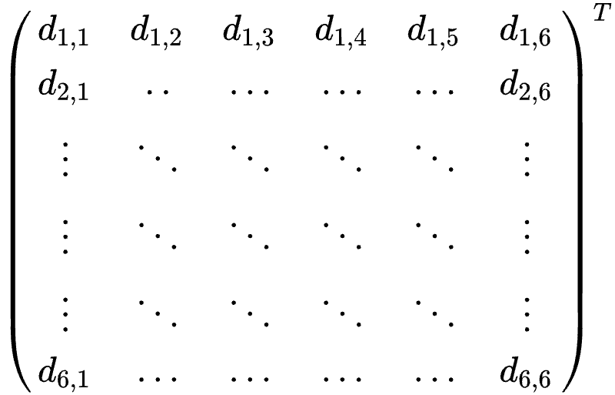
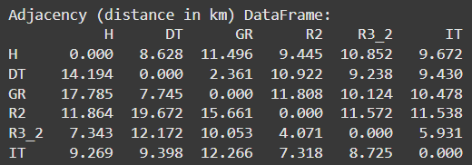
Cost Matrix
We use a map API to calculate the distances between patients and
construct the cost matrix
Notes:
Bassel
\left(
\begin{array}{cccccc}
d_{1,1}&d_{1,2}&d_{1,3}&d_{1,4}&d_{1,5}&d_{1,6}\\
d_{2,1}&..&...&...&...&d_{2,6}\\
\vdots&\ddots&\ddots&\ddots&\ddots&\vdots\\
\vdots&\ddots&\ddots&\ddots&\ddots&\vdots\\
\vdots&\ddots&\ddots&\ddots&\ddots&\vdots\\
d_{6,1}&...&...&...&...&d_{6,6}
\end{array}
\right)^T

Slide 8
Classical Approach
Brute Force,
Heuristic (Greedy),
A* Search,
Mixed Integer Linear Programming
Notes:
Bassel

Slide 9
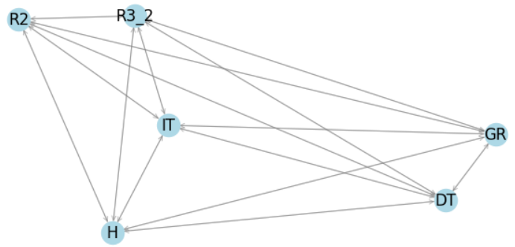
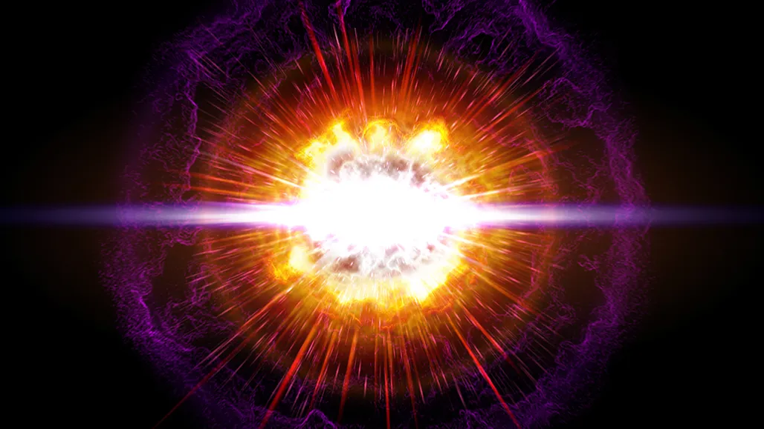
Classical Approach 1: Brute Force
Going through all possible subsets. Computationally Intensive
Combinatorial explosion!
Notes:
Bassel

Slide 10
Classical Approach 2: Heuristic
Add closest next node to our subset
Doesn’t necessarily yield accurate results with all test cases
Notes:
Bassel

Slide 11
Classical Approach 3: A* Search
Since we work on a graph, we use graph search algorithms.
Why A*? Complete & Optimal (guaranteed to find a solution if one exists)
Notes:
Bassel

Slide 12
Classical Approach 4: MILP
Well-suited for constrained optimization
Linear objective function (distance)
Notes:
Bassel

Slide 13
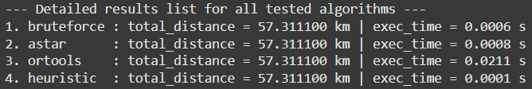
Classical Approach Results:
A heuristic approach aces the problem with the current constraints, but for larger maps, brute force and heuristic are going to fall behind.
Notes:
Bassel

Slide 14
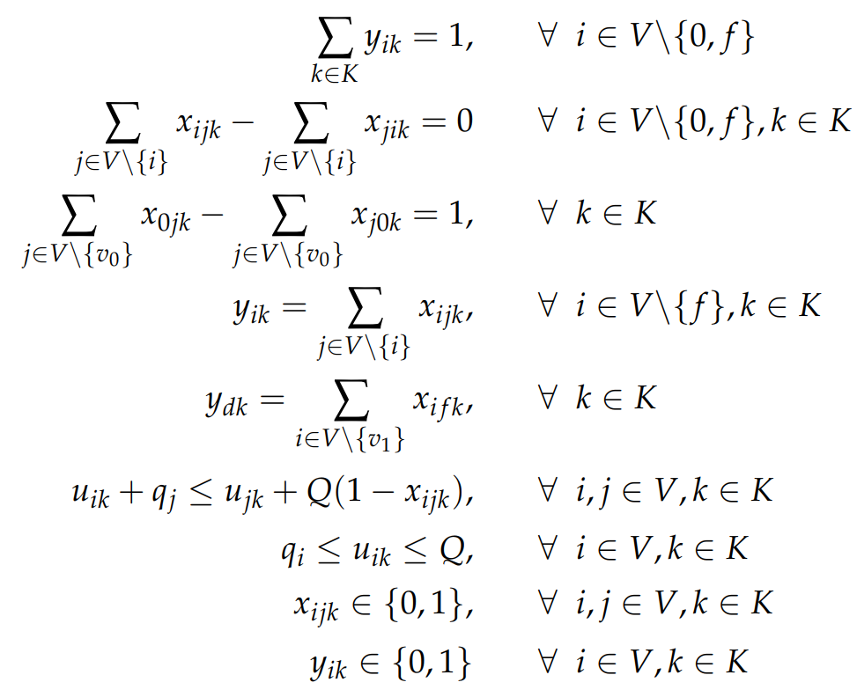
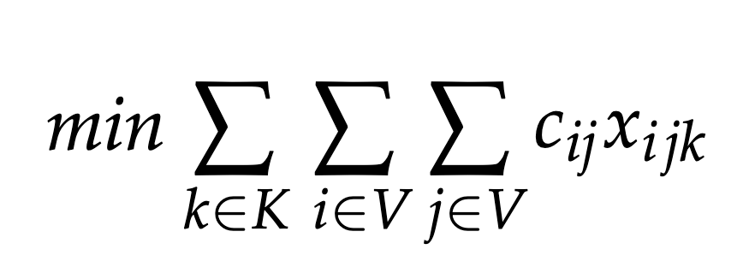
Quantum Approach 1: Initial Idea
We learned from “Capacitated vehicle routing problem with column generation and reinforcement learning techniques” that our problem is a “capacitated vehicle routing problem” (CVRP) with objective function & constraints:
K indexes the trip number,
V indexes the vertices/patients
Notes:
Omar

Slide 15
Quantum approach 1 - Refinement
The prior approach requires (a priori)
maximum # of trips x # of initial vertices x # of final vertices = 5 x 6 x 5 = 180
qubits:
In an effort to reduce the number of qubits from 180 down to 60, we assume the average optimal solution takes 2 trips.
Notes:
Omar

Slide 16
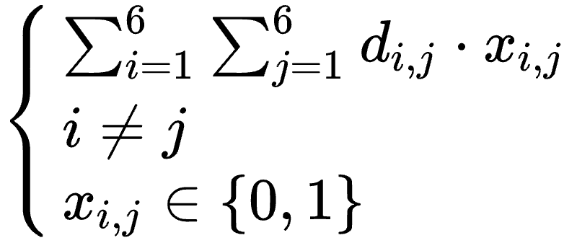
Quantum Approach 1: Cost/objective function
We reduce the number of qubits from 60 to 30 by encoding the “2 trip” hypothesis as two joint constraints, explained later, to this objective function:
Notes:
Omar \begin{cases}
\sum_{i = 1}^6\sum_{j = 1}^6d_{i, j}\cdot x_{i, j}\\
i\neq j\\
x_{i, j}\in\{0, 1\}
\end{cases}

Slide 17
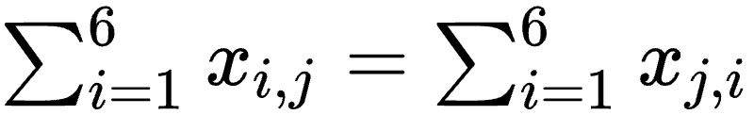
Quantum Approach 1: Constraints – “Enter-leave”
To ensure the ambulance returns to the hospital on each trip, we require each vertex be entered as many times as it is left.
Notes:
Omar \sum_{i = 1}^6 x_{i, j} = \sum_{i = 1}^6 x_{j, i}

Slide 18
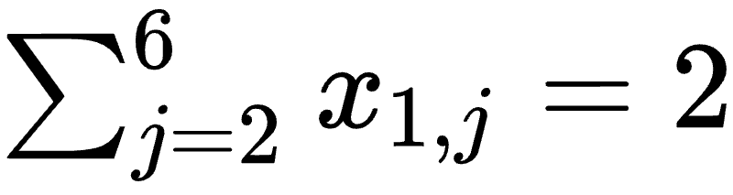
Quantum Approach 1 : Constraints – 2 trips
We limit the number of trips to exactly 2 by setting the number of outgoing edges to 2.
Notes:
Omar \sum_{j = 2}^6 x_{1, j} = 2

Slide 19
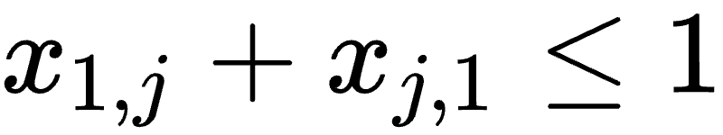
Quantum Approach 1 : Constraints - no little loops
The previous 2 constraints yield 2 possible ways to make the trips {2, 3}, {1, 4} we only need {2, 3}, to prevent the second case from being considered we disallow taking only 1 patient in the trip.
Notes:
Omar x_{1, j} + x_{j, 1} \leq 1

Slide 20
\sum i,j x_i,j \le 4

Slide 21
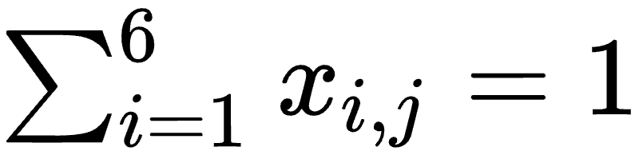
Quantum Approach 1 : Constraints - Visit all Nodes
To visit all patients, every vertex should have 1 edge coming from a different vertex.
Notes:
Omar
\sum_{i = 1}^6 x_{i, j} = 1

Slide 22
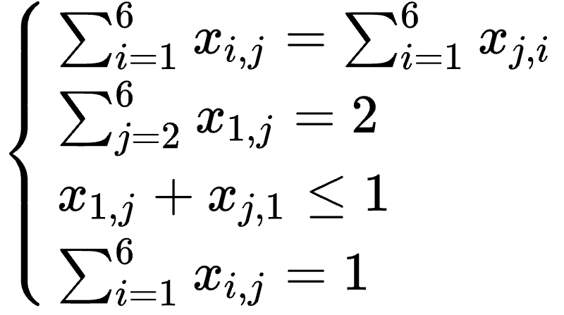
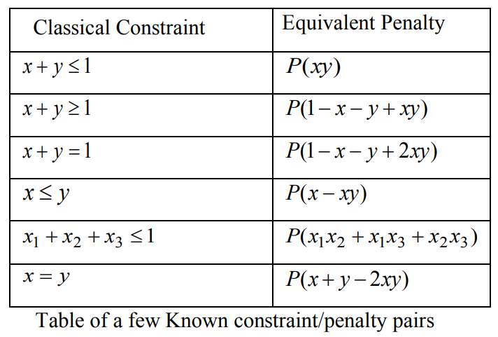
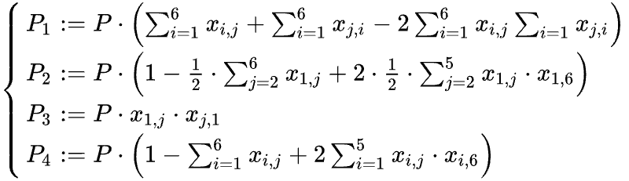
Quantum Approach 1: Formulating the QUBO
We draw our inspiration from Glover et al. to include the constraints in the objective function
Notes:
Mohamed
\begin{cases}
\sum_{i = 1}^6 x_{i, j} = \sum_{i = 1}^6 x_{j, i}\\
\sum_{j = 2}^6 x_{1, j} = 2\\
x_{1, j} + x_{j, 1} \leq 1\\
\sum_{i = 1}^6 x_{i, j} = 1\\
\end{cases}
\begin{cases}
P_1:=P\cdot\left(\sum_{i = 1}^6x_{i, j} + \sum_{i = 1}^6x_{j, i} - 2\sum_{i = 1}^6 x_{i, j}\sum_{i = 1}x_{j, i}\right)\\
P_2:=P\cdot\left(1 - \frac{1}{2}\cdot\sum_{j = 2}^6x_{1, j} + 2\cdot\frac{1}{2}\cdot\sum_{j = 2}^5 x_{1,j}\cdot x_{1, 6} \right)\\
P_3:=P\cdot x_{1, j}\cdot x_{j, 1}\\
P_4:=P\cdot\left(1 - \sum_{i = 1}^6x_{i, j} + 2\sum_{i = 1}^5 x_{i, j}\cdot x_{i, 6}\right)
\end{cases}

Slide 23
Quantum Approach 1: Final QUBO form
Combining all of the constraints with the objective function:
Notes:
Mohamed
Q(x) = \sum_{i = 1}^6\sum_{j = 1}^6d_{i, j}\cdot x_{i, j} + P_1 + P_2 + P_3 + P_4//

Slide 24

1. Problem Formulation
2. Convert QUBO → Ising Hamiltonian
Start with a combinatorial optimization problem (e.g., TSP, MaxCut).
Express it as a QUBO:
Start with a combinatorial optimization problem (e.g., TSP, MaxCut).
Express it as a QUBO:
Notes:
\text{min}_{x\in\{0, 1\}^n}x^TQx
\{0, 1\}\ni x_i\mapsto z_i\in\{+1, -1\}

Slide 25
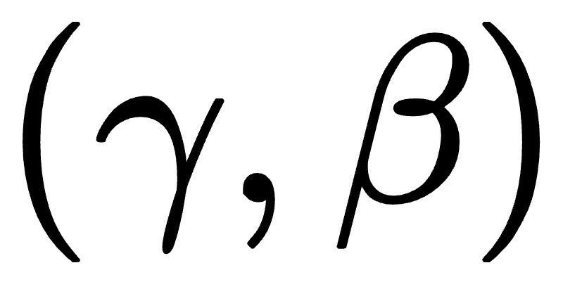

3. Define Cost Hamiltonian in QAOA
4. Variational Optimization
The Ising Hamiltonian HCH_CHC​ from QUBO is used as the cost Hamiltonian.
QAOA alternates between:
Cost Hamiltonian evolution (encode problem).
Mixer Hamiltonian evolution (explore solution space).
Use a classical optimizer to tune QAOA parameters
Minimize expected energy
The solution corresponds to the optimal QUBO assignment.
Notes:
(\gamma, \beta)
\langle\psi|H|\psi\rangle

Slide 26
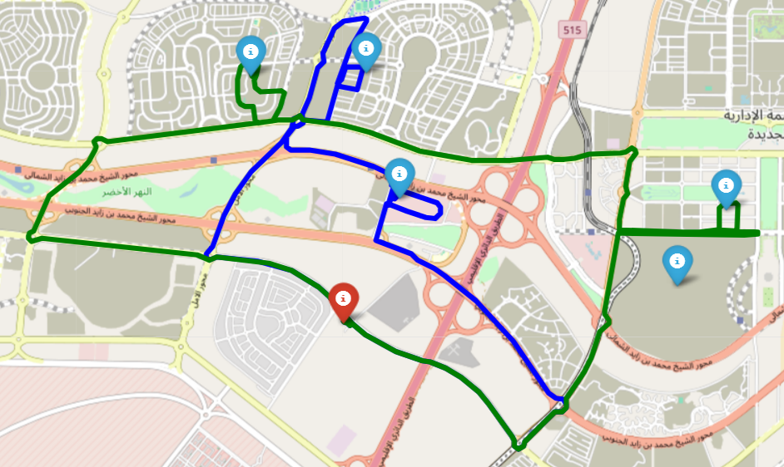
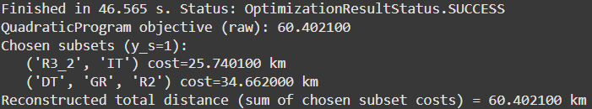
Another Quantum Approach
QUBO with 25 (& later 5) qubits applied to discover minimum over all partitions of 5 patients into subsets that contain patients 1-3, choosing optimal combinations of patients from each subset

Slide 27
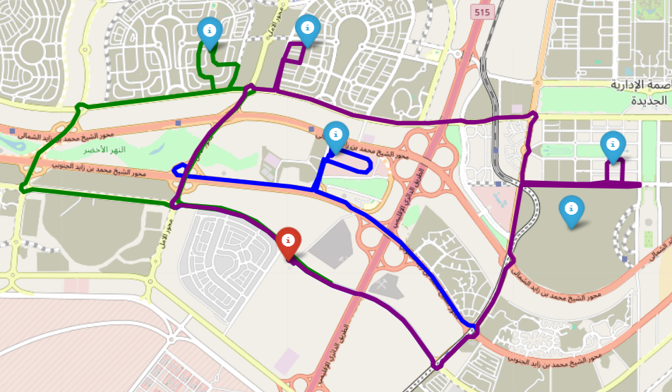
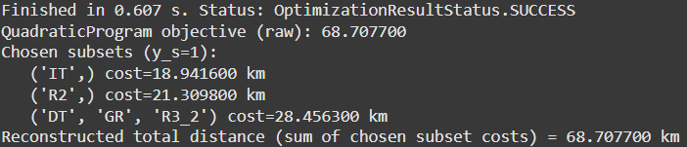
Now, with 5 Qubits

Slide 28
Classical vs. Quantum
Quantum advantage?
As the number of patients increases, classical algorithms will struggle:
Brute Force (O(n!))
Heuristic (Greedy) O(n^4)
A* Search (O(b^{d}), where b branch factor & d is least depth)
Mixed Integer Linear Programming (O(2^{n}))
Via QUBO, for n binary variables, we must search over 2^{n} (< n!) binary vectors, so O(2^{n})
Notes:
Hassan

Slide 29

Hybrid Approach?
Hybrid quantum reduces qubits without losing accuracy,
combining
classical preprocessing with
quantum optimization.
Notes:
Hassan

Slide 30
Future Work
Serve more Patients with less qubits
Explore High Order Binary Optimization (HUBO)
Update Distance Function to include Traffic
Notes:
Hassan

Slide 31
Citations
[1]N. G. Bircher et al., “Delays in Cardiopulmonary Resuscitation, Defibrillation, and Epinephrine Administration All Decrease Survival in In-hospital Cardiac Arrest,” Anesthesiology, vol. 130, no. 3, pp. 414–422, Mar. 2019, doi: https://doi.org/10.1097/aln.0000000000002563.
J. Holmén et al., “Shortening ambulance response time increases survival in out‐of‐hospital cardiac arrest,” Journal of the American Heart Association, vol. 9, no. 21, Nov. 2020, doi: https://doi.org/10.1161/jaha.120.017048.
I. A.A, L. N., A. R.O, and I. J.A, “CAPACITATED VEHICLE ROUTING PROBLEM,” International Journal of Research -GRANTHAALAYAH, vol. 7, no. 3, pp. 310–327, Mar. 2019, doi: https://doi.org/10.29121/granthaalayah.v7.i3.2019.976
“Capacitated Vehicle Routing Problem formulation — AIMMS How-To,” how-to.aimms.com. https://how-to.aimms.com/Articles/332/332-Formulation-CVRP.html
F. Glover, G. Kochenberger, and Y. Du, “Quantum Bridge Analytics I: a tutorial on formulating and using QUBO models,” 4OR, vol. 17, no. 4, pp. 335–371, Nov. 2019, doi: https://doi.org/10.1007/s10288-019-00424-y.

