Slide 1
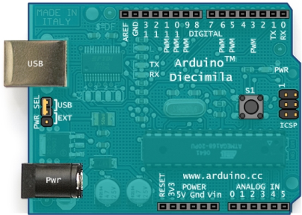
Monterey
Onboard the ROV
CAT5 Ethernet cable
Motor
Motor
Motor
ESC
ESC
ESC
Digital Compass
(i.e. HMc6352)
Voltage Sensor
(i.e. P1135)
Depth Sensor (i.e. Phidgets P1115 in housing)

