Slide 1


QML Lecture Series - 2
Intro to Quantum Machine Learning
https://cglink.me/22J/c38604392504131
Check in here!
Join us on SDC

Slide 2
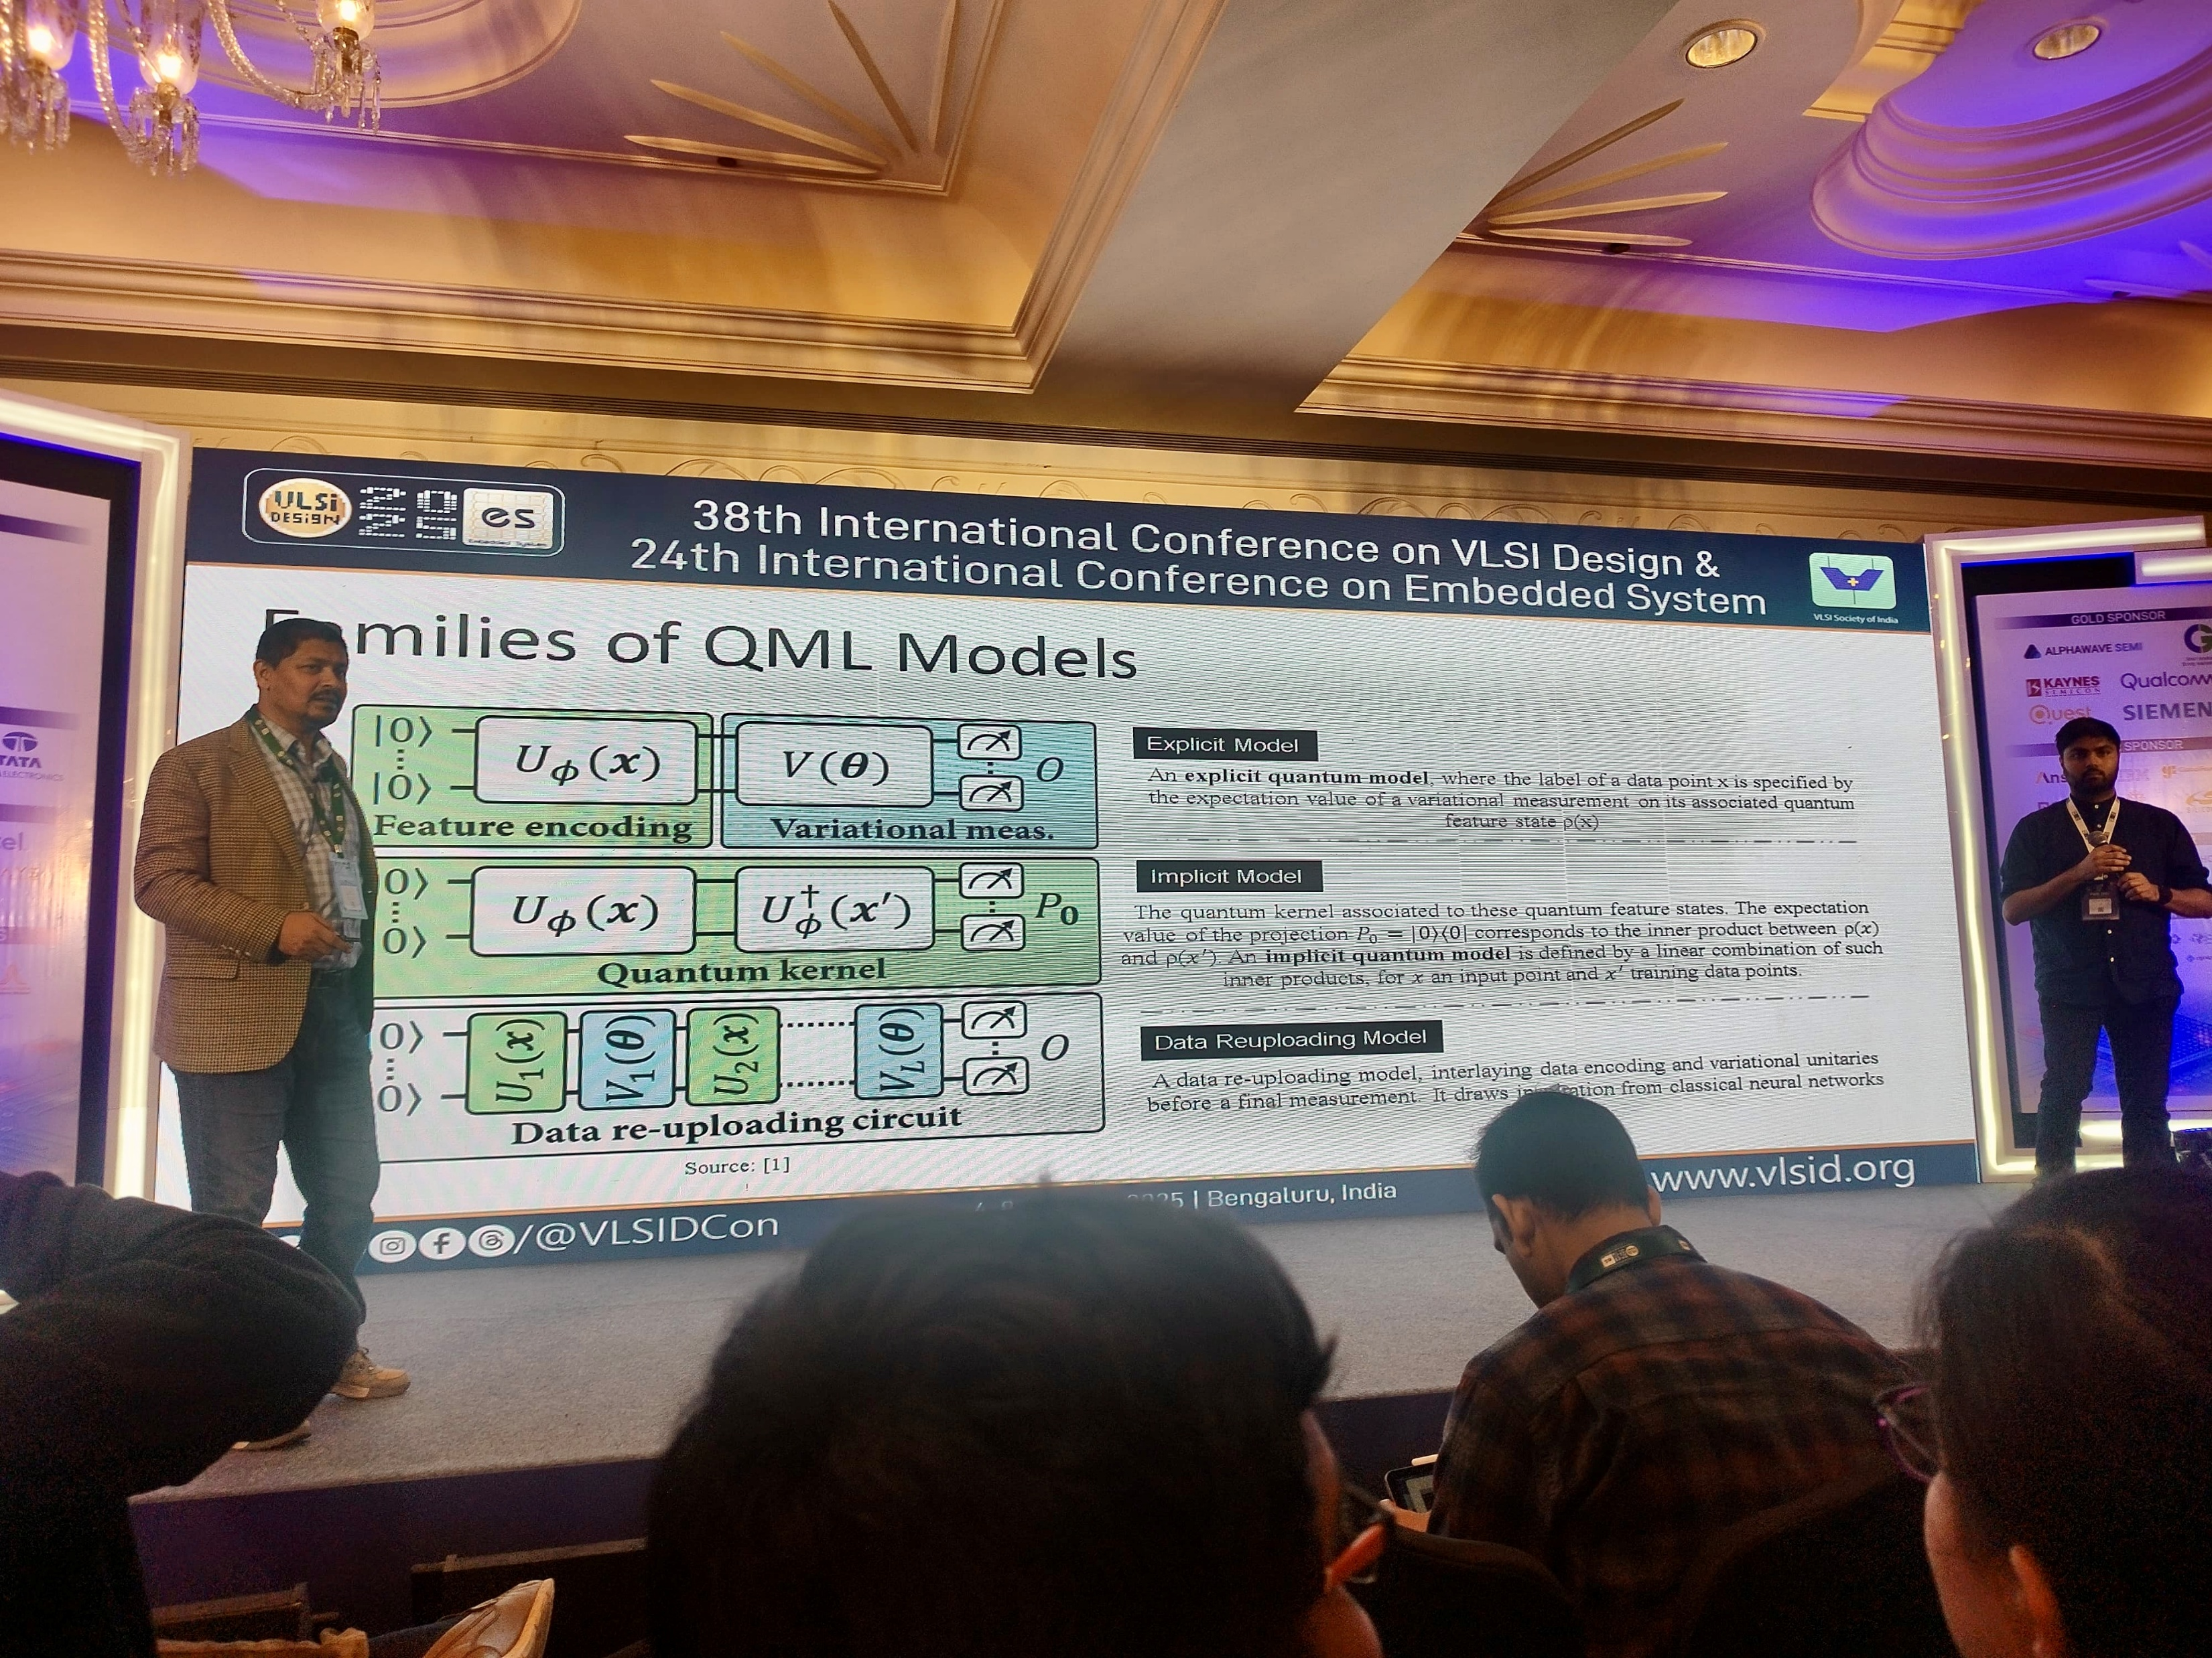

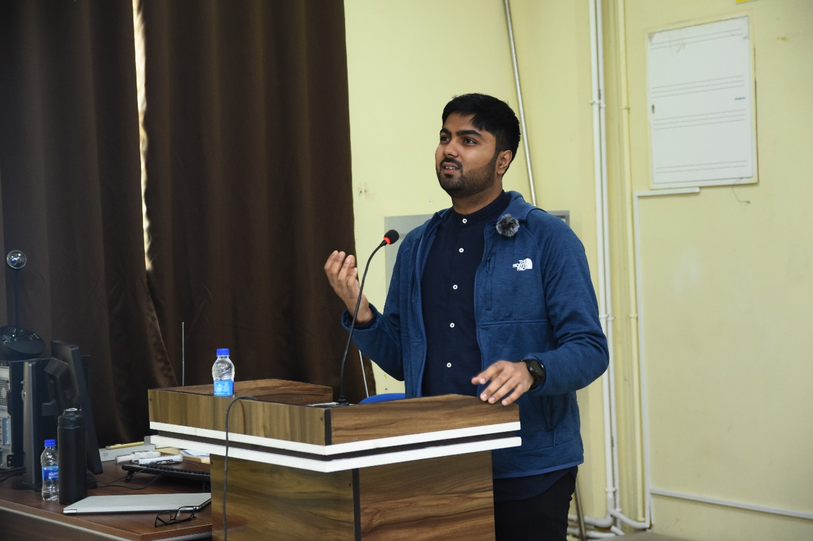
Presenter
Secretary
CSE 598
TA:
Spring 2025
Fall 2023
VLSI Conference,
Guest Speaker, 2024
Vinayak Sharma
Research Interests
Quantum Machine Learning
Representation Learning
ML for Science
PhD Student, MPS Lab
School of Computing and Augmented Intelligence,
NIT Rourkela,
Guest Speaker, 2024

Slide 3
Dirac and Vector Notation
Establishing a common language

Slide 4

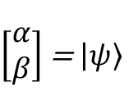
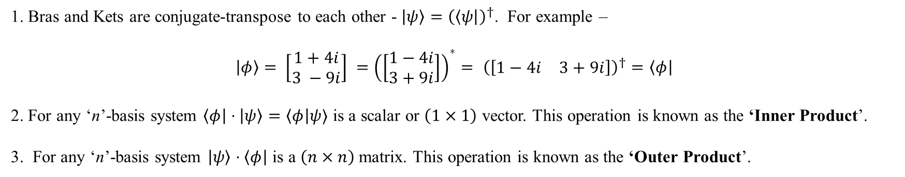
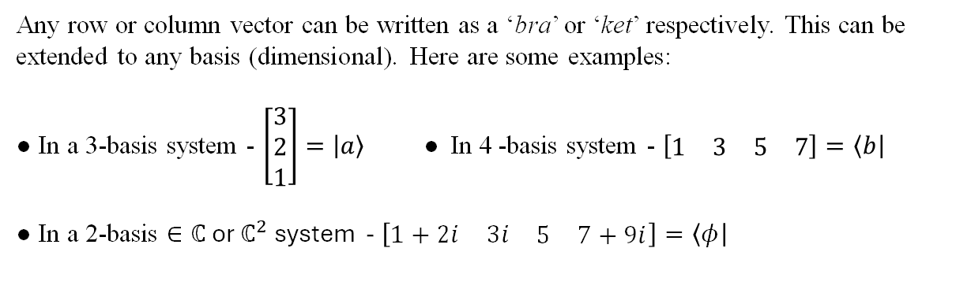
Simplified Vector Notation
Brief : Dirac or ‘Bra-Ket’ notation is a simplified method of writing down row and column vectors and their operations.
Any row or column vector can be written as a ‘bra’ or ‘ket’ respectively. This can be extended to any basis (dimensional). Here are some examples:
● In a 3-basis system - $\left[\begin{matrix}3 \\ 2 \\ 1\end{matrix}\right]=\left|a\right\rangle$ ● In 4 -basis system - $\left[\begin{matrix}\begin{matrix}1 & 3\end{matrix} & \begin{matrix}5 & 7\end{matrix}\end{matrix}\right]=\left\langle b\right|$
● In a 2-basis $∈ℂ$ or $ℂ^{2}$ system - $\left[\begin{matrix}\begin{matrix}1+2i & 3i\end{matrix} & \begin{matrix}5 & 7+9i\end{matrix}\end{matrix}\right]=\left\langle φ\right|$
Bra
Ket
$\left[\begin{matrix}α & β\end{matrix}\right]$ = $⟨ψ|$
$\left[\begin{matrix}α \\ β\end{matrix}\right]$ = $\left|ψ\right\rangle$
Properties of Bra’s and Ket’s :
1. Bras and Kets are conjugate-transpose to each other - $\left|ψ\right\rangle ={\left(\left\langle ψ\right|\right)}^{†}$. For example –
$$\left|φ\right\rangle = \left[\begin{matrix}1+4i \\ 3 −9i\end{matrix}\right] ={\left(\left[\begin{matrix}1−4i \\ 3+9i\end{matrix}\right]\right)}^{∗}= {\left(\left[\begin{matrix}1−4i & 3+9i\end{matrix}\right]\right)}^{†}=\left\langle φ\right|$$
2. For any ‘n’-basis system $\left\langle φ\right|⋅\left|ψ\right\rangle =\left\langle φ\right|ψ⟩$ is a scalar or $\left(1×1\right)$ vector. This operation is known as the ‘Inner Product’.
3. For any ‘n’-basis system $\left|ψ\right\rangle ⋅\left\langle φ\right|$ is a $\left(n×n\right)$ matrix. This operation is known as the ‘Outer Product’.
Let’s try a few examples…

Slide 5
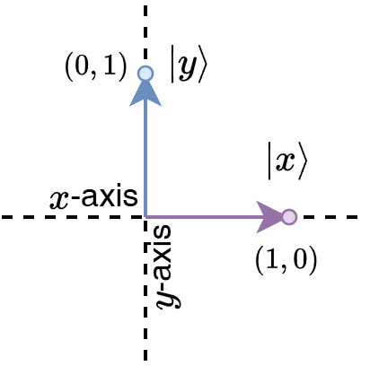


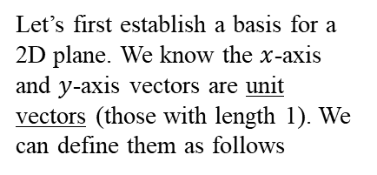





Writing in Basis.
Brief : We can write any vector in an ‘n’-basis system as a weighted sum of the basis vectors.
The simplest way to understand a basis vector is the x and y axes of a 2D plane. We can write every point on the plane in terms of these
Just multiply each term with some scaler – example: 3x + 4y
Setting a Basis :
Let’s first establish a basis for a 2D plane. We know the $x$-axis and $y$-axis vectors are unit vectors (those with length 1). We can define them as follows
$x$-vector
$y$-vector
$$\left|x\right\rangle =\left[\begin{matrix}1 \\ 0\end{matrix}\right]$$
$$\left|y\right\rangle =\left[\begin{matrix}0 \\ 1\end{matrix}\right]$$
Looking at some examples :
We can now write arbitrary vectors as sums of these basis vectors:
● $\left[\begin{matrix}4 \\ 3\end{matrix}\right]=\left[\begin{matrix}4 \\ 0\end{matrix}\right]+\left[\begin{matrix}0 \\ 3\end{matrix}\right]=4\left[\begin{matrix}1 \\ 0\end{matrix}\right]+3\left[\begin{matrix}0 \\ 1\end{matrix}\right]=4\left|x\right\rangle +3|y⟩$
● $\left[\begin{matrix}8 \\ 4\end{matrix}\right]=8\left|x\right\rangle +4|y⟩$
● $\left[\begin{matrix}1+4i \\ 9i\end{matrix}\right]=(1+4i)\left|x\right\rangle +4i|y⟩$
Extending this to the row-vectors (bra-vectors):
● $\left[\begin{matrix}4 & 3\end{matrix}\right]=\left[\begin{matrix}4 & 0\end{matrix}\right]+\left[\begin{matrix}0 & 3\end{matrix}\right]=4\left[\begin{matrix}1 & 0\end{matrix}\right]+3\left[\begin{matrix}0 & 1\end{matrix}\right]=4{\left(\left[\begin{matrix}1 \\ 0\end{matrix}\right]\right)}^{†}+3{\left(\left[\begin{matrix}0 \\ 1\end{matrix}\right]\right)}^{†}=4{\left|x\right\rangle }^{†}+3{\left|y\right\rangle }^{†}=4\left\langle x\right|+3\left\langle y\right|$
Let’s try a few examples…

Slide 6
Summarizing.
Braket\Dirac Notation : A simplified notation to represent vector and their operations.
$\left|ψ\right\rangle ≡$ Column Vectors | $⟨ψ|≡$ Column Vectors | $\left|ψ\right\rangle =({(⟨ψ|)}^{†}$ (bra’s are complex conjugates of kets).
‘Bra’
‘Ket’
Inner Products : Dot Products for complex vectors.
$\left\langle ψ | φ\right\rangle ≡\left\langle ψ,φ\right\rangle →Scalar$ (Row Vector $×$ Column Vector)
Properties,
$\left\langle ψ | ψ\right\rangle ≡1$
$\left\langle ψ | φ\right\rangle ≡0 ∀ |ψ⟩⊥|φ⟩$
Outer Products : Cross Products for complex vectors.
$|ψ⟩⟨φ|→Square Matrix$(Column Vector $×$ Row Vector)
Properties,
$Trace(\left|ψ\right\rangle \left\langle ψ\right|)=1$
$Trace\left(\left|ψ\right\rangle \left\langle φ\right|\right)=Inner Product$

Slide 7
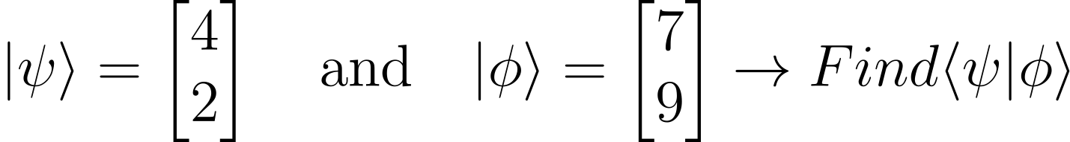
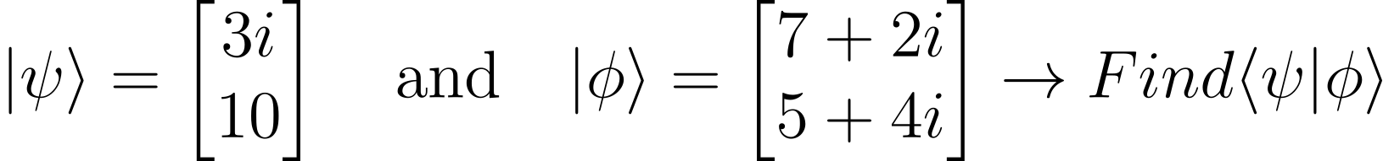
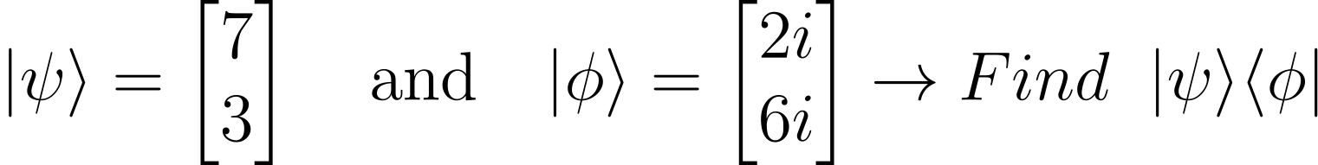
Some Math Practice
Compute the following Inner and Outer Products:
1
2
3

Slide 8
Intro to Quantum Computing
Single Qubit systems

Slide 9
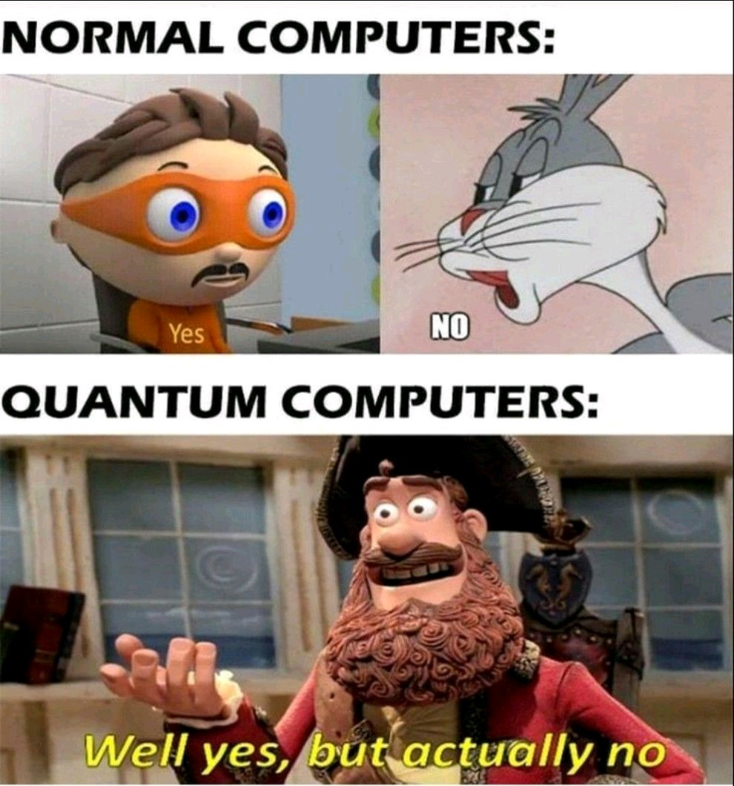
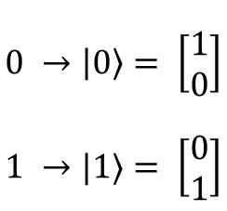
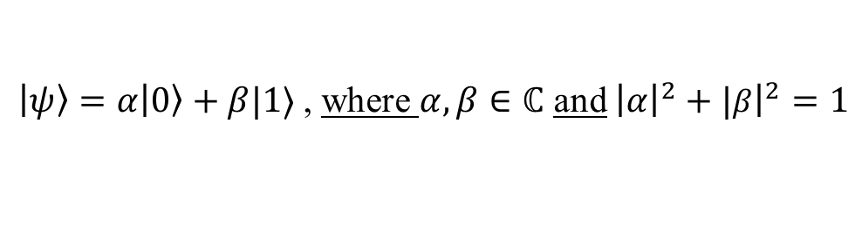
What is a Qubit
This just means traditional computers.
Definition : A qubit is an abstracted unit of computation analogous to bits in a classical computer. Boolean bit values are mapped as follows:
$$0 →\left|0\right\rangle = \left[\begin{matrix}1 \\ 0\end{matrix}\right]$$
$$1 →|1⟩= \left[\begin{matrix}0 \\ 1\end{matrix}\right]$$
However, unlike classical computers, the qubits exist in a ‘mix’ or ‘superposition’ of both of these states, allowing us to – in principle compute on both states in parallel.
We can write any qubit as -
$\left|ψ\right\rangle =α\left|0\right\rangle +β|1⟩$ , where $α,β∈ℂ$ and ${\left|α\right|}^{2}+|{\left.​β\right|}^{2}=1$
We’ll look at this in detail in the upcoming slide.

Slide 10
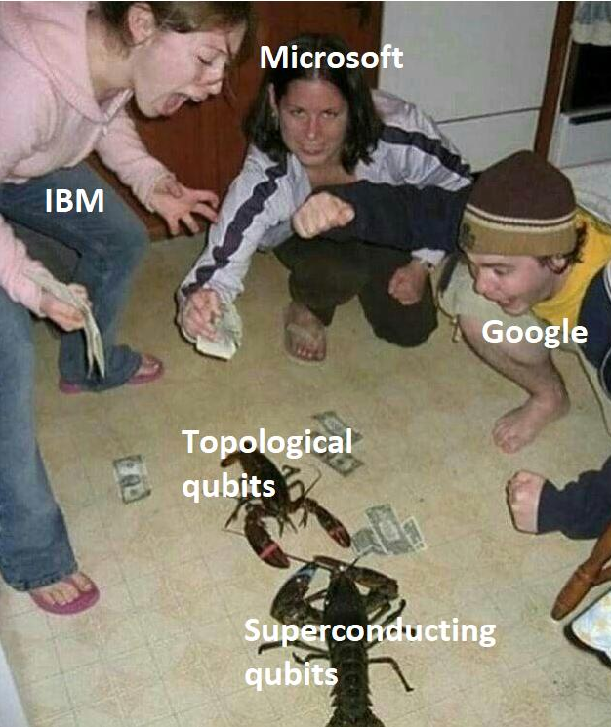
What does this mean in Hardware?
No clear answer exists. Different organizations are using different methods to create qubits.
Superconducting Qubits
They harness the peculiar properties of superconducting materials at extremely low temperatures (near absolute zero) to create and control qubits.
Trapped Ion Qubits
Individual ions are trapped using electromagnetic fields and manipulated by laser light. Highly accurate and have demonstrated long coherence times.
Photonic Qubits
Neutral Atom Qubits
Atoms trapped in optical lattices are used as qubits. Scalability is a major advantage, and interactions between atoms can be controlled.
Entangled photons, where the polarization state represents the qubit. Offers potential for long-distance communication

Slide 11
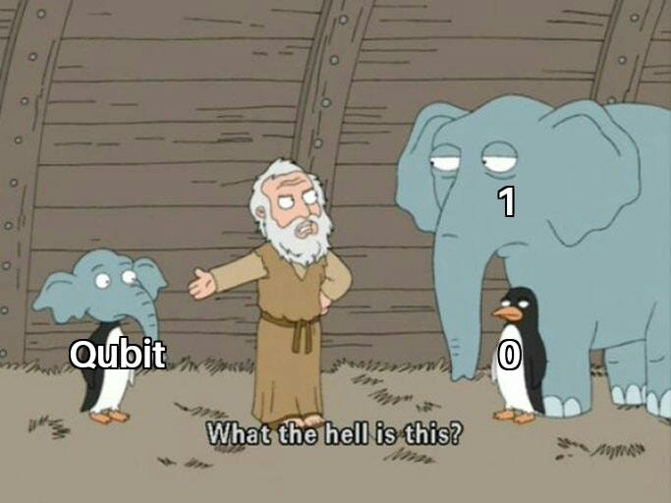
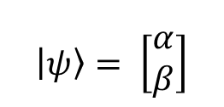
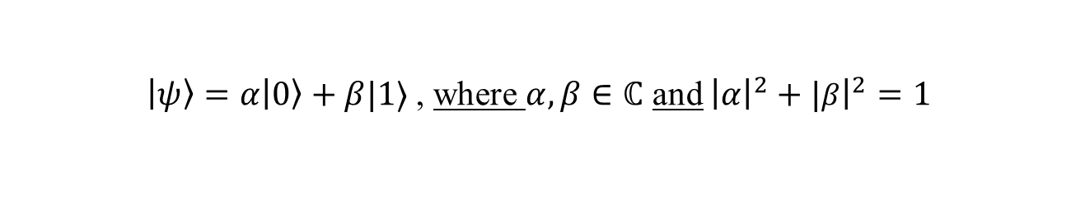
Many States at Once ! - Superposition
They can be 0 and 1 with some probability.
Definition : Unlike a bit, a qubit is a linear combination of the basis states of $\left|0\right\rangle$ and $|1⟩$.
Without the loss of generality, we can represent any give qubit with the formula :
Linear Combination of Basis
Creates a convex combination.
$\left|ψ\right\rangle =α\left|0\right\rangle +β|1⟩$ , where $α,β∈ℂ$ and ${\left|α\right|}^{2}+|{\left.​β\right|}^{2}=1$
Generic Qubit ‘state’
Constants are complex numbers.
Based on the column vectors for $\left|0\right\rangle ,|1⟩$ from the previous slide:
$$\left|ψ\right\rangle = \left[\begin{matrix}α \\ β\end{matrix}\right]$$
The probabilities of the qubit taking the states taking the states $|0⟩$ and $|1⟩$ are:
$P(|ψ⟩=\left|0\right\rangle )={|α|}^{2}$ $P(|ψ⟩=\left|1\right\rangle )={|β|}^{2}$
Also known as the Born Rule

Slide 12
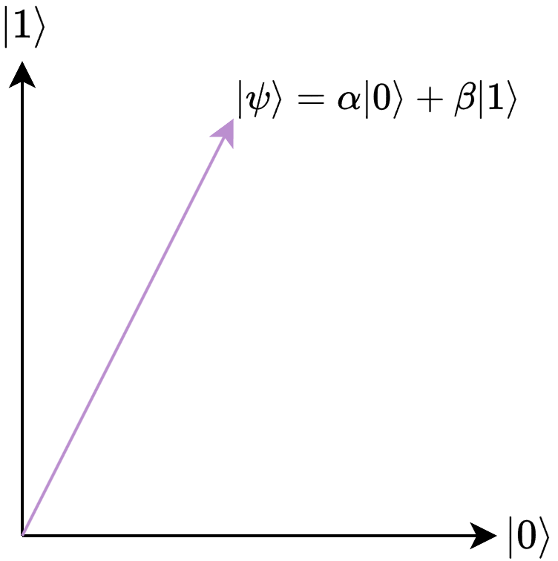
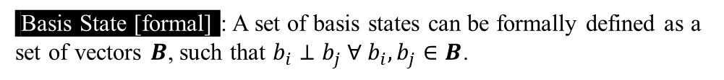


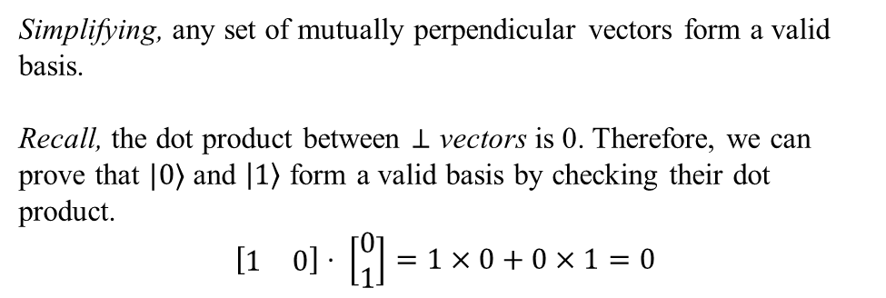
Geometry of Qubits
Proposition : We can represent every qubit as a vector on a 2-D plane formed by our basis states.
Basis State [formal] : A set of basis states can be formally defined as a set of vectors $B$, such that $b_{i}⊥b_{j} ∀ b_{i},b_{j}∈B$.
Qubits can be thought of as vectors
Simplifying, any set of mutually perpendicular vectors form a valid basis.
Recall, the dot product between $⊥$ vectors is 0. Therefore, we can prove that $|0⟩$ and $\left|1\right\rangle$ form a valid basis by checking their dot product.
$$\left[\begin{matrix}1 & 0\end{matrix}\right]⋅ \left[\begin{matrix}0 \\ 1\end{matrix}\right]=1×0+0×1=0$$
$$|0⟩$$
$$|1⟩$$
Why Bother? This interpretation of a qubit becomes extremely useful when looking at 1-qubit quantum gates.

Slide 13

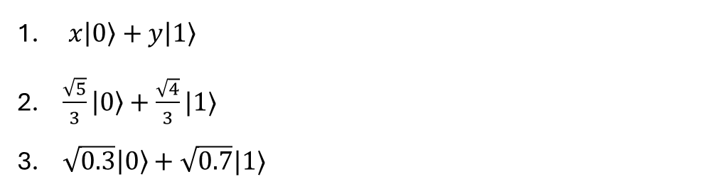





Some Math Practice
Are the following states valid qubit state ?
1. $3\left|0\right\rangle +7\left|1\right\rangle$
2. $\frac{1}{\sqrt{2}}(\left|0\right\rangle +|1⟩)$
3. $\frac{\sqrt{3}}{2}\left|0\right\rangle +\frac{1}{2}|1⟩$
Find ‘$x$’ in the following:
1. $\sqrt{0.2}\left|0\right\rangle +x\left|1\right\rangle$
2. $x\left|0\right\rangle +\sqrt{0.74}|1⟩$
3. $\frac{\sqrt{7}}{\sqrt{10}}\left|0\right\rangle +x|1⟩$
Calculate the probabilities that the following qubit superpositions are will be in the $\left|0\right\rangle$ or $\left|1\right\rangle$state.
$x\left|0\right\rangle +y\left|1\right\rangle$
$\frac{\sqrt{5}}{3}\left|0\right\rangle +\frac{\sqrt{4}}{3}|1⟩$
$\sqrt{0.3}\left|0\right\rangle +\sqrt{0.7}|1⟩$

Slide 14
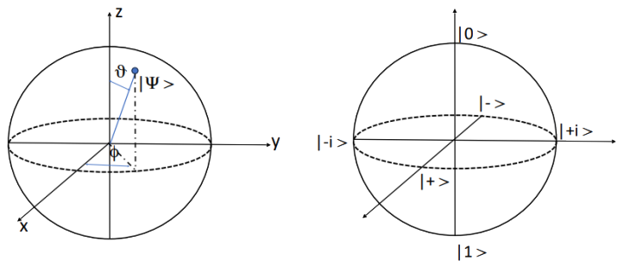
Bloch - Sphere
Bloch Sphere : We can represent any qubit as a parameterized vector on the surface of a $ℝ^{3}$ unit sphere known as the Bloch sphere. (Note: The angles between states are doubled on the Bloch sphere, making $|0⟩$ and $|1⟩$ seem colinear)
Represents any qubit state as a point on the surface of the bloch sphere
Polar Coordinates of a Qubit.
Bloch Sphere axes
Consists of 3 sets of special basis states, known as the Pauli basis
Polar Form of a Qubit : Without Loss of Generality (w.l.o.g), any qubit can be represented as :
$$\left|Ψ\right\rangle =\cos{(\frac{θ}{2})}\left|0\right\rangle +e^{iφ}\sin\left(\frac{θ}{2}\right)|1⟩$$

Slide 15
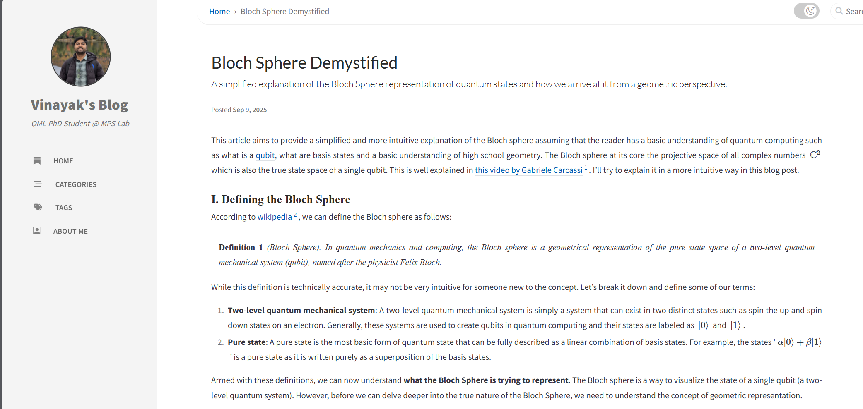
Geometry of the Bloch Sphere
The following blog post better explains the idea of the Bloch Sphere
Bloch Sphere Demystified | Vinayak's Blog

Slide 16

Let’s code some of this out
Open the Git Repository
Open the GitHub repository to look at the code.
QuantumClubASU/QML-Lecture-Series: Repository for QML lecture series
Explicit Quantum Models

Slide 17
Remember to Check-in
https://cglink.me/22J/c38604392504131
Check in here!
Join us on SDC

Slide 18
The End…
We made it folks!!!

