Slide 1


QML Lecture Series - 3
Intro to Quantum Machine Learning
https://cglink.me/22J/c38605092504050
Check in here!
Join us on SDC

Slide 2
Single Qubit Computation
Rotate – Compute – Rotate

Slide 3
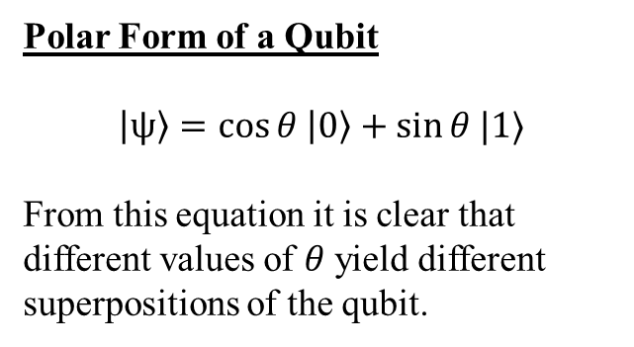


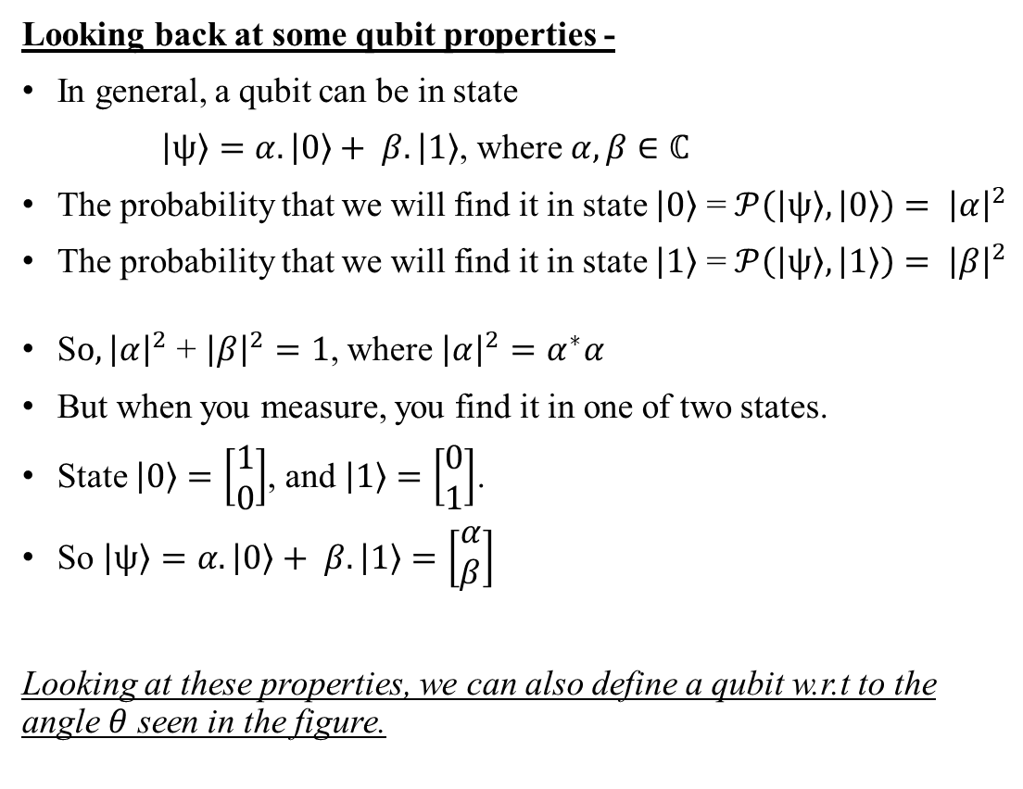


Superposition via Rotation
Brief : Rotating Qubits by angles that are not multiples of $\frac{π}{2}$ we can get superposition states.
$$\left|1\right\rangle$$
Looking back at some qubit properties -
In general, a qubit can be in state
$\left|ψ\right\rangle =α.\left|0\right\rangle + β.\left|1\right\rangle$, where $α, β∈ℂ$
The probability that we will find it in state $\left|0\right\rangle$ = $𝒫\left(\left|ψ\right\rangle ,\left|0\right\rangle \right)= {\left|α\right|}^{2}$
The probability that we will find it in state $\left|1\right\rangle$ = $𝒫\left(\left|ψ\right\rangle ,\left|1\right\rangle \right)= {\left|β\right|}^{2}$
S$o, {\left|α\right|}^{2}$ + ${\left|β\right|}^{2}=1$, where ${\left|α\right|}^{2}=α^{∗}α$
But when you measure, you find it in one of two states.
State $\left|0\right\rangle =\left[\begin{matrix}1 \\ 0\end{matrix}\right]$, and $\left|1\right\rangle =\left[\begin{matrix}0 \\ 1\end{matrix}\right]$.
So $\left|ψ\right\rangle =α.\left|0\right\rangle + β.\left|1\right\rangle =\left[\begin{matrix}α \\ β\end{matrix}\right]$
Looking at these properties, we can also define a qubit w.r.t to the angle $θ$ seen in the figure.
$$\frac{1}{\sqrt{2}}\left|0\right\rangle +\frac{1}{\sqrt{2}}\left|1\right\rangle$$
$$θ$$
$$\left|0\right\rangle$$
Polar Form of a Qubit
$$\left|ψ\right\rangle =\cos{θ \left|0\right\rangle +\sin{θ |1⟩}}$$
From this equation it is clear that different values of $θ$ yield different superpositions of the qubit.

Slide 4
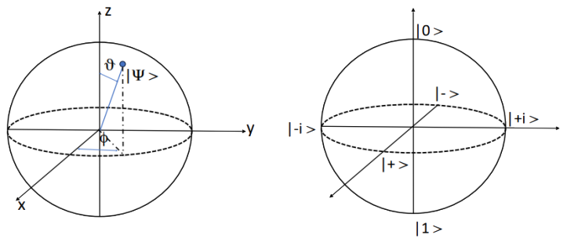
3D Representation Revision…
Bloch Sphere : We can represent any qubit as a parameterized vector on the surface of a $ℝ^{3}$ unit sphere known as the Bloch sphere. (Note: The angles between states are doubled on the Bloch sphere, making $|0⟩$ and $|1⟩$ seem colinear)
Represents any qubit state as a point on the surface of the bloch sphere
Polar Coordinates of a Qubit.
Bloch Sphere axes
Consists of 3 sets of special basis states, known as the Pauli basis
General Polar Form of a Qubit : Without Loss of Generality (w.l.o.g), any qubit can be represented as :
$$\left|Ψ\right\rangle =\cos{(\frac{θ}{2})}\left|0\right\rangle +e^{iφ}\sin\left(\frac{θ}{2}\right)|1⟩$$

Slide 5

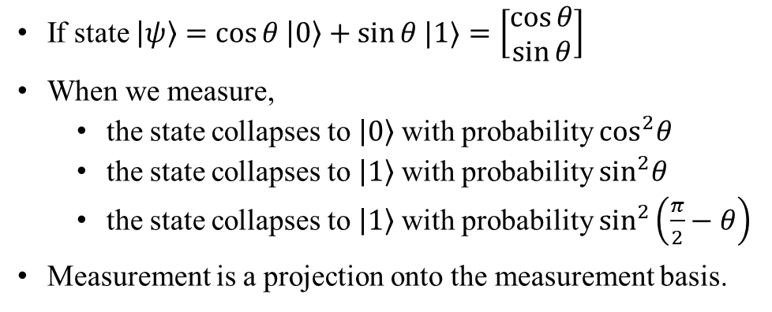



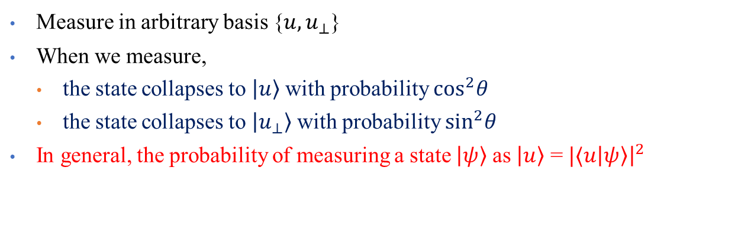
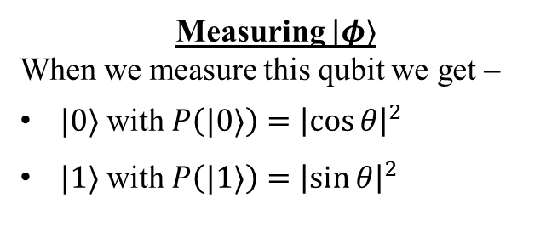
Measurement of Qubits
Brief : While each qubit can store 2 complex numbers, we can only extract a basis state as the reading from a qubit.
If state $\left|ψ\right\rangle =\cos{θ \left|0\right\rangle +\sin{θ |1⟩}}=\left[\begin{matrix}\cos{θ} \\ \sin{θ}\end{matrix}\right]$
When we measure,
the state collapses to $\left|0\right\rangle$ with probability $\cos^{2}θ$
the state collapses to $\left|1\right\rangle$ with probability $\sin^{2}θ$
the state collapses to $\left|1\right\rangle$ with probability $\sin^{2}\left(\frac{π}{2}−θ\right)$
Measurement is a projection onto the measurement basis.
$$\left|1\right\rangle$$
$$|φ⟩= cos{θ}\left|0\right\rangle +\sin{θ}\left|1\right\rangle$$
$$θ$$
$$\left|0\right\rangle$$
When you measure the state is projected onto one of the two basis states -- with probability equal to the cosine squared the angle it makes with the state.
Measuring $|φ⟩$
When we measure this qubit we get –
$|0⟩$ with $P\left(|0⟩\right)={\left|\cos{θ}\right|}^{2}$
$|1⟩$ with $P\left(|1⟩\right)={\left|\sin{θ}\right|}^{2}$
Measure in arbitrary basis {$u, u_{⊥}$}
When we measure,
the state collapses to $\left|u\right\rangle$ with probability $\cos^{2}θ$
the state collapses to $\left|u_{⊥}\right\rangle$ with probability $\sin^{2}θ$
In general, the probability of measuring a state $\left|ψ\right\rangle$ as $\left|u\right\rangle$ = $|⟨u\left|ψ\right\rangle {\left.​\right|}^{2}$

Slide 6
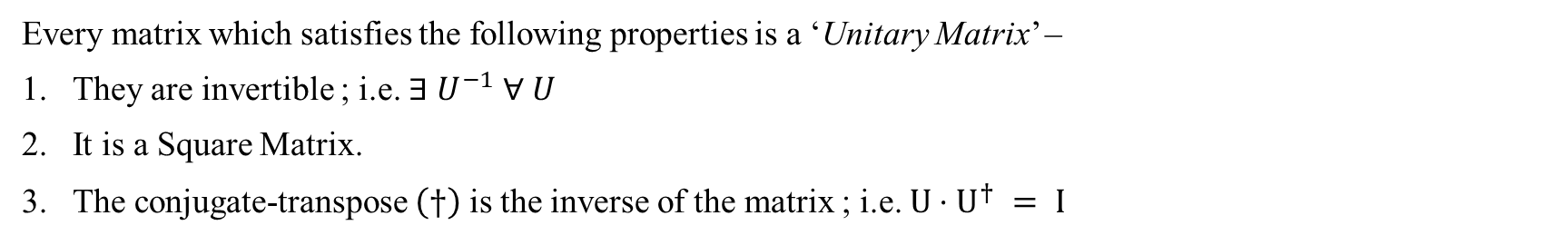
Unitary Matrices
Why do we care? : All quantum gates are special matrices known as Unitary Matrices.
Every matrix which satisfies the following properties is a ‘Unitary Matrix’ –
They are invertible ; i.e. $∃ U^{−1} ∀ U$
It is a Square Matrix.
The conjugate-transpose $\left(†\right)$ is the inverse of the matrix ; i.e. $U⋅U^{†} = I$
$U=\left[\begin{matrix}a & c \\ b & d\end{matrix}\right]$ , $U^{†}=\left[\begin{matrix}a^{∗} & b^{∗} \\ c^{∗} & d^{∗}\end{matrix}\right]{ ∴ U}^{†}U=\left[\begin{matrix}a^{∗} & b^{∗} \\ c^{∗} & d^{∗}\end{matrix}\right]\left[\begin{matrix}a & c \\ b & d\end{matrix}\right] =I$
Unitary transformations are angle preserving
Angle between $|ψ⟩$ and $|φ⟩$ is same as the angle between $U|ψ⟩$ and $U|φ⟩$

Slide 7
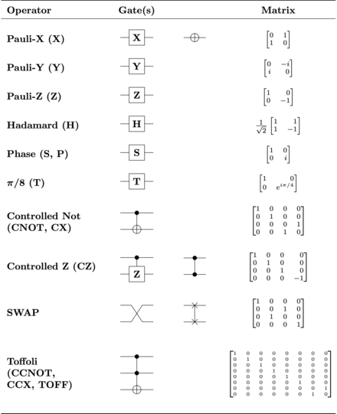
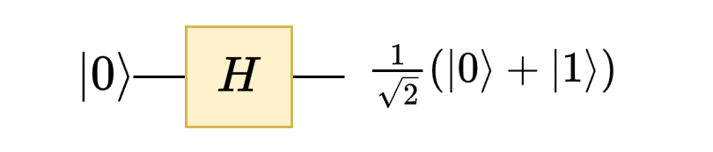
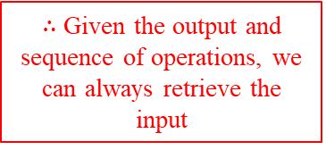

Single Qubit Quantum Gates
Everything is a matrix
Quantum Gates : Quantum Gates are the basic unit of computation in QC’s. They take a qubit in some state as an input and output a qubit in a transformed state.
Common Quantum Gates.
Unlike classical logic gates, Quantum Gates have some special properties:
Every gate can be represented a matrix.
Each matrix is Unitary
As an extension, all gates are invertible
Hence all computation is reversible.
$∴$ Given the output and sequence of operations, we can always retrieve the input
Computational Example
Applying the gate above is equivalent to the following calculation
$$H\left|0\right\rangle = \frac{1}{\sqrt{2}}\left[\begin{matrix}1 & 1 \\ 1 & −1\end{matrix}\right]\left[\begin{matrix}1 \\ 0\end{matrix}\right]=\frac{1}{\sqrt{2}}\left[\begin{matrix}1 \\ 1\end{matrix}\right]=\frac{1}{\sqrt{2}} (\left|0\right\rangle +|1⟩)$$
Don’t worry ! We’ll look at these again.

Slide 8
















Key Single Qubit Gates
Brief : 4 of the most critical gates in quantum computation are the Pauli-Gates and the Hadamard Gate
X-Gate
Z-Gate
$$Pauli−X=\left[\begin{matrix}0 & 1 \\ 1 & 0\end{matrix}\right]$$
$$Pauli−Z=\left[\begin{matrix}1 & 0 \\ 0 & −1\end{matrix}\right]$$
$$α|0⟩ + β|1⟩$$
$$X$$
$$α|1⟩ + β|0⟩$$
$$α|0⟩ + β|1⟩$$
$$Z$$
$$α|0⟩ − β|1⟩$$
Y-Gate
$$Pauli−Y=\left[\begin{matrix}0 & −i \\ i & 0\end{matrix}\right]$$
Hadamard-Gate
$$Hadamard=\frac{1}{\sqrt{2}}\left[\begin{matrix}1 & 1 \\ 1 & −1\end{matrix}\right]$$
$$α|0⟩ + β|1⟩$$
$$Y$$
$$iα|1⟩ − iβ|0⟩$$
$$H$$
$$\frac{1}{\sqrt{2}} (|0⟩+|1⟩ )$$
$$|0⟩$$
Let’s try a few examples…

Slide 9
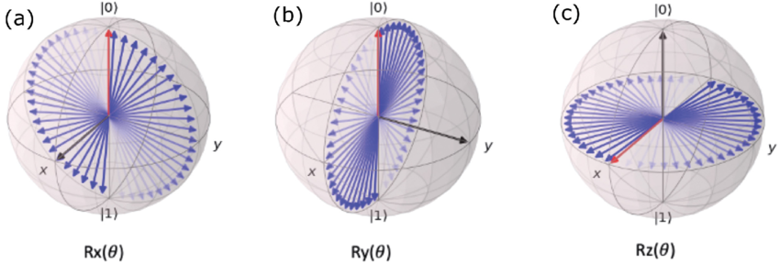



Rotational Gates (Parametrized)
Brief : Rotational Gates are parametrized operations that rotate the quantum state by a controllable angle around a specific axis
RX-Gate
RY-Gate
RZ-Gate
$$R_{X}(θ)=\left[\begin{matrix}cos(\frac{θ}{2}) & −isin(\frac{θ}{2}) \\ isin(\frac{θ}{2}) & cos(\frac{θ}{2})\end{matrix}\right]$$
$$R_{Y}(θ)=\left[\begin{matrix}cos(\frac{θ}{2}) & −sin(\frac{θ}{2}) \\ sin(\frac{θ}{2}) & cos(\frac{θ}{2})\end{matrix}\right]$$
$$R_{Z}(θ)=\left[\begin{matrix}e^{−\frac{iθ}{2}} & 0 \\ 0 & e^{\frac{iθ}{2}}\end{matrix}\right]$$

Slide 10
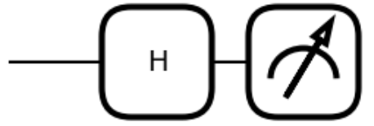
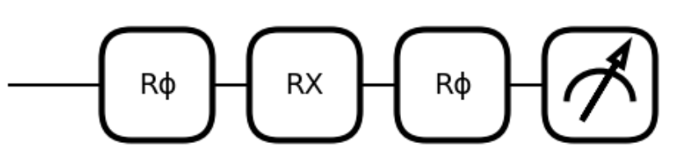


Single Qubits Gates and Pauli Universality
Recall : Any given quantum gate rotates a qubit on the Bloch Sphere.
Also known as the Pauli-Rotational gates, these are “Parameterized Gates” which rotate a qubit about a given axis by a given angle
Theorem : Any single qubit gate can be created using a combination of any of the $R_{X},R_{Y},R_{Z}$ Gates.
$$→\frac{1}{\sqrt{2}}\left(\left|0\right\rangle +|1⟩\right)$$
Equivalent Circuits
$$→\frac{1}{\sqrt{2}}\left(\left|0\right\rangle +|1⟩\right)$$
Rotational Axes
The Pauli Rotational Gates rotate around one of the 3 axes of the sphere.

Slide 11

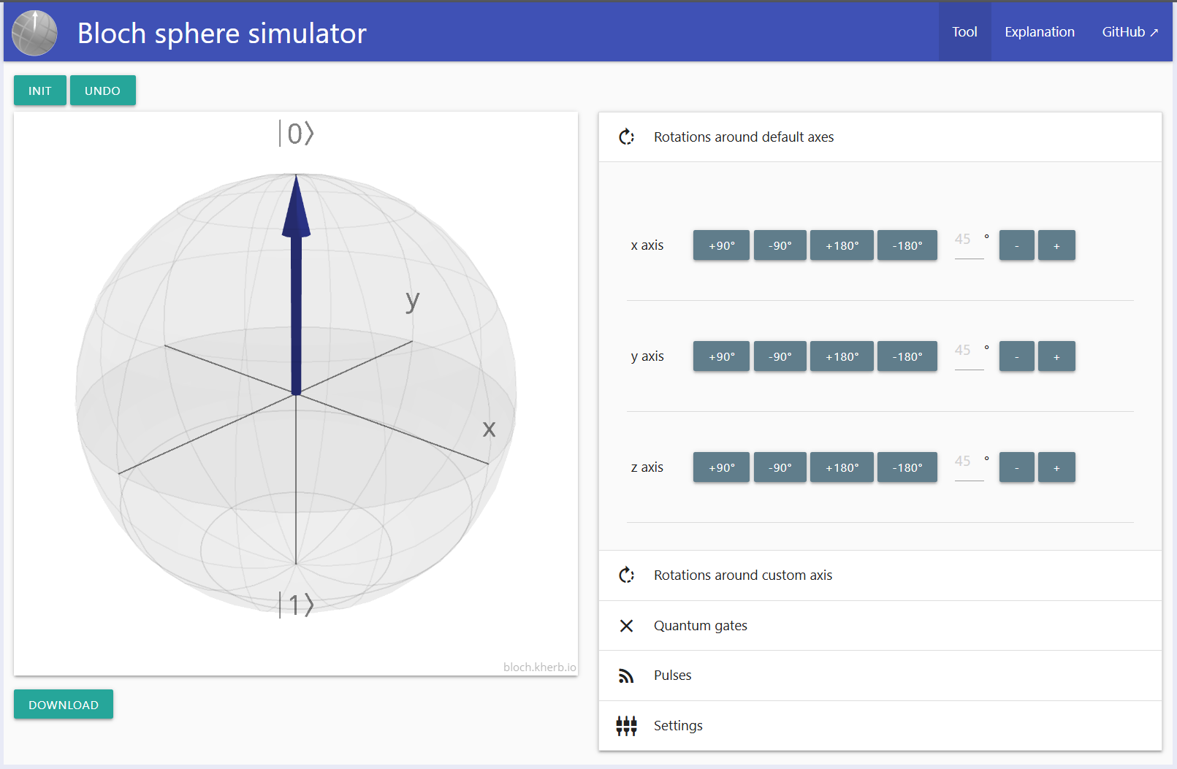
Bloch Sphere Visualization
Bloch sphere visualizer

Slide 12


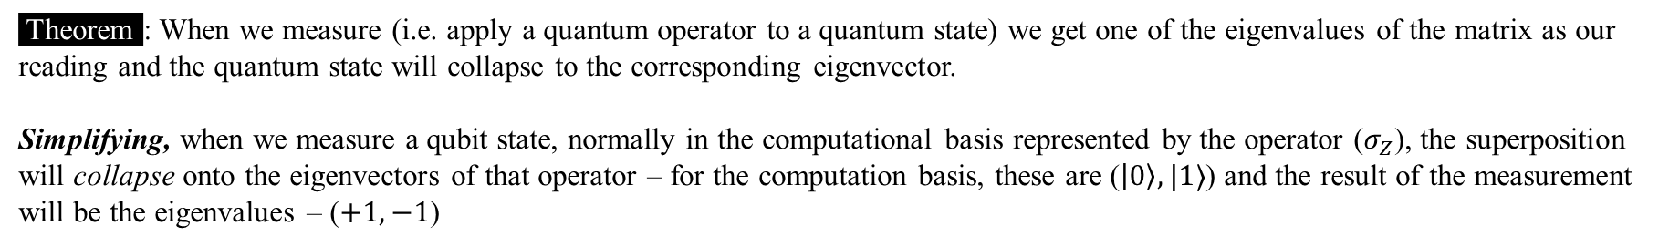


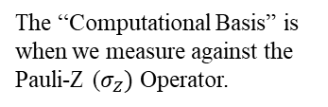



Measurement Postulate
Theorem : When we measure (i.e. apply a quantum operator to a quantum state) we get one of the eigenvalues of the matrix as our reading and the quantum state will collapse to the corresponding eigenvector.
Simplifying, when we measure a qubit state, normally in the computational basis represented by the operator ($σ_{Z}$), the superposition will collapse onto the eigenvectors of that operator – for the computation basis, these are ($\left|0\right\rangle ,|1⟩$) and the result of the measurement will be the eigenvalues – ($+1,−1$)
$$M_{1}=M_{2}=…=M_{n}$$
Computational Basis
$$M_{1}$$
$$M_{2}$$
$$M_{n}$$
Due to measurement collapsing the superposition, the result of all subsequent measurements will be equal to the first one.
$$σ_{Z}=\left[\begin{matrix}1 & 0 \\ 0 & −1\end{matrix}\right]$$
The “Computational Basis” is when we measure against the Pauli-Z ($σ_{Z})$ Operator.
$$|0⟩$$
$$H$$
Pauli-Z Operator
Figure 1. Multiple Measurements Circuit
Measurement results are the only valid outcome from a quantum system. All other values such as quantum state are only available in quantum simulator.
Important to note!

Slide 13




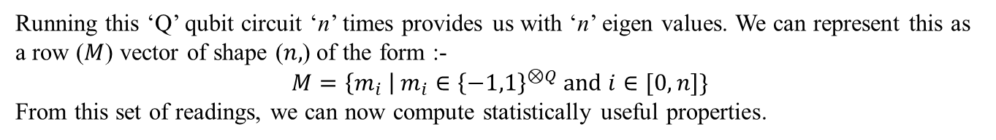



Statistical Measurement
General Idea : While the information a single run of the quantum circuit provides is limited, if we know the gates applied, we can run a circuit multiple times (often called shots) to extract more useful statistical information.
$$×n$$
$$|0⟩$$
$$U_{0}$$
Running this ‘Q’ qubit circuit ‘n’ times provides us with ‘n’ eigen values. We can represent this as a row ($M$) vector of shape ($n,$) of the form :-
$$M=\left\{m_{i} \right| m_{i}∈{\left\{−1,1\right\}}^{⊗Q} \text{and} i∈[0,n]\}$$
From this set of readings, we can now compute statistically useful properties.
$$|0⟩$$
$$U_{1}$$
$$|0⟩$$
$$U_{Q}$$
Statistical Readings from Measurements
Probability
The probability of any eigenvalue.
Expectation Value
The expected value of the measurement operation on that state.
Variance
The variance in the readouts.
The number of times each eigen value occurs.
Counts
Ex: $P\left(−1 ,..n times\right)=p_{n}$
Ex: 𝑃(−1 ,..𝑛 𝑡𝑖𝑚𝑒𝑠)=𝑝_𝑛
Ex: $−1 ,..n times$ = t occurrences
Ex: −1 ,..𝑛 𝑡𝑖𝑚𝑒𝑠 = t occurrences
Ex: $E\left[M\right]= \sum_{i∈M}{i⋅P(i)}$
Ex: 𝐸[𝑀]= ∑_(𝑖∈𝑀)▒〖𝑖⋅𝑃(𝑖)〗
Ex: $E\left[M^{2}\right]−E[M]$
Ex: 𝐸[𝑀^2 ]−𝐸[𝑀]

Slide 14

Let’s code some of this out
Open the Git Repository
Open the GitHub repository to look at the code.
QuantumClubASU/QML-Lecture-Series: Repository for QML lecture series
Explicit Quantum Models

Slide 15
Intro to Quantum Computing
Multi Qubit systems

Slide 16
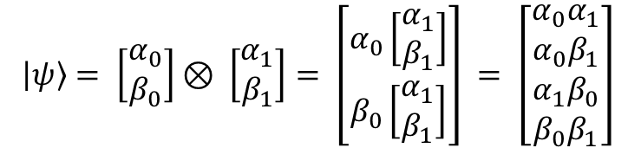
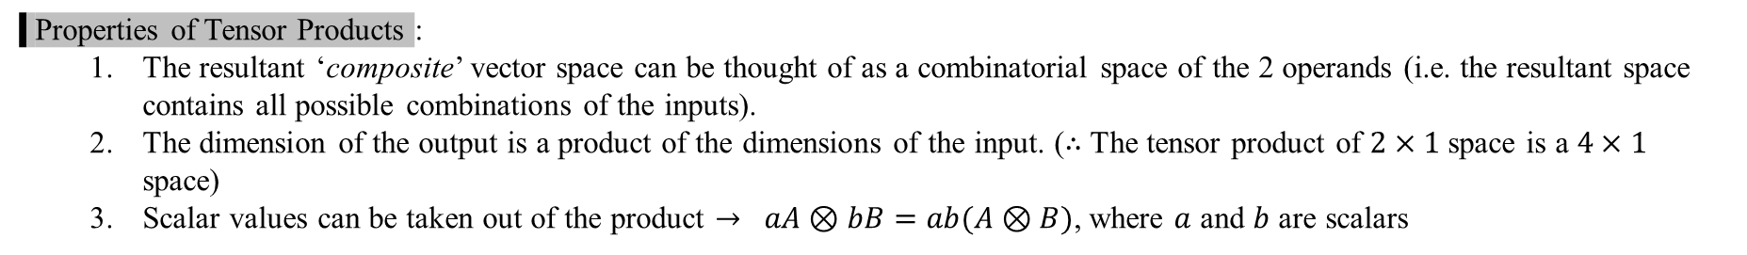
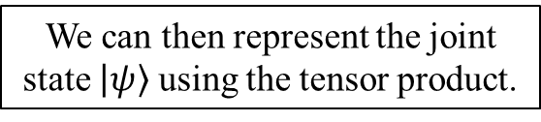
Tensor/Kronecker Product
Tensor Product : The tensor takes 2 vector spaces (V and W) and creates a new composite vector space $V⊗W$. In quantum computing, each vector space represents a qubit. Let us assume 2 qubits with states $\left|ψ_{0}\right\rangle =α_{0}\left|0\right\rangle +β_{0}|1⟩$ and $\left|ψ_{1}\right\rangle =α_{1}\left|0\right\rangle +β_{1}\left|1\right\rangle$,
$$\left|ψ\right\rangle = \left[\begin{matrix}α_{0} \\ β_{0}\end{matrix}\right]⊗ \left[\begin{matrix}α_{1} \\ β_{1}\end{matrix}\right]= \left[\begin{matrix}α_{0}\left[\begin{matrix}α_{1} \\ β_{1}\end{matrix}\right] \\ β_{0}\left[\begin{matrix}α_{1} \\ β_{1}\end{matrix}\right]\end{matrix}\right] = \left[\begin{aligned}\begin{matrix}α_{0}α_{1} \\ α_{0}β_{1} \\ α_{1}β_{0}\end{matrix} \\ β_{0}β_{1}\end{aligned}\right]$$
We can then represent the joint state $\left|ψ\right\rangle$ using the tensor product.
Kronecker Product : In the case of quantum computing, we can use the Kron product and Tensor product interchangeably.
Properties of Tensor Products :
The resultant ‘composite’ vector space can be thought of as a combinatorial space of the 2 operands (i.e. the resultant space contains all possible combinations of the inputs).
The dimension of the output is a product of the dimensions of the input. ($∴$ The tensor product of $2×1$ space is a $4×1$ space)
Scalar values can be taken out of the product $→ aA⊗bB=ab(A⊗B)$, where $a$ and $b$ are scalars
Use in Quantum Computation :
The tensor product of ‘n’ single qubit states yields a ‘n-qubit’ state.
The tensor product of ‘n’ single qubit gates yields a ‘n-qubit’ gate.
Note: Not all multi-qubit states and gates can be represented using the tensor products of single qubit versions.

Slide 17
Properties of Tensor Products
Dimensions
Associativity
Commutativity
Tensor Product of Linear Map
If V and W are vectors spaces of finite dimension, then V⊗W is finite-dimensional, and its dimension is the product of the dimensions of V and W.
The tensor product is associative in the sense that, given three vector spaces ⁠U,V,W⁠, there is a canonical isomorphism $\left(U⊗V\right)⊗W ≅U⊗(V⊗W)$
The tensor product is associative in the sense that, given three vector spaces ⁠U,V,W⁠, there is a canonical isomorphism (𝑈⊗𝑉)⊗𝑊 ≅𝑈⊗(𝑉⊗𝑊)
Tensor products are commutative as a vector space operation (i.e the vector spaces produced by $U⊗V=V⊗U$)
Tensor products are commutative as a vector space operation (i.e the vector spaces produced by 𝑈⊗𝑉=𝑉⊗𝑈 )
Given a function $f:U→V$, we can define the tensor product as $f⊗W:U⊗W→V⊗W$
Given a function 𝑓:𝑈→𝑉, we can define the tensor product as 𝑓⊗𝑊:𝑈⊗𝑊→𝑉⊗𝑊
However , the resultant matrices are not equal.

Slide 18



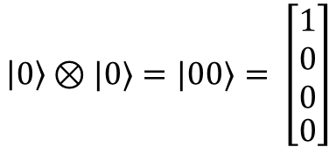






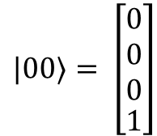

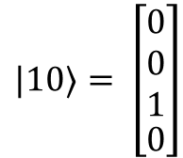



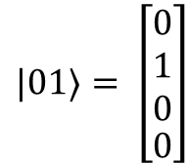



Multi-Qubit States
Multi-Qubit States : We define multi-qubit states w.r.t the basis states created by taking the tensor product of the combinations of basis states of the single qubit. $∴$ n qubits = $2^{n}$ basis states. The basis states of an n-qubit system are the states in their truth table.
Ex. Basis states of a 2-qubit system
$$\left|0\right\rangle ⊗|0⟩=|00⟩= \left[\begin{aligned}\begin{matrix}1 \\ 0 \\ 0\end{matrix} \\ 0\end{aligned}\right]$$
$|01⟩= \left[\begin{aligned}\begin{matrix}0 \\ 1 \\ 0\end{matrix} \\ 0\end{aligned}\right]$
$|10⟩= \left[\begin{aligned}\begin{matrix}0 \\ 0 \\ 1\end{matrix} \\ 0\end{aligned}\right]$
$|00⟩= \left[\begin{aligned}\begin{matrix}0 \\ 0 \\ 0\end{matrix} \\ 1\end{aligned}\right]$
Visualizing Multi-Qubit States : Unlike single qubit states, visualizing multi-qubit states is non-trivial. A single qubit system can be simplified into a 2D plane, however when looking at a similar simplification of 2-qubit systems, we get a 4-D space which is already difficult to visualize. An extremely simplified representation be constructed by representing a qubit as a line which represents the probability distribution over the basis states. A 2-qubit system forms a 2-D square in this case. In this representation, each qubit adds an axis.
$$|00⟩$$
$$|0⟩$$
$$|10⟩$$
Line Representation
$${\left|ψ\right\rangle }_{1}⊗{\left|ψ\right\rangle }_{1}=\frac{1}{\sqrt{2}}(|01⟩+|11⟩)$$
$$|0⟩$$
$$|1⟩$$
$$⊗$$
$$|0⟩$$
$$|1⟩$$
$$|0⟩$$
$$|1⟩$$
$${\left|ψ\right\rangle }_{1}=\frac{1}{\sqrt{2}} (|0⟩+|1⟩)$$
$${\left|ψ\right\rangle }_{2}=|1⟩$$
$$|01⟩$$
$$|1⟩$$
$$|11⟩$$

Slide 19













Naive Multi-Qubit Computation
Naïve Approach : The simplest approach to multi-qubit computation is treating each qubit as a single qubit system. In this scenario, we apply the gates normally and compute the final probability as a product of both measurements.
1
2
$$H$$
$$S$$
$$\frac{1}{\sqrt{2}}(|0⟩+|1⟩ )$$
$$\frac{1}{\sqrt{2}}(|0⟩+i|1⟩ )$$
$P(|0⟩)$ in qubit 1
$$|0⟩$$
1
2
$$∴P\left(|00⟩\right)=P\left({\left|0\right\rangle }_{1}\right)×P\left({\left|0\right\rangle }_{2}\right)$$
$$X$$
$$H$$
$$|1⟩$$
$$\frac{1}{\sqrt{2}}(|0⟩−|1⟩ )$$
$$|0⟩$$
3
4
$P(|0⟩)$ in qubit 2
3
4
Advantages :
Simple to extrapolate from single qubit systems
System is fully factorized, and probabilities are easy to compute
Disadvantages :
System cannot be applied to non-factorizable states (entangled)
* More in detail later
In order to compute with unfactorizable state, we use 2-Qubit gates

Slide 20
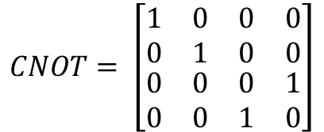
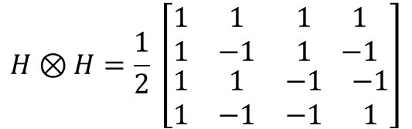
Multi-Qubit Gates
Multi-Qubit Gates : Multi-Qubit gates are gates that take ‘n’ qubits as an input and produce ‘n’ qubit outputs. We can broadly separate them into “native multi-qubit gates” and “composite multi-qubit gates”.
Composite Multi-qubit Gates : Composite multi-qubit gates are abstractions of single qubit gates and created by taking a tensor product of single qubit gates.
$$H⊗H=\frac{1}{2} \left[\begin{matrix}\begin{matrix}1 & 1 \\ 1 & −1\end{matrix} & \begin{matrix}1 & 1 \\ 1 & −1\end{matrix} \\ \begin{matrix}1 & 1 \\ 1 & −1\end{matrix} & \begin{matrix}−1 & −1 \\ −1 & 1\end{matrix}\end{matrix}\right]$$
Example of a 2-qubit Composite Gate [Hadamard gate]:
Native Multi-qubit Gates : Native multi-qubit gates cannot be factorized into single qubit gates and generally create entanglement.
* More in detail later
$$CNOT= \left[\begin{matrix}\begin{matrix}1 & 0 \\ 0 & 1\end{matrix} & \begin{matrix}0 & 0 \\ 0 & 0\end{matrix} \\ \begin{matrix}0 & 0 \\ 0 & 0\end{matrix} & \begin{matrix}0 & 1 \\ 1 & 0\end{matrix}\end{matrix}\right]$$
Example of a 2-qubit Native gate [CNOT]:

Slide 21


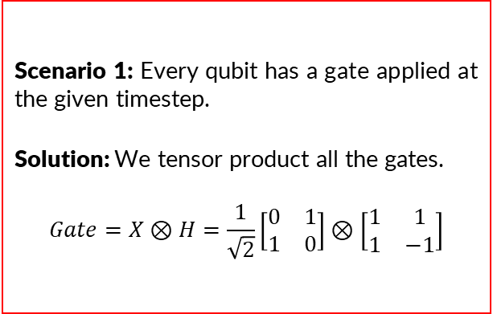

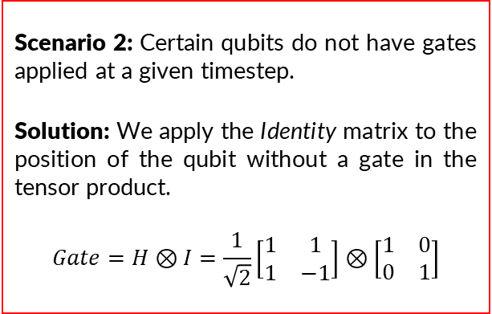


Composite Gates
Recall : Composite multi-qubit gates are abstractions of single qubit gates and created by taking a tensor product of single qubit gates.
Why use them : Composite gates are useful as they allow us a general framework to apply single qubit gates in multi-qubit systems. They are also especially important when we look at ‘Measurement’.
Construction : In general, there are 2 scenarios when constructing composite gates. Both use the tensor product operation. They are -
Scenario 1: Every qubit has a gate applied at the given timestep.
Solution: We tensor product all the gates.
$$Gate=X⊗H=\frac{1}{\sqrt{2}}\left[\begin{matrix}0 & 1 \\ 1 & 0\end{matrix}\right]⊗\left[\begin{matrix}1 & 1 \\ 1 & −1\end{matrix}\right]$$
Scenario 2: Certain qubits do not have gates applied at a given timestep.
Solution: We apply the Identity matrix to the position of the qubit without a gate in the tensor product.
$$Gate=H⊗I=\frac{1}{\sqrt{2}}\left[\begin{matrix}1 & 1 \\ 1 & −1\end{matrix}\right]⊗\left[\begin{matrix}1 & 0 \\ 0 & 1\end{matrix}\right]$$
1
2
$$|0⟩$$
$$X$$
$$H$$
$$|0⟩$$
$$H$$
Computation : As these are equivalent to applying gates on independent systems, we can simplify computation by using the naïve computation method.

Slide 22











Native Multi-Qubit Gates
Recall : Native multi-qubit gates cannot be factorized into single qubit gates. These gates also tend to create unfactorizable states.
Construction : We will be dividing these gates into 3 main families-
Controlled Gates
SWAP Gate
Ising Coupling Gates
Controlled Gates : Controlled gates take 2 types of inputs – control and target. These gates apply some general Unitary operation ($U$) when the states of the control qubits matches a given pattern. The target is generally represented by a ( ) symbol. It is important to note that the control effect also applies to super positions. We will study these properties with the most basic such gate – the CNOT gate.
$$|ψ_{0}⟩$$
$$|ψ_{0}⟩$$
Extending to n-Qubits
$$|ψ_{1}⟩$$
$$⋮$$
$$⋮$$
$$⋮$$
$$|ψ_{1}⟩$$
$$U$$
$$|ψ_{n}⟩$$
General 2-Qubit controlled gate
$$U$$
$$|ψ_{T}⟩$$
General n-Qubit controlled gate
SWAP Gate : The SWAP Gate swaps the states of any 2 qubits.
Ising Coupling Gates : They are a special family of parameterized two-qubit operations that rotate the joint state of qubits rather than individual qubits. We’ll explore them more in the next lecture.

Slide 23

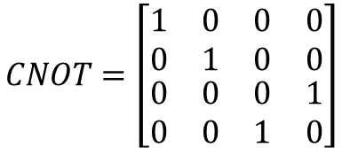




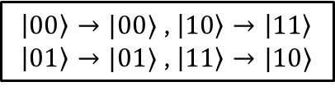
CNOT - Gate
CNOT Gate : The CNOT gate applies the X – Gate to the target when the control is in the $|1⟩$ state. To simplify notation the X-Gate is often written as a $⊕$ symbol on the target. Looking at the circuit and its Unitary -
$$|ψ_{0}⟩$$
$$|ψ_{0}⟩$$
$$CNOT=\left[\begin{matrix}\begin{matrix}1 & 0 \\ 0 & 1\end{matrix} & \begin{matrix}0 & 0 \\ 0 & 0\end{matrix} \\ \begin{matrix}0 & 0 \\ 0 & 0\end{matrix} & \begin{matrix}0 & 1 \\ 1 & 0\end{matrix}\end{matrix}\right]$$
$$|ψ_{1}⟩$$
$$X$$
$$|ψ_{1}⟩$$
+
Equivalent circuit representations of CNOT
CNOT Unitary Matrix
Applying CNOT : We can apply the CNOT with or without superposition :
Without Superpositions
$\left|00\right\rangle →|00⟩$ , $\left|10\right\rangle →\left|11\right\rangle$
$\left|01\right\rangle →|01⟩$ , $\left|11\right\rangle →|10⟩$
Applying these transformations simultaneously allows us to operate on super positions.
With Superpositions
$$a|00⟩+b\left|01\right\rangle +c\left|10\right\rangle +d|11⟩→a|00⟩+b\left|01\right\rangle +c\left|11\right\rangle +d|10⟩$$
A critical observation is that the state produced by the CNOT operation cannot be factorized into the tensor product of any 2 single qubit state. These states are known as entangled states.

Slide 24

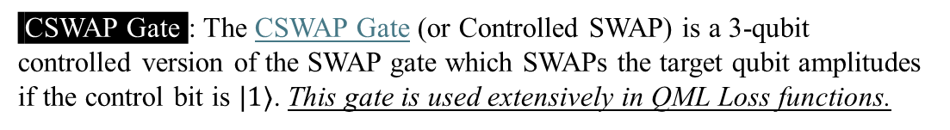





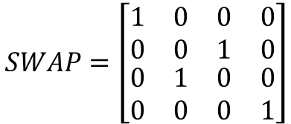


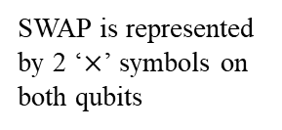



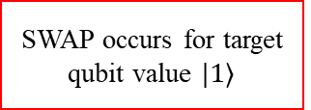
SWAP - Gate
SWAP Gate : The SWAP Gate is a special gate which swaps the amplitudes of 2 qubits. If we give it a 2-qubit state, it will swap the amplitudes of the $\left|01\right\rangle$ and $|10⟩$ states, which translates to swapping the amplitudes in the factorization.
$$\left|ψ_{0}\right\rangle ⊗\left|ψ_{1}\right\rangle =\left(x\left|0\right\rangle +y\left|1\right\rangle \right)⊗\left(a\left|0\right\rangle +b\left|1\right\rangle \right) \underset{→}{SWAP}\left(a\left|0\right\rangle +b\left|1\right\rangle \right)⊗\left(x\left|0\right\rangle +y\left|1\right\rangle \right)=\left|ψ_{1}\right\rangle ⊗\left|ψ_{0}\right\rangle$$
$$SWAP=\left[\begin{matrix}\begin{matrix}1 & 0 \\ 0 & 0\end{matrix} & \begin{matrix}0 & 0 \\ 1 & 0\end{matrix} \\ \begin{matrix}0 & 1 \\ 0 & 0\end{matrix} & \begin{matrix}0 & 0 \\ 0 & 1\end{matrix}\end{matrix}\right]$$
CSWAP Gate : The CSWAP Gate (or Controlled SWAP) is a 3-qubit controlled version of the SWAP gate which SWAPs the target qubit amplitudes if the control bit is $|1⟩$. This gate is used extensively in QML Loss functions.
SWAP Unitary Matrix
1
2
$$\frac{1}{\sqrt{2}}(|0⟩+|1⟩ )⊗|ψ_{0}⟩⊗|ψ_{1}⟩$$
$$|ψ_{T}⟩$$
1
Circuit Representation
SWAP is represented by 2 ‘$×$’ symbols on both qubits
$$|ψ_{0}⟩$$
$$a\left|0\right\rangle +b\left|1\right\rangle$$
$$x\left|0\right\rangle +y\left|1\right\rangle$$
$$\frac{1}{\sqrt{2}}\left(\left|0\right\rangle ⊗\left|ψ_{0}\right\rangle ⊗\left|ψ_{1}\right\rangle +\left(|1⟩⊗|ψ_{1}⟩⊗|ψ_{0}⟩\right)\right)$$
2
$$|ψ_{0}⟩$$
$$|ψ_{1}⟩$$
SWAP occurs for target qubit value $|1⟩$
$$|ψ_{1}⟩$$
CSWAP Gate Circuit
It is important to note that the addition symbol here breaks factorizability – hence creating entangled states (more on entanglement next lecture)
$$x\left|0\right\rangle +y\left|1\right\rangle$$
$$a\left|0\right\rangle +b\left|1\right\rangle$$
SWAP Gate Circuit

Slide 25
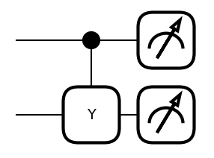
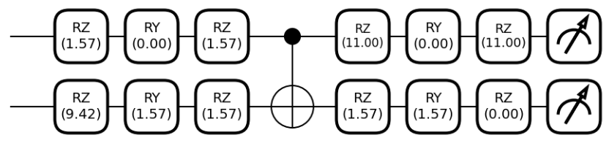






Multi-Qubit Universal Gates
Theorem : Any multi-qubit gate can be created using a combination of the $R_{X},R_{Y},R_{Z}$ Gates and the CNOT gate.
$$|+⟩$$
$$→\frac{1}{\sqrt{2}}\left(\left|00\right\rangle +i|11⟩\right)$$
$$|0⟩$$
Equivalent Circuits
$$|+⟩$$
$$→\frac{1}{\sqrt{2}}\left(\left|00\right\rangle +i|11⟩\right)$$
$$|0⟩$$
Note: The state $\left|+\right\rangle =\frac{1}{\sqrt{2}}\left(\left|0\right\rangle +|1⟩\right)$ and is the result of the $H$ gate on $|0⟩$

Slide 26
Let’s code some of this out
Open the Git Repository
Open the GitHub repository to look at the code.
QuantumClubASU/QML-Lecture-Series: Repository for QML lecture series
Explicit Quantum Models

Slide 27
QML Lecture Series - 3
Intro to Quantum Machine Learning
https://cglink.me/22J/c38605092504050
Check in here!
Join us on SDC

Slide 28
The End…
We made it folks!!!

