Slide 1
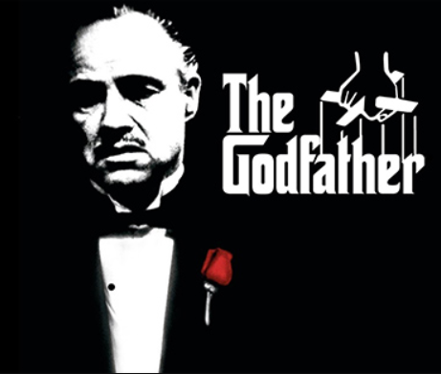

IMDb TOP 250 Movies Analysis
Xin Ou
https://cutt.ly/5ymKP3v

Slide 2
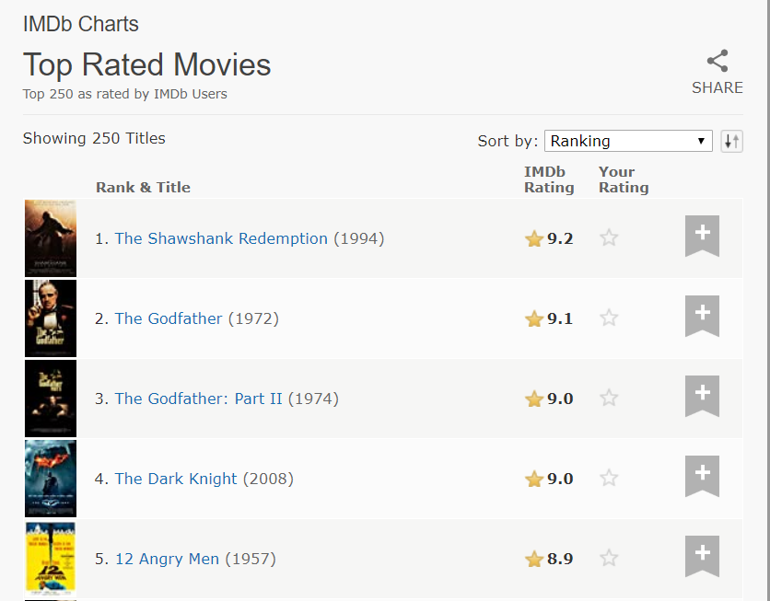
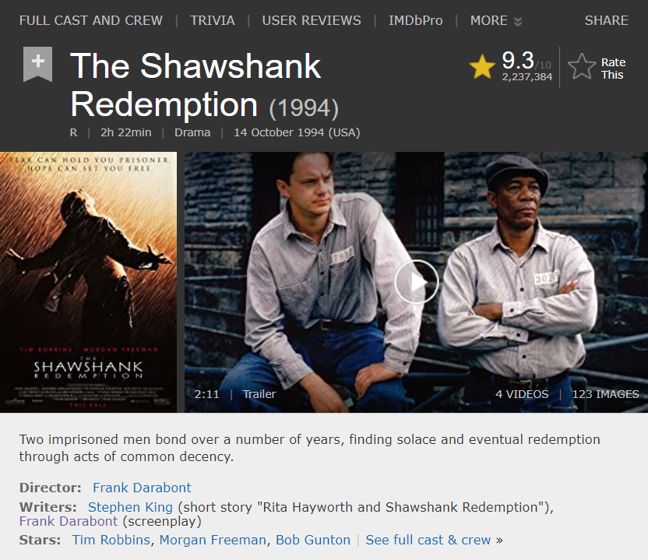
Data Source
Main Page
Sub Page

Slide 3
Content
Movie Data Analysis
Word Vector Analysis
Score Prediction

Slide 4
Movie Data Analysis
Country Analysis
Genre Analysis
Director Analysis
Star Analysis

Slide 5
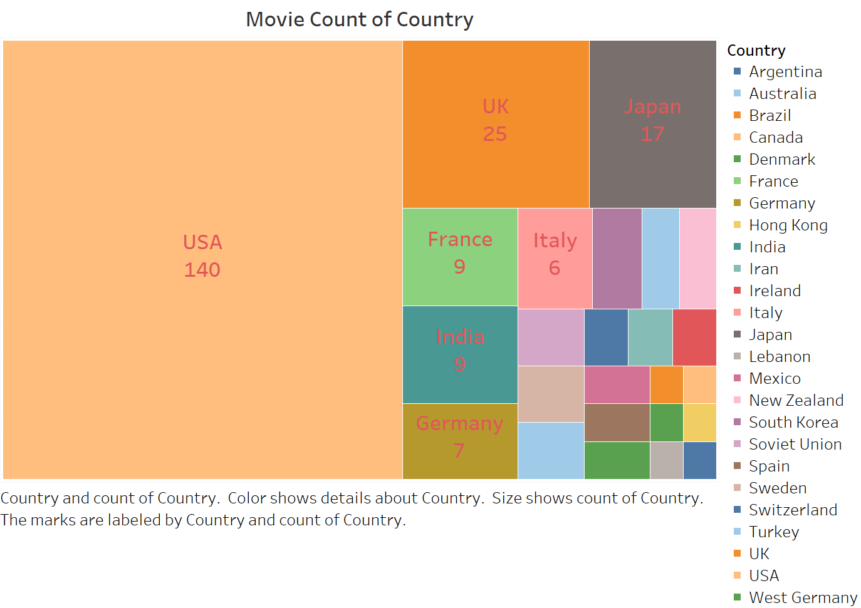

Slide 6
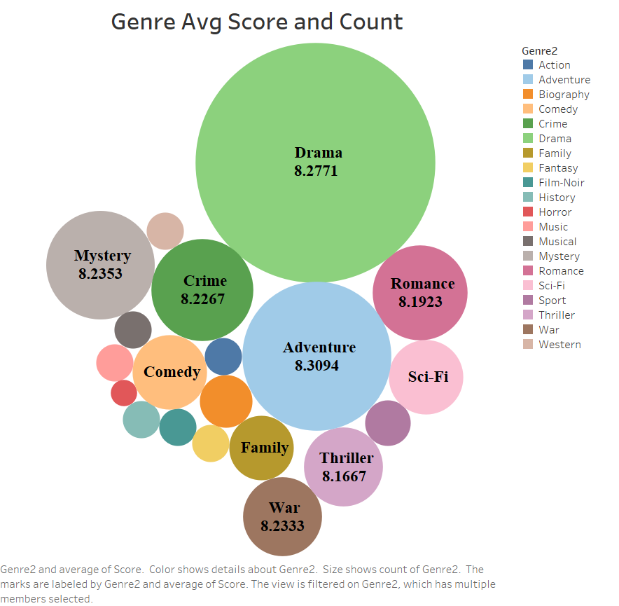

Slide 7
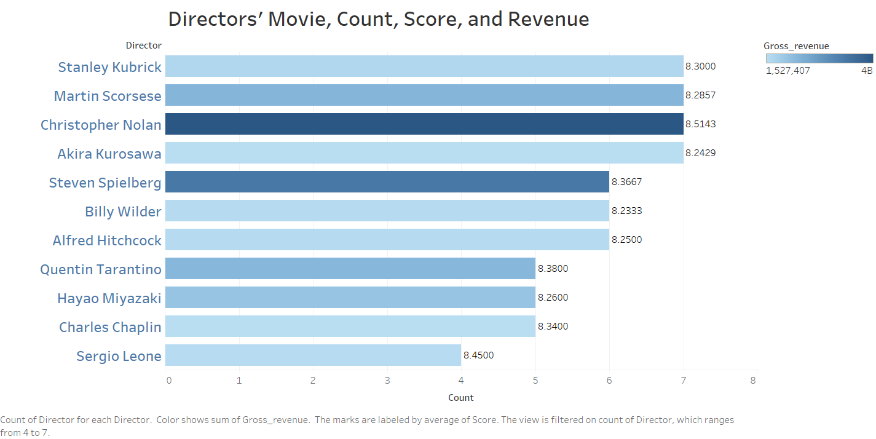

Slide 8
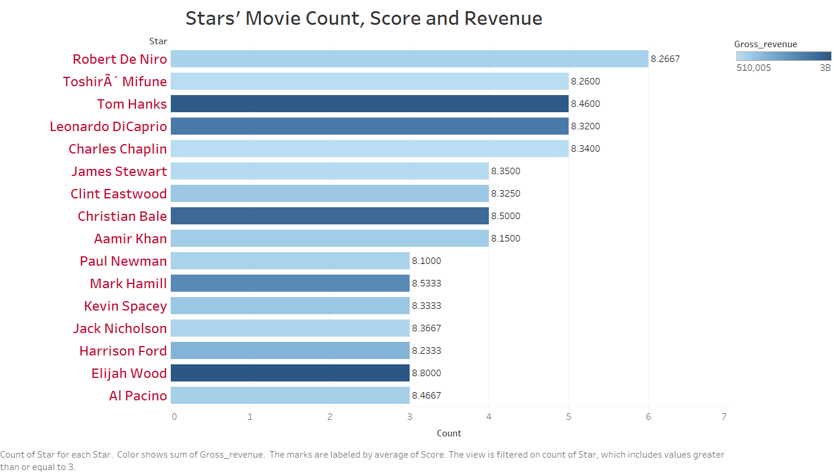

Slide 9
Word Vector Analysis
Text Feature
Word Vector
Similarity Matrix
Similar Movie Recommendation

Slide 10
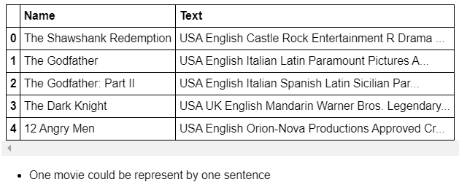
Country
Language
Production
Rating
Genre
Story
Director
Writer
Star
Merge
Text
USA English Castle Rock Entertainment R Drama Two imprisoned men bond over a number of years, finding solace and eventual redemption through acts of common decency. Frank Darabont Stephen King Frank Darabont Tim Robbins Morgan Freeman Bob Gunton
Word2Vec Model

Slide 11
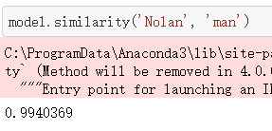
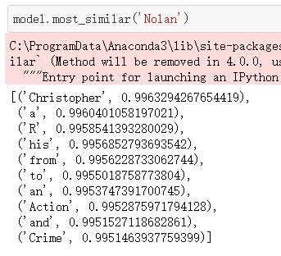
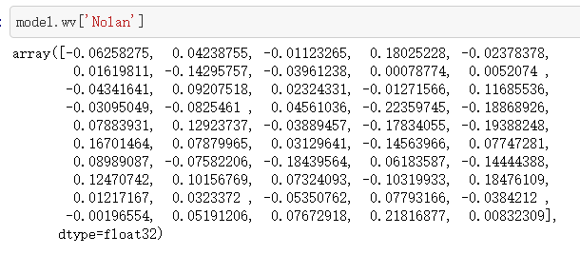
Similarity Between Two Words
Similar Words
Word Vector

Slide 12
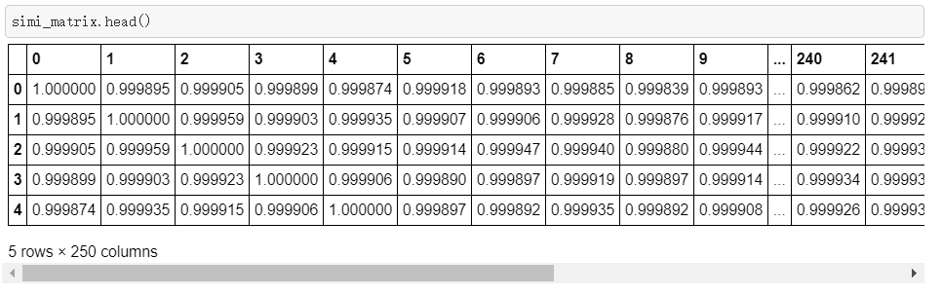
Movie Similarity Matrix

Slide 13
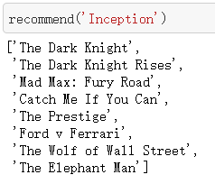
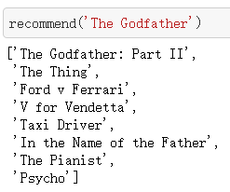
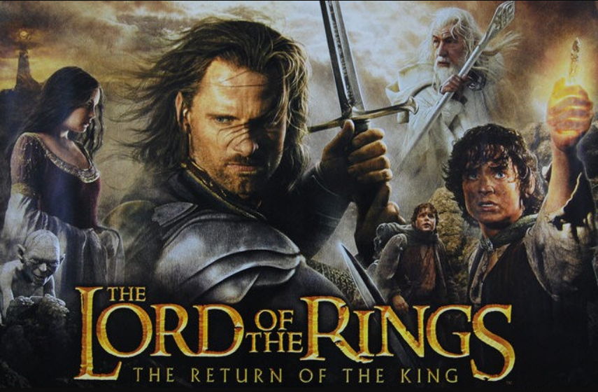
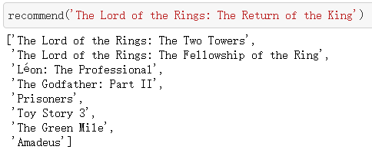
Movie Recommendation

Slide 14
Score prediction
TF-IDF features
Linear Regression model (LR)
Random Forest Regression model (RF)

Slide 15
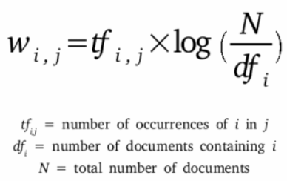
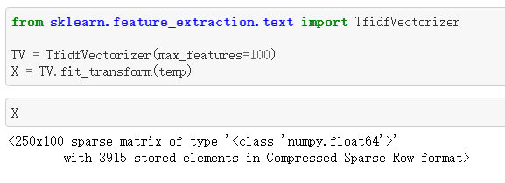
TF-IDF

Slide 16
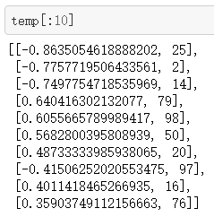
Linear Regression Model
Top 10 Weights
R^2: 0.8624

Slide 17
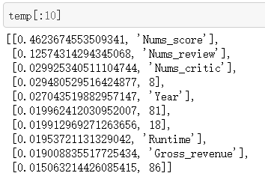
Random Forest Regressor
Features Importance

Slide 18
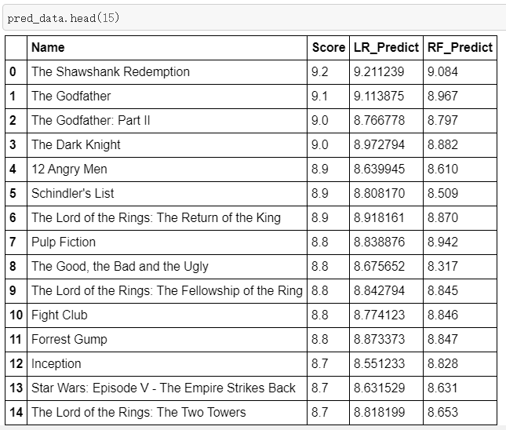

Comparison

Slide 19
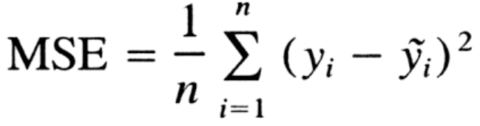
Linear Regression vs Random Forest
 | LR | RF
MSE of Train Data | 0.0076 | 0.0040
MSE of Test Data | 0.0657 | 0.0259
MSE of All Data | 0.0251 | 0.0105

Slide 20
Thank you! Question ?

