Slide 1

Biomedical image analysis using a quantum computer
IQuCodeFest 2026
https://github.com/algolab-iqucodefest/iqucodefest-2026
Samuel Richard
Guy-Philippe Nadon
Jacob Bernier
Victor Rochon

Slide 2
Presentation Plan
Quantum Sketching
Quantum Sketching Experiments
QCNN
Notes:
Completer un protocole de correction d’erreur

Slide 3
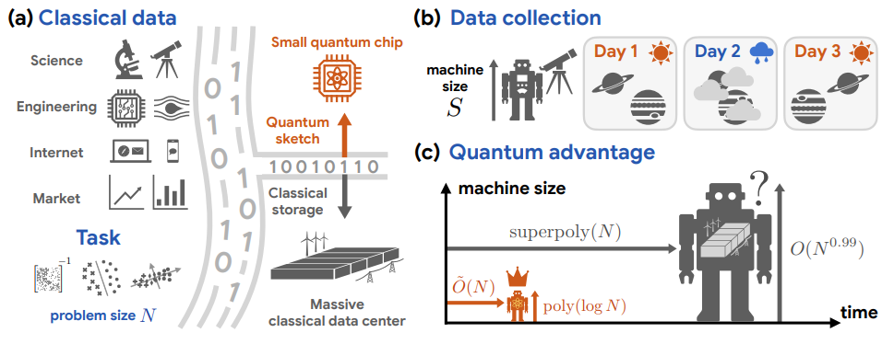
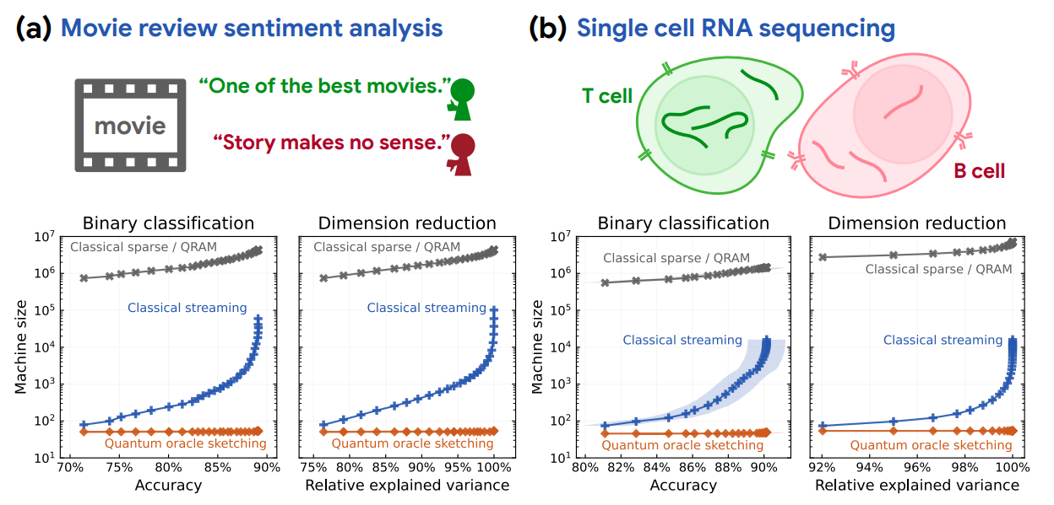
Quantum Sketching Attempt
https://github.com/haimengzhao/quantum-oracle-sketching/tree/main
https://arxiv.org/pdf/2604.07639
Notes:
This work suggests quantum may help with data compression / feature extraction / representation learning, not directly “making better images.”
“quantum oracle sketching” processes classical samples on the fly instead of loading/storing the whole dataset

Slide 4
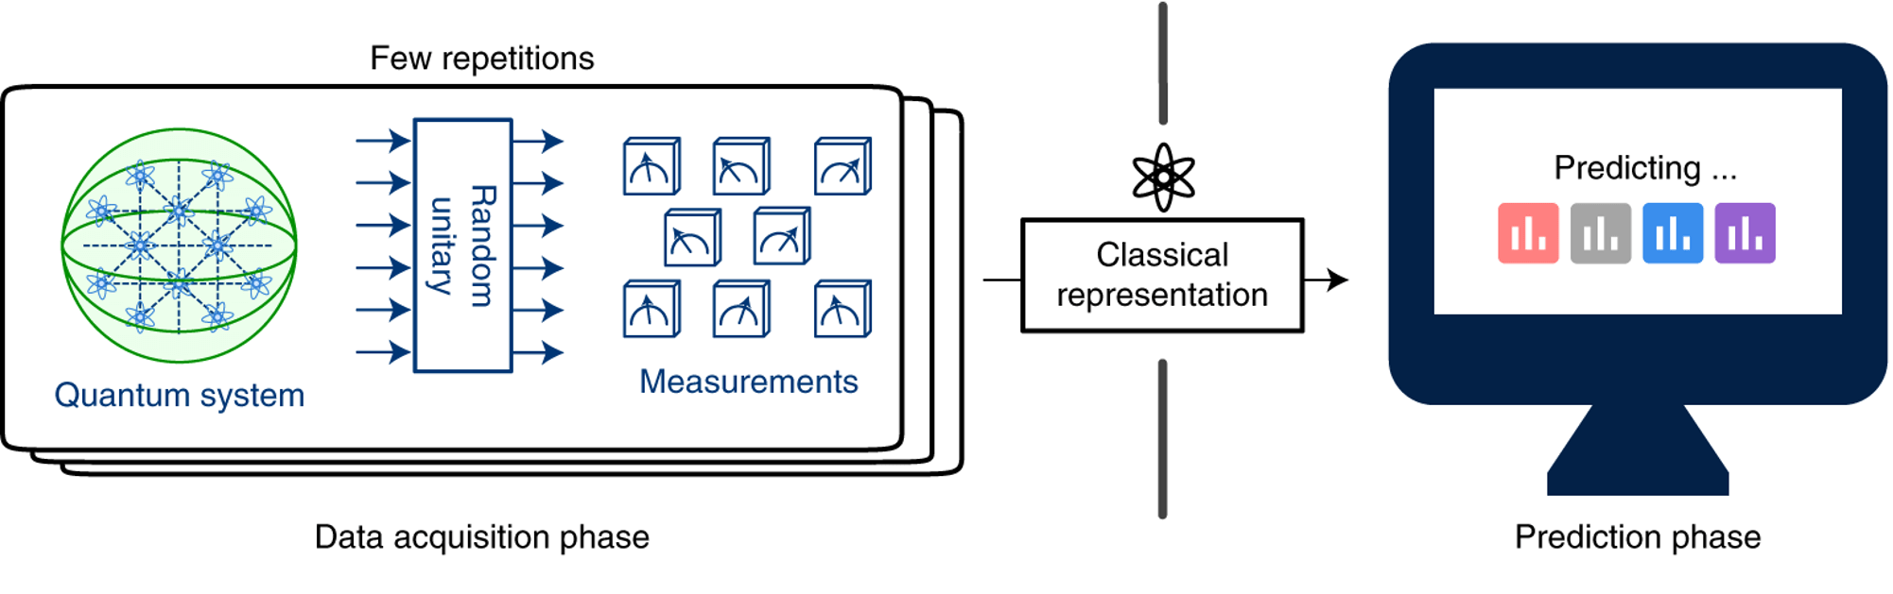
Classical Shadow
From https://pennylane.ai/demos/tutorial_classical_shadows

Slide 5
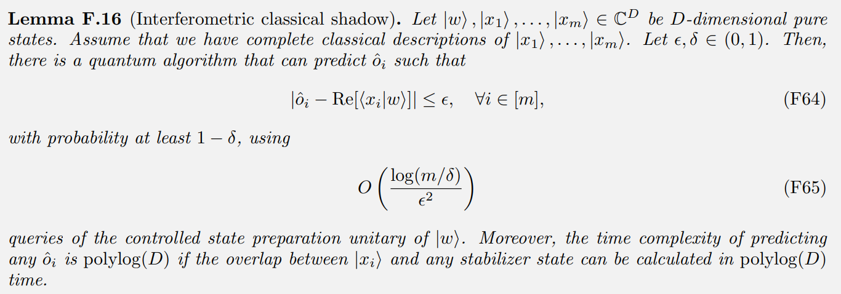
Interferometric classical shadow

Slide 6
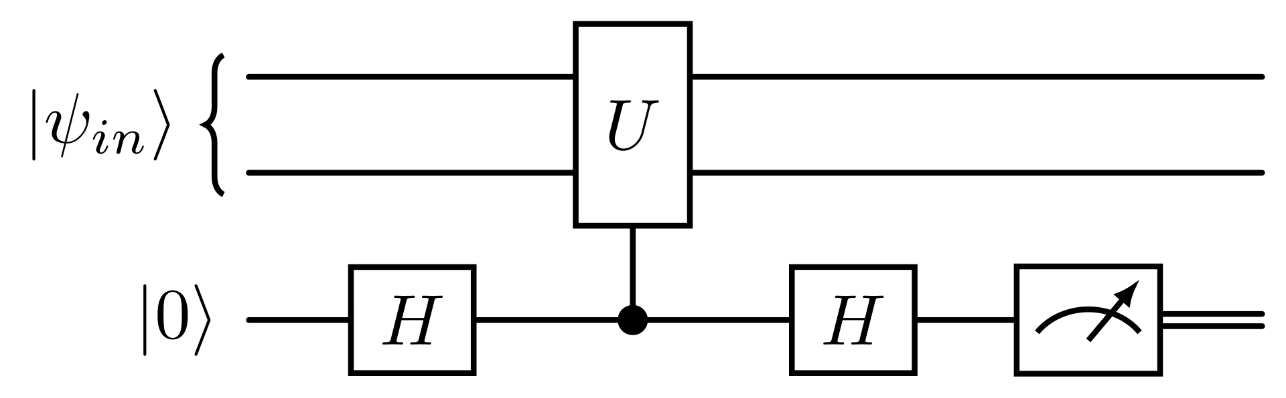
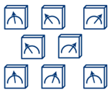
Interferometric classical shadow

Slide 7
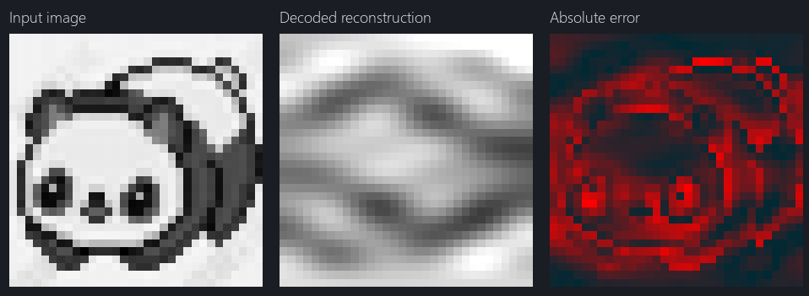
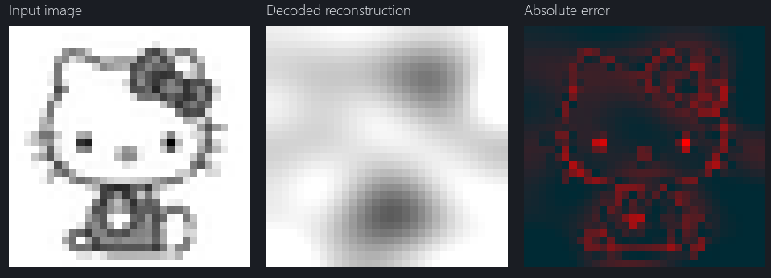
Quantum Sketching k = 12, with top coefficient
Notes:
Using top discrete cosine transform coefficient

Slide 8
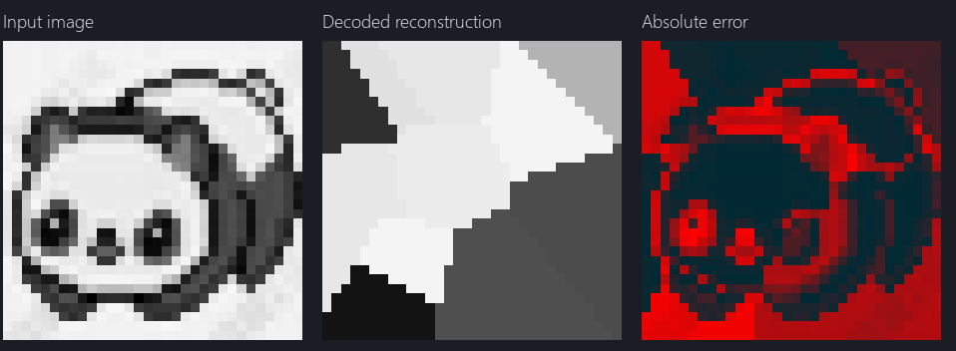
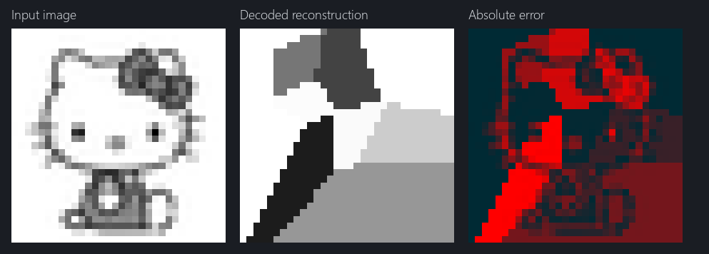
Quantum Sketching k = 12, random
Notes:
full image -> randomly choose k pixel positions -> keep only those k pixel intensities

Slide 9
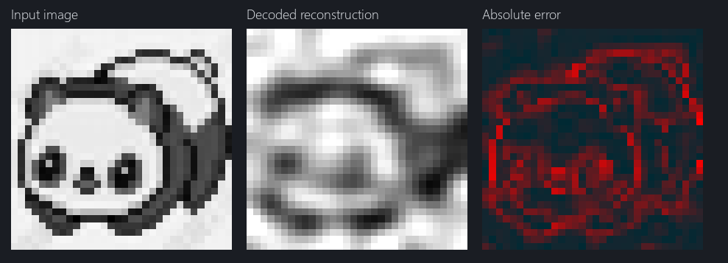
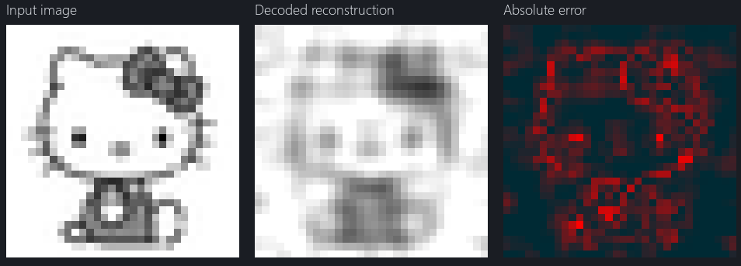
Quantum Sketching k = 43, with top coefficient
Notes:
Using top k DCT coefficient

Slide 10
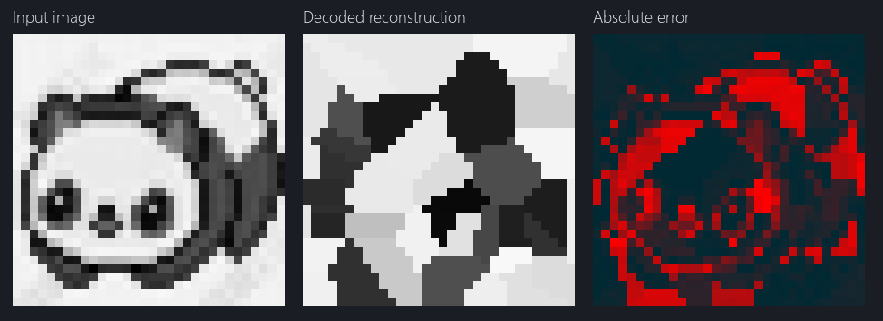
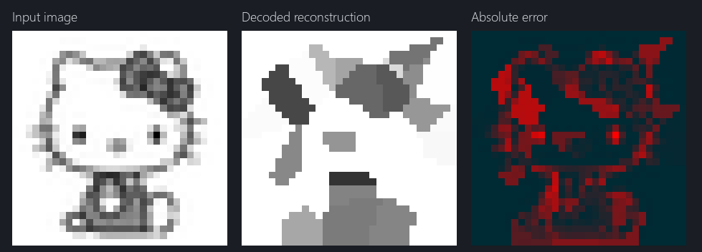
Quantum Sketching k = 43, random
Notes:
full image -> randomly choose k pixel positions -> keep only those k pixel intensities

Slide 11
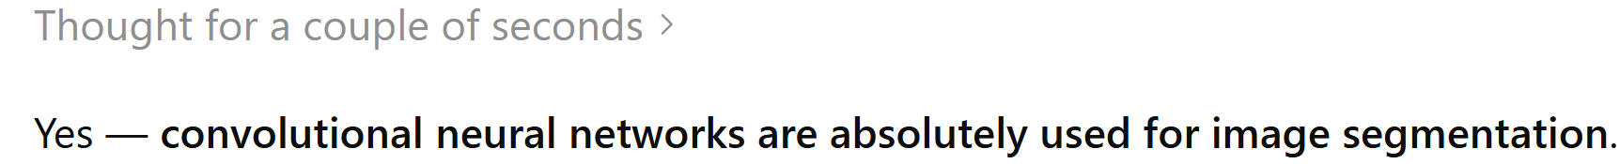
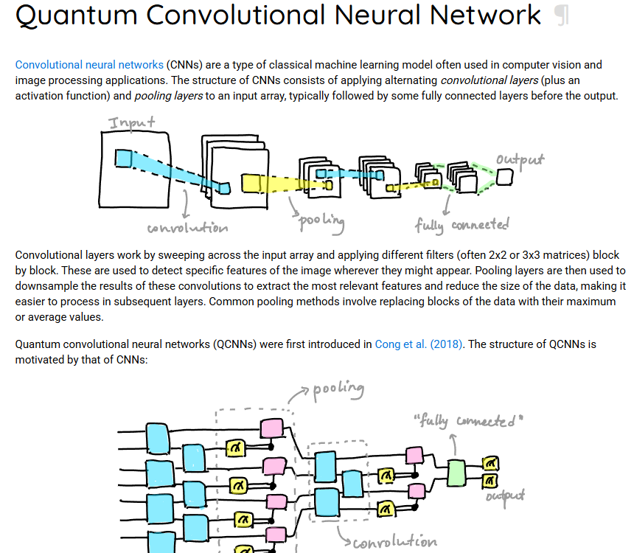

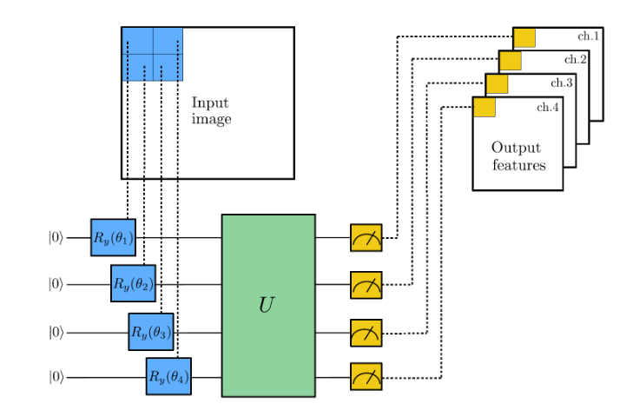
Quantum Convolational neural network
https://pennylane.ai/demos/tutorial_quanvolution
https://pennylane.ai/glossary/qcnn

Slide 12
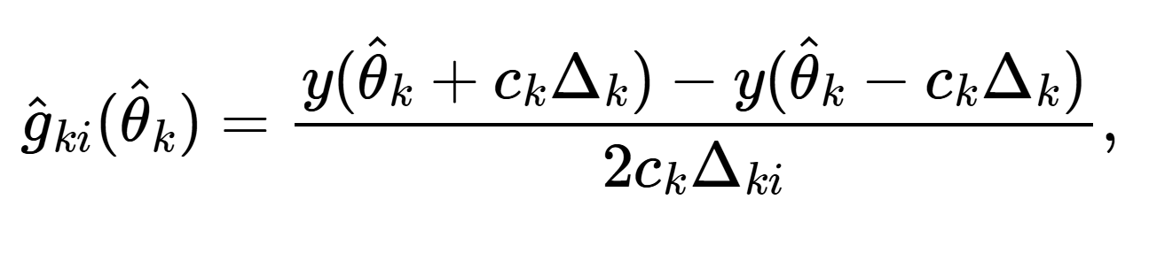
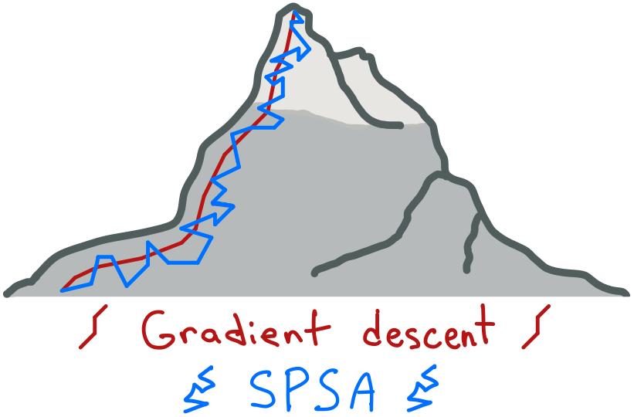
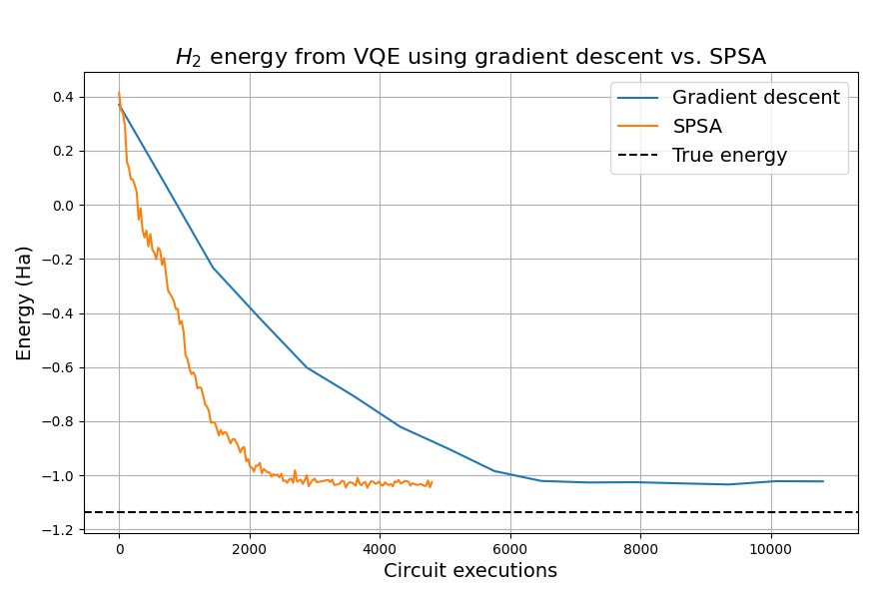
Optimizer used
Images from https://pennylane.ai/demos/tutorial_spsa

Slide 13
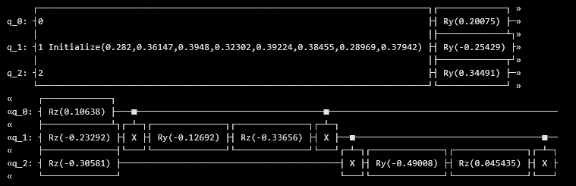
QCNN

