Slide 1
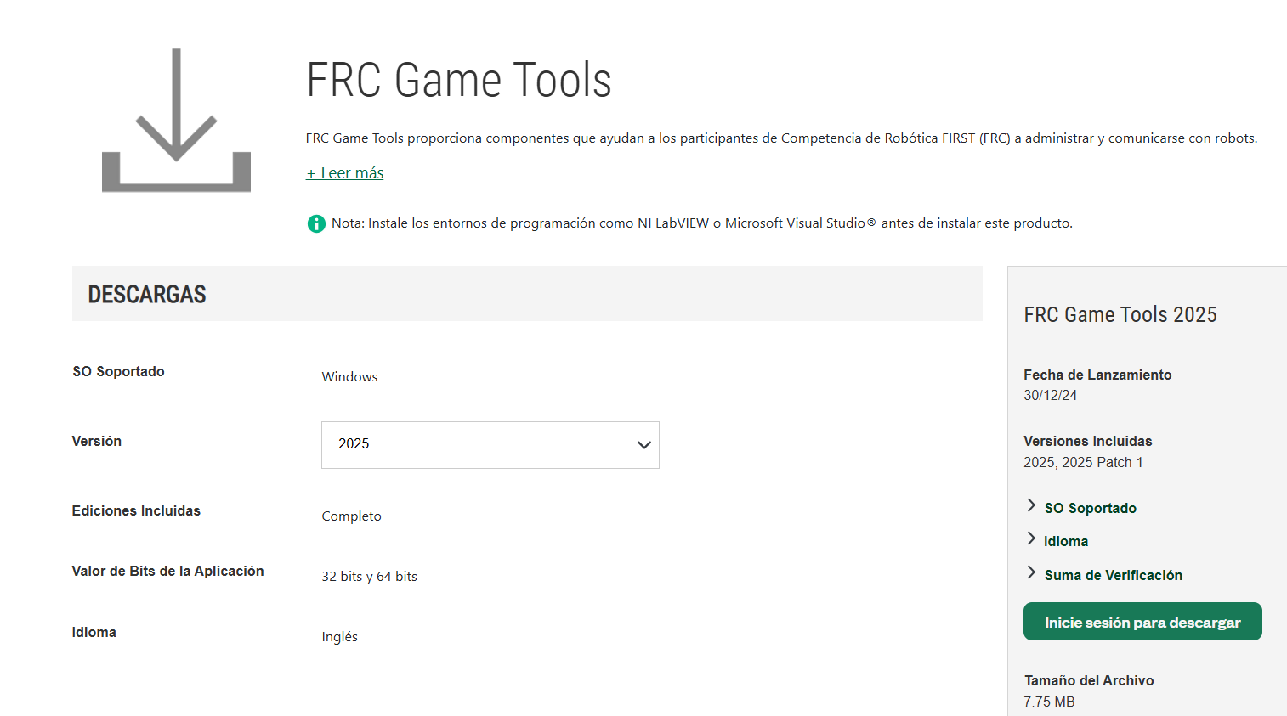
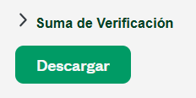

https://docs.wpilib.org/en/stable/docs/zero-to-robot/step-2/offline-installation-preparations.html

Slide 2
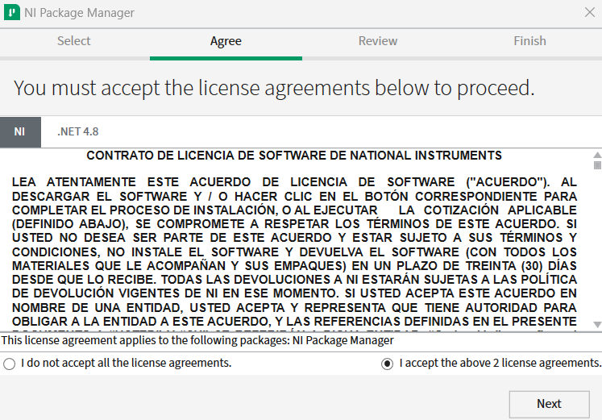
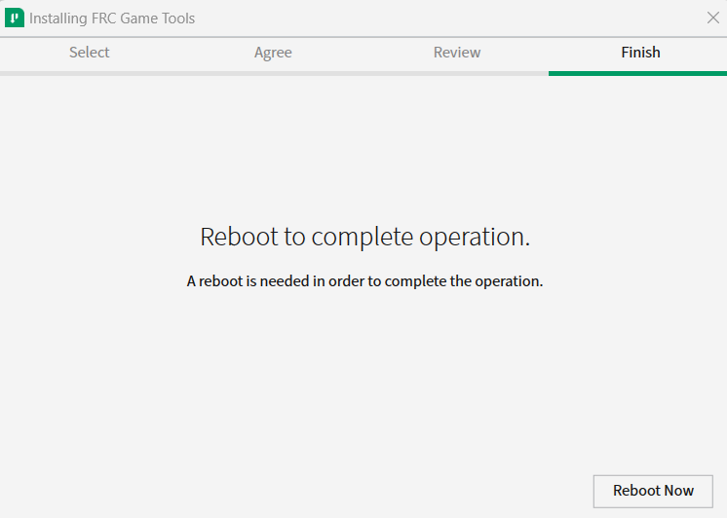



Slide 3




