Slide 1
Phone Camera
2D Image
Convolutional Autoencoder
Depth Information
Manual
Automated
Use of PCL
Image
Post-Process
Point Cloud Generation
Point Cloud Post-Process
Mesh Reconstruction
Texturing
Completed Model

Slide 2
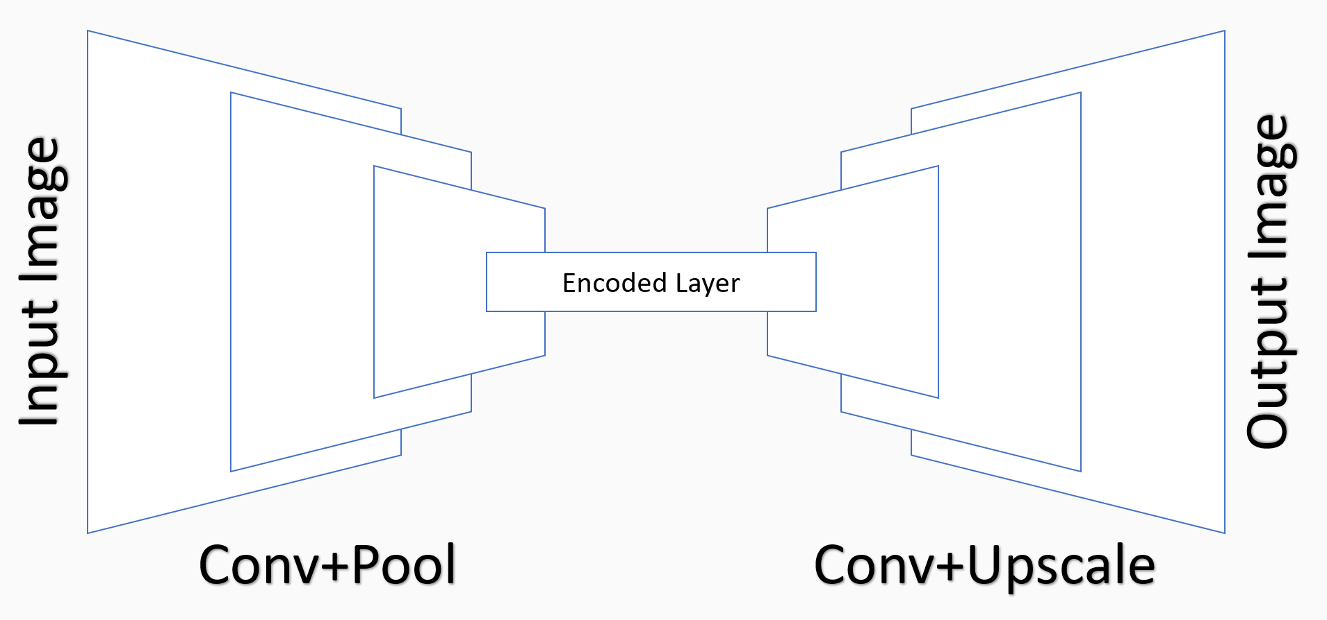
Input Image
Encoded Layer
Output Image
Conv+Pool
Conv+Upscale

Slide 3
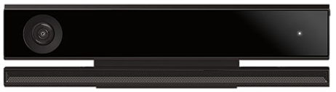

Color Images
Kinect V2 Sensor
UW-App
Data
Pre-process
Packed training dataset (HDF5)
Depth Frames

Slide 4
r
Viewport origin
d (focal length)
y
x
Projection plane
d*r

