Slide 1
UE20CS461A – Project Phase – 2
END SEMESTER ASSESSMENT
Project Title : | Spatio Temporal Traffic Forecasting Using Machine Learning
Project ID : | 107
Project Guide : | Prof. Sreenath MV
Project Team : | Adnan Suhail Ahmed - PES2UG20CS489 Aravind A - PES2UG20CS495 Syed Arbaz - PES2UG20CS473 Mohamed Shifaan - PES2UG20CS520

Slide 2
Outline
Abstract
Summary of Requirements and Design ( Phase - 1)
Summary of Design Methodology / Approach (Phase - 2)
Design Description
Modules and Implementation Details
Project Demonstration and Walkthrough
Test Plan and Strategy
Results and Discussion
Lessons Learnt
Conclusion and Future Work
References

Slide 3
Abstract
Traffic congestion generates economic, social and environmental issues in many cities around the world.
Therefore the main objective of traffic/civil engineers is to handle traffic in a such a way that enables a higher quality of service on the roads to maximize the mobility and minimize the congestion.
It has the potential to help road users make better travel decisions, alleviate traffic congestion, reduce carbon emissions, and improve traffic operation efficiency.

Slide 4
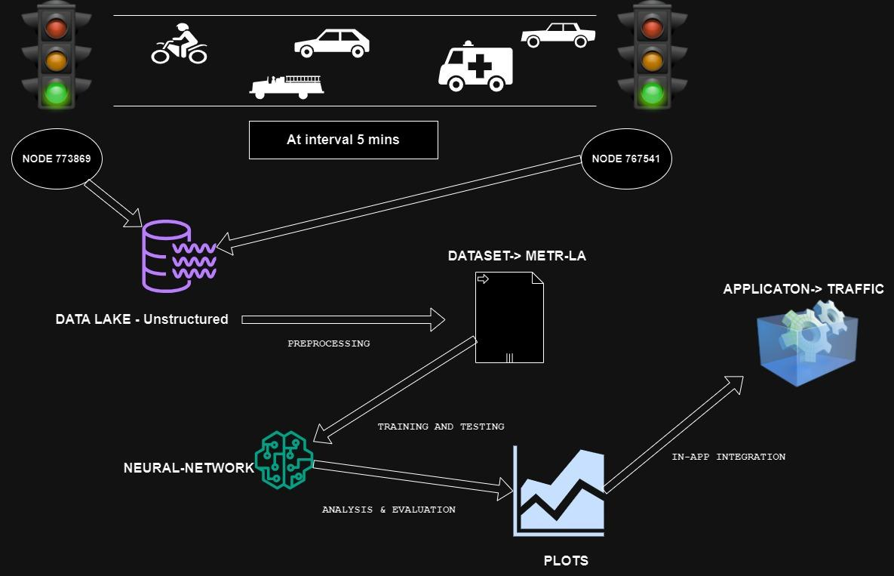
Design Approach

Slide 5
Summary of Requirements
Major requirements for our project:
Data Handling: Acquire and preprocess METR-LA and PEMS-D8 dataset for relevant traffic features.
Model Selection: Choose and implement ML models specifically Neural networks and for spatio-temporal traffic forecasting.
Training and Testing: Define training strategy (No. of epochs, timesteps) and evaluate models using Error metrics.

Slide 6
Summary of Requirements
Major requirements for our project:
Documentation: Document codebase, model architecture, and preprocessing steps.
Validation: Validate models against ground truth data for real-world reliability.

Slide 7
Design Details
Data Flow:
Data Acquisition: Retrieve data from data lakes in CSV format.
Data Preprocessing: Employ appropriate techniques to preprocess the data. Address missing values, outliers, and ensure data readiness.
Model Training and Testing:Feed preprocessed data into the feed models.
Evaluation Metrics: Assess model performance using accuracy metrics.

Slide 8
Design Details
Implementation Steps:
CSV to Data Lakes: Import data from data lakes into CSV format.
Data Preprocessing Techniques: Apply preprocessing techniques for data cleaning and formatting.
Model Integration: Integrate preprocessed data with neural networks models.
Training and Testing: Train models on the prepared data and conduct testing.
Accuracy Metrics:Evaluate model accuracy using appropriate metrics.

Slide 9
Dataset
The datasets consist of an adjacency matrix representing the road network and a Time Series of average speeds at regular intervals, traffic flow and occupancy in the network.
PEMS08: It contains traffic data collected from loop detectors on the California highway network. The dataset includes flow data from 170 sensors located on the highway network. The dataset contains 17,856 time steps.
METR-LA: It contains traffic speed data for 207 sensors in the Los Angeles area over a period of 34272 time steps. The dataset contains speed aspect as the feature for the study purpose.

Slide 10
Dataset
Dataset | Nodes | Edges | Timesteps
METR-LA | 207 | 1722 | 34272
PEMS08 | 170 | 295 | 17856

Slide 11
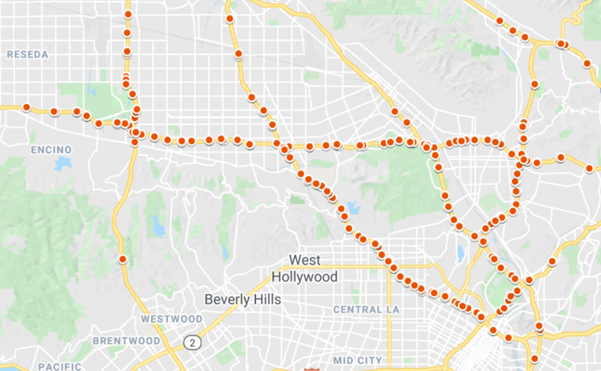
Dataset
METR-LA

Slide 12
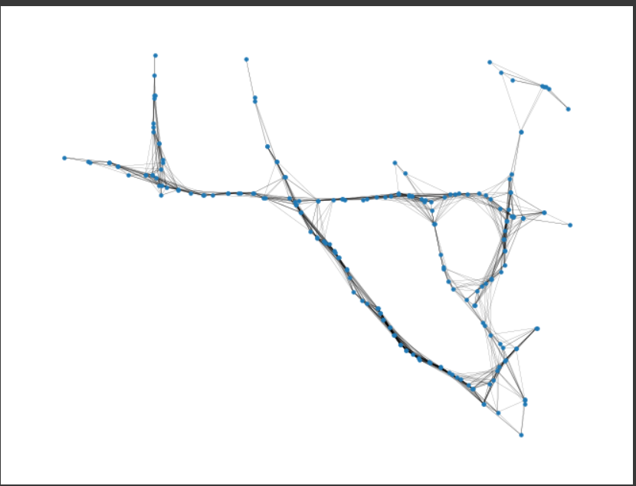

Slide 13
Model Description
DCRNN (Diffusion Convolutional Recurrent Neural Network):
Diffusion convolutional layers for spatio-temporal dependency capture.
Integration of recurrent neural networks (RNNs) for temporal modeling.
Representation of traffic as a graph for spatial dependency learning.
STGCN (Spatio-Temporal Graph Convolutional Network):
Graph convolutional layers for spatial dependency capture.
Temporal convolutional layers for handling temporal dynamics.
Effective fusion of spatial and temporal information using fully connected layers.

Slide 14
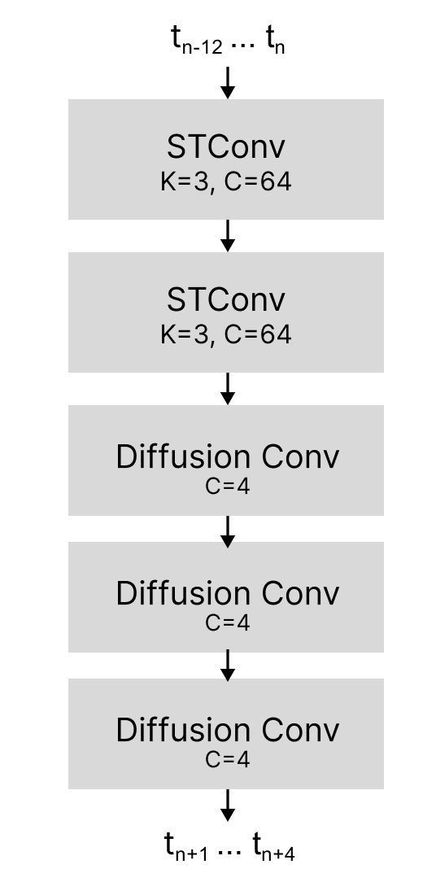
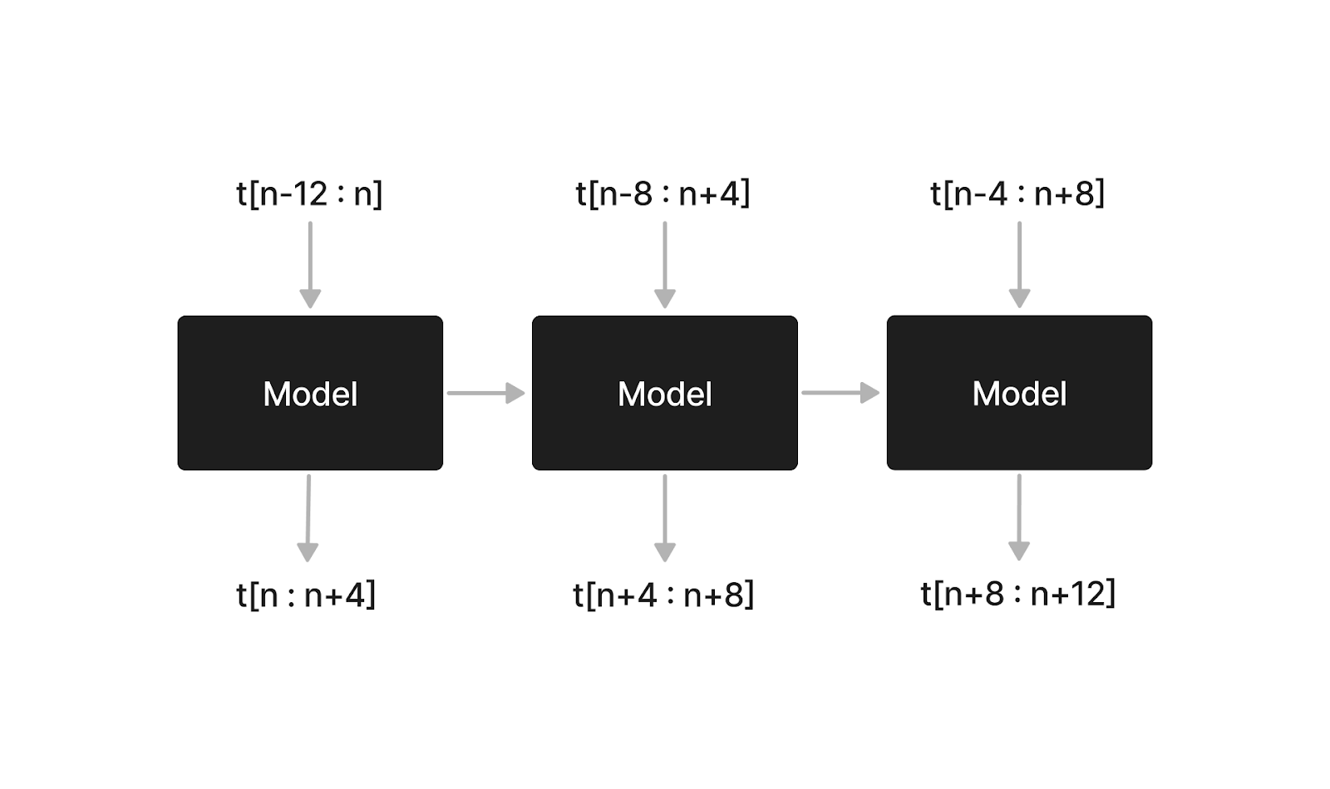
Model Architecture

Slide 15
Modules and Implementation Details
Programming Language: Python
Platform: Google Colab / Jupyter Notebook
Frameworks/Libraries used
pytorch 2.0.1+cu118
numpy 1.23.5
scipy 1.11.3
networkx 3.7.1
matplotlib 3.1

Slide 16
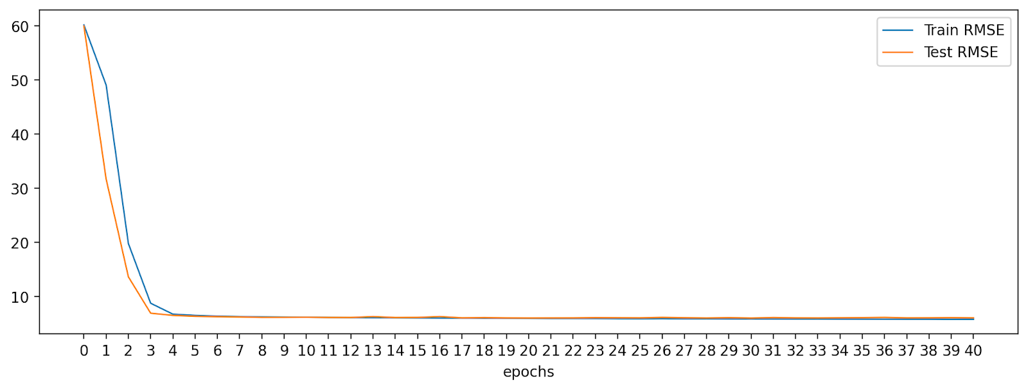
Training
Loss (RMSE)
Epochs = 40
Batch size = 32
Loss fn = RMSE
Optimizer = Adam
Learning rate = 0.02

Slide 17
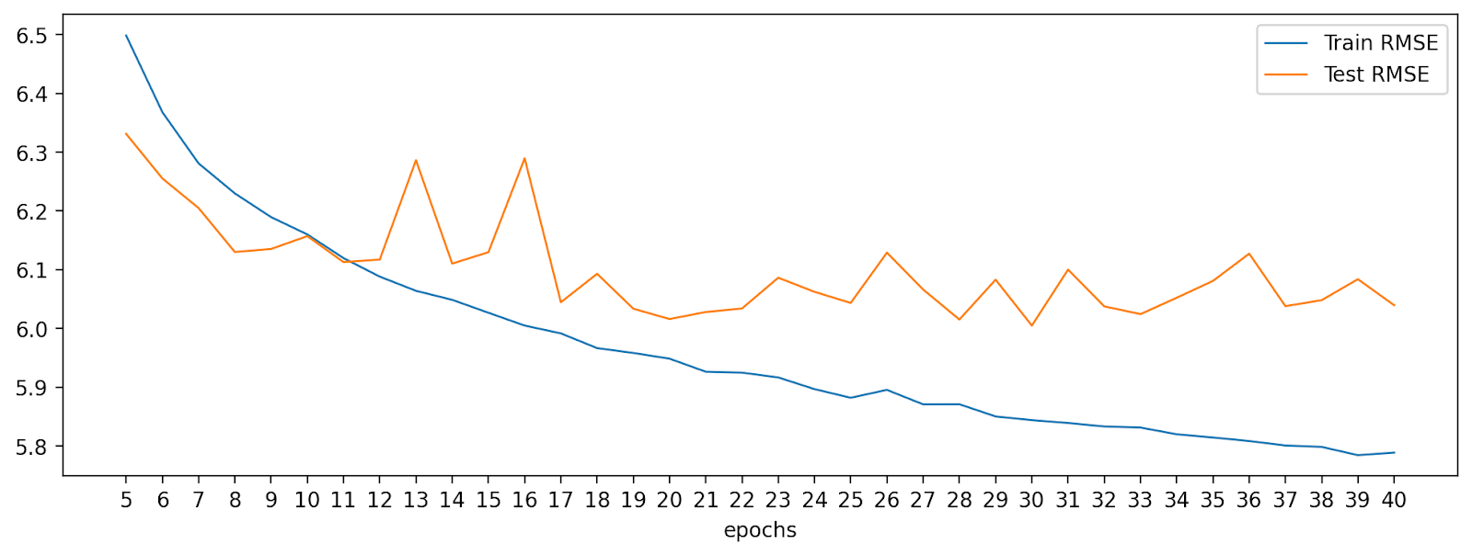
Training
Loss (RMSE)

Slide 18
Results
 | 15 min |  |  | 30 min |  |  | 1 hr
Dataset | MAE | MAPE | RMSE | MAE | MAPE | RMSE | MAE | MAPE | RMSE
METR-LA | 3.0390 | 8.200 | 5.3993 | 3.3719 | 9.3106 | 6.0016 | 3.9701 | 11.2179 | 6.9797
PEMSD8 | 1.5041 | 3.4085 | 3.2687 | 1.6704 | 3.9253 | 3.7975 | 1.9085 | 4.5673 | 4.2843

Slide 19
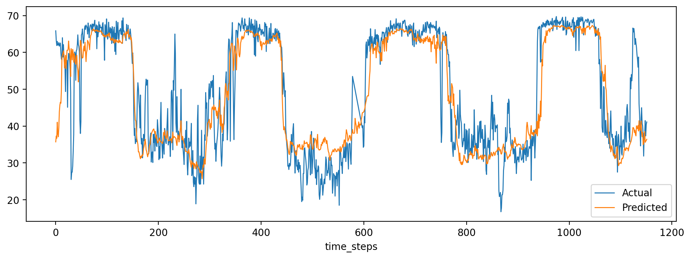
Results
Speed
Dataset : METRLA
sensor = 15

Slide 20
Documentation
Project Report: Completed--Corrections[if any]
Research Paper: Completed-Corrections[if any]
Link to Source code:
https://colab.research.google.com/drive/1R9wgZvyM0FJo_0OqWRugB9baLjeSepYa#revisionId=0B9IjZnCSCB1DVFM3eEZwRFQ1dkRaU2pHUFBTd1hycDNTZllrPQ&scrollTo=nZJc-VMqL_ke

Slide 21
Future work
Scalability:
Explore methods to enhance the scalability of the models.
Consider how the models can be adapted for larger datasets or extended to cover additional geographic areas.
Model Interpretability:
Investigate techniques to improve the interpretability of the models.
Explore ways to make the insights gained from the models more accessible and understandable.
Incorporate Additional Data:
Assess the impact of incorporating additional data sources (e.g., weather, events) on model performance.
Explore the potential for enhancing predictions with diverse data inputs.

Slide 22
Future work
Optimization and Fine-Tuning:
Fine-tune model hyperparameters for better performance.
Experiment with different optimization strategies to further enhance training efficiency.
Real-time Implementation:
Investigate the feasibility of deploying the models for real-time traffic forecasting.
Explore integration with traffic management systems for practical applications.
User Interface Enhancement (if applicable):
Consider improving the user interface for better user experience.
Gather user feedback and implement enhancements based on usability studies.

Slide 23
Conclusion
Improvised Forecasting Accuracy:
Successfully implemented DCRNN and STGCN models for spatio-temporal traffic forecasting.
Achieved significant improvements in accuracy compared to traditional forecasting methods and the referred paper.
Traffic forecasting can be considered both a regression and a prediction problem.
The goal was to predict the future traffic volume based on past observed data, which can be seen as a prediction task.
However, the predicted traffic volume is a continuous variable, which makes it a regression problem.
The model is designed to learn the spatial and temporal dependencies in the traffic data and make accurate predictions of future traffic volume.

Slide 24
References
Li, Y., Yu, R., Shahabi, C., & Liu, Y. (2018). Diffusion Convolutional Recurrent Neural Network: Data-Driven Traffic Forecasting. In International Conference on Learning Representations (ICLR '18).
Jiabin Tang, Tang Qian, Shĳing Liu, Shengdong Du, Jie Hu, & Tianrui Li. (2022). Spatio-Temporal Latent Graph Structure Learning for Traffic Forecasting.
Yu, B., Yin, H., & Zhu, Z. (2018). Spatio-temporal Graph Convolutional Networks: A Deep Learning Framework for Traffic Forecasting. In Proceedings of the 27th International Joint Conference on Artificial Intelligence (ĲCAI).

Slide 25
Thank you

Slide 26
Modules Implementation
Import Libraries
Key Libraries:
Import essential libraries for data manipulation and deep learning.
Examples: Pandas, NumPy, TensorFlow/PyTorch for deep learning.
Load Dataset
Dataset Source:
Load traffic dataset from CSV files.
Use Pandas or similar libraries for efficient data loading.
Plot Dataset
Data Visualization:
Visualize key features of the dataset (e.g., traffic patterns, trends).
Matplotlib or Seaborn can be employed for plotting.

Slide 27
Modules Implementation
Split into Train and Test
Train-Test Split:
Split the dataset into training and testing sets.
Ensure a representative distribution in both sets for accurate evaluation.
DCRNN Layers
Architecture Overview:
Describe the layers in the DCRNN model.
Include diffusion convolutional layers and recurrent neural networks.
STGCN Layers
Architecture Overview:
Describe the layers in the STGCN model.
Highlight the use of graph convolutional layers and temporal convolutional layers.

Slide 28
Modules Implementation
Create Model
Model Initialization:
Instantiate the DCRNN and STGCN models.
Define model parameters and architecture.
Loss Function, Optimizer, and Train Loop
Loss Function:
Specify the loss function used for model training.
Example: Mean Squared Error for regression tasks.
Optimizer:
Choose an optimizer for gradient descent.
Examples: Adam, SGD.
Train Loop:
Outline the training loop structure.
Iteratively update model parameters to minimize the loss.

Slide 29
Modules Implementation
Train and Test
Training Process:
Train the models on the training set.
Monitor convergence and adjust hyperparameters if necessary.
Testing Process:
Evaluate the models on the test set.
Collect performance metrics such as accuracy and RMSE.
Plot Metrics and Predicted Data
Metrics Visualization:
Plot training and testing metrics over epochs.
Visualize predicted traffic data against actual data.

