Slide 1
9-13组会汇报
徐磊

Slide 2
KMC_tensorkmc

Slide 3
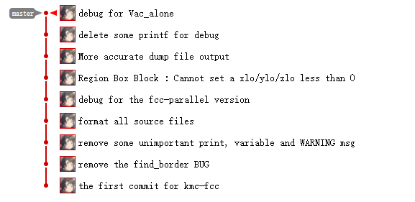
KMC_fcc

Slide 4
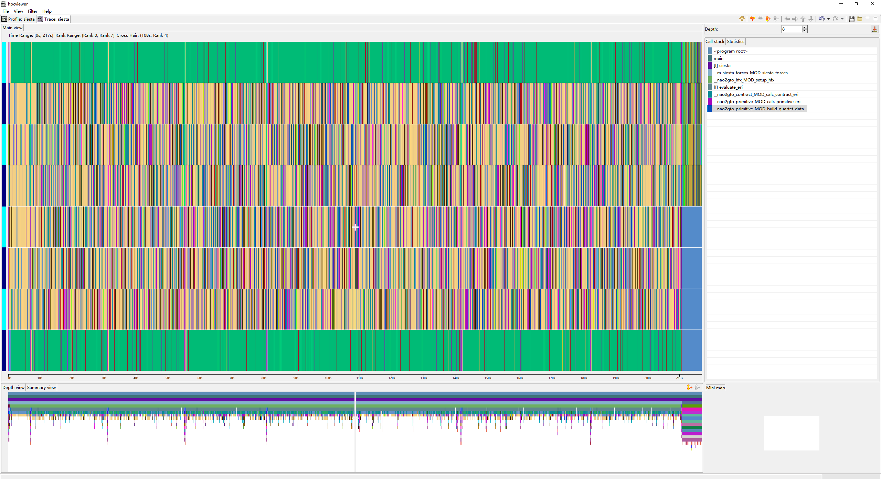
Honpas->profile with hpctoolkit

Slide 5
following work
Honpas优化，上申威
KMC-深度学习加速

