Slide 1
Debugging the single photon experiment sequence
It seems that the photons during the readouts are being undercounted (not all of the events are read out, though the experiment sequence for loading an atom seems bug free and the histogram clearly shows the bimodal tell-tale signature of single atom loading, just with lower overall counts).
In what follows, I reduce the experiment sequence until the count rate seems to match that of the single atom loading experiment, then add parts back in to see where the issue occurs. The cooling laser is unlocked as it has been finnicky today, so we will only be measuring the background counts.

Slide 2
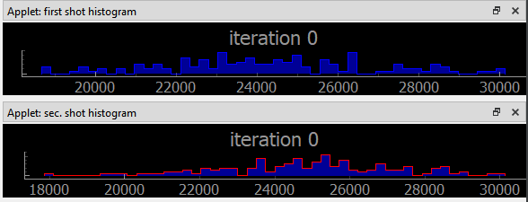
Debugging the single photon experiment sequence
The background with atom_loading_experiment
Mean ~ 24700

Slide 3
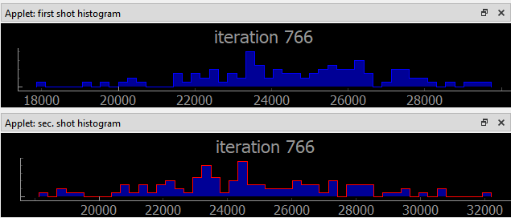
Debugging the single photon experiment sequence
single_photon_experiment:
Just one optical pumping phase between the readouts (nothing else):
Mean ~ 24700

Slide 4
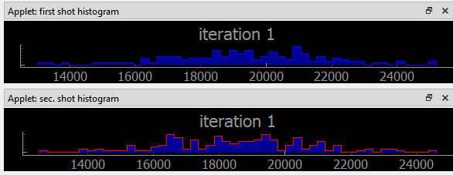
Debugging the single photon experiment sequence
single_photon_experiment:
Just one optical pumping phase between the readouts (nothing else),
But I turn block counts to SPCM (gate on) before the OP phase and ungate before the second readout.
Mean ~ 19000
Maybe we’re actually collecting more photons from background in a typical experiment if we aren’t turning the gate on and off?

Slide 5
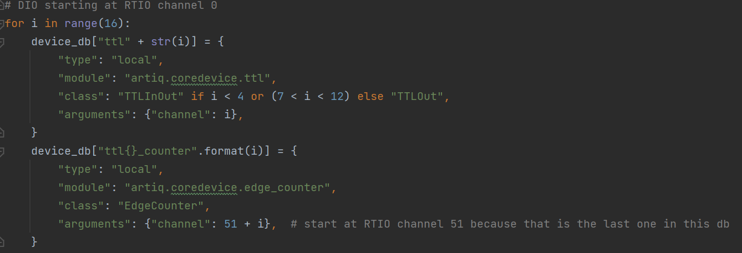
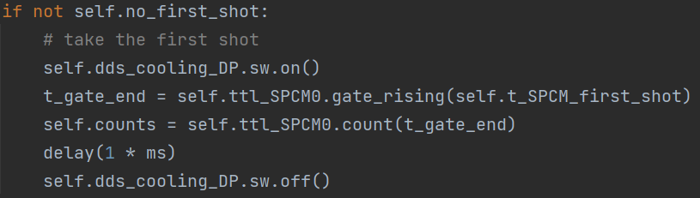
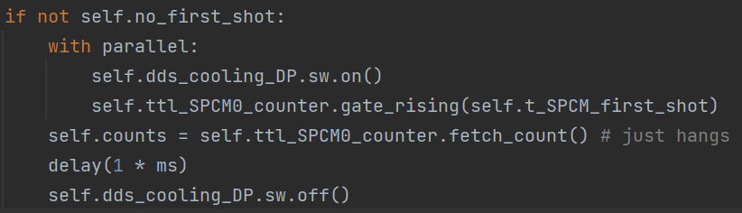
After this slide I rebuilt the Kasli-SoC gateware to include EdgeCounters on both ttl cards
See:
https://m-labs.hk/artiq/manual-beta/core_drivers_reference.html#module-artiq.coredevice.edge_counter
Using EdgeCounter instead of TTLInOut to count
atom_loading_with_edgecounter_experiment
I modified the device_db to include EdgeCounter channels
This code hangs on the fetch_count call.

Slide 6
2024.10.21
I’m now using EdgeCounters for the first and second atom readouts and have wrapped those blocks into functions.
Nevertheless, the undercounting issue persists in single_photon_experiment.

