Slide 1
Quantum Computing and its security implications
Jim Keeler, Ph.D.
Innotech Oklahoma City 11/1/18

Slide 2
Outline
Introduction: Different types of computing
The basics What is quantum computing anyway?
qubits
Quantum entanglement
Quantum information exchange
Difficulties with quantum computing
What exists now
Quantum key exchange
Secure Quantum network communications
Quantum annealing
What to expect in the next several years
First commercial quantum computers
Expansion of quantum networks
Expansion of quantum key exchanges
What it all means
Re-think encryption
Use quantum networks

Slide 3
Abstract
Quantum and promises to change the computing landscape in the near future. For example, cracking encryption that would take millions of years on a current supercomputer could be done in seconds on a quantum computer. This is no longer science fiction. D-Wave has shipped several quantum computers and IBM announced that they will have a quantum computer within two years. Quantum network encryption and quantum key exchange is available today via various companies. This presentation will help people understand quantum computing, how it works, what is available now and what the future may bring.

Slide 4
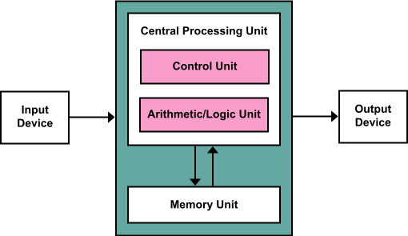
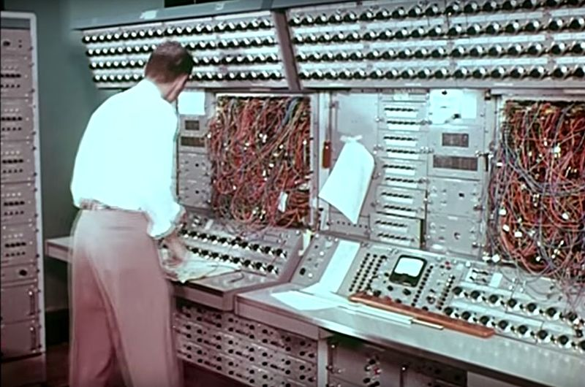
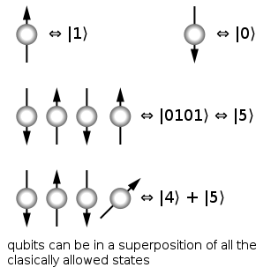
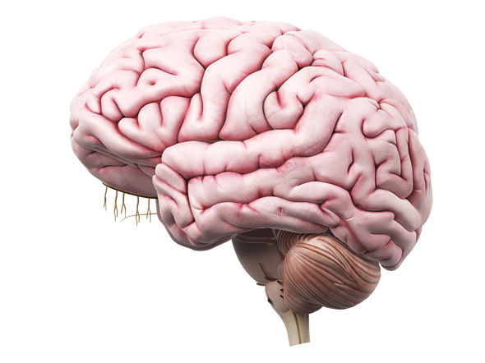
Four types of computers
Digital Computer (Von Neumann Architecture)
Works on binary units, the type of computer that we all use.
Analog computer
Works on analog signals using resistors, capacitors & inductors to solve differential equations.
Quantum Computer
Works on qubits, quantum-entangled bits of information.
Parallel Distributed Processor (Neural Network/Brain)
Memory, processing & connectivity are all massively distributed.

Slide 5
Types of computers (continued)
Digital computers
Good at integer-based math, rule-based expert systems, digital image processing, logic.
Not good at things like: factoring large primes, travelling salesman problems, solving distributed differential equations, pattern recognition, unconstrained control problems, etc.
Analog computers
Good at simulating differential equations.
Not good at things like: exact answers, logic, pattern recognition, unconstrained control problems.
Quantum computers
Good at solving certain classes of problems like factoring large primes, random walks, unordered data retrieval, etc.
Not good at things like: exact answers, logic, pattern recognition, unconstrained control problems.
Parallel distributed processors
Good at: Pattern recognition, unconstrained control problems, imagination, innovation, etc.
Not good at things like: Math, logic, reasoning, etc.

Slide 6
What Quantum Computing can do
Factor primes
Encryption algorithms like RSA, SSL, etc. are based on the fact that factoring large primes (say 2048 bit) would take millions of years on a super computer.
Quantum computers could do this in minutes. (Yikes!)
Secure communications
Quantum-based networking allows perfectly secure communications. Any eaves-dropping on the signal destroys the signal, hence quantum networks are perfectly secure and invulnerable to hijacking.
Solve a variety of problems that are hard for digital computers
Random walk problems & classes of NP problems may be tractable with quantum computers.
Solve quantum-mechanics/material science problems
What better to solve quantum mechanics problems than a quantum computer?
But, they are not a panacea
They will not replace digital computers for day-to-day tasks. We will still need digital computers.

Slide 7
How quantum computing works
The mysterious, magical qubits

Slide 8
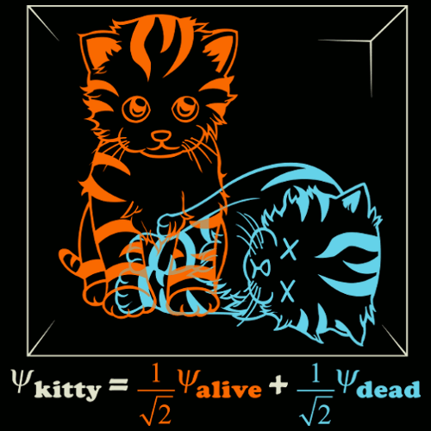
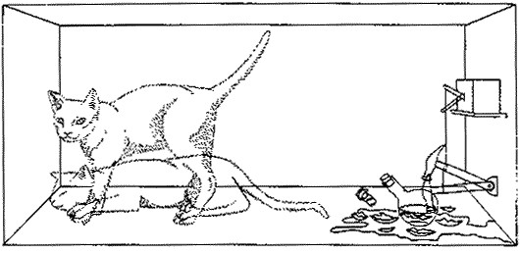
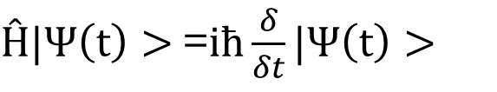
Qubits rely on Quantum entanglement
First we need to talk about superposition of quantum states.
Let’s start with Schrödinger’s Wave Equation:
$Ĥ|Ψ\left(t\right)>$=$iħ\frac{δ}{δt}|Ψ\left(t\right)>$
Schrödinger’s Cat

Slide 9
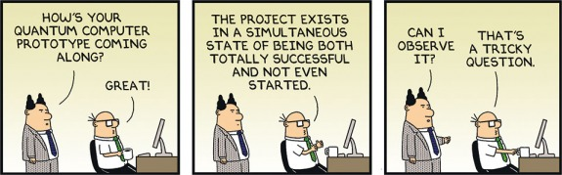
Quantum superposition and project management

Slide 10
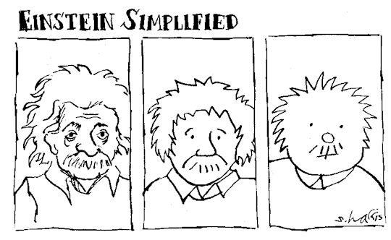
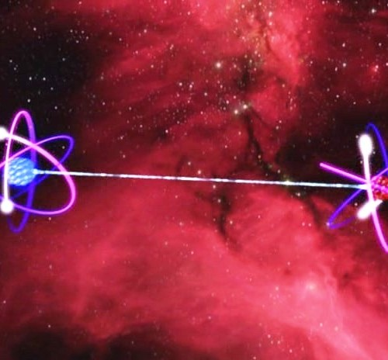
Quantum entanglement
Entangled particles seem to communicate state information instantaneously even if they are separated by a great distance.
Einstein called this “Spooky action at a distance”
Einstein–Podolsky–Rosen paradox or EPR paradox
It is as if there is a spooky connection that instantaneously tells one entangled particle the state of the other entangled particle no matter how far apart they are.

Slide 11
Quantum entanglement
But how do we know that there aren’t just some hidden variables or hidden dimensions?
Bell’s Theorem proved the superimposed view of quantum mechanics. The math is a little hard, but we can demonstrate the basic idea with some coins.

Slide 12
Quantum entanglement
OK, but you still haven’t told me what a qubit is.
What the heck is it?
A qubit is a quantum-entangled bit of information. Just like a bit is a 1 or a 0, a qubit is two entangled states that either could be one or zero, but is both 1 and 0 at the same time.
Typically a qubit is an entangled pair of photons, electrons, or nuclei. The entangled part is the spin of the particle (spin up versus spin down). The spin can be measured with an electromagnetic field, and can be manipulated (flipped, if you will) with a pulse of radio-frequency energy, or measured via a light polarizer.

Slide 13
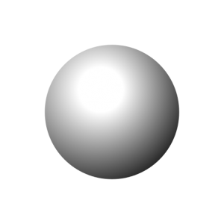
2 qubit example
Because the particles are in superimposed states, it takes four numbers to specify the state of these two entangled particles, whereas in a binary system it only takes two numbers (e.g. 0,1).
0.2
α
(0,0)
(1,0)
(0,1)
(1,1)
0.4
β
More generally, a quantum computer with N spins requires 2^{N} numbers to describe the state of the system (compared to N numbers for a binary computer).
0.1
γ
0.3
δ

Slide 14
Enormous quantum power
Example:
A 64-bit computer can perform manipulation on 64 -bit binary numbers at a time.
A 64-qubit quantum computer operates in a space of 2⁶⁴ dimensions, or roughly 16,000,000,000,000,000,000 (16*10¹⁸)numbers to specify the state of the quantum system.
Using cleverly crafted quantum algorithms and “quantum gates”, the computation can happen in this enormous space in parallel – it is as if all of the answers were being evaluated simultaneously, and the quantum system freezes out the right answer from this vast space.
It also means you double the power with every added qubit.
To double the power of a digital computer 32bits -> 64 bits
To double the power of a quantum computer 32qubits -> 33 qubits

Slide 15
Standard computing versus Quantum
Half Adder Circuit
A
Sum
B
Carry
Binary values are represented by electric signals:
0 = no current, 1 = current

Slide 16
Standard computing versus Quantum
EXOR
0
A
Sum
0
B
0
Carry
0
AND

Slide 17
Standard computing versus Quantum
EXOR
1
A
Sum
1
B
0
Carry
0
AND

Slide 18
Standard computing versus Quantum
EXOR
1
A
Sum
0
B
1
Carry
1
AND

Slide 19
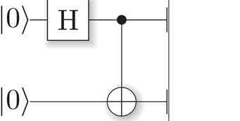
Standard computing versus Quantum
Full Adder Circuit
Quantum Circuit example
A
Sum
B
C_{IN}
C_{OUT}
Hadamard CNOT combo
0
measure
1

Slide 20
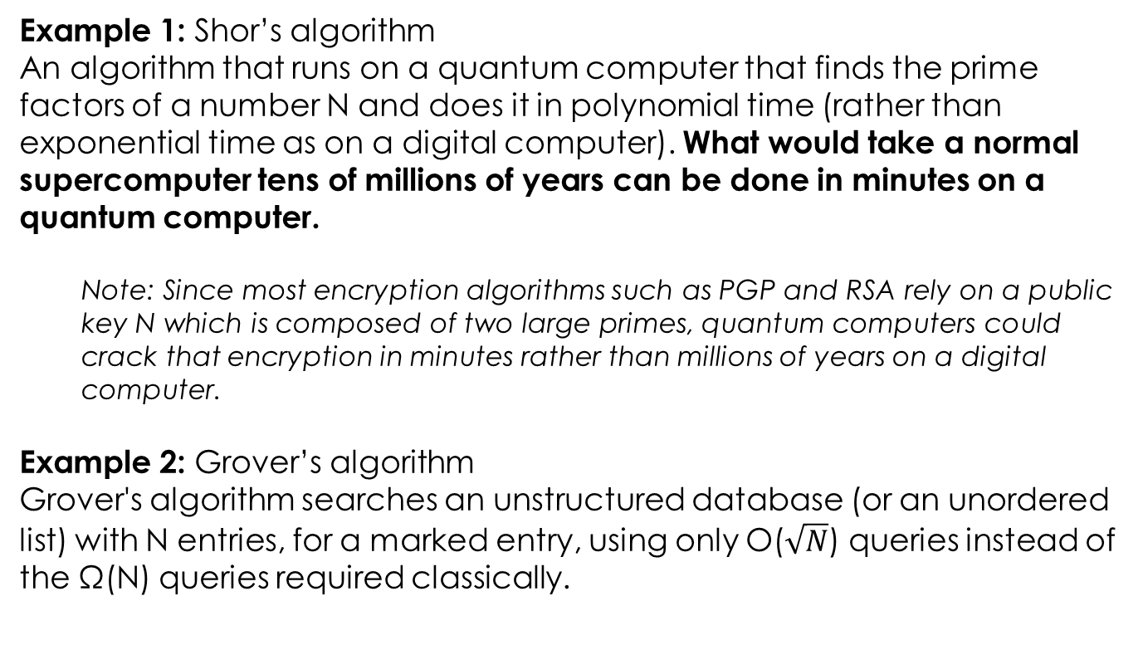
So what can Quantum computers do?
Example 1: Shor’s algorithm
An algorithm that runs on a quantum computer that finds the prime factors of a number N and does it in polynomial time (rather than exponential time as on a digital computer). What would take a normal supercomputer tens of millions of years can be done in minutes on a quantum computer.
Note: Since most encryption algorithms such as PGP and RSA rely on a public key N which is composed of two large primes, quantum computers could crack that encryption in minutes rather than millions of years on a digital computer.
Example 2: Grover’s algorithm
Grover's algorithm searches an unstructured database (or an unordered list) with N entries, for a marked entry, using only O($\sqrt{N}$) queries instead of the Ω(N) queries required classically.

Slide 21
Quantum communication
Unhackable Communication
Using the properties of quantum entanglement, quantum communication is immune to “man-in-the-middle” eavesdropping.
Anyone trying to listen to the communication breaks the entanglement, rendering the eavesdropping useless.

Slide 22
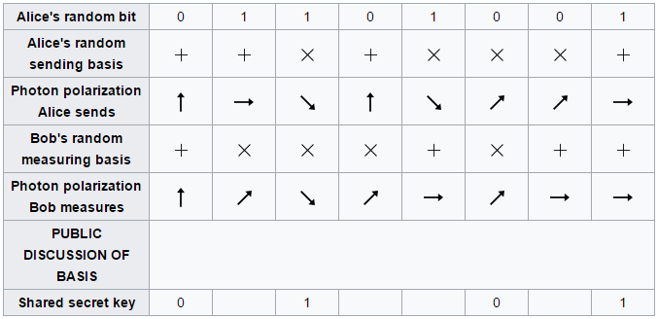
Quantum communication (BB84 algorithm)
Alice
Bob
Optical channel
Laser
Detector
Polarizer
Polarizer
Eve (Eavesdropper)

Slide 23
Is this just Science Fiction?
Commercial QKD is more than a decade old
Several companies are offering commercial quantum key distribution systems: ID Quantique (Geneva), MagiQ Technologies, Inc.(New York), QuintessenceLabs (Australia) and SeQureNet (Paris).
Several other companies also have active research programs, including Toshiba, HP, IBM, Mitsubishi, NEC and NTT
In 2004, the world's first bank transfer using quantum key distribution was carried out in Vienna Austria using ID Quantique systems.

Slide 24
Is this just science fiction?
D-wave already has quantum annealing computers
2000 qubit available now and 4000 bit available soon: http://www.nature.com/news/d-wave-upgrade-how-scientists-are-using-the-world-s-most-controversial-quantum-computer-1.21353
IBM, Google, Microsoft, Intel and others are all in a race for the quantum computer
Intel announced 49-qbit chip in January 2018
https://spectrum.ieee.org/tech-talk/computing/hardware/intels-49qubit-chip-aims-for-quantum-supremacy
Google a 72-qbit quantum computer in March 2018
https://www.sciencenews.org/article/google-moves-toward-quantum-supremacy-72-qubit-computer
China and others are working on satellite-based Quantum Key Distribution. Demonstrated > 1,000KM this year.
http://www.nature.com/news/chinese-satellite-is-one-giant-step-for-the-quantum-internet-1.20329

Slide 25
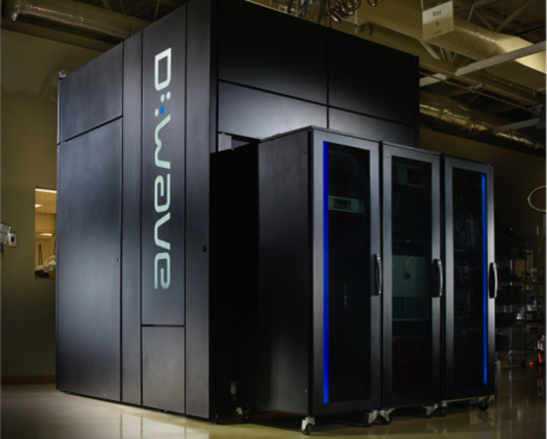
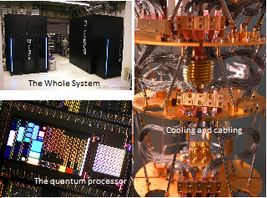
D-wave quantum computer

Slide 26
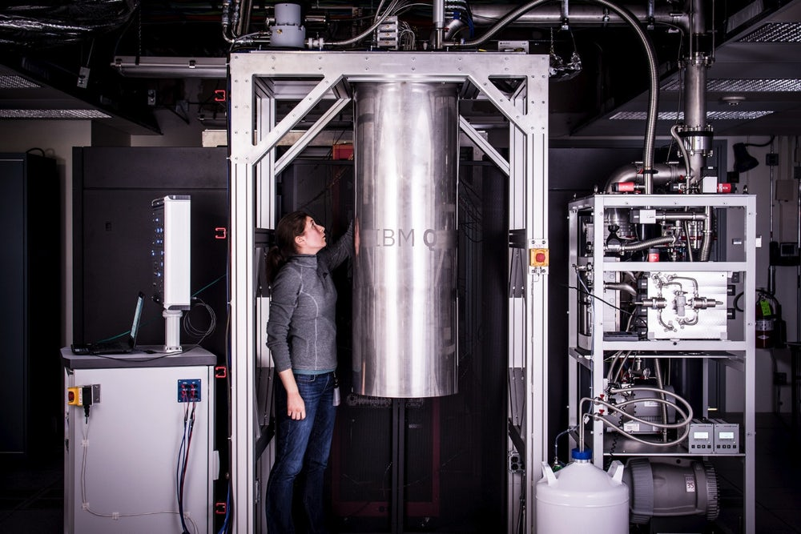
IBM Atlas quantum computer

Slide 27
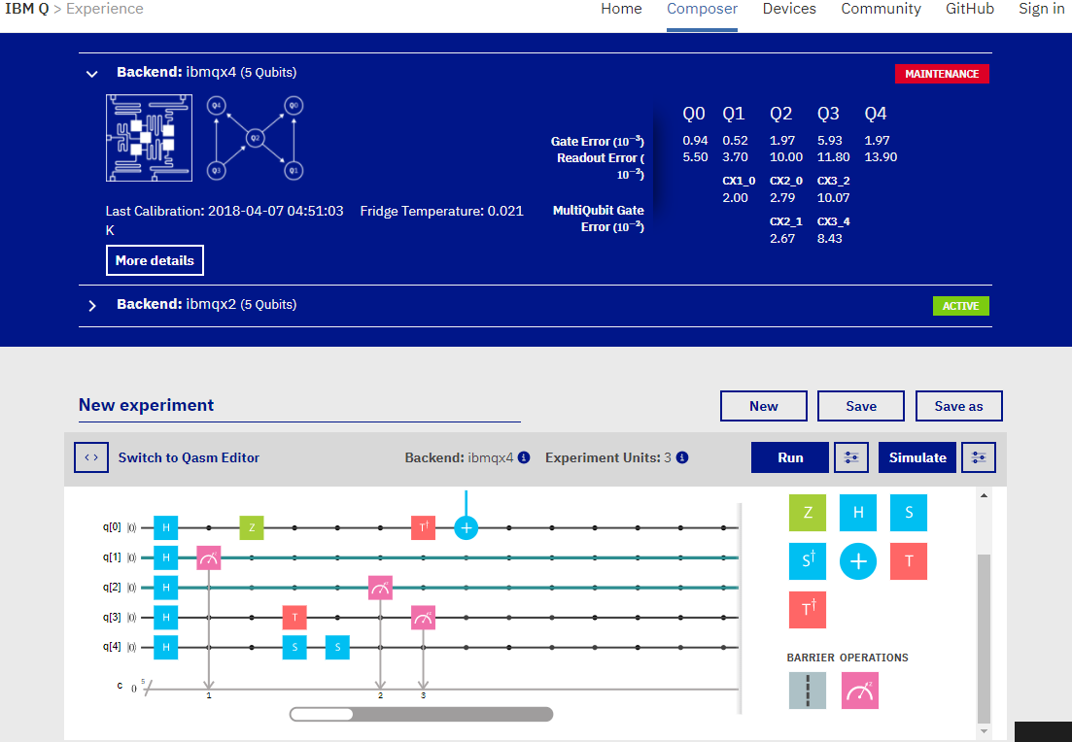
IBM Free Quantum computer in the cloud https://quantumexperience.ng.bluemix.net/qx/experience

Slide 28
3 types of quantum computers
Not all quantum computers are equal
Quantum Annealing computer
Analog Quantum Computer
Universal Quantum Computer

Slide 29
1: Quantum Annealing
Quantum Annealer
The quantum annealer is the least powerful and most restrictive form of quantum computers. It is the easiest to build, yet can only perform one specific function. The consensus is that a quantum annealer has no known advantages over conventional computing.
Generality of Applications
Computational Power
Difficulty
Level
Partial
Med
Med
Restricted
Universal
Low
High
Easy
Hard
Optimization Problems
Similar to traditional computers
Easiest to build
Bottom Line: A very specialized form of quantum computing with unproven advantages over conventional computing. D-Wave is one example. Google claimed a particular problem was solved 3000 times faster than conventional computers in a demo.
From: http://www.visualcapitalist.com/three-types-quantum-computers/

Slide 30
2: Analog Quantum
Analog Quantum
The analog quantum computer will be able to simulate complex quantum interactions that are intractable for any known conventional computer. It is conjectured that the analog quantum computer will contain between 50 and 100 qubits.
Generality of Applications
Computational Power
Difficulty
Level
Partial
Med
Med
Restricted
Universal
Low
High
Easy
Hard
Quantum chemistry
Material science
Optimization Problems
Sampling
Quantum Dynamics
Millions of times faster than conventional computers on special problems
Moderately hard to build
Bottom Line: The most likely form of quantum computing that will first show a true quantum speedup over conventional computing. This could happen within the next five years.
From: http://www.visualcapitalist.com/three-types-quantum-computers/

Slide 31
3: Universal Quantum
Universal Quantum
The universal quantum computer is the most powerful, the most general, and the hardest to build. It poses a tremendous number of technical challenges. Only about 8,000 is estimated to crack RSA-2048).
Generality of Applications
Computational Power
Difficulty
Level
Partial
Med
Med
Restricted
Universal
Low
High
Easy
Hard
Secure computing
Machine Learning
Cryptography
Searching
+ all of Analog Quantum.
Many trillions of times faster than conventional computers
Extremely hard to build
Bottom Line: This is the “holy grail” of quantum computing, offering the potential to be exponentially faster than traditional computers for a number of important problems.
From: http://www.visualcapitalist.com/three-types-quantum-computers/

Slide 32
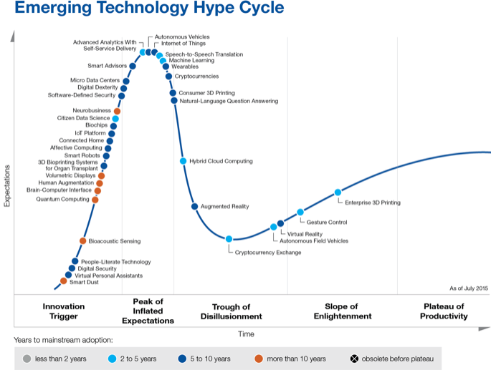
Gartner Hype Cycle.
Gartner projects a $5B market by 2020 worth perhaps >$100B in ten years

Slide 33
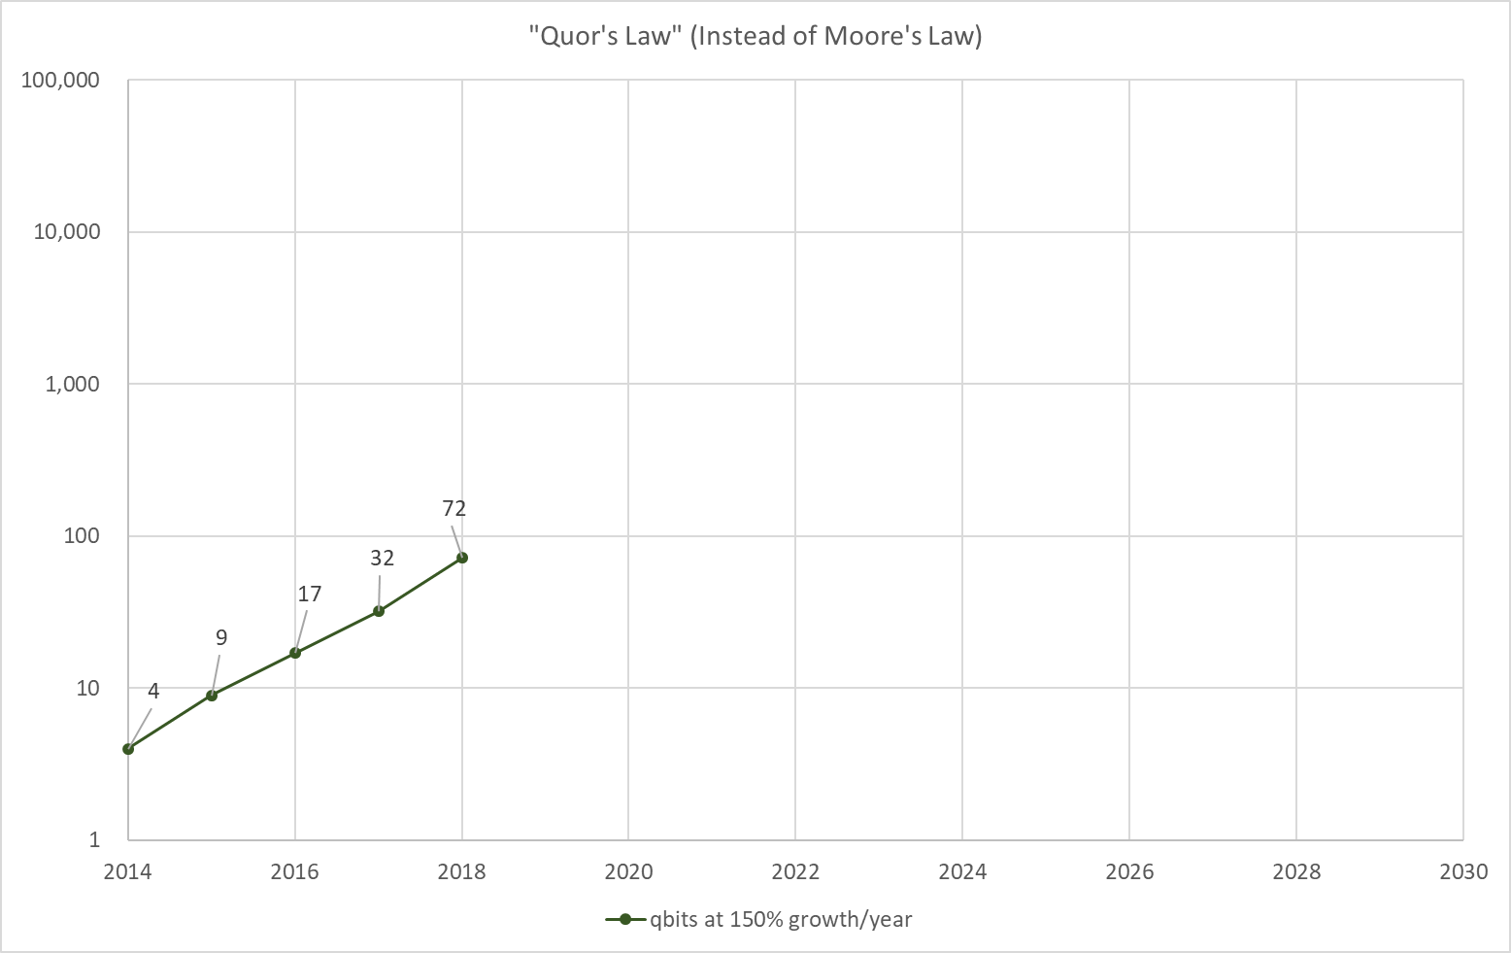
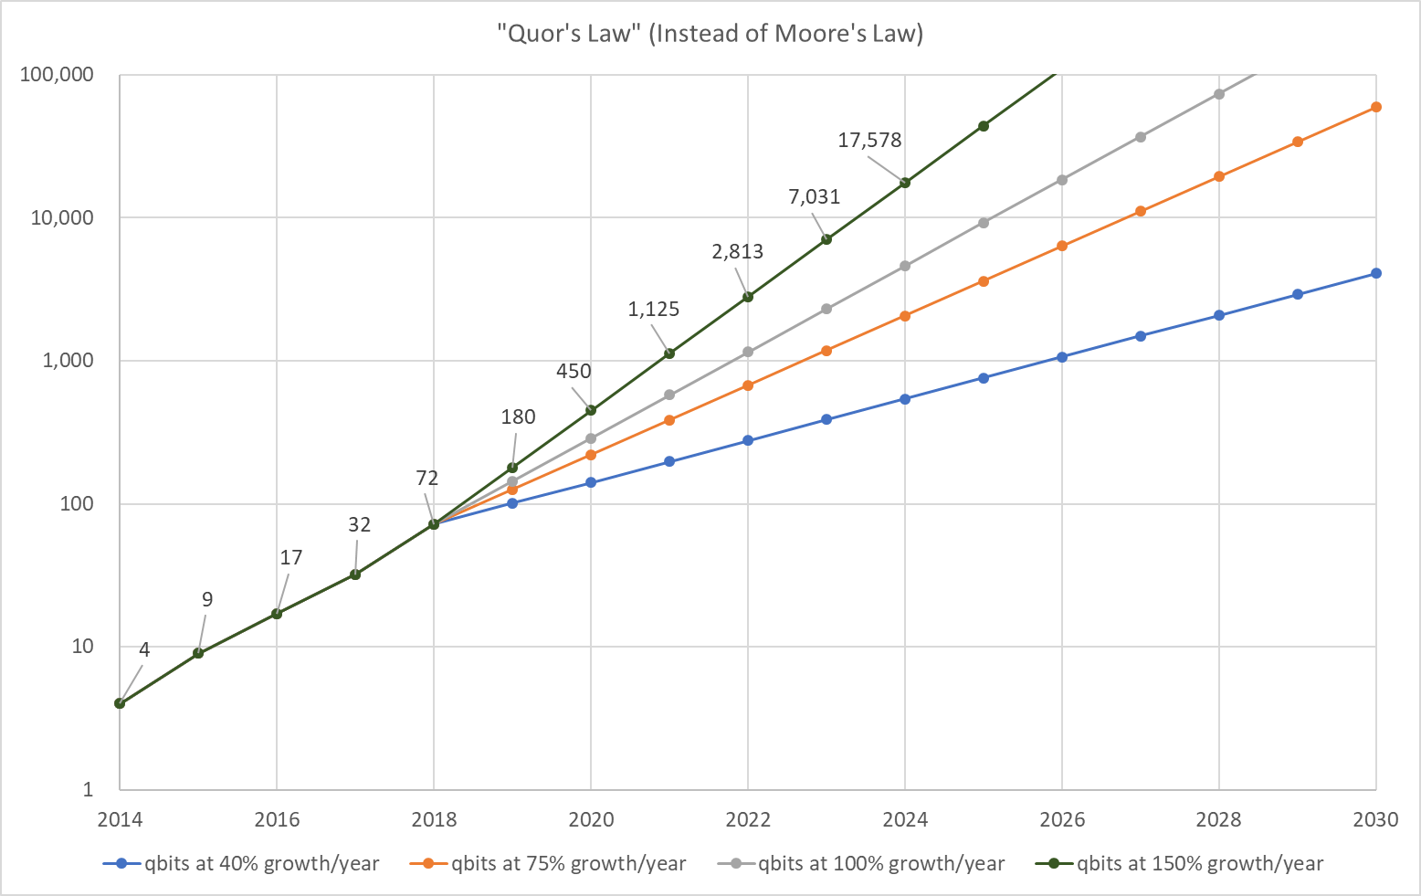
Scaling in quantum computing
Danger zone:
2048 bit encryption
Can be cracked
Qubits in computers announced over the past 5 years

Slide 34
Post-Quantum world
There is a good chance that quantum computers will be able to crack RSA-2048 within five-ten years (need about 8,000 qubits in a universal computer to do this).
Some encrypted data has a shelf-life of more than ten years. It may take ten years to cut over to a new encryption scheme, so companies and governments are scrambling to figure out what to do.
Most encryption used today is not safe in a quantum world.
If someone has been recording a https session, say, they may not be able to decrypt it now, but a few years from now, who knows.
There are encryption algorithms that are safe:
Secure communications will move to symmetric encryption or hash algorithms, or perhaps lattice algorithms.
QKD will likely be more popular for the most sensitive communications
Some governments and banks are already starting to use “Quantum Safe” algorithms, and this is expected to increase over the next decade.

Slide 35
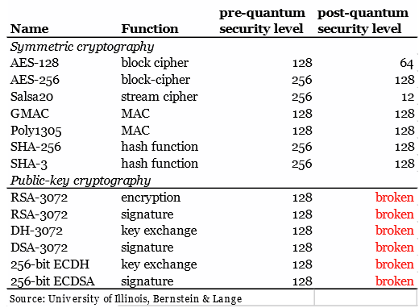
Post-Quantum Algorithm Assessment
Grover’s Algorithm cuts these in 1/2
Shor’s Algorithm blasts these apart

Slide 36
Start thinking post-quantum now
It may take 5-10 years to replace infrastructure & software
It is good advice, I think, to start moving to a post-quantum secure world now.
Here is a good place to start
https://csrc.nist.gov/Projects/Post-Quantum-Cryptography

Slide 37
Questions?
Some of the best videos explaining quantum computers:
https://www.youtube.com/watch?v=JRIPV0dPAd4
https://www.youtube.com/watch?v=zNzzGgr2mhk
Some other links:
https://www.technologyreview.com/s/603495/10-breakthrough-technologies-2017-practical-quantum-computers/
https://www.technologyreview.com/s/604242/googles-new-chip-is-a-stepping-stone-to-quantum-computing-supremacy/
E-mail me if you have any questions/comments: dr.jkeeler@gmail.com

