Slide 1
Quantum Computing
An exploration through experiments

Slide 2
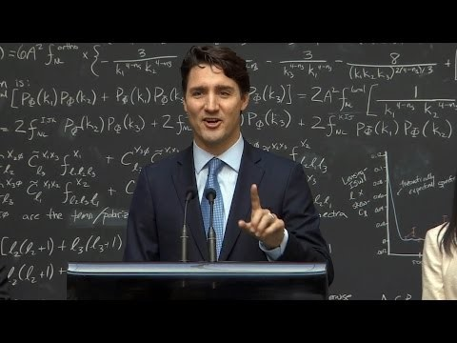
Any body can compute quantum?

Slide 3
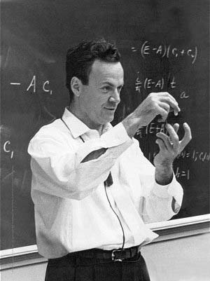
Introduction
“I think I can safely say that nobody understands quantum mechanics” - Feynman
1982 - Feynman proposed the idea of creating machines based on the laws of quantum mechanics instead of the laws of classical physics.
1985 - David Deutsch developed the quantum turing machine, showing that quantum circuits are universal.
1994 - Peter Shor came up with a quantum algorithm to factor very large numbers in polynomial time.
1997 - Lov Grover develops a quantum search algorithm with O(√N) complexity

Slide 4
Talk Outline
Quantum
Random
Walks
Background
What is Quantum Computation?
Quantum Algorithms
Decoherence and Noise
Implementations
Applications
Noise in Grover’s
Algorithm
O
Decoherence in Spin
Systems

Slide 5
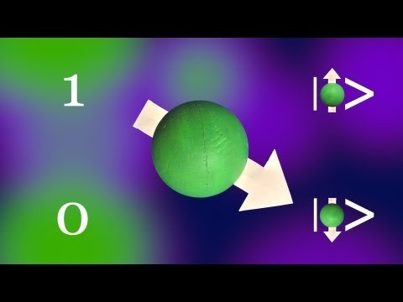
Quantum computing an introduction

Slide 6
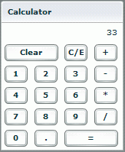

Background: Classical Computation
Input
Computation
Output
2 + 2
4
C:\Hello.exe
Hello World!
What is the essence of computation?

Slide 7
Classical Computation Theory
Church-Turing Thesis: Computation is anything that can be done by a
Turing machine. This definition coincides with our intuitive ideas of
computation: addition, multiplication, binary logic, etc…
What is a Turing machine?
…0100101101010010110…
Input
Finite State Automaton
(control module)
Infinite
tape
Computation
…0000001011111111100…
Read/Write
head
…0100101101010010110…
…1110010110100111101…
Output

Slide 8
Classical Complexity
Some problems are more difficult than others.
Polynomial hierarchy
All Turing machine-equivalent
computers have an identical
hierarchy.
NP-complete
NP
P
Require exponential(?) time to solve
Require exponential time to solve
Require polynomial time to solve

Slide 9
Classical Complexity
Some important problems do not have known classical
polynomial algorithm and or a known place in the hierarchy.
Polynomial hierarchy
NP-complete
?
Factoring
NP
Best known algorithm to factor N-digit number:
Time ~ Exp(N^{1/3})
P
?
Graph Isomorphism
Best known algorithm to compare
two N-node graphs:
Time ~ Exp(N)

Slide 10
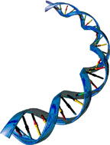
Classical Computation Theory
What kind of systems can perform
universal computation?
Desktop computers
Billiard balls
DNA
These can all be shown to be
equivalent to each other and to
a Turing machine!
Cellular automata
The Big Question: What next?

Slide 11

What Is Quantum Computation?
Conventional computers, no matter how exotic, all obey the laws of
classical physics.
On the other hand, a quantum computer obeys the laws of quantum physics.

Slide 12
The Bit
The basic component of a classical computer is the bit, a single
binary variable of value 0 or 1.
1
0
At any given time, the value
of a bit is either ‘0’ or ‘1’.
0
1
The state of a classical computer is described by some
long bit string of 0s and 1s.
0001010110110101000100110101110110...

Slide 13
The Qubit
A quantum bit, or qubit, is a two-state system which
obeys the laws of quantum mechanics.
Spin-½ particle
Valid qubit states:
|ψ⟩ = |0⟩
=|1⟩
=|0⟩
|ψ⟩ = |1⟩
|ψ⟩ = (|0⟩- e^{iπ/4} |1⟩)/√2
|ψ⟩ = (2|0⟩- 3e^{i5π/6} |1⟩)/√13
The state of a qubit |ψ⟩ can be thought of as a vector in
a two-dimensional Hilbert Space, H₂, spanned by the
Basis vectors |0⟩ and |1⟩.

Slide 14
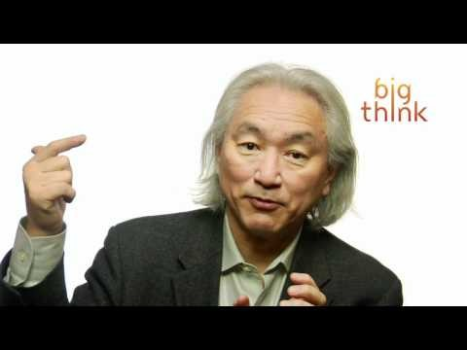
How to program a quantum computer

Slide 15
Computation with Qubits
How does the use of qubits affect computation?
Classical Computation
Quantum Computation
Data unit: bit
Data unit: qubit
= ‘1’
= ‘0’
=|1⟩
=|0⟩
Valid states:
Valid states:
x = ‘0’ or ‘1’
|ψ⟩ = c₁|0⟩ + c₂|1⟩
x = 0
x = 1
|ψ⟩ = |0⟩
|ψ⟩ = |1⟩
|ψ⟩ = (|0⟩ + |1⟩)/√2
0
0
1
1

Slide 16
Computation with Qubits
How does the use of qubits affect computation?
Classical Computation
Quantum Computation
Operations: logical
Operations: unitary
Valid operations:
Valid operations:
in
σ_{X} =
0 | 1
1 | 0
σ_{z} =
1 | 0
0 | -1
NOT =
 | 0 1
 | 1 | 0
1-bit
1-qubit
out
0 | i
-i | 0
1
1 | 1
1 | -1
σ_{y} =
H_{d} =
√2
in
1 | 0 | 0 | 0
0 | 1 | 0 | 0
0 | 0 | 0 | 1
0 | 0 | 1 | 0
 | 0 1
0 1 | 0 | 0
 | 0 | 1
AND =
2-bit
2-qubit
CNOT =
in
out

Slide 17
Computation with Qubits
How does the use of qubits affect computation?
Classical Computation
Quantum Computation
Measurement: deterministic
Measurement: stochastic
State
Result of measurement
State
Result of measurement
x = ‘0’
‘0’
|ψ⟩ = |0⟩
‘0’
x = ‘1’
‘1’
|ψ⟩ = |1⟩
‘1’
|ψ⟩ = |0⟩- |1⟩
‘0’ 50%
√2
‘1’ 50%

Slide 18
More than one qubit
Single qubit
Two qubits
|0⟩,|1⟩
|00⟩,|01⟩,|10⟩,|11⟩
Hilbert
space
1
0
0
0
0
1
0
0
0
0
1
0
0
0
0
1
1
0
0
1
H₂ =
H₂ ^{⊗2} = H₂⊗H₂ =
,
,
,
,
c₁
c₂
c₃
c₄
Arbitrary
state
c₁
c₂
c₁|00⟩ + c₂|01⟩ +
c₃|10⟩ + c₄|11⟩
|Ψ⟩
=
|ψ⟩ = c₁|0⟩ + c₂|1⟩ =
=
u₁₁ | u₁₂ | u₁₃ | u₁₄
u₂₁ | u₂₂ | u₂₃ | u₂₄
u₃₁ | u₃₂ | u₃₃ | u₃₄
u₄₁ | u₄₂ | u₄₃ | u₄₄
c₁
c₂
c₃
c₄
Operator
U|ψ⟩ =
u₁₁ | u₁₂
u₂₁ | u₂₂
c₁
c₂
U|Ψ⟩ =

Slide 19
Quantum Circuit Model
Example Circuit
One-qubit
operation
Two-qubit
operation
Measurement
|0⟩
σ_{x}
|1⟩
CNOT
|1⟩
‘1’
|0⟩
|0⟩
|1⟩
‘1’
1
0
0
0
0
0
1
0
0
0
0
1
0
0
0
1
0 | 0 | 1 | 0
0 | 0 | 0 | 1
1 | 0 | 0 | 0
0 | 1 | 0 | 0
1 | 0 | 0 | 0
0 | 1 | 0 | 0
0 | 0 | 0 | 1
0 | 0 | 1 | 0
σ_{x} ⊗ I =
CNOT =

Slide 20
Quantum Circuit Model
Example Circuit
50%
50%
|0⟩ + |1⟩
|0⟩ + |1⟩
______
______
?
‘1’
σ_{x}
CNOT
‘0’
√2
√2
or
|0⟩
|0⟩
?
‘0’
‘1’
1/√2
0
1/√2
0
1/√2
0
1/√2
0
1/√2
0
0
1/√2
1
0
0
0
0
0
0
1
or
Separable state:
can be written as
tensor product
Entangled state:
cannot be written
as tensor product
|Ψ⟩ = |φ⟩ ⊗ |χ⟩
|Ψ⟩ ≠ |φ⟩ ⊗ |χ⟩

Slide 21


Some Interesting Consequences
Reversibility
Since quantum mechanics is reversible (dynamics are unitary),
quantum computation is reversible.
|00000000⟩
|ψφβπμψ⟩
|00000000⟩
Quantum Superordinacy
All classical quantum computations can be performed by a quantum
computer.
U
No cloning theorem
It is impossible to exactly copy an unknown quantum state
|ψ⟩
|ψ⟩
|0⟩
|ψ⟩

Slide 22
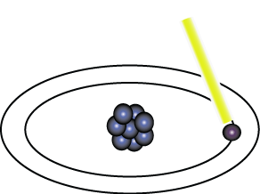
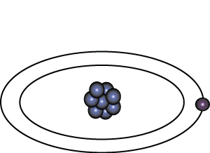
Representation of Data - Qubits
A bit of data is represented by a single atom that is in one of two states denoted by |0> and |1>. A single bit of this form is known as a qubit
A physical implementation of a qubit could use the two energy levels of an atom. An excited state representing |1> and a ground state representing |0>.
Light pulse of frequency λ for time interval t
Excited State
Ground State
Nucleus
Electron
State |0>
State |1>

Slide 23
Representation of Data - Superposition
A single qubit can be forced into a superposition of the two states denoted by the addition of the state vectors:
|ψ> = α |0> + α |1>
Where α and α are complex numbers and |α | + | α | = 1
1
2
2
2
1
2
1
2
A qubit in superposition is in both of the states |1> and |0 at the same time

Slide 24
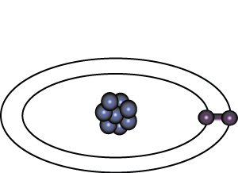
Representation of Data - Superposition
Light pulse of frequency λ for time interval t/2
State |0>
State |0> + |1>
Consider a 3 bit qubit register. An equally weighted superposition of all possible states would be denoted by:
|ψ> = |000> + |001> + . . . + |111>
1
1
1
√8
√8
√8

Slide 25
Data Retrieval
In general, an n qubit register can represent the numbers 0 through 2^n-1 simultaneously.
Sound too good to be true?…It is!
If we attempt to retrieve the values represented within a superposition, the superposition randomly collapses to represent just one of the original values.
In our equation: |ψ> = α |0> + α |1> , α represents the probability of the superposition collapsing to |0>. The α’s are called probability amplitudes. In a balanced superposition, α = 1/√2 where n is the number of qubits.
1
2
1
n

Slide 26
Relationships among data - Entanglement
Entanglement is the ability of quantum systems to exhibit correlations between states within a superposition.
Imagine two qubits, each in the state |0> + |1> (a superposition of the 0 and 1.) We can entangle the two qubits such that the measurement of one qubit is always correlated to the measurement of the other qubit.

Slide 27
Operations on Qubits - Reversible Logic
Due to the nature of quantum physics, the destruction of information in a gate will cause heat to be evolved which can destroy the superposition of qubits.
Ex.
The AND Gate
Input
Output
In these 3 cases, information is being destroyed
A | B | C
0 | 0 | 0
0 | 1 | 0
1 | 0 | 0
1 | 1 | 1
A
C
B
This type of gate cannot be used. We must use Quantum Gates.

Slide 28
Quantum Gates
Quantum Gates are similar to classical gates, but do not have a degenerate output. i.e. their original input state can be derived from their output state, uniquely. They must be reversible.
This means that a deterministic computation can be performed on a quantum computer only if it is reversible. Luckily, it has been shown that any deterministic computation can be made reversible.(Charles Bennet, 1973)

Slide 29
Quantum Gates - Hadamard
Simplest gate involves one qubit and is called a Hadamard Gate (also known as a square-root of NOT gate.) Used to put qubits into superposition.
H
H
State |0>
State |0> + |1>
State |1>
Note: Two Hadamard gates used in succession can be used as a NOT gate

Slide 30
Quantum Gates - Controlled NOT
A gate which operates on two qubits is called a Controlled-NOT (CN) Gate. If the bit on the control line is 1, invert the bit on the target line.
Input
Output
A - Target
A’
A | B | A’ | B’
0 | 0 | 0 | 0
0 | 1 | 1 | 1
1 | 0 | 1 | 0
1 | 1 | 0 | 1
B - Control
B’
Note: The CN gate has a similar behavior to the XOR gate with some extra information to make it reversible.

Slide 31
Example Operation - Multiplication By 2
We can build a reversible logic circuit to calculate multiplication by 2 using CN gates arranged in the following manner:
Input
Output
Carry Bit | Ones Bit | Carry Bit | Ones Bit
0 | 0 | 0 | 0
0 | 1 | 1 | 0
0
Carry Bit
H
Ones Bit

Slide 32
Quantum Gates - Controlled Controlled NOT (CCN)
A gate which operates on three qubits is called a Controlled Controlled NOT (CCN) Gate. Iff the bits on both of the control lines is 1,then the target bit is inverted.
Input
Output
A | B | C | A’ | B’ | C’
0 | 0 | 0 | 0 | 0 | 0
0 | 0 | 1 | 0 | 0 | 1
0 | 1 | 0 | 0 | 1 | 0
0 | 1 | 1 | 1 | 1 | 1
1 | 0 | 0 | 1 | 0 | 0
1 | 0 | 1 | 1 | 0 | 1
1 | 1 | 0 | 1 | 1 | 0
1 | 1 | 1 | 0 | 1 | 1
A - Target
A’
B - Control 1
B’
C - Control 2
C’

Slide 33
A Universal Quantum Computer
The CCN gate has been shown to be a universal reversible logic gate as it can be used as a NAND gate.
A - Target
A’
Input
Output
A | B | C | A’ | B’ | C’
0 | 0 | 0 | 0 | 0 | 0
0 | 0 | 1 | 0 | 0 | 1
0 | 1 | 0 | 0 | 1 | 0
0 | 1 | 1 | 1 | 1 | 1
1 | 0 | 0 | 1 | 0 | 0
1 | 0 | 1 | 1 | 0 | 1
1 | 1 | 0 | 1 | 1 | 0
1 | 1 | 1 | 0 | 1 | 1
B - Control 1
B’
C - Control 2
C’
When our target input is 1, our target output is a result of a NAND of B and C.

Slide 34
Qubits
A Quantum Bit (Qubit) is a two-level quantum system.
We can label the states |0> and |1>.
In principle, this could be any two-level system.
|1>
|0>

Slide 35
Qubits
Unlike a classical bit, which is definitely in either state, the state of a Qubit is in general a mix of |0> and |1>.
We assume a normalized state:

Slide 36
Qubits
For convenience, we will use the matrix representation

Slide 37
Quantum Gate
A Quantum Logic Gate is an operation that we perform on one or more Qubits that yields another set of Qubits.
We can represent them as linear operators in the Hilbert space of the system.

Slide 38
Quantum NOT Gate
As in classical computing, the NOT gate returns a 0 if the input is 1 and a 1 if the input is 0.
The matrix representation is

Slide 39
Other Quantum Gates
Other gates include the Hadamard-Walsh matrix:
And Phase Flip operation:

Slide 40
Multiple Qubits
Any useful classical computer has more than one bit. Likewise, a Quantum Computer will probably consist of multiple qubits.
A system of n Qubits is called a Quantum Register of length n.
To represent that Qubit 1 has value b₁, Qubit 2 has value b₂, etc., we will use the notation:

Slide 41
Multiple Qubits
For n Qubits, the vector representing the state is a 2n column vector.
The operations are then 2n x 2n matrices.
For n = 2, we use the representations

Slide 42
Quantum CNOT Gate
An important Quantum Gate for n = 2 is the conditional not gate.
The conditional not gate flips the second bit if and only if the first bit is on.

Slide 43
Reversibility and No-Cloning
In Quantum Computing, we use unitary operations (U*U = 1).
This ensures that all of the operations that we perform are reversible.
This fact is important, because there is no way to perfectly copy a state in Quantum Computing (No-Cloning Theorem).

Slide 44
No-Cloning Theorem
That is, the No-Cloning Theorem says that there is no linear operation that copy an arbitrary state to one of the basis states:
We can get around this if we are only interested in copying basis vectors, though.

Slide 45
Entanglement
In Quantum Mechanics, it sometimes occurs that a measurement of one particle will effect the state of another particle, even though classically there is no direct interaction. (This is a controversial interpretation).
When this happens, the state of the two particles is said to be entangled.

Slide 46
Entanglement: Formalism
More formally, a two-particle state is entangled if it cannot be written as a product of two one-particle states.
If a state is not entangled, it is decomposable.

Slide 47
Entanglement: Example
The state of two spinors is prepared such that the z-component of the spin is zero.
If we measure m = +1/2 for one particle, then the other particle must have m =-1/2.
The measurement performed on one particle resulted in the collapse of the wavefunction of the other particle.

Slide 48
Universal Gate Sets
It would be convenient if there was a small set of operations from which all other operations could be produced.
That is, a set of operators {U₁,…,U_{n}} such that any other operator W could be written W = U_{i}U_{j}…U_{k}.
Such a set of operators in the context of computation is called a universal gate set.

Slide 49
Classical NAND Gate
One universal set for Classical Computation consists of only the NAND gate which returns 0 only if the two inputs are 1.

Slide 50
Quantum Universal Gate Set
There are a few universal sets in Quantum Computing.
Two convenient sets:
CNOT and single Qubit Gates
CNOT, Hadamard-Walsh, and Phase Flips
Having such a set could greatly simplify implementation and design of Quantum Algorithms.

Slide 51
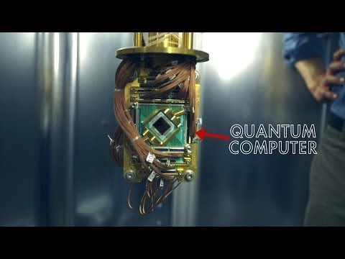
Quantum Computers today

Slide 52
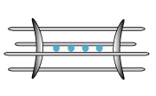
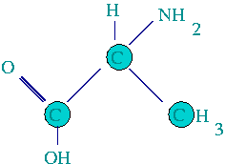

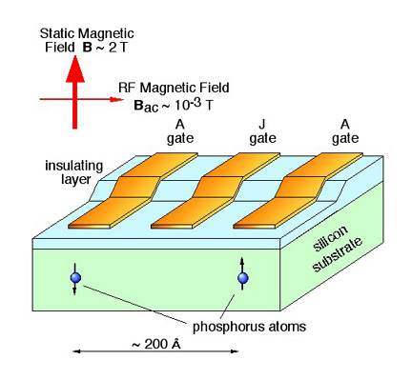
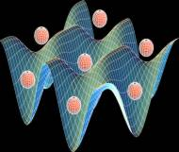
Some Proposed Implementations for QC
NMR
Ion trap
B
Kane
Proposal
Optical Lattice

Slide 53
Physical Implementation
Any physical implementation of a quantum computer must have the following properties to be practical(DiVincenzo)
The number of Qubits can be increased
Qubits can be arbitrarily initialized
A Universal Gate Set must exist
Qubits can be easily read
Decoherence time is relatively small

Slide 54
Decoherence
As the number of Qubits increases, the influence of external environment perturbs the system.
This causes the states in the computer to change in a way that is completely unintended and is unpredictable, rendering the computer useless.
This is called decoherence.

Slide 55
Quantum Algorithms: What can quantum computers do?
Grover’s search algorithm
Quantum random walk search algorithm
Shor’s Factoring Algorithm

Slide 56
Grover’s Search Algorithm
Imagine we are looking for the solution to a problem with
N possible solutions. We have a black box (or ``oracle”) that
can check whether a given answer is correct.
Question: I’m thinking of a number between 1 and 100. What is it?
Oracle
78
No
Oracle
3
Yes

Slide 57
Grover’s Search Algorithm
Classical computer
Quantum computer
Oracle
Oracle
1
No
1+2+3+...
No+No+Yes+No+...
Oracle
2
No
Superposition over all N possible inputs.
Oracle
Using Grover’s algorithm, a quantum computer can find the answer in √N queries!
3
Yes
...
The best a classical computer
can do on average is N/2 queries.

Slide 58
Grover’s Search Algorithm
Pros:
Can be used on any unstructured search problem, even
NP-complete problems.
Cons:
Only a quadratic speed-up over classical search.
O(√N) iterations
|0⟩
H_{d}
H_{d}
σ_{z}
H_{d}
H_{d}
σ_{z}
H_{d}
…
|0⟩
H_{d}
H_{d}
H_{d}
H_{d}
H_{d}
…
O
O
…
…
…
…
…
|0⟩
H_{d}
H_{d}
H_{d}
H_{d}
…
H_{d}
The circuit is not complicated, but it doesn’t provide an immediately
intuitive picture of how the algorithm works. Are there any more
intuitive models for quantum search?

Slide 59
Quantum Random Walk Search Algorithm
Idea: extend classical random walk formalism to quantum mechanics
Classical random walk:
Quantum random walk:
Moves walkers
based on coin
Flips coin

Slide 60
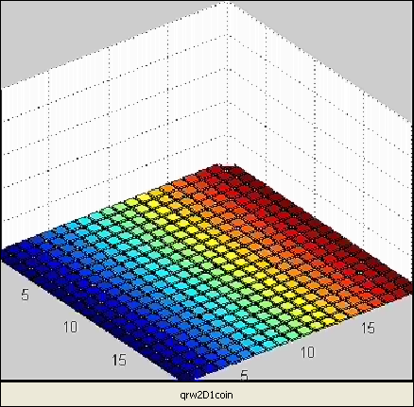
Quantum Random Walk Search Algorithm
To obtain a search algorithm, we use our “black box” to apply a different
type of coin operator, C₁, at the marked node
C₁
C₀
1
1 | -1 | -1 | -1
-1 | 1 | -1 | -1
-1 | -1 | 1 | -1
-1 | -1 | -1 | 1
-1 | 0 | 0 | 0
0 | -1 | 0 | 0
0 | 0 | -1 | 0
0 | 0 | 0 | -1
C₀=
C₁=
2

Slide 61
Quantum Random Walk Search Algorithm
Pros:
As general as Grover’s search algorithm.
Cons:
Same complexity as Grover’s search algorithm.
Slightly more complicated in implementation
Slightly more memory used
Interesting Feature: Search algorithm flows naturally
out of random walk formalism. Motivation for new QRW-
based algorithms?

Slide 62

Shor’s Factoring Algorithm
Makes use of quantum Fourier Transform, which is exponentially
faster than classical FFT.
Find the factors of: 57
Find the factors of: 1623847601650176238761076269172261217123987210397462187618712073623846129873982634897121861102379691863198276319276121
3 x 19
whimper
All known algorithms for factoring an n-bit number on a
classical computer take time proportional to O(n!).
But Shor’s algorithm for factoring on a quantum computer
takes time proportional to O(n² log n).

Slide 63
Shor’s Algorithm
A Quantum Algorithm, due to P. W. Shor (1994) allows for very fast factoring of numbers.
The algorithm uses other algorithms: the Quantum Fourier Transform, and Euclid’s Algorithm.
It also relies on elements of group theory.

Slide 64
Shor’s Algorithm
Because of the unpredictability of Quantum Mechanics, it only gives the correct answer to within a certain probability.
Multiple runs can be performed to increase the probability that the answer is correct. This increases the complexity to
A Quantum Computer with 7 Qubits was developed in 2001 to implement Shor’s algorithm to factor 15.

Slide 65
Shor’s Factoring Algorithm
The details of Shor’s factoring algorithm are more complicated than
Grover’s search algorithm, but the results are clear:
with a classical computer
# bits 1024 2048 4096
factoring in 2006 10⁵ years 5x10¹⁵ years 3x10²⁹ years
factoring in 2024 38 years 10¹² years 7x10²⁵ years
factoring in 2042 3 days 3x10⁸ years 2x10²² years
with potential quantum computer
(e.g., clock speed 100 MHz)
# bits 1024 2048 4096
# qubits 5124 10244 20484
# gates 3x10⁹ 2X10¹¹ X10¹²
factoring time 4.5 min 36 min 4.8 hours
R. J. Hughes, LA-UR-97-4986

Slide 66
Shor’s Algorithm
Shor’s algorithm shows (in principle,) that a quantum computer is capable of factoring very large numbers in polynomial time.
The algorithm is dependant on
Modular Arithmetic
Quantum Parallelism
Quantum Fourier Transform

Slide 67
Shor’s Algorithm - Periodicity
An important result from Number Theory:
F(a) = x mod N is a periodic function
a
Choose N = 15 and x = 7 and we get the following:
0
7 mod 15 = 1
7 mod 15 = 7
7 mod 15 = 4
7 mod 15 = 13
7 mod 15 = 1
1
2
3
4
.
.
.

Slide 68
Shor’s Algorithm - In Depth Analysis
To Factor an odd integer N (Let’s choose 15) :
Choose an integer q such that N < q < 2N let’s pick 256
Choose a random integer x such that GCD(x, N) = 1 let’s pick 7
Create two quantum registers (these registers must also be entangled so that the collapse of the input register corresponds to the collapse of the output register)
Input register: must contain enough qubits to represent numbers as large as q-1. up to 255, so we need 8 qubits
Output register: must contain enough qubits to represent numbers as large as N-1. up to 14, so we need 4 qubits
2
2

Slide 69
Shor’s Algorithm - Preparing Data
Load the input register with an equally weighted superposition of all integers from 0 to q-1. 0 to 255
Load the output register with all zeros.
The total state of the system at this point will be:
1
255
∑ |a, 000>
√256
a=0
Output Register
Note: the comma here denotes that the registers are entangled
Input Register

Slide 70
Shor’s Algorithm - Modular Arithmetic
a
Apply the transformation x mod N to each number in the input register, storing the result of each computation in the output register.
Note that we are using decimal numbers here only for simplicity.
a
Input Register | 7 Mod 15 | Output Register
|0> | 7 Mod 15 | 1
|1> | 7 Mod 15 | 7
|2> | 7 Mod 15 | 4
|3> | 7 Mod 15 | 13
|4> | 7 Mod 15 | 1
|5> | 7 Mod 15 | 7
|6> | 7 Mod 15 | 4
|7> | 7 Mod 15 | 13
0
1
2
3
4
5
6
7
.
.

Slide 71
Shor’s Algorithm - Superposition Collapse
Now take a measurement on the output register. This will collapse the superposition to represent just one of the results of the transformation, let’s call this value c.
Our output register will collapse to represent one of the following:
|1>, |4>, |7>, or |13
For sake of example, lets choose |1>

Slide 72
Shor’s Algorithm - Entanglement
Now things really get interesting !
Since the two registers are entangled, measuring the output register will have the effect of partially collapsing the input register into an equal superposition of each state between 0 and q-1 that yielded c (the value of the collapsed output register.)
Since the output register collapsed to |1>, the input register will partially collapse to:
|0> + |4> + |8> + |12>, . . .
The probabilities in this case are since our register is now in an equal superposition of 64 values (0, 4, 8, . . . 252)
1
1
1
1
√64
√64
√64
√64
1
√64

Slide 73
Shor’s Algorithm - QFT
We now apply the Quantum Fourier transform on the partially collapsed input register. The fourier transform has the effect of taking a state |a> and transforming it into a state given by:
1
q-1
∑ |c> * e
2πiac / q
√q
c=0

Slide 74
Shor’s Algorithm - QFT
1
∑ |a> , |1>
√64
a ∈ A
1
255
∑ |c> * e
2πiac / 256
√256
c=0
a
Note: A is the set of all values that 7 mod 15 yielded 1. In our case A = {0, 4, 8, …, 252}
So the final state of the input register after the QFT is:
1
1
255
∑ |c> * e
∑ , |1>
2πiac / 256
√64
a ∈ A
√256
c=0

Slide 75
Shor’s Algorithm - QFT
The QFT will essentially peak the probability amplitudes at integer multiples of q/4 in our case 256/4, or 64.
|0>, |64>, |128>, |192>, …
So we no longer have an equal superposition of states, the probability amplitudes of the above states are now higher than the other states in our register. We measure the register, and it will collapse with high probability to one of these multiples of 64, let’s call this value p.
With our knowledge of q, and p, there are methods of calculating the period (one method is the continuous fraction expansion of the ratio between q and p.)

Slide 76
Shor’s Algorithm - The Factors :)
Now that we have the period, the factors of N can be determined by taking the greatest common divisor of N with respect to x ^ (P/2) + 1 and x ^ (P/2) - 1. The idea here is that this computation will be done on a classical computer.
We compute:
Gcd(7 + 1, 15) = 5
Gcd(7 - 1, 15) = 3
We have successfully factored 15!
4/2
4/2

Slide 77
Shor’s Algorithm - Problems
The QFT comes up short and reveals the wrong period. This probability is actually dependant on your choice of q. The larger the q, the higher the probability of finding the correct probability.
The period of the series ends up being odd
If either of these cases occur, we go back to the beginning and pick a new x.

Slide 78
NMR Implementation
Vandersypen, et al. used an NMR computer to implement Shor’s algorithm.
We can consider two different Qubits as two different nuclei in the magnetic field, oriented in slightly different directions, so that the energy splitting is different between them.
|1>₂
|1>₁
|0>₁
|0>₂

Slide 79
NMR Implementation
Since the energy splittings are different, we can control each Qubit independently by using different frequencies of radiation.
The two Qubits will also interact slightly due to their spins. This allows for the implementation of a CNOT gate.

Slide 80
Other Implementations
There are other possible ways to produce quantum computers:
Quantum dots
Superconductors
Lasers acting on ion traps
Molecular magnetic computers

Slide 81
Decoherence and Noise
What happens to a qubit when it interacts with an environment?
Quantum computer
Environment
V
σ₁
σ₂
σ₃
…
σ_{N}
Quantum information is lost through decoherence.

Slide 82
Types of Decoherence
T₁ processes: longitudinal relaxation, energy is lost to the environment
V
T₂ processes: transverse relaxation, system becomes entangled with the environment
+
V
+
What are the effects of decoherence?

Slide 83
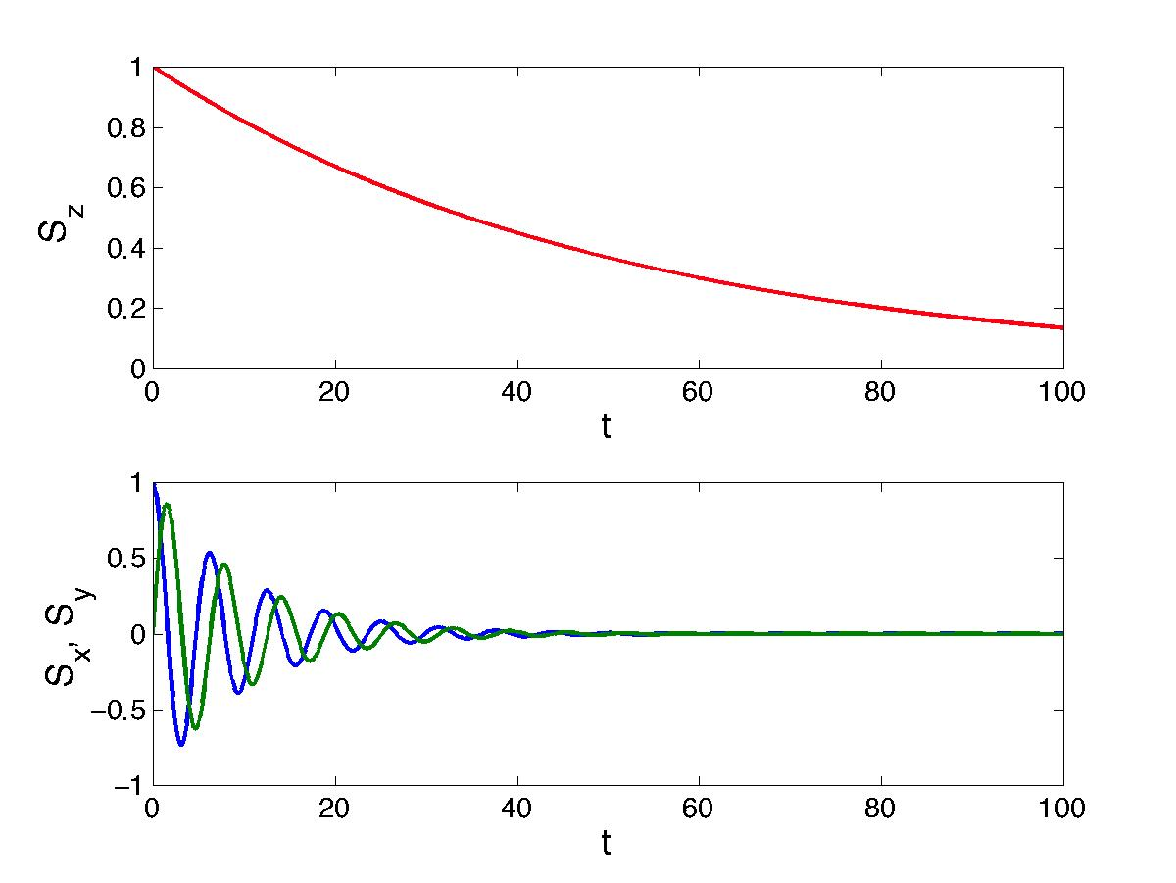
Effects of Environment on Quantum Memory
T₁ – timescale of
longitudinal relaxation
T₂ – timescale of
transverse relaxation
Fidelity of stored information decays with time.

Slide 84
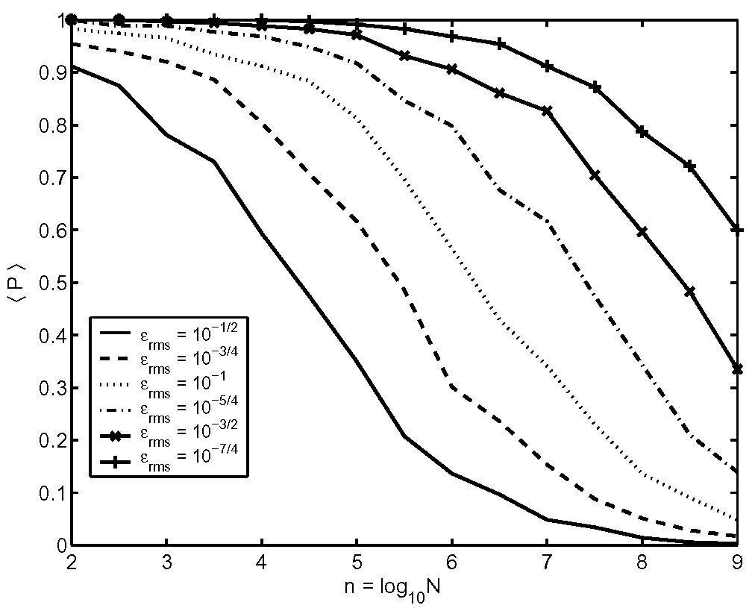
Effects of Environment on Quantum Algorithms
Ideal
oracle
O
Grover’s algorithm success rate
Noisy
oracle
O
n = # of qubits
Errors accumulate, lowering success rate of algorithm

Slide 85
Suppressing Decoherence
1. Remove or reduce V, i.e. build a better computer
System isolated from environment
2. Increase B, i.e. increase level splitting
E
|1⟩
When ΔE >> V, decoherence
is small
ΔE
|0⟩
B
Use decoherence free subspace (DFS)
4. Use pulse sequence to remove decoherence

Slide 86
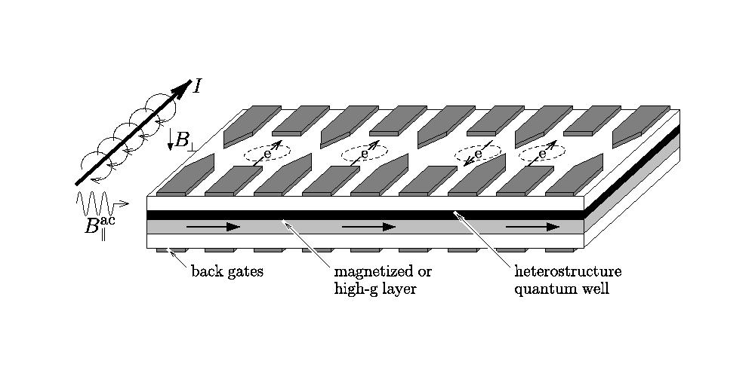
The Loss-Divincenzo Proposal
D. Loss and D.P. DiVincenzo, Phys. Rev. A 57, 120 (1998);
G. Burkhard, H.A. Engel, and D. Loss, Fortschr. der Physik 48, 965 (2000).

Slide 87
Solid State Electron Spin Qubit
Electron wavefunction
Si²⁸ (no spin)
Phosphorus
impurity
Dipolar coupling
Hyperfine coupling
External Magnetic
Field, B
Silicon lattice
Si²⁹ (spin ½)

Slide 88
System Hamiltonian
Hyperfine coupling
Dipolar coupling
Electron
spin
N nuclear
spins
~10¹¹ Hz / T
~10⁷ Hz / T
~10⁵ Hz
~10² Hz

Slide 89
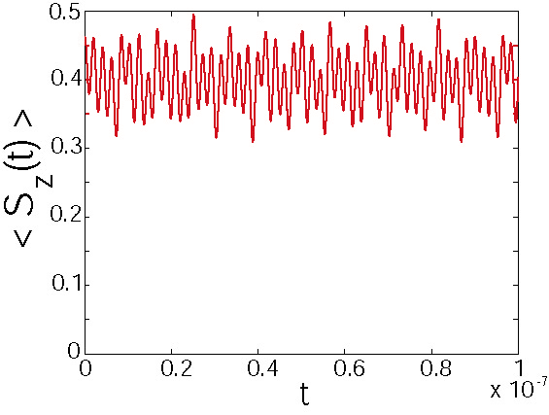
Hyperfine-Induced Longitudinal Decay
Critical field for electron
spin relaxation:
For B > B_{c}, T₁ is infinite

Slide 90
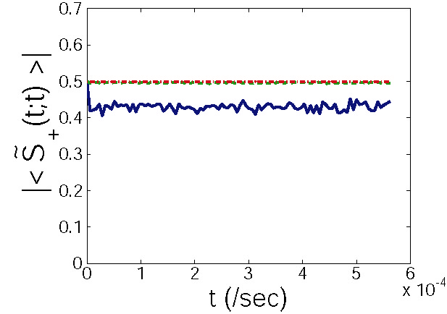
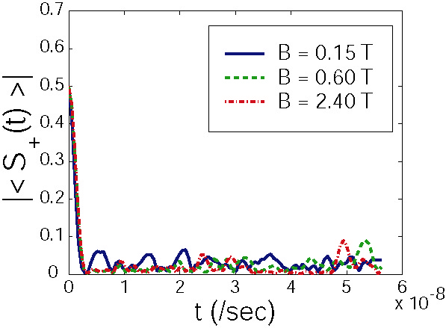
Hyperfine-Induced Transverse Decay
Free evolution
Spin echo pulse sequence
Spin echo pulse sequence removes nearly all dephasing!

Slide 91
Applications
Factoring – RSA encryption
Quantum simulation
Spin-off technology – spintronics, quantum cryptography
Spin-off theory – complexity theory, DMRG theory, N-representability theory

Slide 92
Future Prospects
Currently, research in Quantum Computing is more based on proof-of-principle rather than research into practical applications.
The infancy of the science is a significant inhibitor. In the future, decoherence may be a serious issue.

Slide 93
Future Prospects
Although many Quantum Algorithms seem to threaten classical computing (such as RSA-encryption), Classical Computers will be significantly larger than Quantum Computers for the foreseeable future.
Kurzweil, for example, suggests that practical quantum computing will be achieved at approximately the same time humanity achieves immortality (before 2099).

Slide 94
Concluding Remarks
Quantum Computing could provide a radical change in the way computation is performed.
The unit of information in Quantum Computing is the Qubit, which is a two state-system. Basic operations are unitary operators on the Hilbert space of this system.
The advantages of Quantum Computing lie in the aspects of Quantum Mechanics that are peculiar to it, most notably entanglement.
Practical Quantum Computers are a significant ways off.

