Slide 1

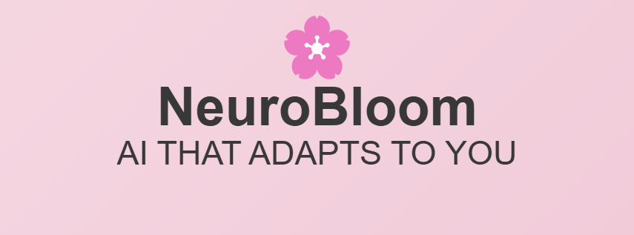
NeuroBloom – AI that Adapts to you
Hackhive 2025 – AI for better tomorrow
Group 59 – Sadhna Drall, Pranav Chaudhari, William Dolan

Slide 2
What is NeuroBloom?
AI-driven platform for neurodivergent individuals, the elderly, and people with disabilities.
Adaptive AI platform enhancing accessibility, user experience, and mental well-being through personalized UI and interaction features.

Slide 3
Key Features
Personalized UI: Adjustable fonts, contrast, and layout for every user.
AI Text-to-Speech & Speech-to-Text: Seamless interaction via voice and text conversion.
Mobility Assistance: Gesture-based navigation and real-time captions.
AI Productivity Tools: Task prioritization, distraction blockers, and smart reminders.

Slide 4
Why AI?
Adaptive to User Needs:
AI personalizes UI based on user preferences (font size, color contrast, layout).
Adapts to users with visual impairments, dyslexia, and other accessibility needs.
Seamless Interaction:
AI powers Text-to-Speech (TTS) and Speech-to-Text (STT) for hands-free navigation.
Provides a smooth, intuitive user experience without complex settings
Mental Health Support:
AI-driven chatbox feature enables users to communicate with others, providing emotional support and reducing feelings of isolation.
Offers a safe space for users facing mental health challenges to talk and feel heard..

Slide 5
Data Handling
Privacy First:
User data is encrypted and protected.
Strict privacy guidelines to ensure data is handled responsibly.
Bias-Free AI:
Regular checks for AI bias to ensure fairness for all users.
Ensures accessibility tools work equally well for different groups.

Slide 6
Why NeuroBloom?
Empowering Everyone: NeuroBloom makes technology inclusive for individuals with disabilities, neurodivergent conditions, and the elderly.
Effortless Accessibility: AI automatically adapts the platform to user needs, removing barriers without complex settings.
One Platform, Many Solutions: From reading and writing tools to mobility assistance, NeuroBloom is a holistic solution that improves lives through smart, intuitive tech.
Mental Health Support: Integrated chatbox feature allows users to connect with others. Offers a safe space for users facing mental health challenges to talk and feel heard.

Slide 7

Thank You!
Join us in shaping an accessible AI future!

