Slide 1
Agent-based Housing Model
Marcus Lundberg

Slide 2
Outline
Background
  Residential segregation
  Schelling’s original model
  Modern agent-based models
Dynamic housing quality model
  Description
  Preliminary ”results”
Extensions, ideas, general thoughts

Slide 3
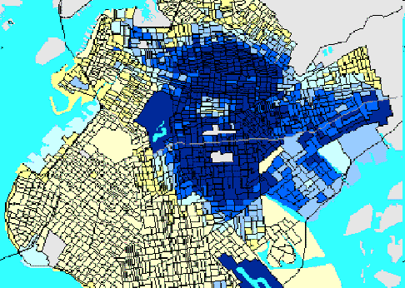
Residential Segregation
Study initially concerned blacks & whites in American cities and towns
Discrimination vs preference
Tipping points
Social consequences
Brooklyn

Slide 4
Measures of Segregation
Uneven distribution
  D*: The proportion of minority households that would need to relocate in order to achieve the segregation expected under random assignment
Isolation & exposure
  Measure levels of potential in-group and out-group contact

Slide 5
Schelling 1971
Coins on a checkerboard = racial segregation
Model:
  Define neighborhood as the 8 nearest squares (Moore)
  If a coin is in the minority in its neighborhood, it is dissatisfied
  Dissatisfied coins are moved to an empty spot that fulfills the satisfaction criterion

Slide 6
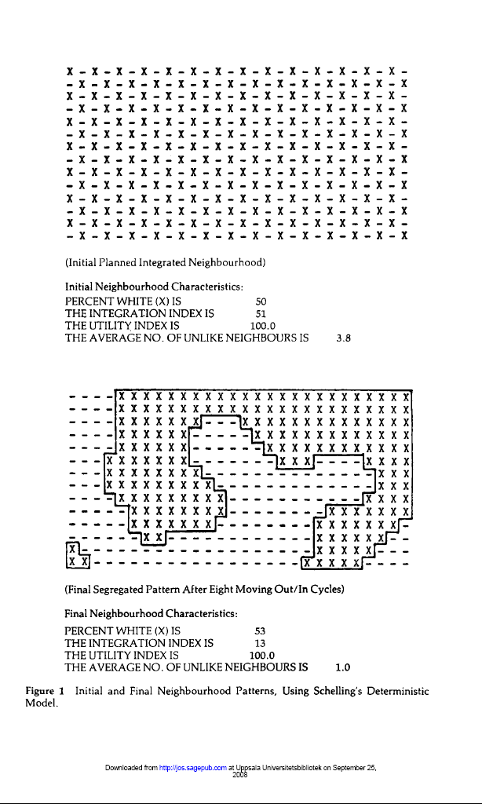
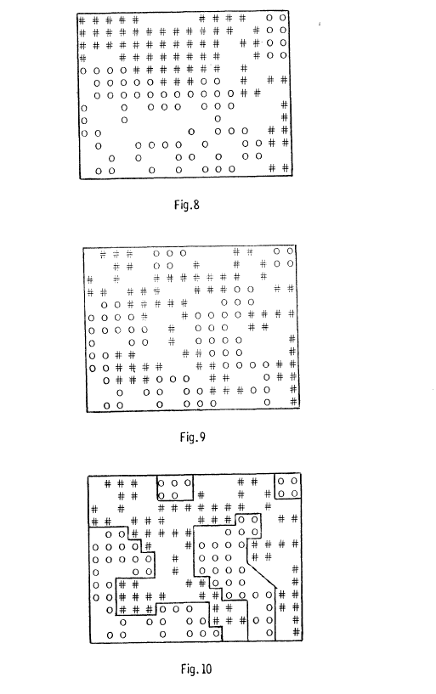
(Schelling 1971)
(Jones 1985)

Slide 7
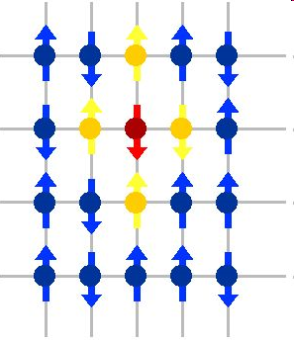
Schelling (cont’d)
What to do if satisfaction is impossible?
  ”Fluid” model vs ”Solid” model
Varying satisfaction criteria
Changing neighborhood size
Similarity with Ising Model in ferromagnetism
Including churn

Slide 8
Two modern approaches
Physics
  Statistical mechanics – Ising-type models
  Vinkovic and Kirman (2006) have produced an analogous continuous physical model
Sociology:
  Mostly ignores the enthusiasm of physicists
  Fossett (2004) has combined many elements into one model, SimSeg

Slide 9
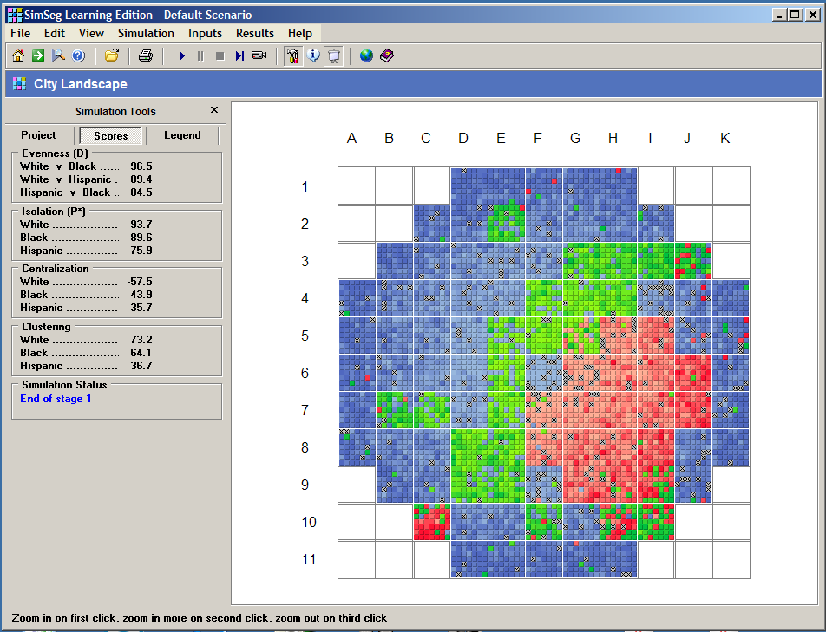
Simseg
Area stratification
Minority economic disadvantage
Whites’ preference for in-group contact
Minorities’ preference
White exclusion of minorities

Slide 10
A few conclusions from the models
Segregation is a very stable process
Sociologists liked to concentrate on discriminatory behavior, like minority exclusion and ethnic steering, to explain segregation
Why does segregation continue when discrimination decreases?

Slide 11
Residential Segregation in Sweden
Virtually all poor neighborhoods have a concentration of visible minorities
Between 1990 and 2002, the proportion of Swedish-born in poor areas decreased
The proportion of poor people in poor neighborhoods increased

Slide 12
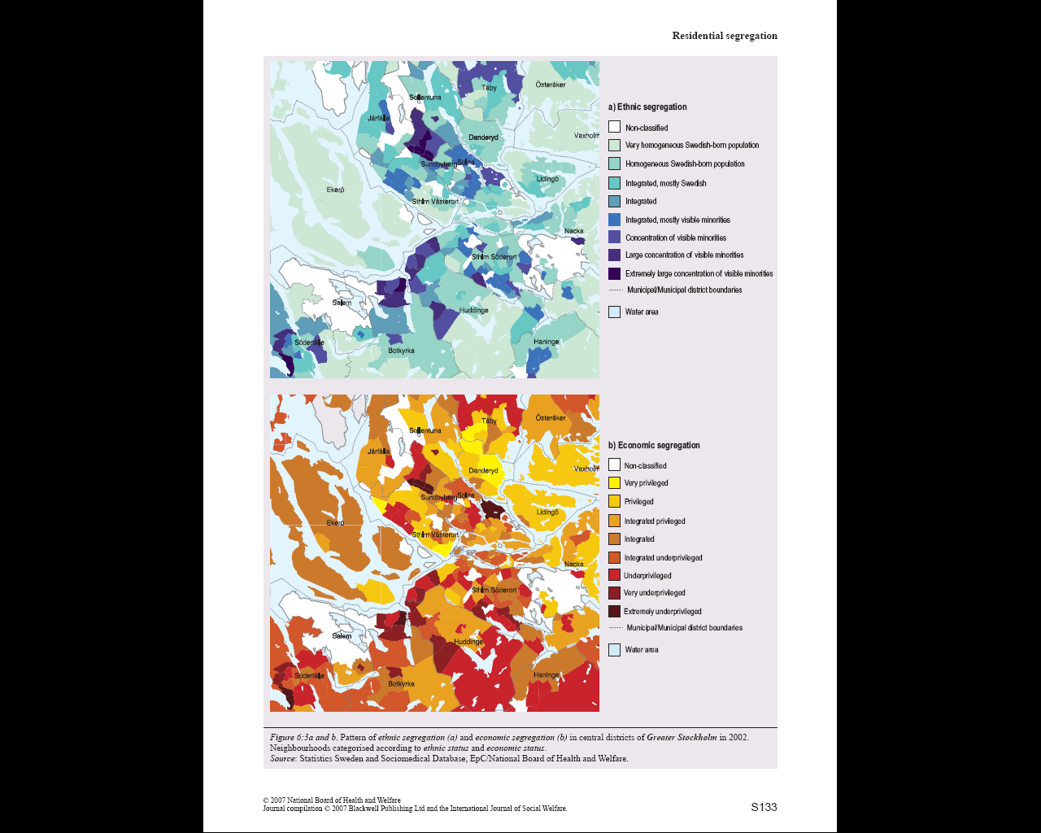
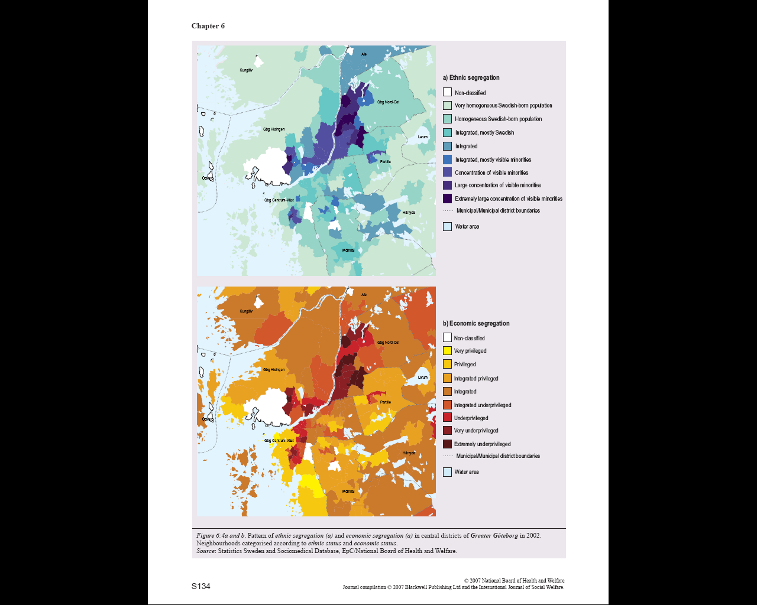
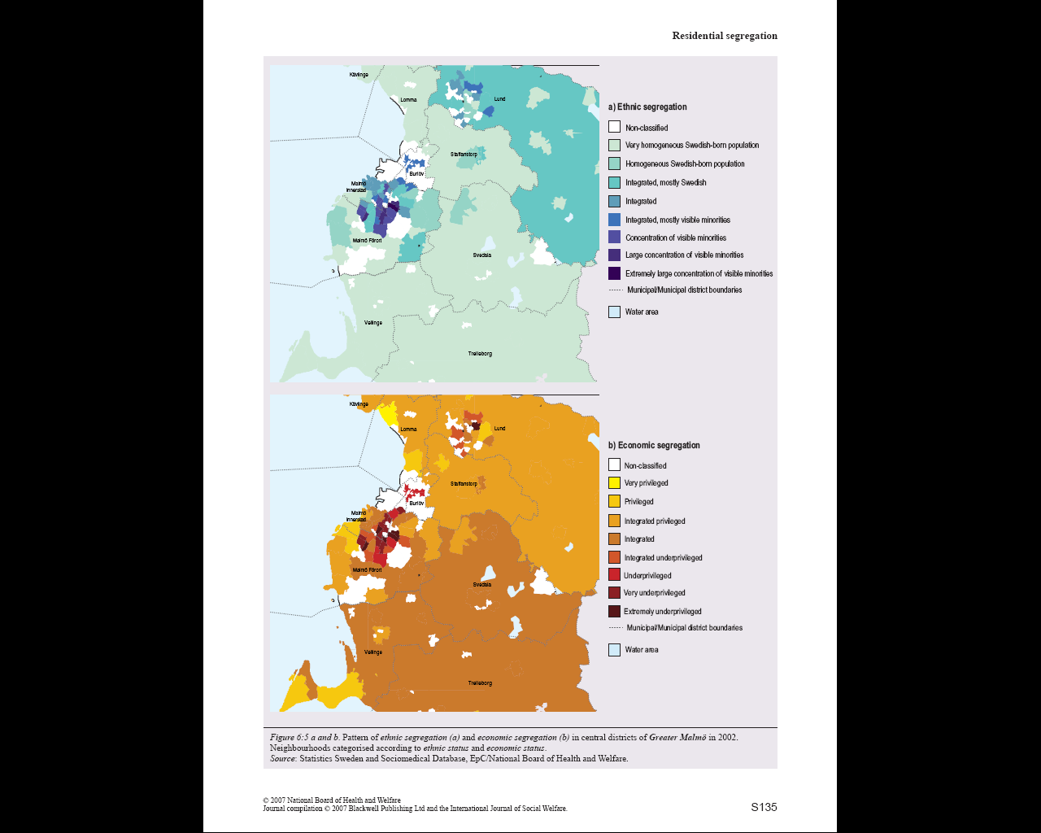

Slide 13
Socioeconomic segregation & housing model
Previous models of socioeconomic segregation have ignored housing quality or declare it constant
Social status of a neighborhood has an effect on housing price
This model attempts to combine dynamic housing quality with status effects

Slide 14
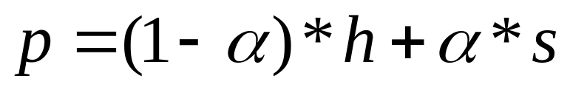
Housing model (2)
Model city is an N_{n}xN_{n} grid of neighborhoods.
Each neighborhood contains H housing units.
Each agent (household) has a fixed wealth/status c.
Each housing unit has a quality h, and the price p of a unit is
S is the average status of the agents in the neighborhood.

Slide 15
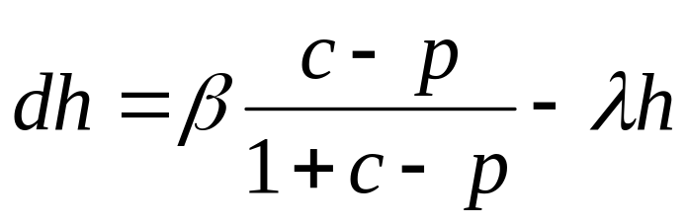
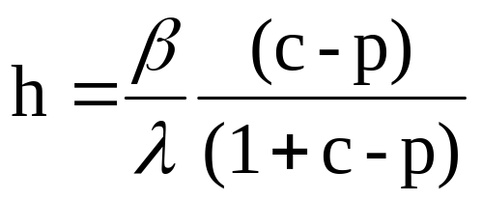
Housing model (3)
Every year, housing quality is updated to reflect decay and renovation.
Assume that available funds(c-p)limit renovation
β gives the rate of home repair
λ is the rate of decay.
Equilibrium at

Slide 16
Housing Model (4)
Each year, a number of agents are chosen at random
An agent moves only to an affordable empty lot
Agents prefer the lot with the highest future price

Slide 17
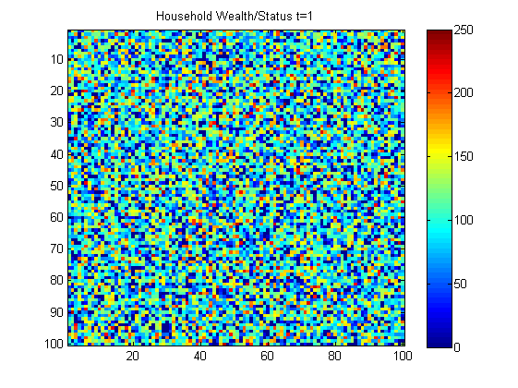
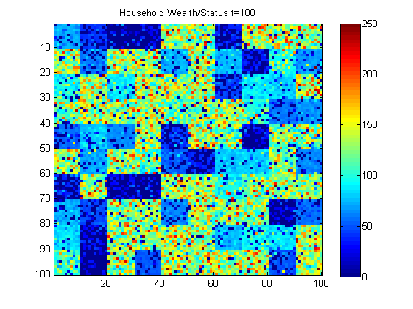
Some results
Nn=10
H=100
α=0.5
β=2
λ=0.02

Slide 18
Extensions, open questions
Initial geographical distribution of wealth & housing quality
Distribution of wealth (normal, power, ?)
Vertical mobility
Racial preference
A housing market
Some housing quality is constant: shoreline, distance to cultural centers, etc.
What sort of policy decisions can reverse the trend or make it innocuous?

Slide 19
References
Schelling (1971) ”Dynamic Models of Segregation”, Journal of Mathematical Sociology: 1: pp 143-186
Vinkovic D, Kirman A. ”A physical analogue of the Schelling model” (2006) Proc Natl Acad Sci USA 103:19261–19265.
Benard S, Willer R (2007) ”A Wealth and Status-Based Model of Residential Segregation”, Journal of Mathematical Sociology, 31:2, 149-174
L Dall’Asta et al. ”Statistical physics of the Schelling model of segregation”, J Stat Mech (2008) L07002
Jones. ”Simulation Models of Group Segregation” Journal of Sociology 1985: 21: pp 431-444
Stauffer D, Solomon S. ”Ising, Schelling and self-organized segregation”, Eur Phys J B: 57: pp 473-479
Biterman D, Franzén E. ”Residential segregation (Chapter 6)”, Int J Soc Welfare 2007: 16: pp 127-162

