Slide 1

Quantum.ai
Welcome
3Days
Hands-on
MACHINE LEARNING
workshop
3Days
Hands-on
MACHINE LEARNING
workshop

Slide 2
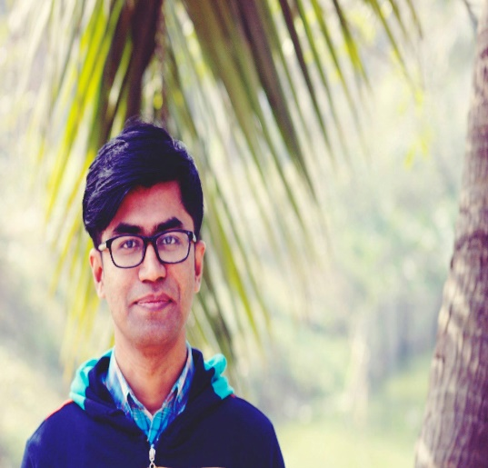

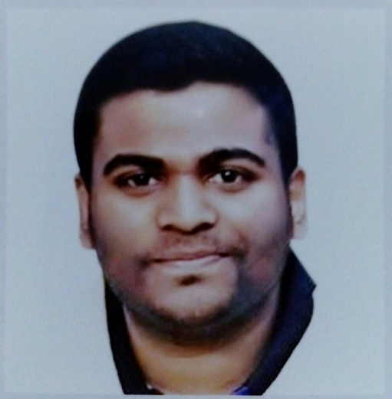
Instructors
Masudur Rahman
Shaiful Islam
Harun-Ur-Rashid
Research Fellow,
AIMS Lab, UIU
Trainee AI Programmer,
Zantrik
Kaggle Expert, Kaggle
Mentor, Amar iSchool আমারই স্কুল

Slide 3
Day1 Agenda
Basic Python
What is AI
AI vs ML
What is ML
Maths for ML
Dataset
Next Step

Slide 4
Basic Python
What is Python
List Tuples & Dictionaries
Basic Programming Constructs
Strings Standard Input and File
Notes:
rgb(243,156,18)

Slide 5

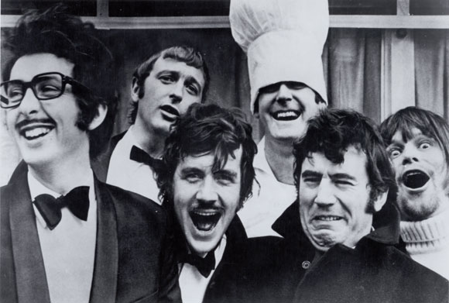


Python?

Slide 6
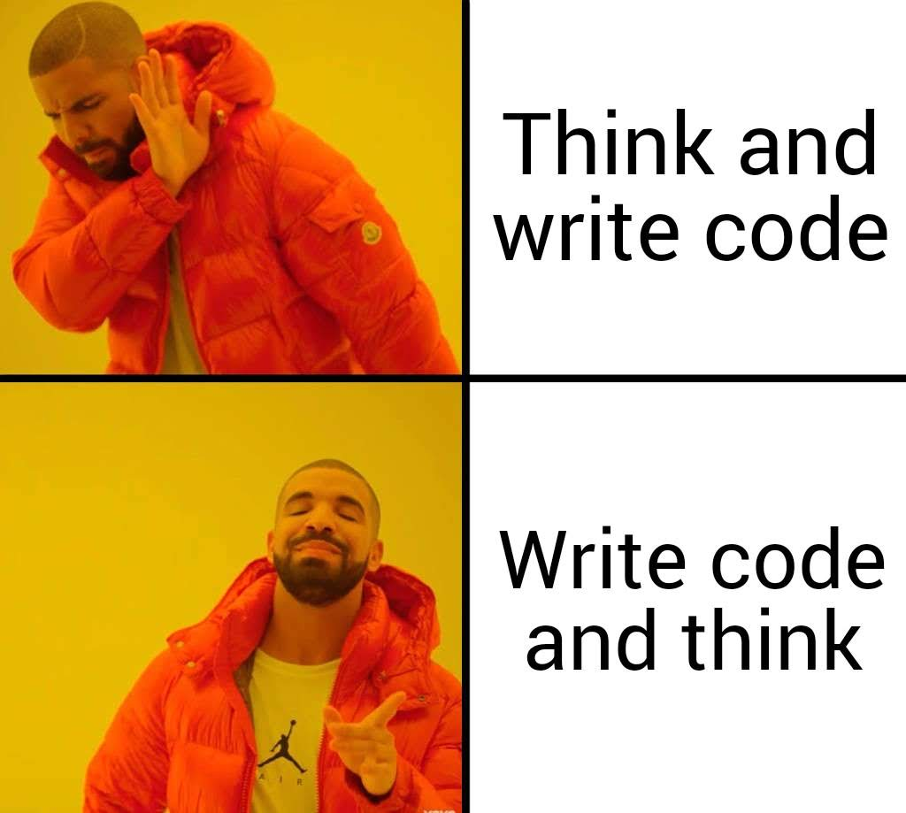
Coding
Notes:
rgb(243,156,18)

Slide 7
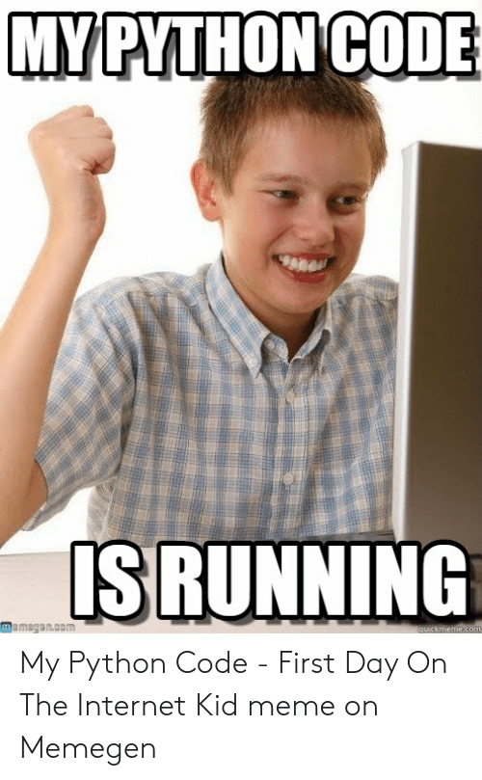
Done!
Notes:
rgb(243,156,18)

Slide 8
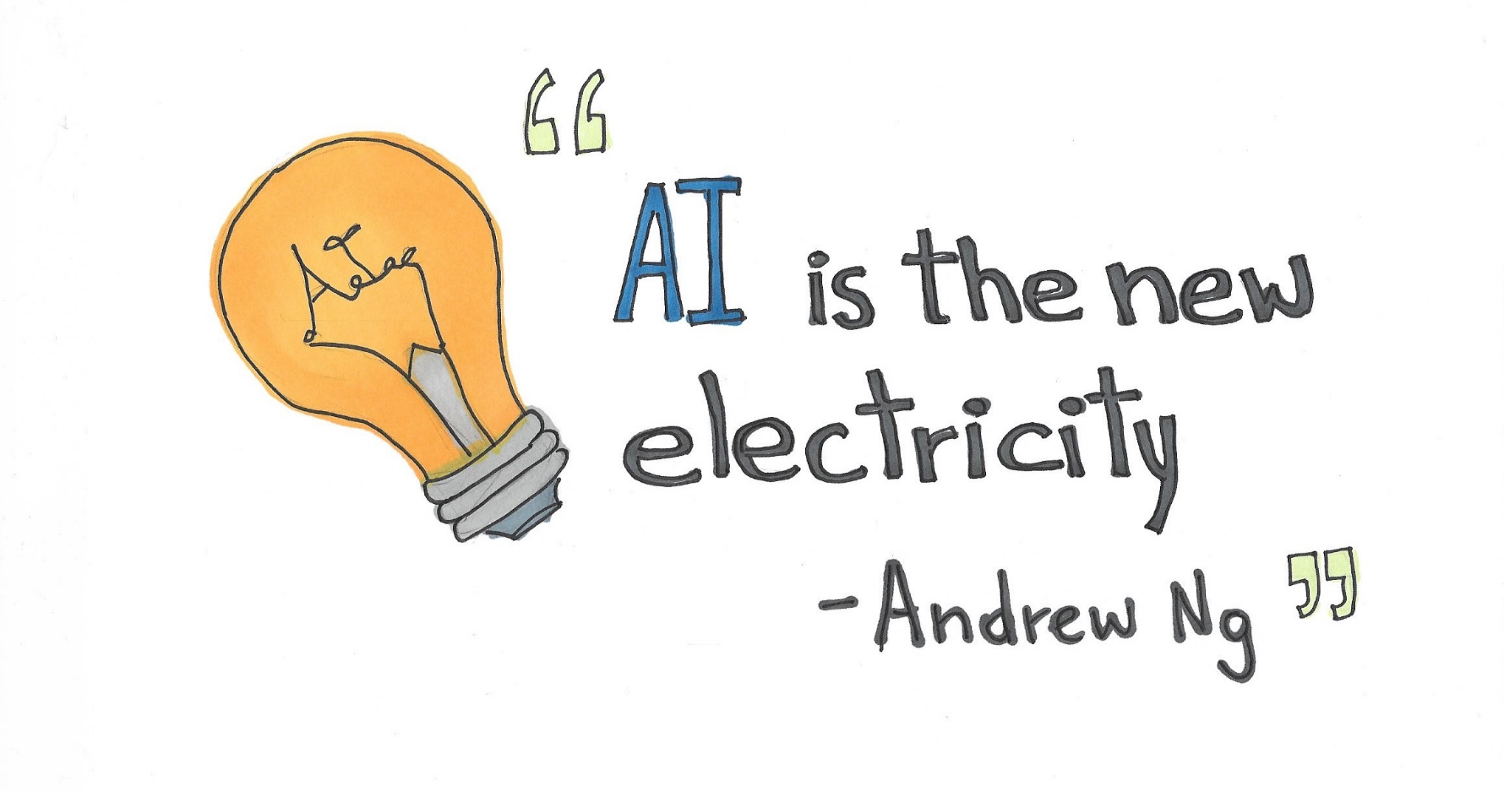
What is AI
Notes:
rgb(243,156,18)

Slide 9
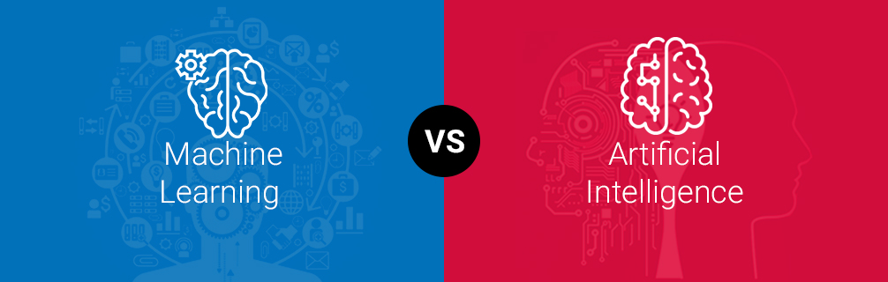
AI vs ML
Notes:
rgb(243,156,18)

Slide 10
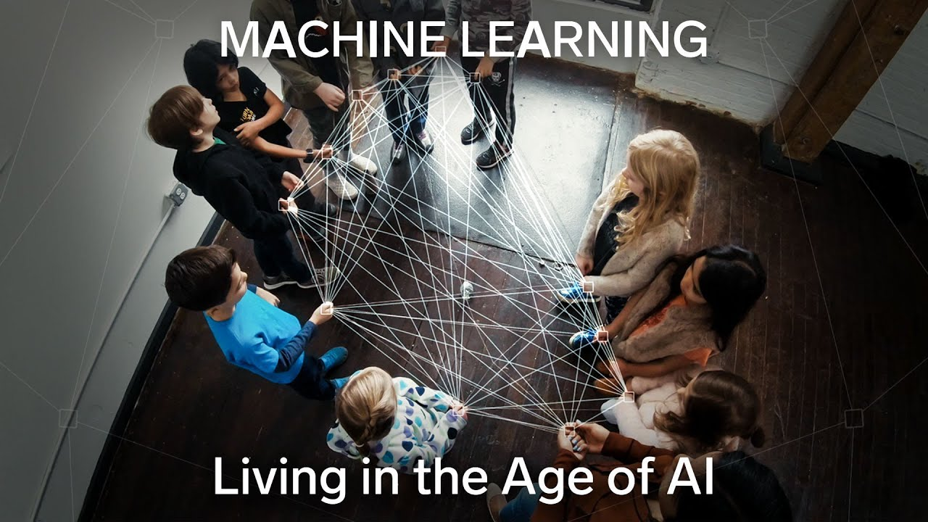
What is ML
Notes:
rgb(243,156,18)

Slide 11
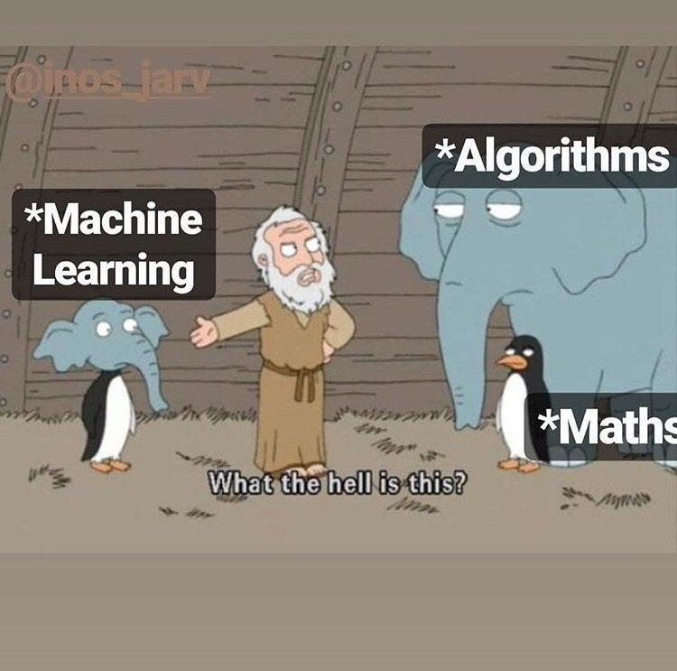
Maths
Notes:
rgb(243,156,18)

Slide 12
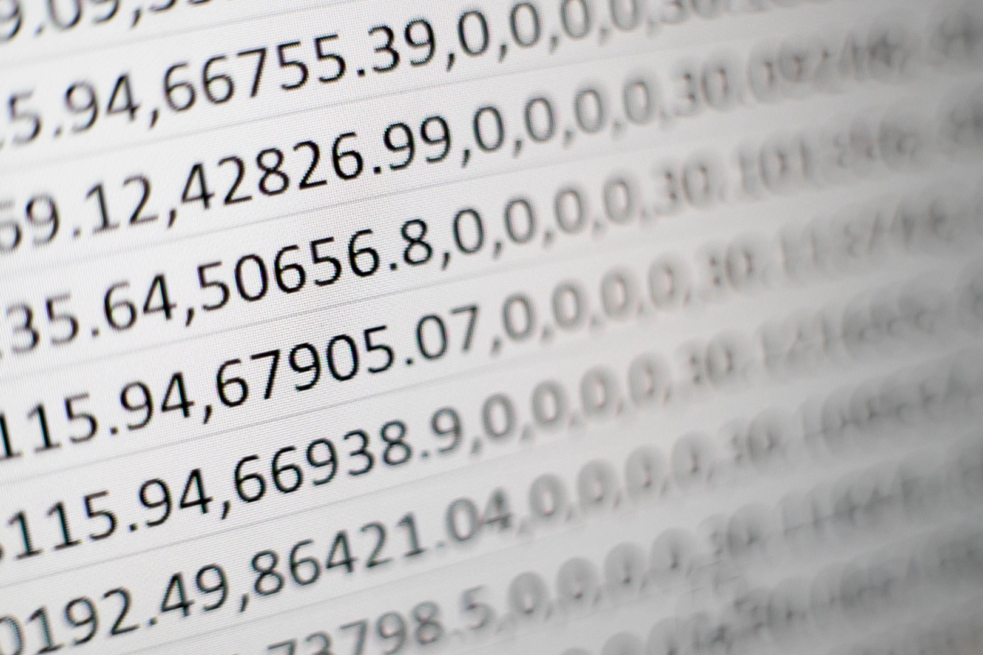
Dataset
Notes:
rgb(243,156,18)

Slide 13




