Slide 1

Quantum.ai
Welcome
3Days
Hands-on
MACHINE LEARNING
workshop
3Days
Hands-on
MACHINE LEARNING
workshop

Slide 2
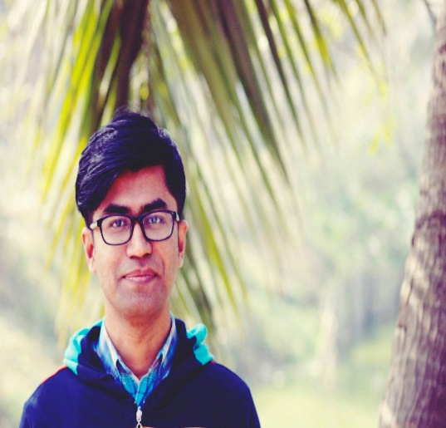

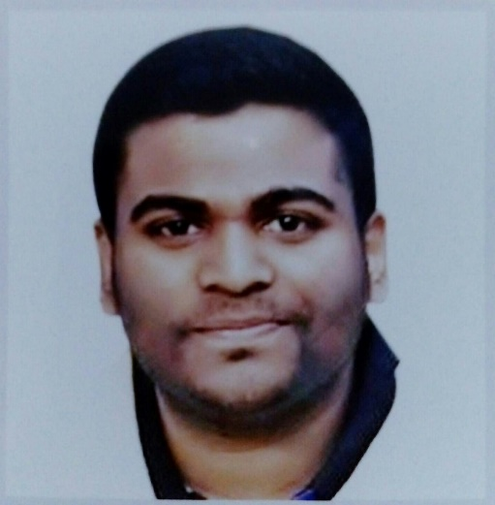
Instructors
Masudur Rahman
Shaiful Islam
Harun-Ur-Rashid
Research Fellow,
AIMS Lab, UIU
Trainee AI Programmer,
Zantrik
Kaggle Expert, Kaggle
Mentor, Amar iSchool আমারই স্কুল

Slide 3
Day1 Agenda
Basic Python
What is AI
AI vs ML
What is ML
Maths for ML
Dataset
Next Step

Slide 4
Day2 Agenda
Basic Pandas,Numpy,Matplotlib
Data Pre-processing and visualization
Data analysis and visualization on excel
Machine learning model apply(classification)
Model save and test
Next Step

Slide 5
Day3 Agenda
Model deploy
How to join Kaggle competition
Machine learning project store in GitHub
End

Slide 6
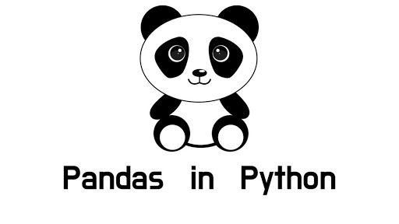
Pandas
Notes:
rgb(243,156,18)

Slide 7

NumPy
Notes:
rgb(243,156,18)

Slide 8
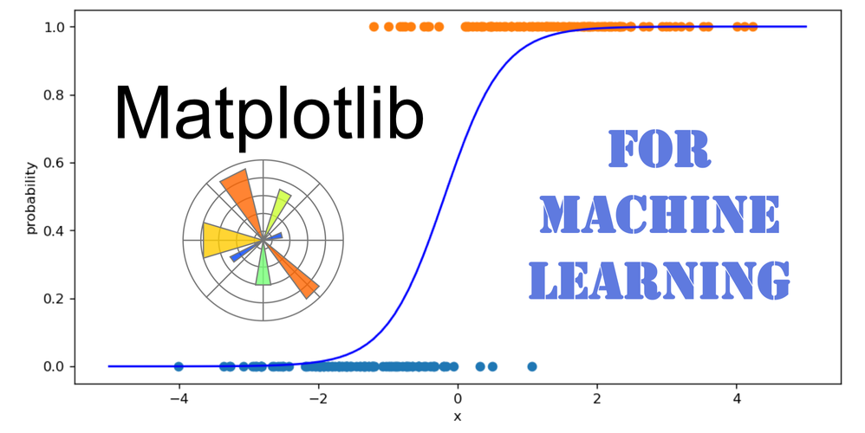
Matplotlib
Notes:
rgb(243,156,18)

Slide 9
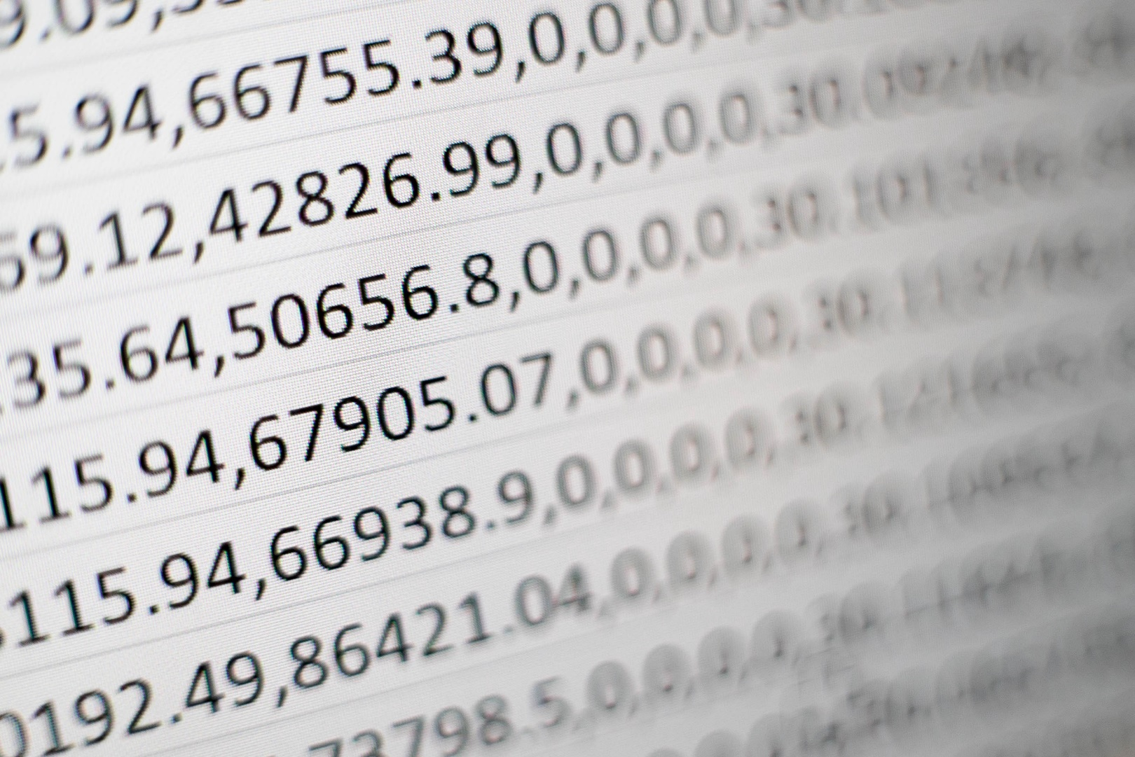
Dataset
Notes:
rgb(243,156,18)

Slide 10
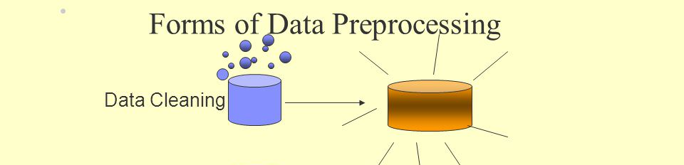

Data Pre-processing and visualization
Notes:
rgb(243,156,18)

Slide 11
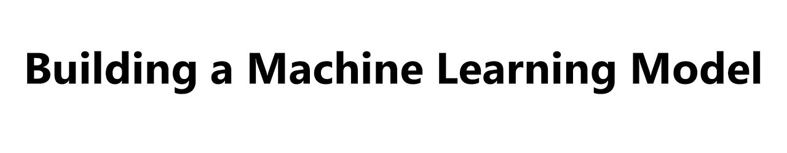
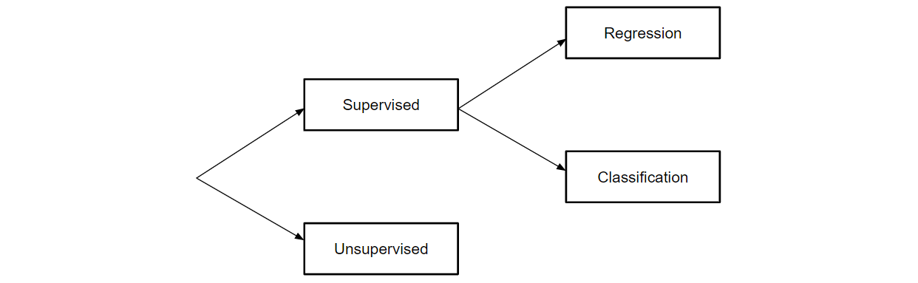
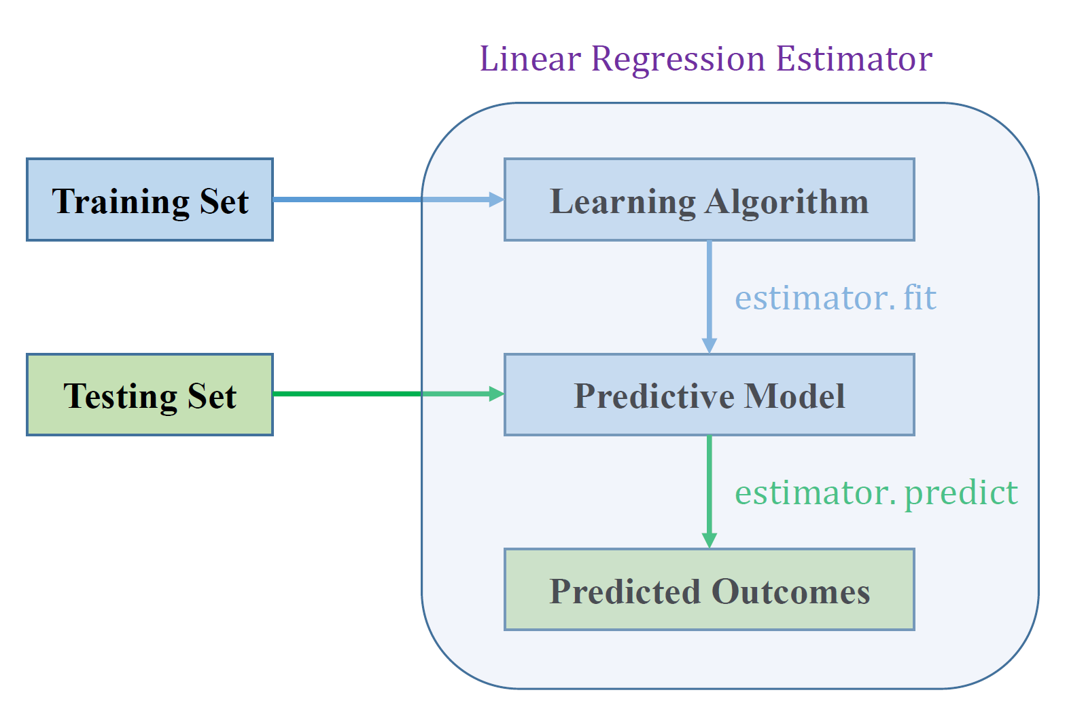
ML Model Apply
Notes:
rgb(243,156,18)

Slide 12
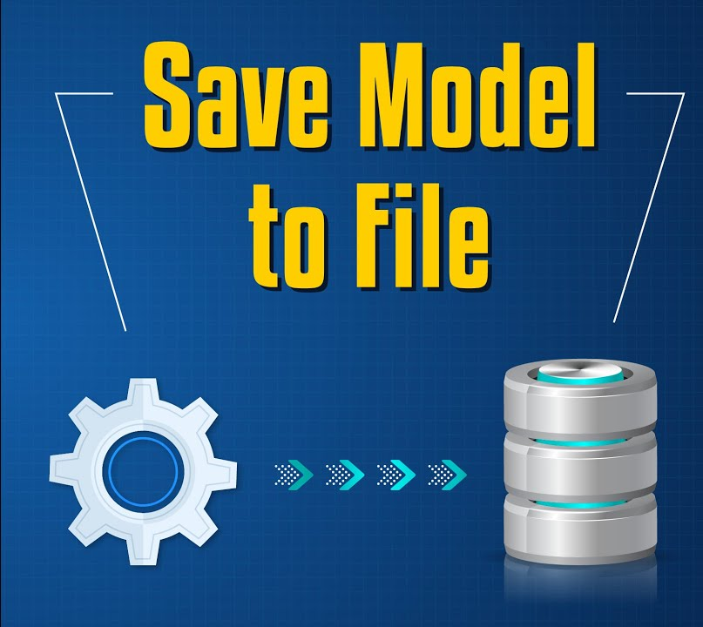
Model save
Notes:
rgb(243,156,18)

Slide 13

Done!
Notes:
rgb(243,156,18)

Slide 14
Data Pre-processing and Visualization
About Excel
Data
Science
Pipeline
Why excel
Data Pre-processing
Data Visualization
Task

Slide 15
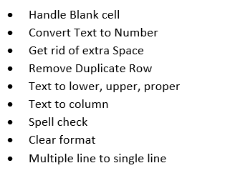
Data Pre-processing in Excel
Notes:
rgb(243,156,18)

Slide 16
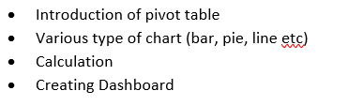
Data Visualization in Excel
Notes:
rgb(243,156,18)

Slide 17




