Slide 1


Notion of an algorithm, Fundamentals of algorithmic problem solving and problem types Session No.: 1 Course Name: Design and analysis of algorithm Course Code: R1UC407B Instructor Name: Pradeep Chauhan Duration: 50 Min. Date of Conduction of Class:

Slide 2
Review of the key concepts 1.Basic concepts of data structure 2. searching algorithm 3. Sorting Algorithm

Slide 3
Q1: What are the difference between algorithm and pseudocode?

Slide 4
Learning Outcome
Develop an algorithm to solve a given problem.
Relate with different types of algorithmic problems.

Slide 5
Session Outline
1 Introduction to notion of an algorithm,
2 Fundamentals of algorithmic problem solving and problem types
3 Concept and definition for learning Activity
4 Activity (scenario based)
5 Reflection learning activity
6 Conclusion

Slide 6
Definition
A step-by-step procedure to solve a any particular problem.

Slide 7
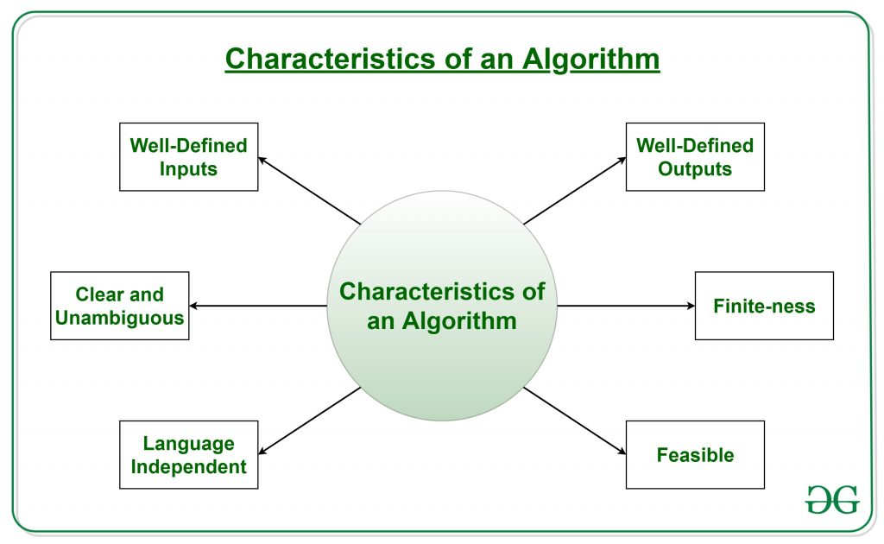
Characteristics of an algorithm
Effectiveness

Slide 8
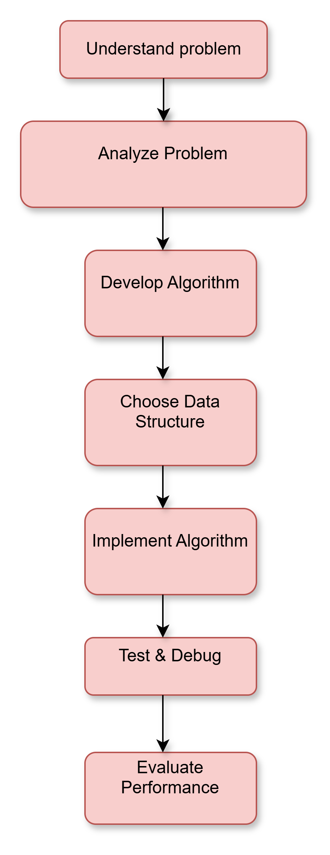
Fundamentals of Algorithmic Problem Solving
Algorithmic problem-solving is the process of designing and implementing a solution to a problem using a series of steps or rules.

Slide 9
Activity-1: Think Pair Share (15 minutes)
Write an algorithm to check whether a given is leap year or not.

Slide 10
Reflection- Leap year: 1. Enter a year y. 2. if y %100 == 0 then goto step3 else goto step4. 3. if y%400== 0 then print “leap year” otherwise print “not leap year” and goto step5 4. if y%4== 0 then print “leap year” otherwise print “not leap year” . 5. stop.

Slide 11
Problem Types in Algorithmic Problem Solving
Decision Problems: Answer is Yes/No
Optimization Problems: Find the best solution
Search Problems: Find an element in a dataset
Computational Problems: Require mathematical computations

Slide 12

Activity-2: Individual(10 minutes)
Scan QR code and complete within 10 minutes.

Slide 13
Summary An algorithm is a finite set of well-defined instructions designed to perform a task or solve a problem. Effective algorithmic problem solving involves understanding the problem, designing a clear solution strategy, and analyzing the algorithm's efficiency.

Slide 14
Post session activities MCQ Based Quiz.

Slide 15
In the next session, analysis of algorithm efficiency, asymptotic notation will be discussed in detail.

Slide 16
Review and Reflection from students

