Slide 1
Documentation for GUI submodule
Shuhao Wu

Slide 2
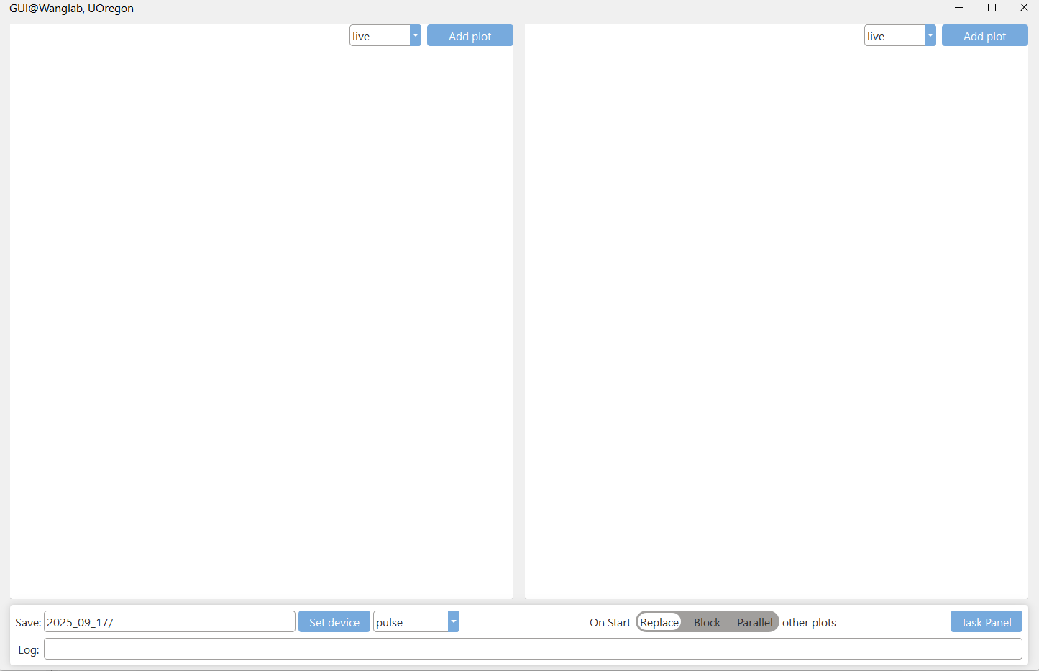
GUI
from Confocal_GUIv2.logic import GUI
GUI()
Replace: If you start a new measurement it will stop and the current running measurement before start new one
Block: You must manually stop running measurement before you can start new one
Parallel: You can run multiple measurements at the same time (Do not use this unless you know what you are doing)
Add the measurement you want, make sure you have already imported desired measurement into jupyter environment
Task panel to configure and
run more complicated experiment
Consists of multiple measurements
All saves of live_plot inside GUI will go to this folder
Open selected device GUI

Slide 3
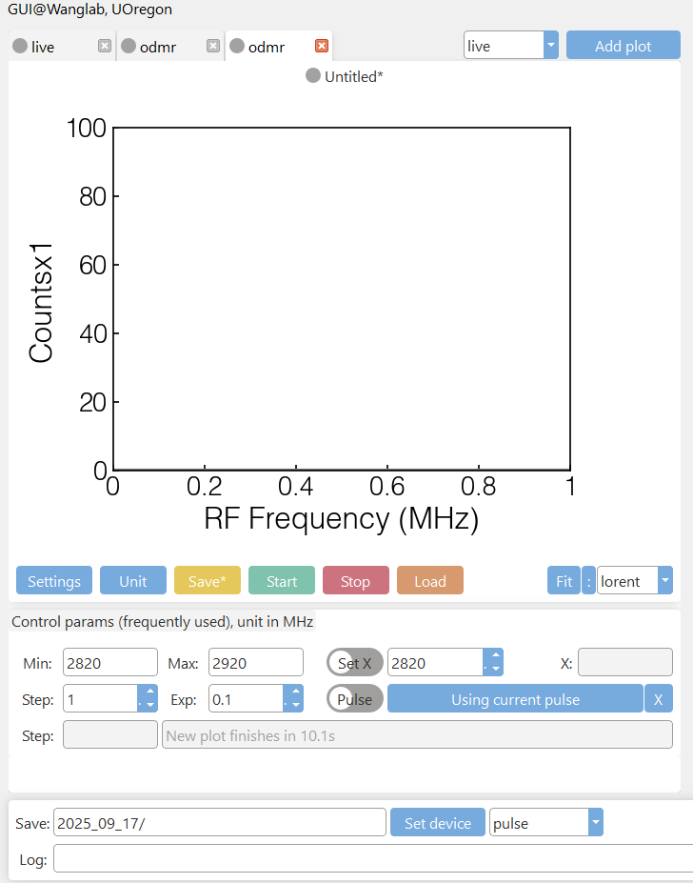
GUI
You can have three pages at most

Slide 4
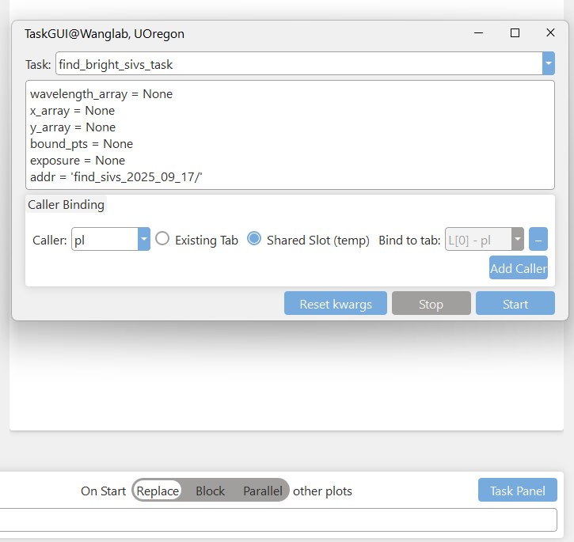
Task panel
Any function imported that ends with _task
This will replace all caller of measurement in the task
with the measurement in GUI that allows you to pass
exisiting parameters.
1, shared slot, will open a page on the left side of GUI and
use all the parameters you input
2, existing tab, will reuse the existing measurement currently
in GUI by restart it

