Slide 1
Documentation for live_plot submodule
Shuhao Wu

Slide 2
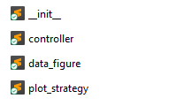
Location: Confocal-GUIv2/Confocal_GUIv2/live_plot
Controls how live_plot show results in jupyter, pyqt environment and also handles interrupt etc.
Defines how to fit, save, change unit of a live_plot figure
Defines how Live1D, Live2DDis, LiveLiveDis display

Slide 3
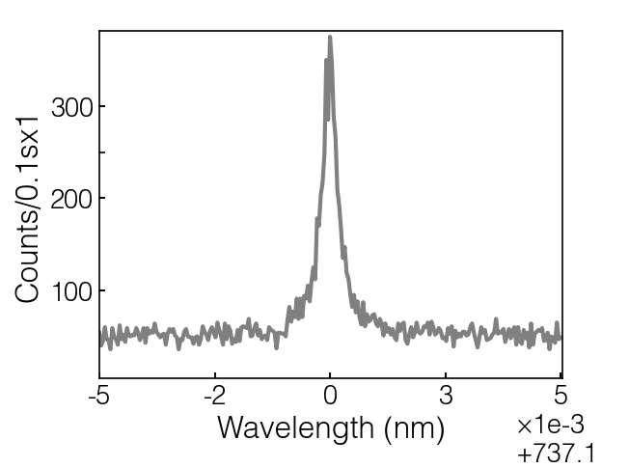
Live1D
Scale and offset, actual data is data_x(actual) = data_x(display)*scale + offset
Counts/{exposure}x{repeat_cur}
Or
Counts/{sample_num}x{repeat_cur} in apd_sample mode
unit

Slide 4
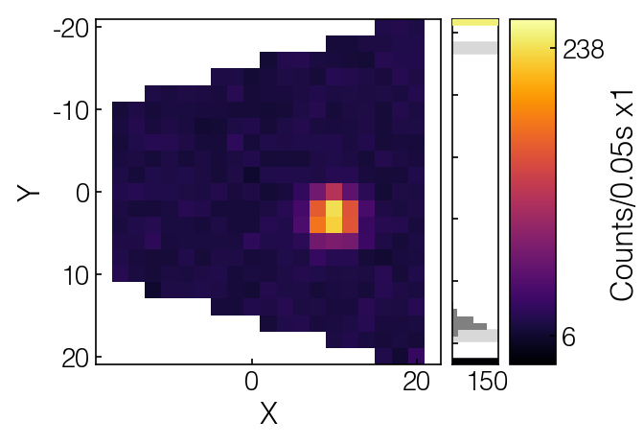
Live2DDis
Distribution of data_y
Maximum data_y
Minimum data_y
Distribution number in each bin

Slide 5
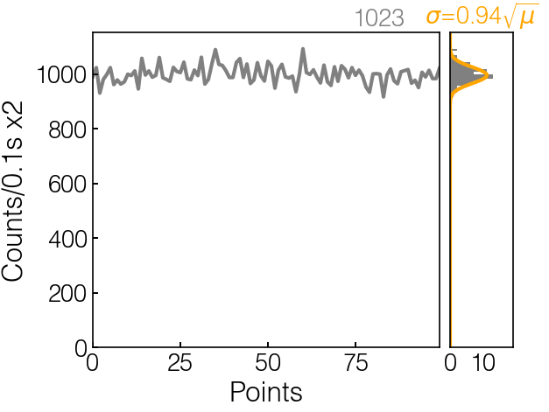
LiveLiveDis
Monitor newest data
How far is it from poisson distribution, 1 for a perfect poission
Distribution of data_y

Slide 6
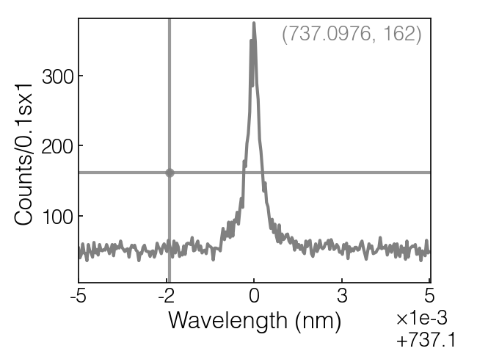
Cross selector
Right click on figure will create a crosshair, double right click to cancel cross selector
1, cross selector is linked to set_x in GUI

Slide 7
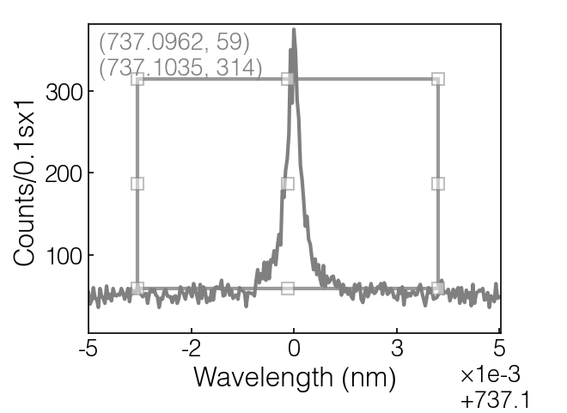
Rectangle selector
Left click and drag to create a rectangle selector, drag on squares to edit area. Left click outside area to cancel.
1, area in rectangle is linked to min, max range in GUI

Slide 8
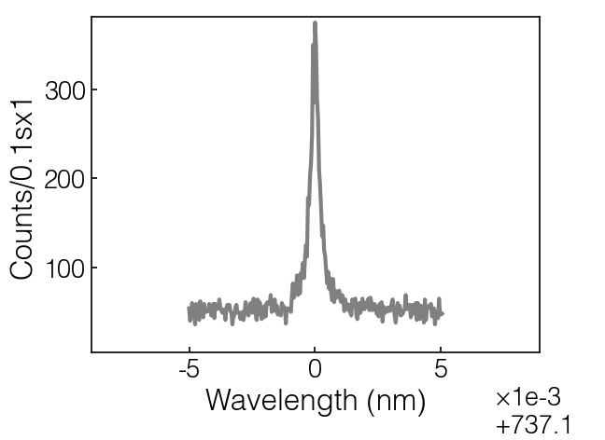
Scroll
Scroll to change the display range, double click scroll wheel to return to original range
1, this is linked to min, max range in GUI

Slide 9
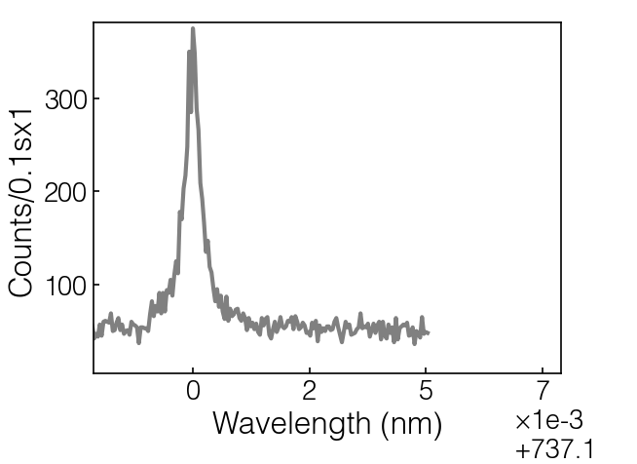
Drag
Hold scroll wheel to drag the center of display range
1, this is linked to max, min range in GUI

Slide 10
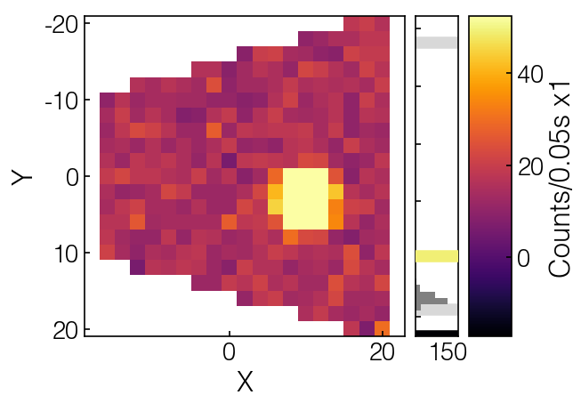
Drag line (only for Live2DDis)
Use mouse left to drag the yellow/black line in colorbar to update color range

Slide 11
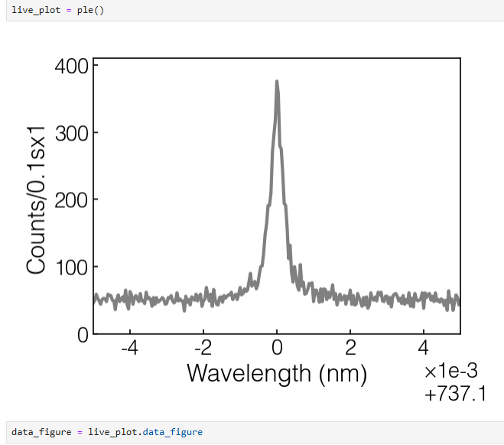
Data_figure
Using live_plot.data_figure to get the handle to data_figure for data processing

Slide 12
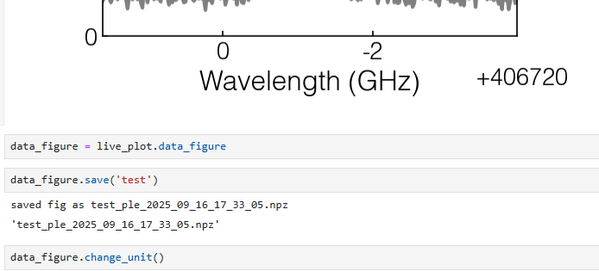
Data_figure
Save data and figure, you can also call data_figure.save()
Change unit of the figure, nm->GHz->MHz->nm loop or ms->us->ns->ms loop

Slide 13
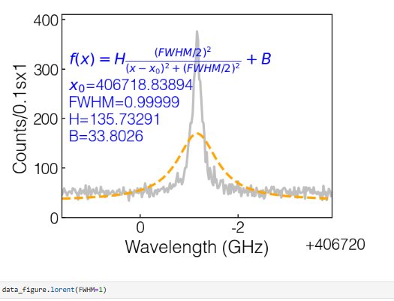
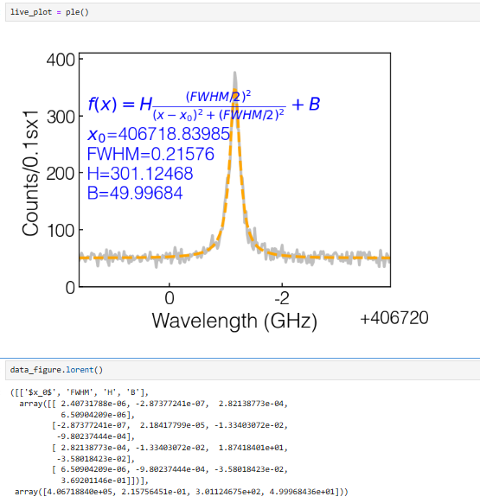
Data_figure
Force curve_fitting with one or multiple parameters fixed
Fit data using lorent(), available options are
Lorent, decay, rabi, center etc.
Data_figure.clear() to clear fit

Slide 14
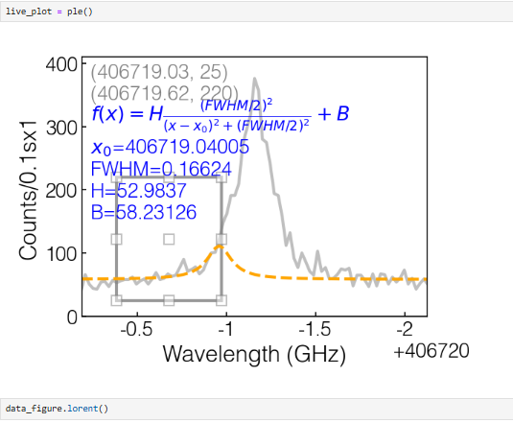
Data_figure
Select only a subarea for curve_fitting

Slide 15
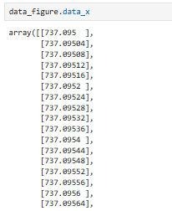
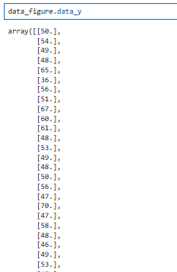
Data_figure
You can get data_x, data_y of a data_figure if you want to process it yourself

Slide 16
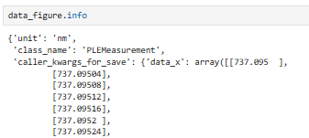
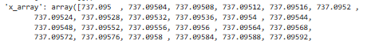
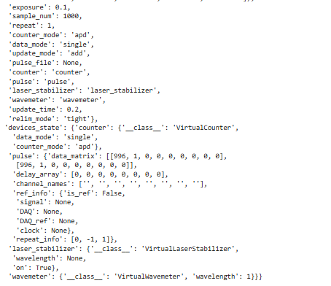
Data_figure
You can reproduce the data/live_plot using the information in data_figure.info. For old data, first use the load() function to load it and then check data_figure.info.
Caller_kwargs_for_save: all parameters input to the caller of the measurement
Devices_state: ues the snapshot method of BaseDevice to save all devices properties that with @BaseDevice.ManagedProperty. Then you can retrieve pulse, or other devices states of any experiment measurement.

