Slide 1
Documentation for Logic submodule
Shuhao Wu

Slide 2

Location: Confocal-GUIv2/Confocal_GUIv2/logic
The logic of different measurement, e.g. Rabi, PL, PLE
More complicated logic that multiple measurements may be involved, and also may have processing of data

Slide 3
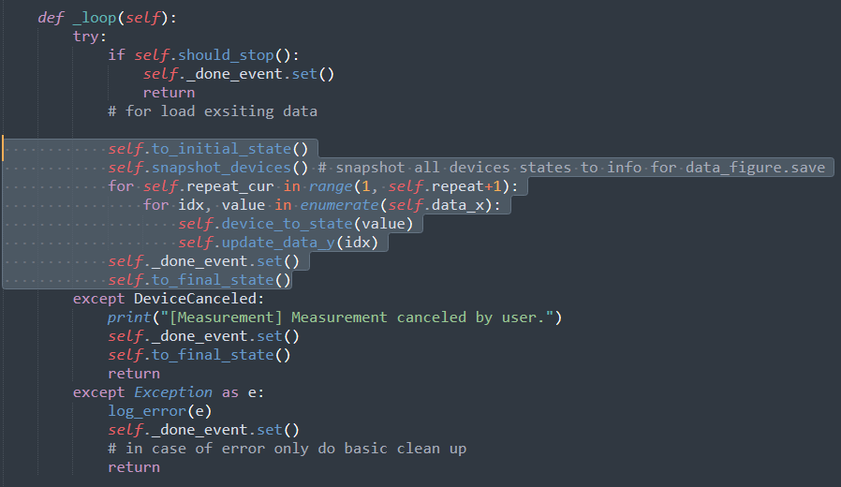
BaseMeasurement
Measurement consists of a few key steps:
1, to_initial_state(), set all devices to the initial state for this measurement
2, loop repeat_cur, value in repeat, data_x. This is the variable in a measurement, e.g. frequency in ODMR measurement
3, device_to_state(value), set devices to certain state based on current data_x.
4, update_data_y(idx), acquire data_y (photon counts in most cases) and update its value to data_y array
5, to_final_state(), set devices to its final state, or in other words, clean up.
Core of the measurement loop

Slide 4
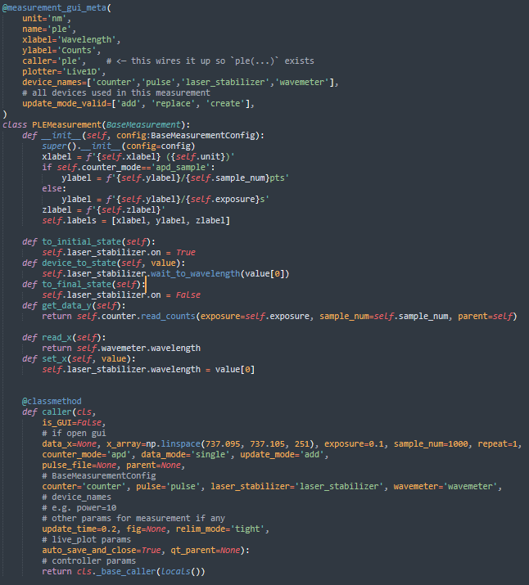
Measurement
Define your axis labels
Use decorator to register basic information
1, caller defines how you can call this measurement
2, plotter defines which live_plotter to plot the live result, can be Live1D, Live2DDis, LiveLiveDis
3, device_names are all the devices used
4, update_mode_valid defines all useable update_mode
5, use 1 for unit if you don’t have a unit
All methods you must realize to complete a base measuement
Read_x, set_x used by GUI to display and set data, set_x can be device_to_state
All parameters you need to input to start a measurement
1, data_x is (n, 1) np.array, generated from x_array, y_array etc. if not given
2, if pulse_file is not None, then measurement will apply given pulse in the beginning
3, counter=‘counter’, the first counter is the device name in measurement code, the second counter is the device name in your jupyter environment. Others as well.
4, If you add/use any other params, add to caller and also to __init__, ref to ODMRMeasurement for example.

Slide 5
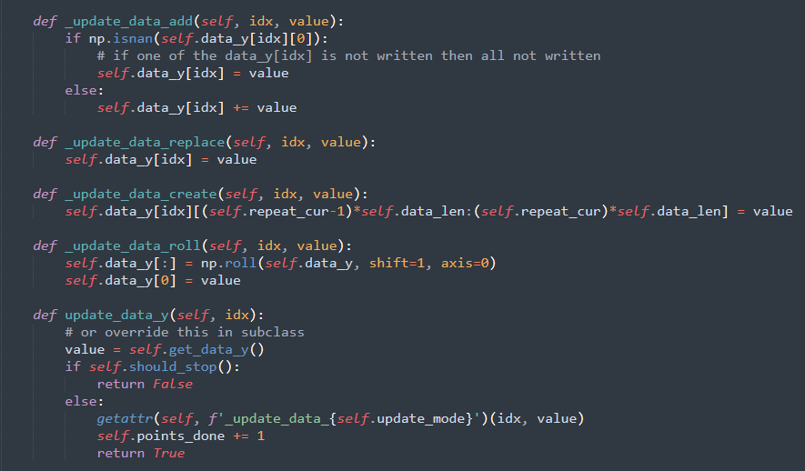
Update_mode
Update_mode defines how data_y acquired in repeat_cur more than one ‘add’ to previous data_y results
1, add means add
2, replace means replace
3, create means create new line without clear the old results
4, roll means shift the results, used in live measurement which newest data always at the left most position

Slide 6
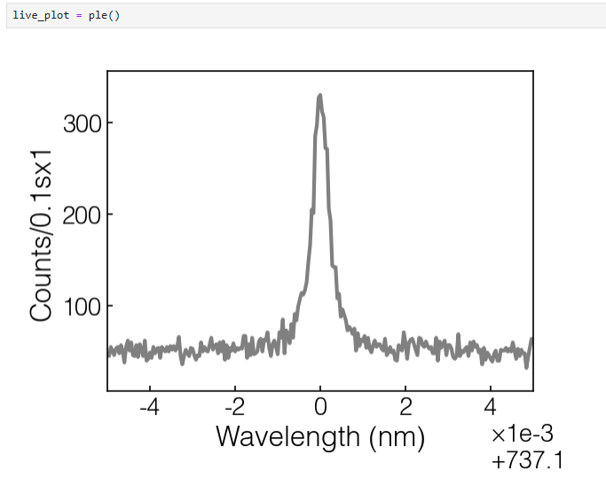
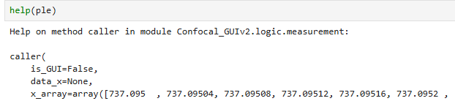
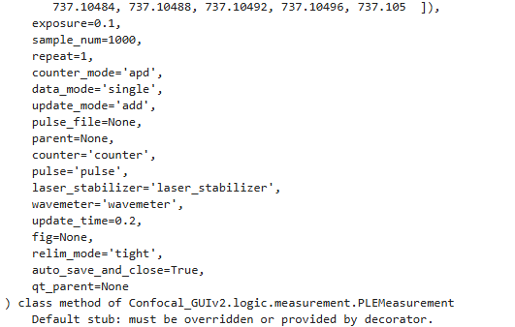
Run measurement

Slide 7

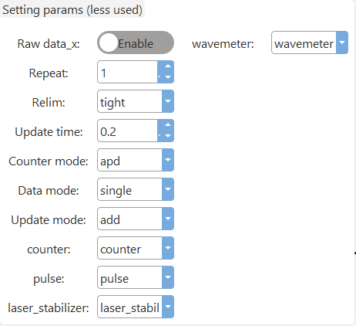
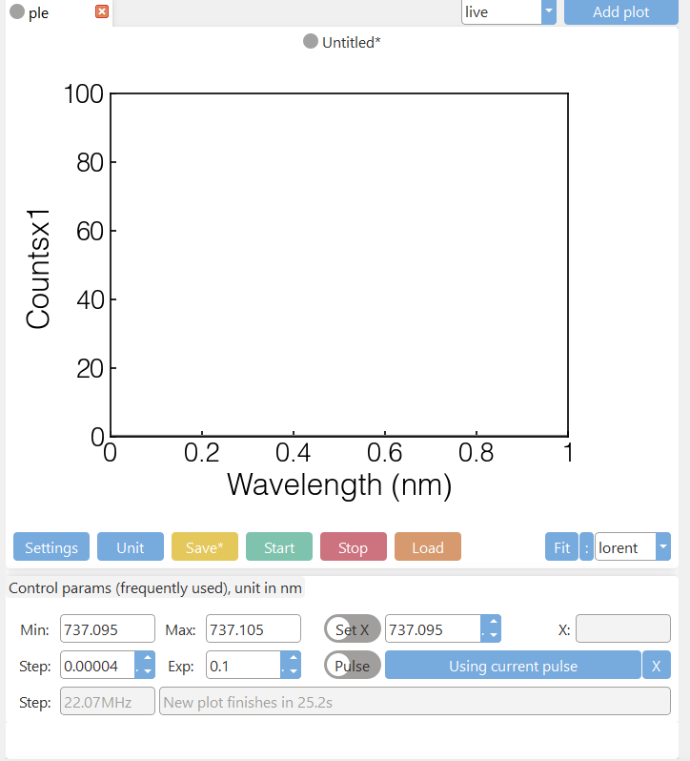
Run measurement
Set basic parameters in settings button
Change unit
1, nm->GHz->MHz->nm
2, us->ns->ms->us
Load existed result
1, Min, max, step to generate x_array
2, exp for exposure, if you change counter_mode to apd_sample, exp will change to pts which is sample_num
3, If you enable raw data_x, this will change to data_x edit line
Turn on to use right click on fig to device_to_state to where you click
If you turn it on, this is same as pulse_file parameter

Slide 8
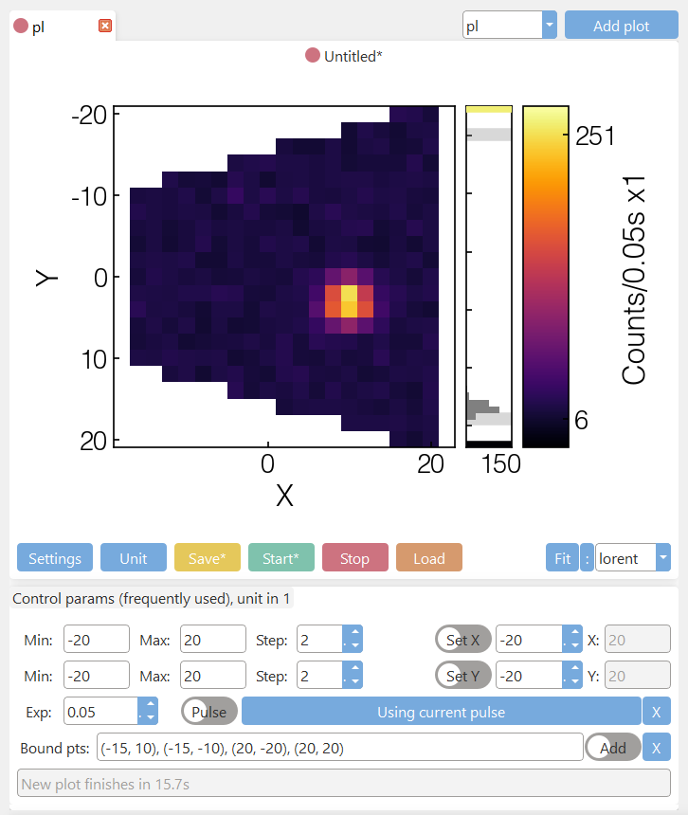
Run measurement
For 2D measurement, there is a bound_pts parameter, and the data_x is calculated as the points inside polygon based on x_array, y_array and bound_pts (more than two points). If you don’t want bound_pts, hit that X button to clear the coordinates.
You can edit coordinates directly or turn on Add and use right click on figure to add point.

Slide 9
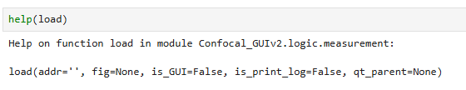

Load
And then you can load old results, and access to its data and device states etc.

Slide 10
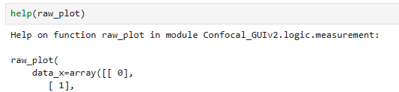
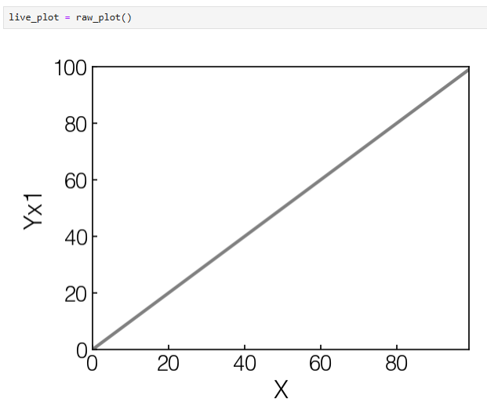


Raw_plot
You can create live_plot using any data_x, data_y
1, data_x is (n,1) np.array, data_y is (n,1) np.array
2, raw_plot uses the caller in cls_name_str to plot this figure, ‘ple’ in this case, you can use other e.g. ‘pl’.

Slide 11
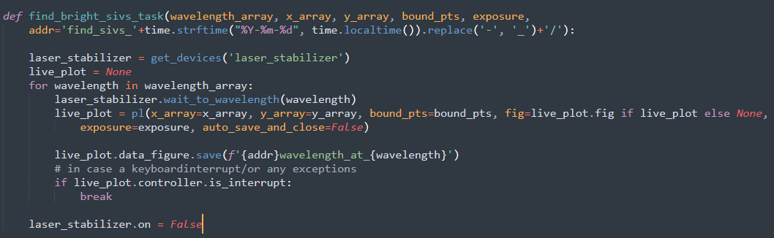
Tasks
All tasks should end with _task to be found in GUI

