Slide 1
Documentation for Device submodule
Shuhao Wu

Slide 2
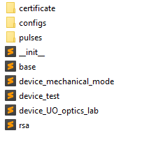

Location: Confocal-GUIv2/Confocal_GUIv2/device
Folder for saving rsa related files
Json files for configuring an experiment
Pulse files for generating your pulse sequence for experiment
Base classes and functions for all devices
Simulated devices for test only
Write your own devices for you own experiment
generate_ssl_certificate function

Slide 3

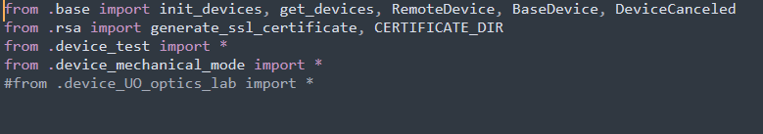
Init devices
Import all the devices you want into the jupyter environment, otherwise init_devices won’t find the devices you want.
Also make sure from .device_for_your_project import * in the __init__.py of device submodule, and comment other device files (except device_test) to avoid possible name conflict

Slide 4
Init devices
Pass the jupyter environment to device_manager
Address of the config file (support re expression), if no file use None
Open GUI to edit if you want to change or create new config, otherwise pass False

Slide 5
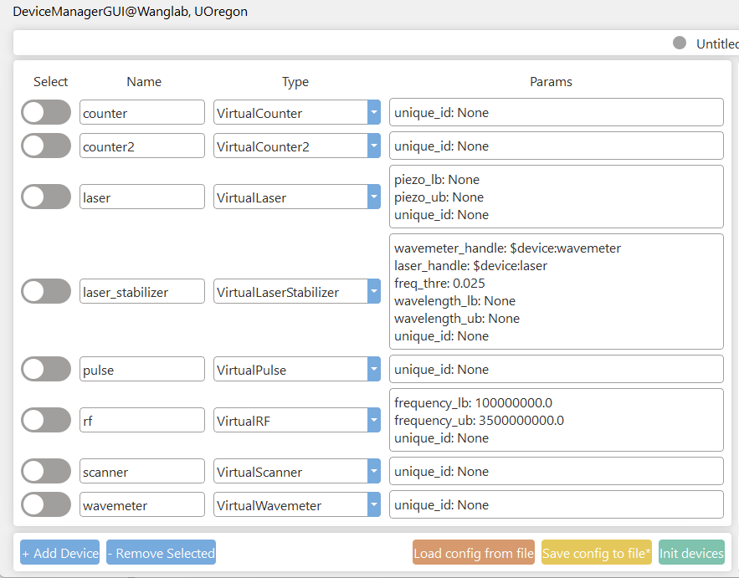
Init devices
Params for initializing the device
The class name of this device
The name you want to use for calling this device
Unique_id: None if you dont care about this parameter (initialization using same device class and same unique_id will be treated as same device, therefore reuse the old instance or close the old instance and reinit with new params)
Xxx_handle:reference to other device

Slide 6
Init devices
To make sure all devices are singleton which means only one instance for one physical device. We use the unique_id and other parameters to determine the initialization behaviour.
1, If initialize using same device_class and same unique_id, same other parameters, then the second initialization will return the reference to the first initialization
2, If initialize using same device_class and same unique_id, different other parameters, then the second initialization will first close the device and reinitialize the device with new parameters
3, If initialize using same device_class and different unique_id, then the second initialization will create a new instance without closing the first one

Slide 7
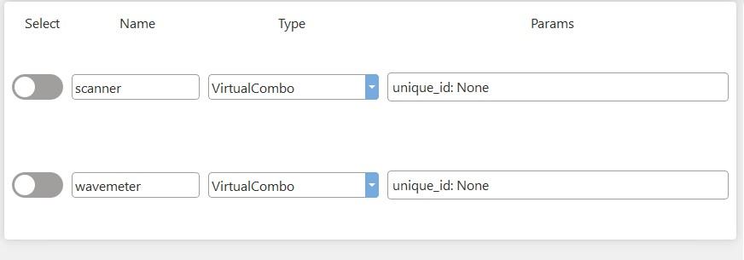
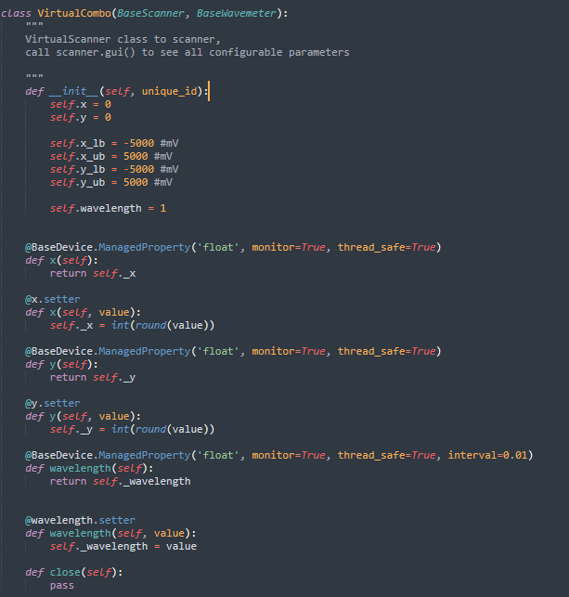
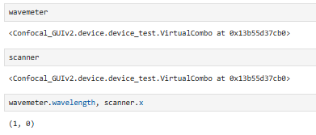
Init devices
There are cases you want to have a physical device serves as more than one functional device, then you can initialize them using the same parameters. And eventually wavemeter and scanner refer to the same instance.

Slide 8
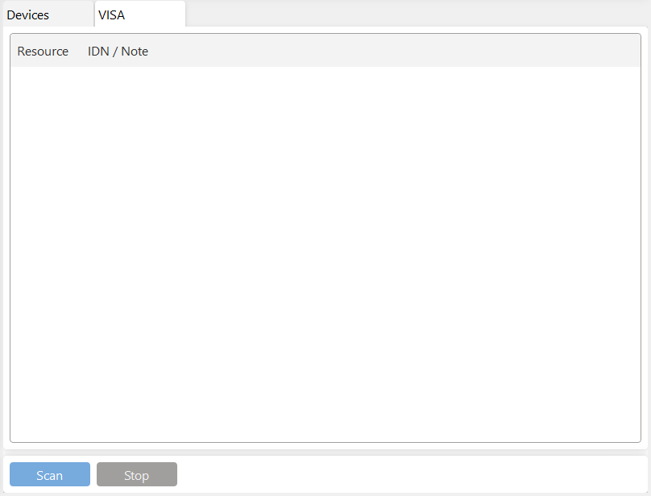
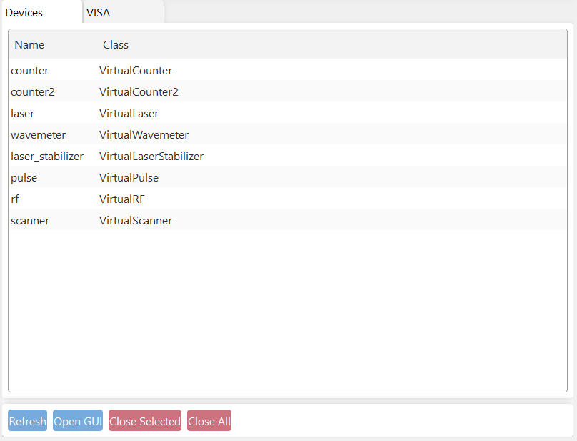
Init devices
Monitor all devices you have initialized,
or all pyvisa devices you have

Slide 9
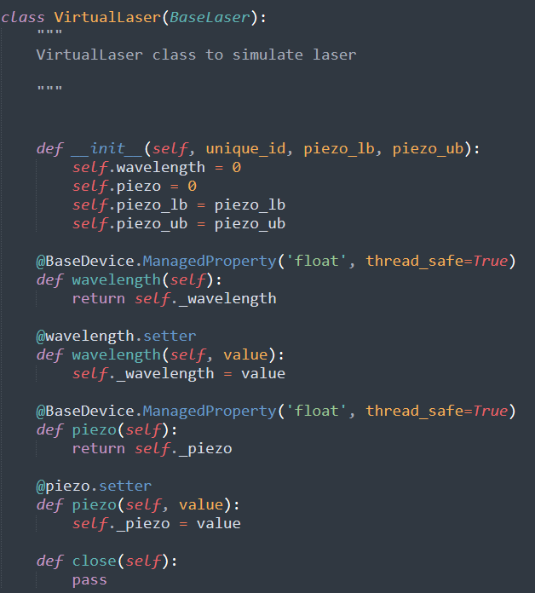
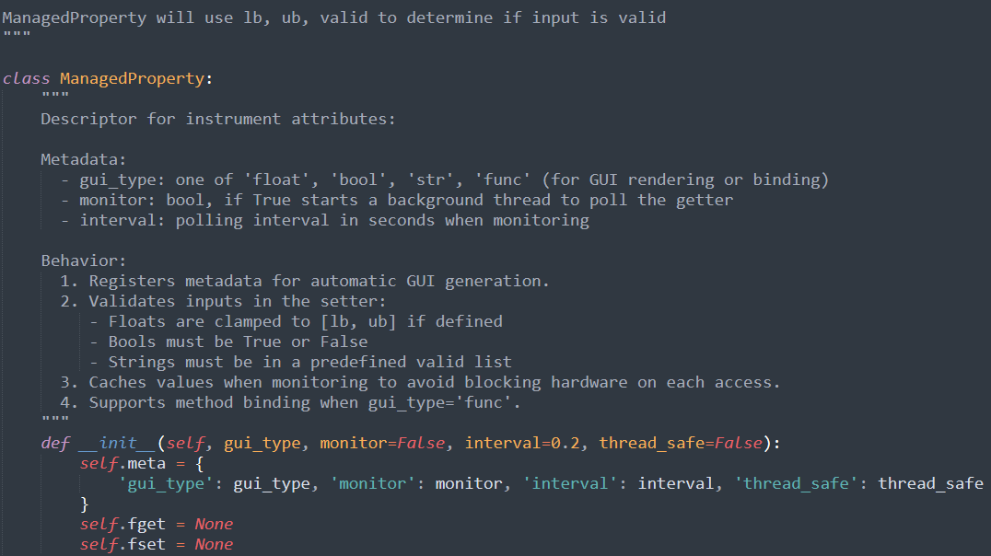
Init device
Read the comment on ManagedProperty

Slide 10
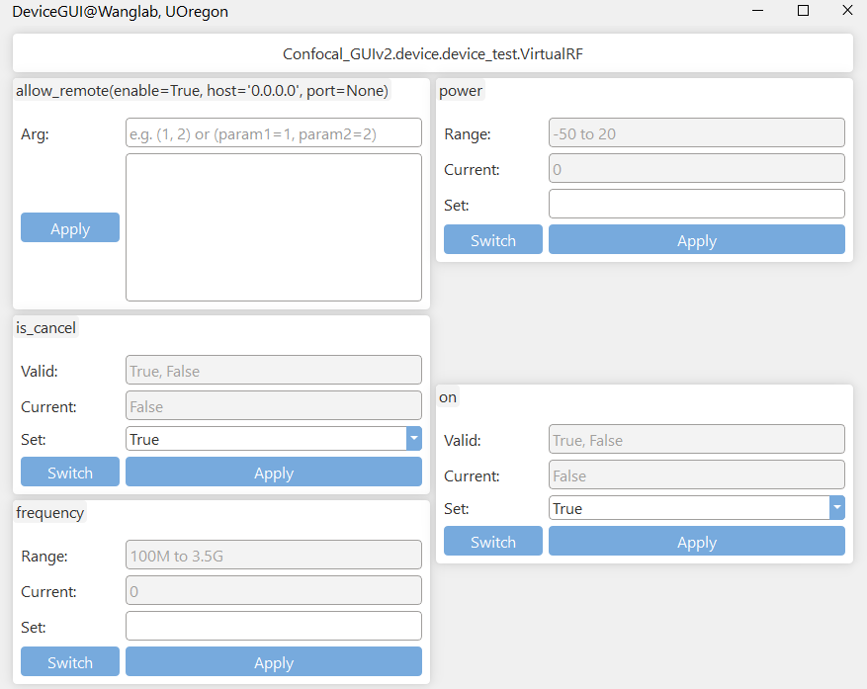
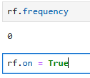
Device GUI
Once you have the device, call .gui()
Check remote devices section
If the device is interrupted by external , normally you don’t need to care about this
You can also access/change the property of device in non-GUI way
Set by frequency_lb, frequency_ub

Slide 11
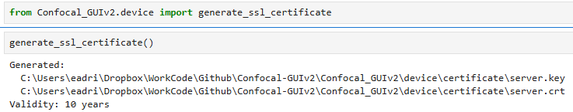
Remote device
Generate key and certificate before you can safely create remote device at server and use at client. Run this generate_ssl_certificate() at server, and make sure you have the same (copy using flash drive etc.) file at the client.

Slide 12
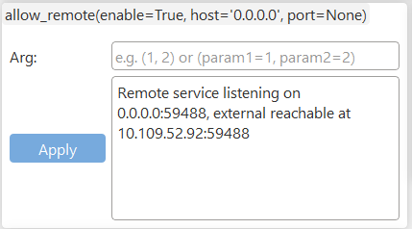
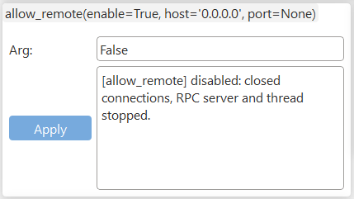
Remote device
Open and close allow access on the server device. The client can then access to server device using the ip and port shown above. The device on client side should be initialized using RemoteDevice class with ip and port.

Slide 13
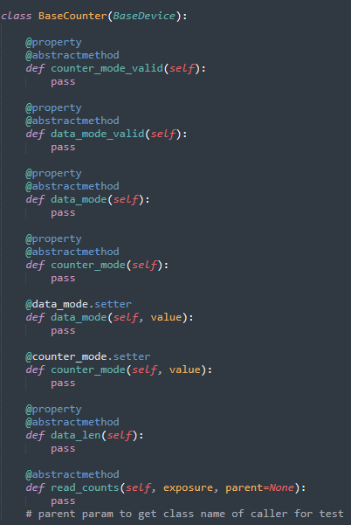
Counter
Any counter is child class of BaseCounter therefore must has these methods.
Data_len gives the length of returning array, default is 1

Slide 14
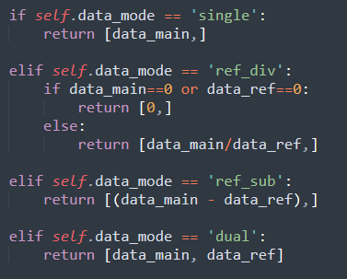
BaseCounterNI
And couter_mode is one of counter_mode_valid
BaseCounterNI wraps NIDAQ as counter
Default settings are,
Data_mode: one of the data_mode_valid

Slide 15
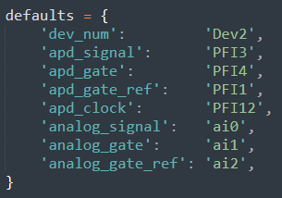
BaseCounterNI
Apd: count the edges at apd_signal port, with apd_gate, apd_gate_ref provide gatings for data_main and data_ref. Exposure is controlled by on board clock, but since exposure may not be integer times of actual pulse cycle so apd data_mode may still have counting error.
Analog: similar to apd
Apd_sample: similar to apd but gate using sample number which overcomes the counting error. Apd_clock defines how many samples are acquired which means only one apd_clock high signal during on complete pulse cycle.
Call function read_counts to get counts

Slide 16
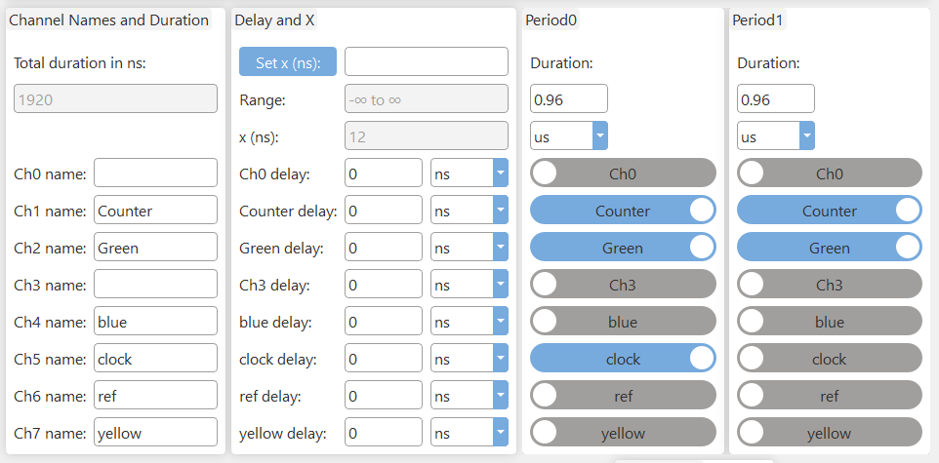
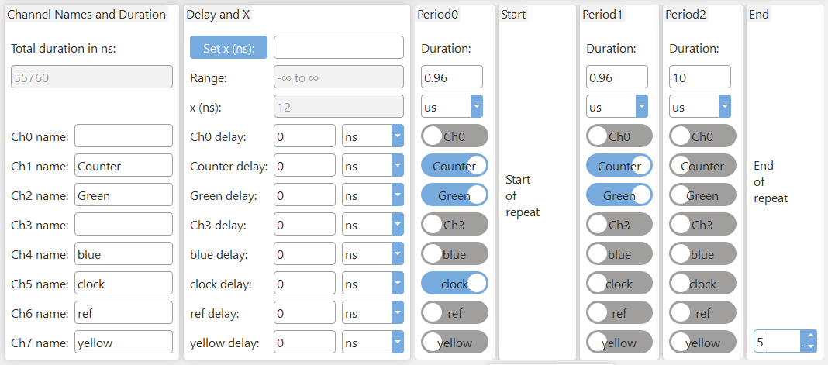
BaseCounterNI
For the use of apd_sample counter_mode, you need to send a clock signal to apd_signal port to allow counter counts sample number. Above are two examples of valid clock settings in pulse, make sure you have only one clock signal in one complete pulse.

Slide 17
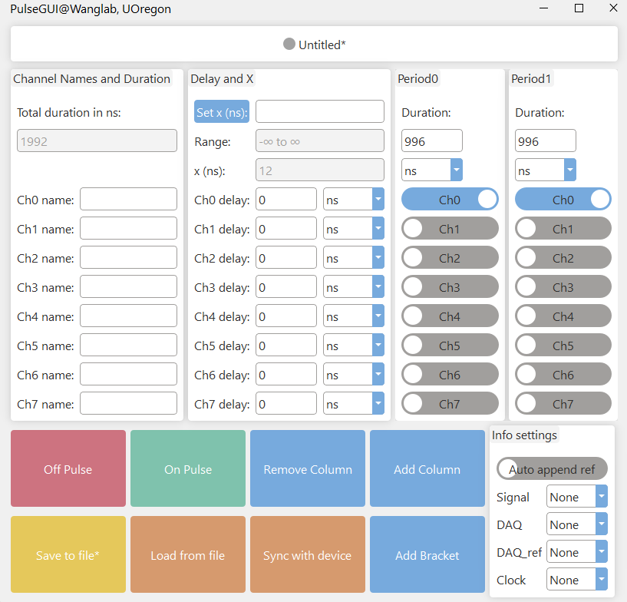
Pulse
Sync pulse in GUI with pulse running in hardware
All durations, delays, X, will be rounded to grid of min(min_width, resolution) that is determined by hardware. E.g. Spincore 12ns, PulseStreamer 1ns.
X can appear in delays, durations, is a variable you can change for certain experiments, e.g. Rabi oscillation
Auto append ref: will append pulse after current pulse for data_ref. Signal will be turned off, DAQ on period will be replaced by DAQ_ref on, and clock will not appear in ref pulse. Do not turn it on if you already have ref gating in pulse.
Change channel names to
the names you want
Set delays to channel to compensate hardware latency
Add a block which you can repeat pulse within bracket

Slide 18
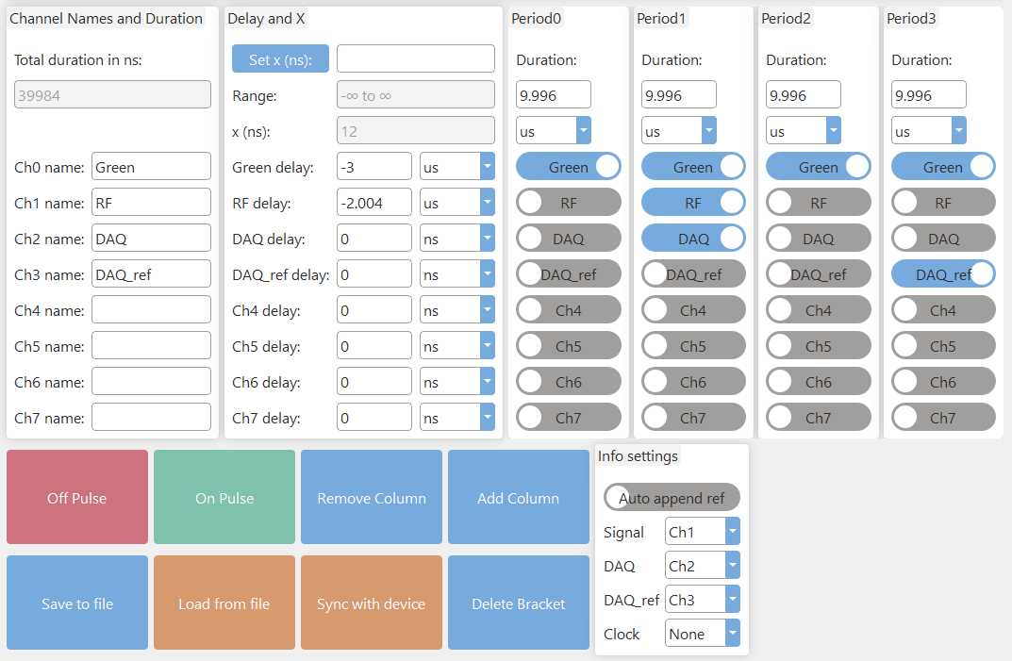
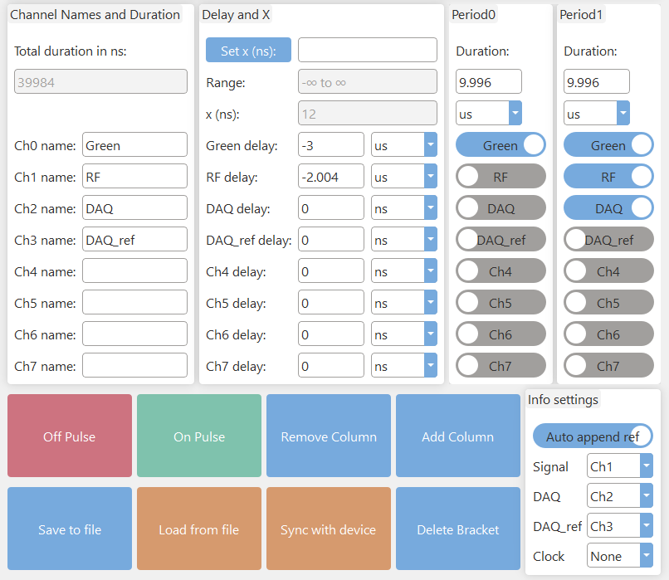
Pulse
Auto append ref will generate the ref pulse for you, therefore the two pulses above are equivalent.

Slide 19
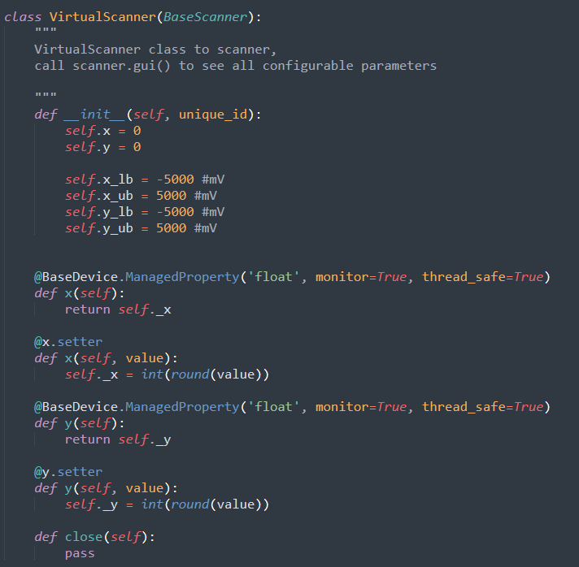
Write your own devices
1, Make sure inherite BaseXXX therefore inherite BaseDevice.
2, You must have a unique_id parameter, this is how BaseDevice uses to realize single instance of a physical device.
3, Define how you want the device clean up itself at exit, if no then leave pass in close method.
4, Make sure you decorate all properties that you want to access externally/GUI.
4.1, Can be one of ‘float’, ‘bool’, ‘str’, ‘func’, read ManagedProperty comment
4.2, monitor=True if you want to cache the result, otherwise will only read when you call the property
4.3, thread_safe=True if this involves communication with physical device to make sure only one thread is talking to device at one time.

