Slide 1

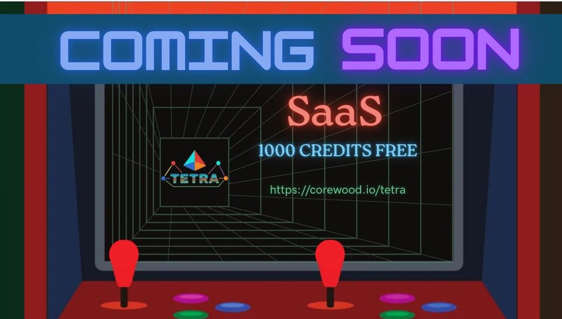
QI STUDIOS · A TETRA WORLD CONCEPT
THE GRAPH OF EVERYTHING THAT GOT US HERE
A demo concept for TETRA by Corewood
66 MB
USD 299
RAM VS 710MB NEO4J
FLAT MONTHLY, NO PER-GB
14/14
100%
LDBC IC QUERIES
OPENCYPHER TCK
TETRA BY COREWOOD tetra.corewood.io
WIN WITH TETRA.

Slide 2
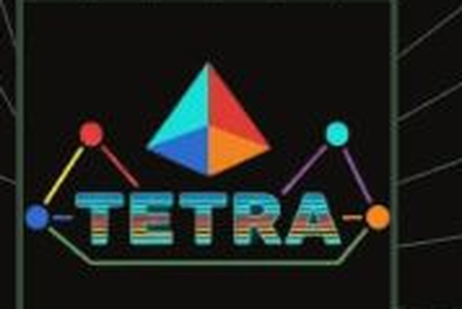
WHAT TETRA IS · IN PLAIN LANGUAGE
We took machine learning, reversed it, and built a database.
CREDITS · ARCADE PRICING
DEMO
PLAYER ONE
SIGNAL
COMMAND
Free
49/mo
299/mo
1,500/mo
1K CR
25K CR
1M CR
50M CR
10 seconds
For developers
For AI builders
Your data is already connected. TETRA stores it that way — as pure math, not a spreadsheet. Smaller. Faster. Cheaper.
Every JOIN you write pays a 50-year-old tax on a bad assumption. TETRA eliminates the assumption.
Vector databases find similar things. TETRA finds connected things. That is why GraphRAG is 3.4x more accurate.
Backup: cp Restore: cp Replicate: rsync
The math is old. The application is new.

