Slide 1
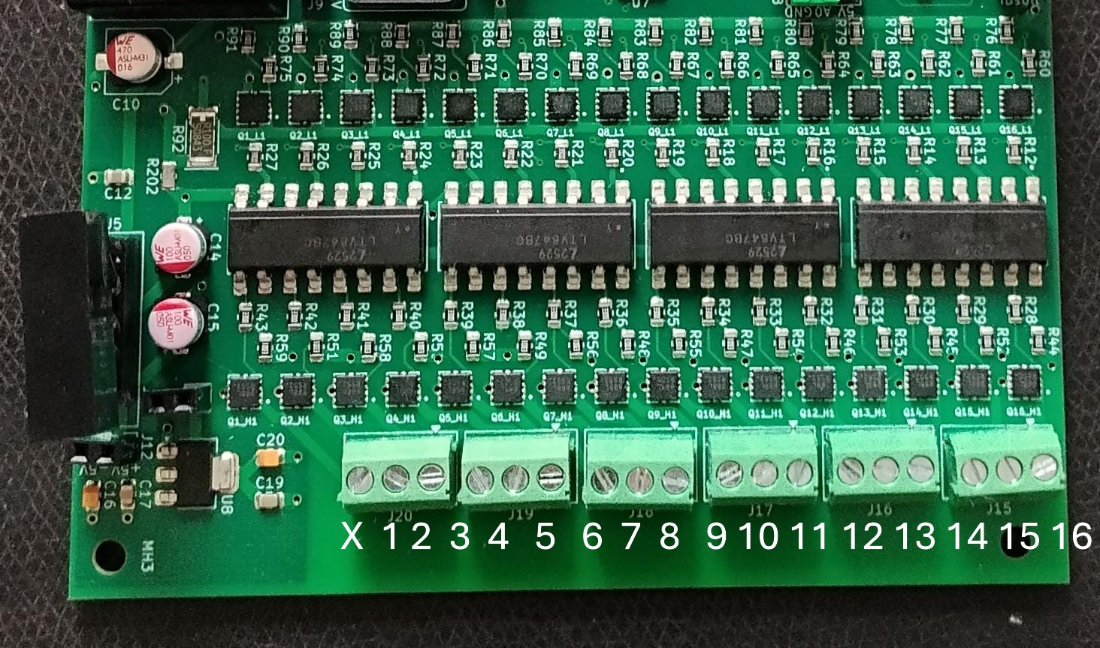
Lowside-MOSFET 1
Highside-MOSFET 1

