Slide 1
How to Plateau
Calibration of the QuarkNet Cosmic-Ray Detectors
A Guide for Students and Teachers.
Edited Summer 2008, instructions specific for 6000 series detectors.

Slide 2
If you are ready to plateau the counter, that assumes you have properly assembled and connected the counters to a computer. If you have not finished assembly and connection, open the assembly file.

Slide 3
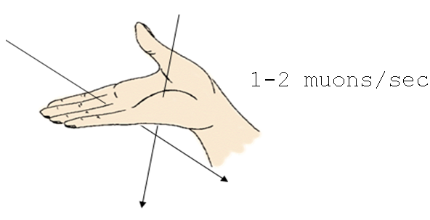
    We expect about 1 count per square cm per minute, assuming a horizontal surface, infinitely thin (!) scintillator, unshielded from the sky, at sea level, with new-ish scintillator and a good PMT. Your actual results may vary.
    Make sure your counters are in a stacked configuration (one on top of the other).

Slide 4
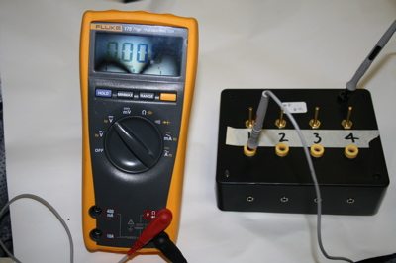
Step A
Set all tube voltages (V_{T}) to minimum (~ .3 V) by turning potentiometers on the 4-way power supply box all the way counterclockwise.
The picture shows a multimeter set up to check the DC voltage to counter 1
Note: this picture is slightly inaccurate, as the 4 way box is not connected to the DAQ or the counters !

Slide 5
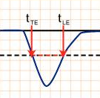
Step B
Set threshold voltage for all 4 counters on the DAQ
    In Hyperterm for PCs (Z-Term for Macs), type V1.
    It will report information such as coincidence level, active channels, pipeline delay (d), gatewidth (w), and threshold voltages for each of the four channels.
The graph to the side shows the leading edge (LE) and trailing edge (TE) of a pulse that dips below the default threshold voltage value.
Voltage (V)
0
Time (ns)
-0.300
Threshold value

Slide 6
    The default setting on most DAQ boards is .300 Volts. This is suitable for most experiments. To return to all default settings type “RE” in Hyperterm.
    To manually set the threshold voltage of any channel type:
    “TL (channel #) (voltage in millivolts)”
    The command TL 4 500 will set all four of the counters to 500 mV threshold voltage.

Slide 7
Step E
    Quick & Dirty: Test counters 0 & 1
      Use the potentiometer on the 4-way power supply to set Counter 0 (Reference counter) so that it yields about 40 Hz of singles counts.
      Use Hyperterm to set parameters on the DAQ for
      2-fold coincidence counts between 0 & 1.
      WT 01 00
      WT 02 04
      WC 00 1F
      WC 02 0A
      WC 03 00
      Adjust the other tube voltage on counter 1 (Test counter) so that it yields a coincidence rate of a few counts per minute (as measured on the DAQ display as a starting point).
      BTW, ALL this is really easy to do in Excel with this nice template.
Sets the time register and delay.
Sets 2-fold coincidence with all counters active.
Sets the gate width.
Type V1 to view the effects of any command. And type RE to reset DAQ to default values.

Slide 8
Step F
Record all parameters & settings:
    a. QNet DAQ serial #
    b. Experimenter, Experiment location, purpose, date, and any observations that might be relevant
    c. V_{T} (tube voltage) & V_{D} (discriminator voltage) for each channel
    d. In Hyperterm, enter V1 and record the output for the settings you used.
    e. Physical layout of counters.
    f. Use a standard file name that includes the date.
    BTW, ALL this is really easy to do in Excel with this nice template.

Slide 9
Step G
Plan the sequence of careful measurements for each channel
    Determine a test time interval that will give you a large enough count (N) that the uncertainty (√N) will be small enough but not so large that the measurements take too long. A good target is 100 counts - uncertainty is √N, or 10, which is 10 % of N.
    Vary one and only one of the tube voltages at a time. Change the voltage carefully and slowly. Wait until the count rate stabilizes after every change.

Slide 10
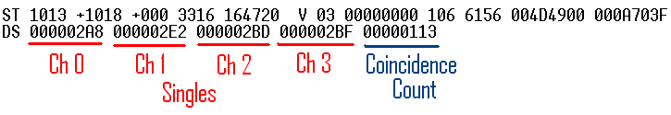
Step H
Take Measurements on Each Channel
    Use the Hyperterm commands:
      ST 3 1 (mode 3 displays the scalar count from each channel and resets the counters after each display. The 1 stands for the time interval you choose in minutes.) below is an example clipped from Hyperterm. (Note: the values are in hexidecimal)
      CD stops the scrolling of event lines.

Slide 11
Step H(b)
Take Measurements on Each Channel
Alternative to ST command
Get a stopwatch
Type SA <Enter> saves all coincidence settings
HT: type RB but do not press <Enter>
At the moment your finger starts the watch, press ENTER in HT
While watch is running, shortly before the end of the interval, type DS (if an unentered command sits more than 20 seconds, it gets wiped)
At exact end of time interval, press <Enter>.
Hyperterm returns a number. That’s your counts.

Slide 12
Step I Record data in a table
    These registers read in Hexadecimal.
    Record the readings for your 2 scalars of interest & the scalar for coincidence in hex and then convert to decimal. (For the first time through, look at scalars S0, S1, &S4)
    BTW, ALL This is really easy to do in Excel with this nice template.
    Calculate the uncertainty (√N) for each coincidence measurement.
    Convert each count and uncertainty to counts per minute.
    Create a data table:

Slide 13
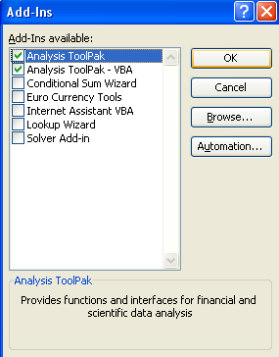
Have we suggested you do this in Excel with this nice template? Here are some tips
Note: If you have never used the HEX2DEC( ) command in Excel you will get a NAME## error in some boxes.
You need to activate the proper tools
Go to the Tools pull down menu and select Add-Ins.
Then check the two top boxes: Analysis ToolPak, and Analysis ToolPak – VBA.
Click <OK> and you the file should now convert hexidecimal to decimal properly.

Slide 14
Step J Locate the plateau region for the tube under test.
    Graph the Coincidence Rate vs.V_{T} with uncertainty as error bars
    Locate the plateau. Hopefully, you’ll see it around 10 Hz, or 600 counts per minute.
    Check that singles rate on the test tube do not exceed about 200 Hz. (or 12,000 per minute)
    Set the test tube voltage to a voltage near the middle of the plateau.
    Now reverse places between the reference and test tube. Repeat the process.

Slide 15
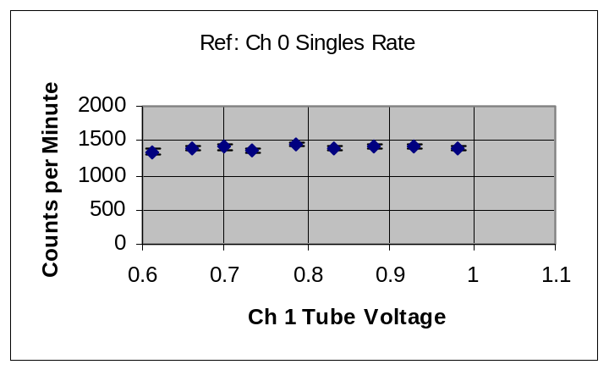
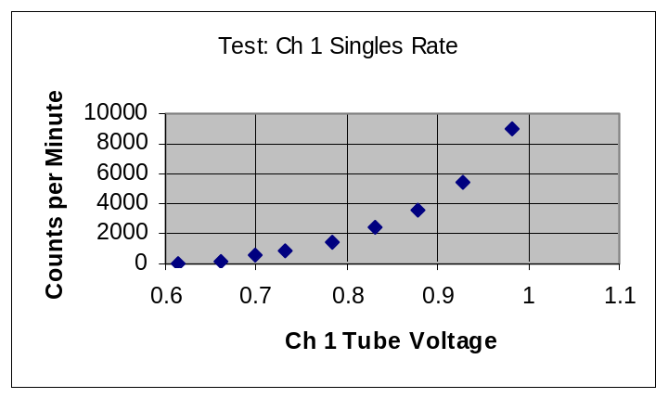
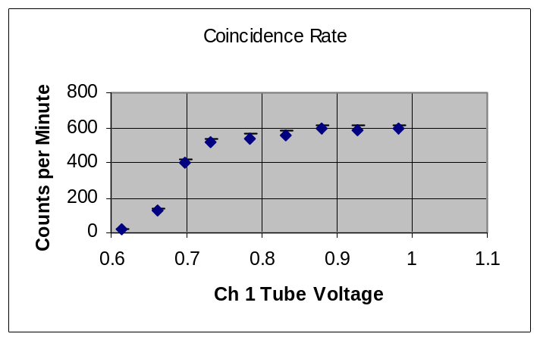
The Excel template file found at the quarknet cosmic ray wiki will help you produce these graphs.
The top graph shows the constant singles rate of the reference tube (Ch0).
The middle graph shows the gradual increase of singles on the test tube (Ch1).
<Notice, we stop collecting data when singles exceed ~200Hz.>
The bottom graph shows the plateau of coincidence counts between. (Ch0 and Ch1)

Slide 16
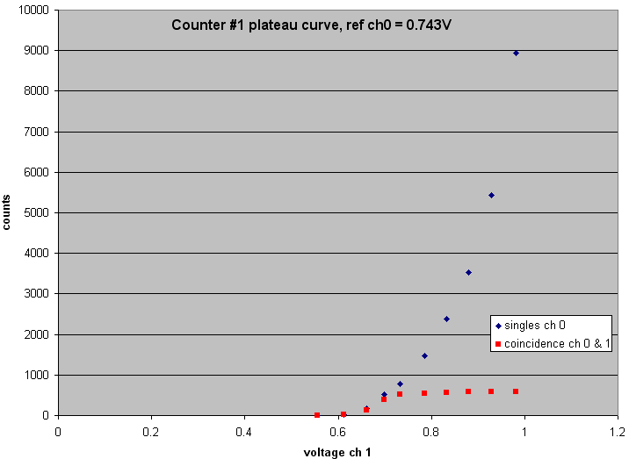
The singles and coincidence graphs can be merged into a single one.

Slide 17
Now that counter 1 is calibrated (plateaued), use it as the reference counter and let counter 0 be the test counter. Sweep voltages in the same way, working up to find a plateau.
Finally, set counter 0 as the reference counter to test counters 2 & 3.

Slide 18
Step K
Repeat entire process for the other pairs of counters.
Here are some Hyperterm commands for setting specific coincidences:
2-fold Ch 0 & 1: WC 00 13 because 3hex = 0011 in binary
2-fold Ch 0 & 2: WC 00 15 because 5hex = 0101 in binary
2-fold Ch 0 & 3: WC 00 19 because 9hex = 1001 in binary
Quiz: How would you program 4-fold coincidence on all channels?
Answer: WC 00 3F

Slide 19
Step M
Fully document the data and graphs.
Write down the conditions and all the settings that you chose.

Slide 20
Now your instrument is set . . . for the moment.
Be aware though, the detector might drift. This plateau process ought to be repeated at least once a year. It’s a good thing for every new group to do, kind of like an initiation.

Slide 21

Whoa ! That was severe. Now that the instrument is optimized, how about some real science ?
What’s the effect of air pressure / time of day / time of year / solar activity / counter arrangement / altitude / shielding / temperature / cloud cover / etc, etc on count rate ??????????
See the e-lab for help analyzing data and viewing other groups’ efforts.

