Slide 1

Let’s count cosmic rays.
To prepare mentally,
hum a few bars of “Cosmick Debris” by Frank Zappa.
Ready ?
Quarknet DAQ card series 6000 instructions revised 7/10/2007 2:25 pm

Slide 2
Plateau-ing the counters
Each one is at least a little bit different
We’re trying to find a happy place where…
When a muon makes light in the scintillator plastic, we’ll get a count.
When a muon doesn’t make light, we won’t get a “noise” count anyway.
We won’t make it perfect, but we’ll make it as optimum as possible.

Slide 3
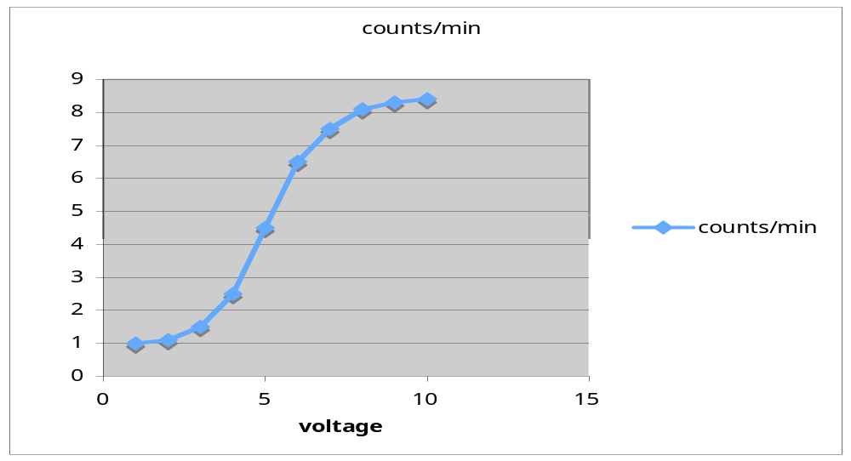
We’re making a graph sort of like this

Slide 4
To notice: a change in voltage here makes little to no difference in the counts. A change in x produces no change in y. This is not the area of the graph where we want our counter to work.
Let’s find the best voltage. That’s “plateau-ing”.

Slide 5
It’s called “Signal-to-Noise”
We are trying to find the optimum signal to noise ratio.
Imagine you can turn your hearing up & down.
If it’s set too low, you don’t hear nuthin’
If it’s set too high, you hear EVERYTHING.
Scientists need to be just like Goldilocks………just right.

Slide 6
Get set up…….Materials
4 counters (PMT’s attached to scintillators wrapped or shrouded to be light tight)
1 4-way power distribution box
4 BNC extension cables
1 DAQ board
1 USB cord
1 Cat 5 (ethernet cable)
1 5V DC power supply
1 power extension cord
1 GPS antenna
GPS/thermometer interface box
1 Designated Computer with USB port (turned on)
1 Multimeter
        Pictures of each of these to follow…………>>

Slide 7
The counter
We’ll refer to the black wrapped devices as counters. They’re interesting (that’s where the physics takes place), and there’s more than 1 thing in there, but we’ll refer to the whole thing as a COUNTER.
Engineers, and now you, will refer to these by number: 0,1,2,3 (not 1,2,3,4)

Slide 8
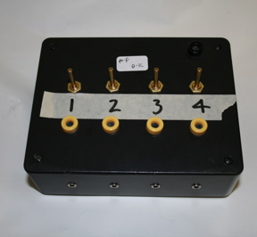
1
Note: MAKE SURE 4-way BOX HAS NO POWER (In other words, it’s completely disconnected)! This is because the internal fuse will blow if power is on when PMTs are plugged in. This may harm the PMTs.
You did check that, right ???
DO THE REST OF THESE DIRECTIONS IN ORDER, OR BAD THINGS MAY OCCUR. You wouldn’t want that.

Slide 9
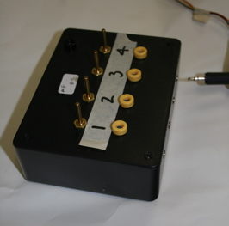
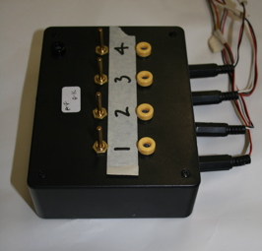
2
    • Attach 4 counter power cables (black) to the 4 way box
    • Turn all potentiometer dials on the box counterclockwise as far as possible.

Slide 10
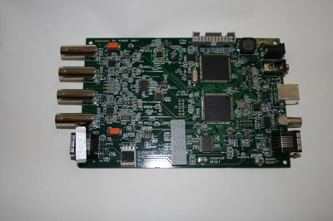
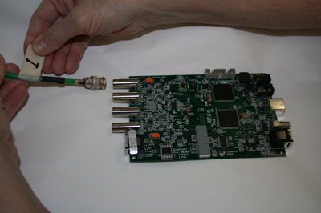
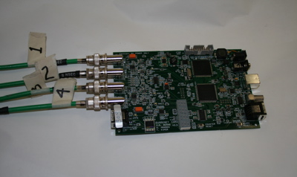
4
    • Attach the green signal cable from each counter to the 4 ports on reverse of the DAQ board.
    IN ORDER would be good, huh ?
    • It sure is helpful to label thecounterrs and/or corresponding ports on the power supply with their order on the DAQ board. Note: the picture shows these labeled 1,2,3,4 - thatreally should be 0,1,2,3

Slide 11
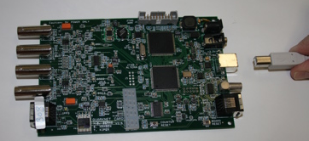
5
Use the USB cable to connect the DAQ card to the USB port on your computer.

Slide 12
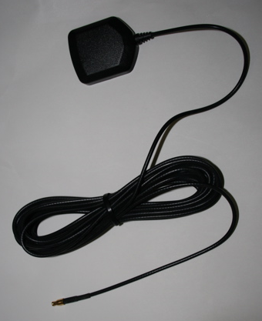
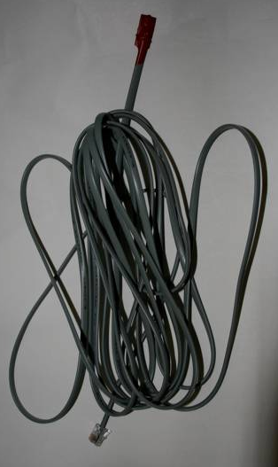
6
    • Position the GPS in an unobstructed location such as a roof.
    • Your GPS may pick up satellites through a wood roof or glass windows. But it works best with an unobstructed view of the sky. We’ll show you in a moment how to check that your GPS is seeing satellites.
    • Position the thermometer either near the counters, or outside, so it can measure outside air temperature. What’s the difference ? How would it matter ? You decide, just record what you do….

Slide 13
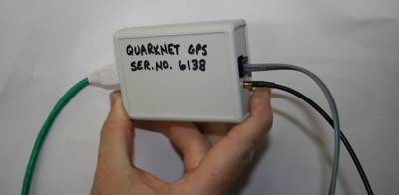
7
Connect the GPS cable and thermometer cable to the GPS/thermometer interface box

Slide 14
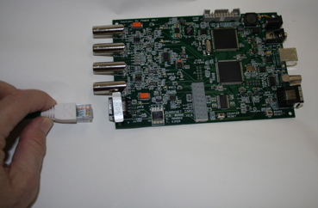
8
Connect the Cat5 cable between the DAQ and the GPS/thermometer interface box.

Slide 15
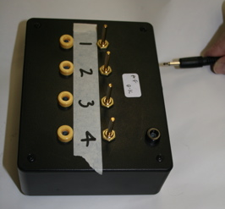
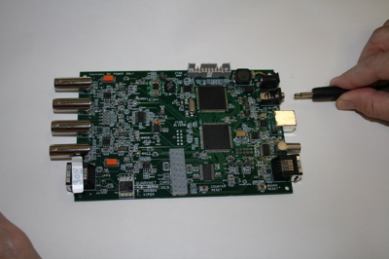
9
Using the power extension cord, fix the power supply box to the left power jack of the DAQ board.

Slide 16
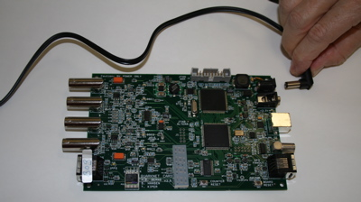
10
Join the right power jack on the DAQ board to a power outlet using the 5V power supply.
If you’ve done all that, you should be ready to start doing science.

Slide 17
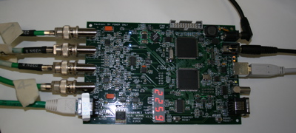
A DAQ board, all connected.

Slide 18
Talk to the DAQ Board
    1. On PCs: open the software called “Hyper Terminal,” which will be on all Windows operating systems. (except Vista. Find a shareware, Vista users HT Setup (Hyper Terminal)
      1) “Default Telnet Program”: click no
      2) “Location Information”: click cancel; click yes; click ok
      3) “Connection Description”: Create new connection: under name, call it “DAQ”, then click ok
      4) “Location Information”: click cancel; click yes; click ok
      5) “Connect to”: (connect using [COM1]); click ok
      6) COM1 properties: (bits per second: 19200, data bits: 8, parity: none, stop bits: 1, flow control: Xon / Xoff)
      7) Go to the menu “Transfer” along the top bar→ Capture Text, start
    Mac users: zterm. This is shareware. Just Google it and do the usual things to download and install it. Macs will also require a driver. This is downloadable from the url printed on the back of the DAQ board, or by clicking here. On our Mac, once Zterm was open, we had to configure these pieces: a. serial port to SLAB_USBtoUART b. connection > data rate to 115200

Slide 19
HT Commands
RB: Reset Board.
This command will clear the counter. This is important to use before beginning a timed experiment.

Slide 20
HT Commands, continued
DS: Outputs the amount of counts received by each jack.
These will be in the order S0, S1, S2, and S3.
Said numbers will be in hexadecimal.
To convert hexadecimal on the PC calculator: Go to the start menu→ programs→ accessories→ calculator. Go to View→ Scientific. Press F5. Type a number in Hex (any letters can be just typed as letters). Now press F6. Magically the number will now be in base ten, the stuff that you can read. The Mac calculator can do this, too.
Excel can do this, too. Open Excel and search help.

Slide 21
HT Commands, continued
WC 00 ##: Sets the coincidence of the experiment.
The first # should either be 0, 1, 2 or 3. “0” means the computer does not check for coincidence. “1”: the computer checks coincidence between two PMT’s. “2”: means the computer checks coincidence between 3. “3”: means the computer checks for coincidence in all 4.
The second # refers to the base16 (hexidecimal) equivalent of a binary “mask” of which ports should be checked for coincidence.

Slide 22
WC command example
Example: WC 00 1B
S3:yes S2:no S1:yes S0:yes
The setup above describes if we wanted to check for coincidence between S3, S1, and S0, but not S2.
This is because B (in base 16) is equal to 11 in base ten, which is equivalent to 1011 in base two (binary). Each number (1 or 0) in the binary corresponds to yes or no (1 is yes, 0 is no).
So: 1011: first # is 1 and that means yes, include counter 1, counter 2 = no, counter 3 = yes, counter 4 = yes
Decide which coincidences you want to check and put it in the 4-digit, binary format. Good Luck. Robots, who will surely rule the Earth someday, speak in binary amongst themselves. Learning binary will help you to survive.
Go to your calculator. Press F8. Type the number in binary that your setup requires. Press F5. Your command will be WC 00 1(The number you have just received). Note to the note: if you do not care about coincidence, enter WC 00 0(the number you have just received), which will be the sum instead of coincidence.

Slide 23
HT Example Run:
• RB
WC 00 13 *this will check for coincidence between S1 and S0*
DS *start a timer when you input this command*
DS *end the timer when you input this command*
Use the calculator to subtract the first number from the second number of a given port. Divide this by the time in minutes to get the count rate in CPM (counts per minute, to you).
There’s a command to do this automatically. You’ll get to that in a bit…

Slide 24
Finding Satellites
Put the GPS on a roof, and then run HT command GP to see how many satellites are picking up your signal.
You should have at least 3 satellites that show up; 2 satellites = bad, 1 = worse, 0 = definite no-no.
If you get no satellites, try putting the GPS somewhere else, preferably a wide open area unobstructed by trees, buildings, etc. GPS signals do not pass through metal or concrete very well.

Slide 25
It’s Time to Plateau…
    We expect about 1 count per square cm per minute, assuming a horizontal surface, infinitely thin (!) scintillator, unshielded from the sky, at sea level, with new-ish scintillator and a good PMT. Your actual results may vary.

Slide 26
This is a sort of cookbook: not much imagination required, at least to start
Follow the directions carefully, and you’ll get a 4-way detector that’s well tuned and delivers results you can trust a little bit.
If you’re at all a curious person, there’s a zillion parts of this procedure that beg the question, “What am I doing this part for?”
Those are RRRRReally good questions. Good for you to have the wits to ask them. Jot them down, so the next question doesn’t make you forget the last.
Think & Talk about your questions with someone: another student, a teacher, an expert, a guru…

Slide 27
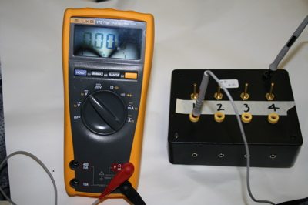
Step A
Set all tube voltages (V_{T}) to minimum (~ .3 V) by turning potentiometers on the 4-way power supply box all the way counterclockwise.
The picture shows a multimeter set up to check the DC voltage to counter 1
Note: this picture is slightly inaccurate, as the 4 way box is not connected to the DAQ or the counters !

Slide 28
B
Determine and set a starting discriminator voltage (V_{D}) for all 4 counters on the DAQ
    In HT, type V1
    It will report coincidence level, pipeline delay (d), gatewidth (w), threshold voltages for each of the four channels.
    To set threshold voltage all channels 0 to .3 volts: TL 4 300
    Edit this command line slightly to set tv’s on the other 3 channels

Slide 29
C
    Set parameters on the DAQ for singles counts on counter 1 & 2, using HT commands:
      RE, CE, WT 01 00, WT 02 02, WC 00 0F

Slide 30
D
    Vary the tube voltage (V_{t}) to determine the range of voltage to produce singles counts from 0 counts up to about 200 Hz. V_{T} is measured at the 4-way power supply (using the multimeter, see step A). Use the DAQ red on-board display & the reset button next to it to measure this rate.
    Find the tube voltage that produces a count rate of about 40 Hz. That’s a good setting.
    This can be done fairly quickly. There’s no need to write every voltage and count rate. We’re just getting a feel for the voltage range.
    You need only do this for one tube. We’ll measure more accurately how they’re different later…
    Keep all potentiometers, except the one being tested, adjusted far counterclockwise.
    Record this voltage range and your 40 Hz setting in a notebook or Excel.

Slide 31
E
    Quick & Dirty: Test counters 0 & 1
      Use the potentiometer on the 4-way power supply to set Counter 0 (Reference counter) so that it yields about 40 Hz of singles counts.
      Use HT to set parameters on the DAQ for 2-fold coincidence counts between 0 & 1.
      RE, CE, WT 01 00, WT 02 04, WC 00 1F, WC 02 0A, WC 03 00
      This command counts all counters, so turn tube voltage to minimum for any counters not under test.
      Adjust the other tube voltage on counter 1 (Test counter) so that it yields a coincidence rate of about 1-2 Hz (as measured on the DAQ display as a starting point).
      Of course, record this, huh ?
      BTW, ALL this is really easy to do in Excel with this nice template.

Slide 32
Now that counter 1 is set, use it as the reference counter and 0 as the test counter. Sweep voltages in the same way, working up to find a plateau. Hopefully, you’ll see a plateau around 10 Hz.
Use counter 0 as the reference counter to test 2 & 3.

Slide 33
F
Record all parameters & settings:
    a. QNET DAQ serial #
    b. Experimenter, Experiment location, purpose, date, and any observations that might be relevant
    c. V_{T} (tube voltage) & V_{D} (discriminator voltage) for each channel
    d. In HT, enter V1 and record the output for the settings you used.
    e. Physical layout of counters.
    f. Use a standard file name that includes the date.
    BTW, ALL this is really easy to do in Excel with this nice template.

Slide 34
G Plan the sequence of careful measurements for each channel
    Determine a test time interval that will give you a large enough count (N) that the uncertainty (√N) will be small enough but not so large that the measurements take too long. A good target is 100 counts - uncertainty is √N, or 10, which is 10 % of N.
    Vary one and only one of the tube voltagse at a time. Change the voltage carefully and slowly. Wait until the count rate stabilizes after every change.

Slide 35
H
Take Measurements on Each Channel
    Use the command sequence:
      ST 2 6 (where 2 stands for mode 2, which displays counts from the DAQ in HT, and 6 stands for the time interval you chose. The 6 may vary according to your choice).
      CD stops the scrolling of event lines. This might be helpful if your personal bandwidth is exceeded by the flow of data.
      Note: as of 7/10/2007, the ST command is unreliable. Until fixed, use the directions on the following page->

Slide 36
H
Take Measurements on Each Channel alternative to ST command
Get a stopwatch
HT: SA enter saves all coincidence settings
HT: type RB
At the moment your finger starts the watch, press ENTER in HT
While watch is running, shortly before the end of the interval, type DS (if an unentered command sits more than 20 seconds, it gets wiped)
At exact end of time interval, press ENTER in HT.
HT returns a number. That’s your counts.

Slide 37
I Record this data in a table
    These registers read in Hexadecimal.
    Record the readings for your 2 scalars of interest & the scalar for coincidence in hex and then convert to decimal. (For the 1st time through, this will be scalars S0, S1, &S4)
    BTW, ALL This is really easy to do in Excel with this nice template.
    Calculate the uncertainty (√N) for each coincidence measurement.
    Convert each count and uncertainty to a rate per minute.
    Create a data table:
      1. Time of day at start of each measurement,
      2. test interval for counts,
      3. Hex counts: Singles 0, Singles 1, Coincidence,
      4. Dec counts: Singles 0, Singles 1, Coincidence, uncertainty
      5. Dec Rates: Singles 0, Singles 1, Coincidence, uncertainty

Slide 38
J Locate the plateau region for the tube under test.
    a. Graph the Coincidence Rate vs.V_{T} with uncertainty as error bars
    b. Locate the plateau. You know what a plateau is, right? If you don’t see a plateau, nobody else does, either. Test additional voltages if necessary to find that plateau, buddy. It’s there…
    c. Check that singles rates do not exceed about 200 Hz.
    d. Set the tube voltage to a voltage near the middle of the plateau and repeat process for the other tube, exchanging places as Reference and Test.

Slide 39
K
Repeat entire process for the other pair.
Here is a set of results that we got in the summer of 2007 with your same equipment. Notice plateaus, and notice there are some anomalies. Was it a lightning storm ? Did someone turn on fluorescent light ? Was our equipment misbehaving ?
Then, your instrument is set.
For the moment.
Be aware - it might maybe probably drift, so this plateau business ought to be repeated at least once a year. It’s a good thing for every new group to do. Kind of like an initiation.

Slide 40
M
Fully document the data and graphs.
This means typed with all relevant information and descriptions and posted on our website.

Slide 41

Whoa ! That was severe. Now that the instrument is optimized, how about some real science ?
What’s the effect of air pressure / time of day / time of year / solar activity / counter arrangement / altitude / shielding / temperature / cloud cover / etc, etc on count rate ??????????

