Slide 1
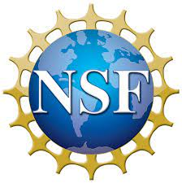



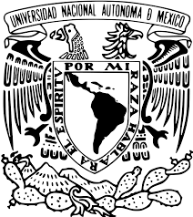


The NAUM (Non-invasive Archaeometry Using Muons) Project
Edmundo Garcia-Solis, Austin Harton (Chicago State University)
Joseph Sagerer (Dominican University)
Mark Adams (UIC/Fermilab-QuarkNet)
Sten Hansen (Fermilab)
Eduardo Pérez de Heredia (Tecnologia Zero)
Jose Osorio, Marco Antonio Santos Ramirez (Instituto Nacional de Arqueologia e Historia - INAH)
Arturo Menchaca Rocha, A. Cervantes, Hesiquio Vargas (Universidad Nacional Autnoma de Mexico)
Ben Cohen, E. Craig Dukes, Eric Fernandez, Luke Watson (University of Virginia)
This project is supported by the National Science Foundation under awards PHY-2011339 and PHY-2011442

