Slide 1
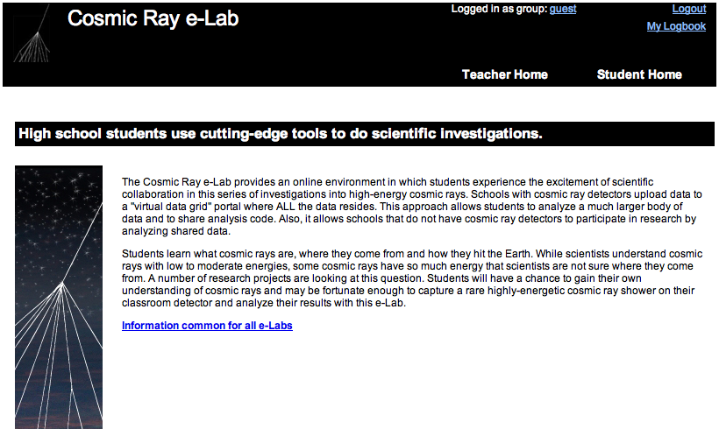
Teaching and Learning
with the Cosmic Ray e-Lab
http://www.i2u2.org/elab/cosmic

Slide 2
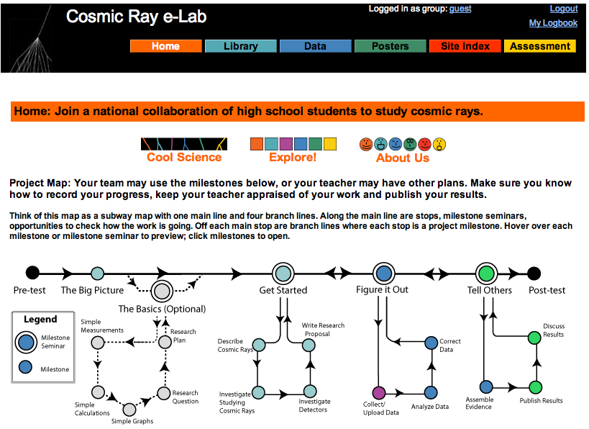

Teaching and Learning
with the Cosmic Ray e-Lab

Slide 3

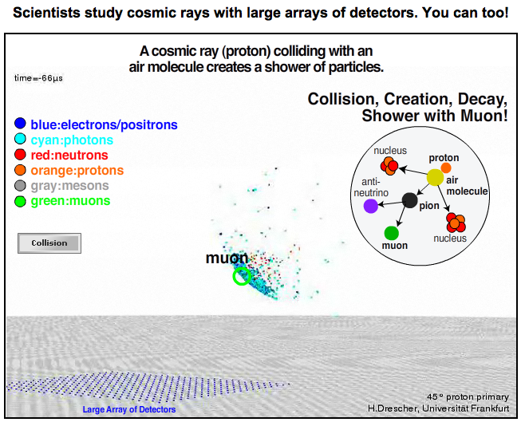
Teaching and Learning
with the Cosmic Ray e-Lab
Quick Links

Slide 4
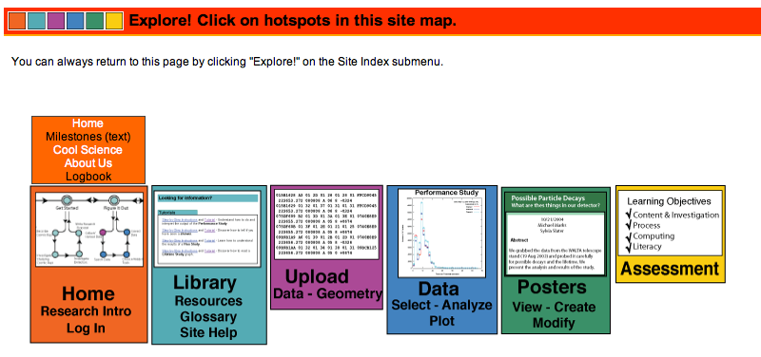
Teaching and Learning
with the Cosmic Ray e-Lab
Quick Links

Slide 5
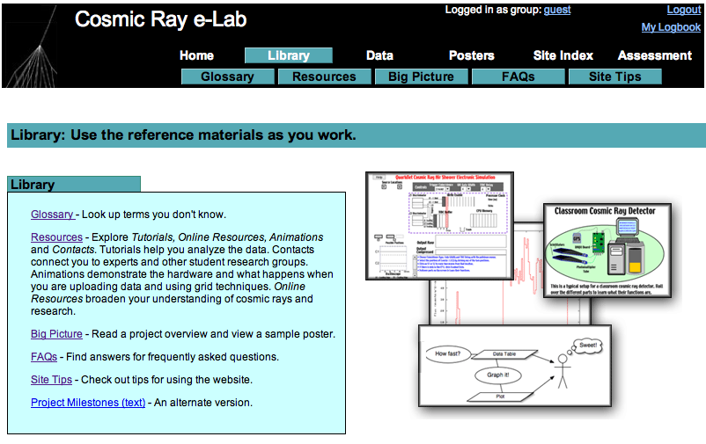

Teaching and Learning
with the Cosmic Ray e-Lab

Slide 6
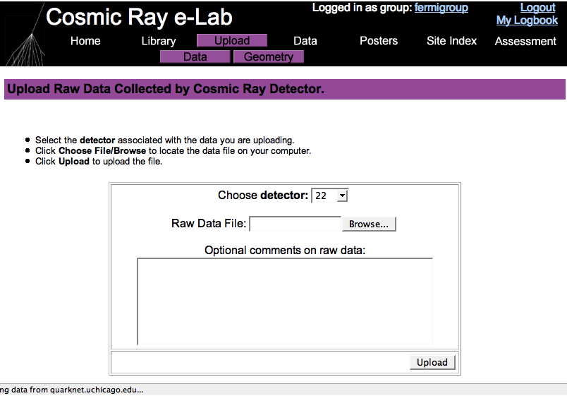

Teaching and Learning
with the Cosmic Ray e-Lab

Slide 7
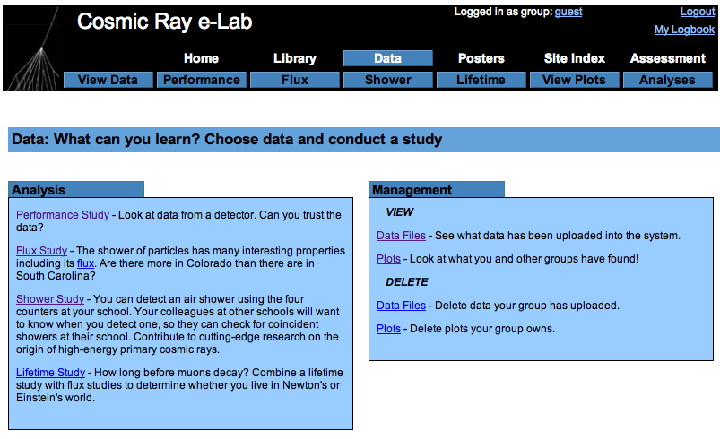

Teaching and Learning
with the Cosmic Ray e-Lab

Slide 8
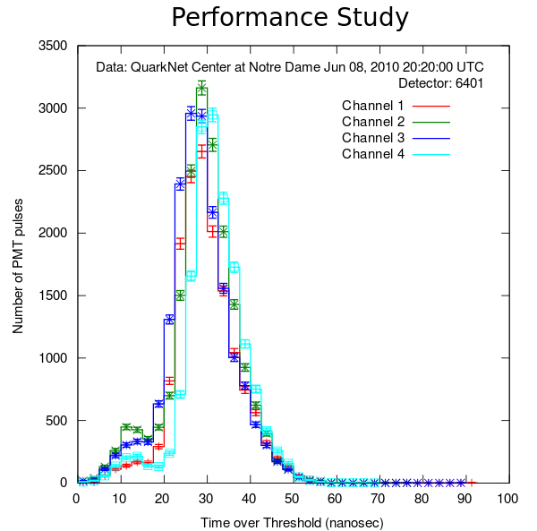
Teaching and Learning
with the Cosmic Ray e-Lab

Slide 9
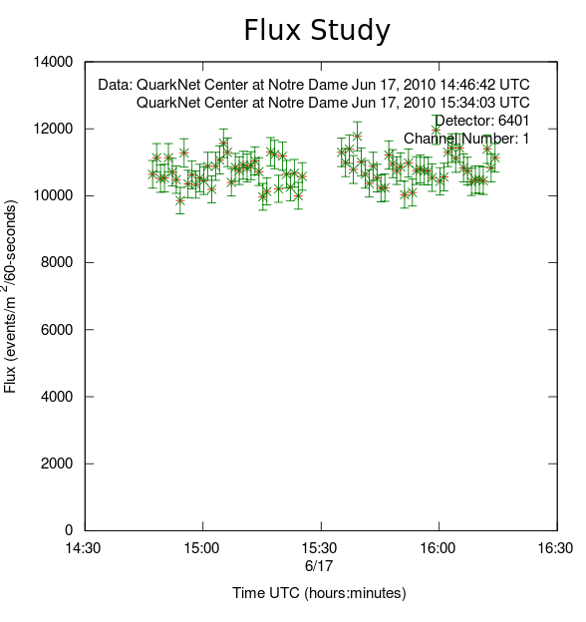
Teaching and Learning
with the Cosmic Ray e-Lab

Slide 10
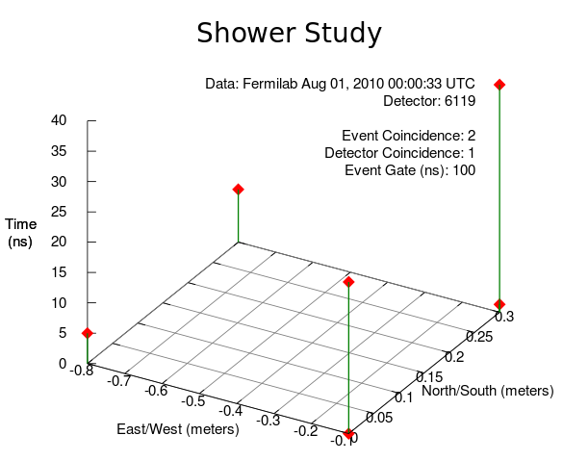
Teaching and Learning
with the Cosmic Ray e-Lab

Slide 11
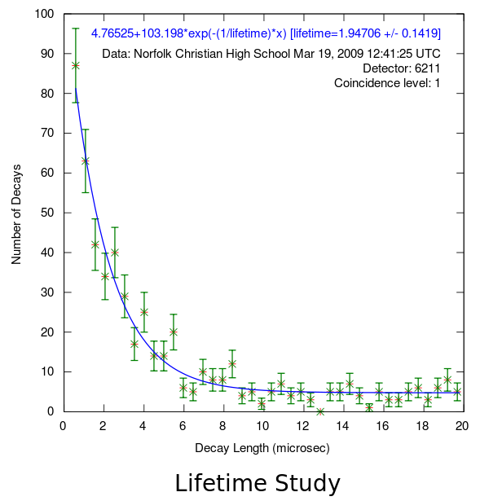
Teaching and Learning
with the Cosmic Ray e-Lab

Slide 12
Teaching and Learning
with the Cosmic Ray e-Lab
For example, flux study:
Flux is number of muons per m^2 per minute
What can affect the rate of muons to the detector?
  clouds?
  air pressure?
  solar activity (sun)?
  what else?
What other questions can we ask?

Slide 13
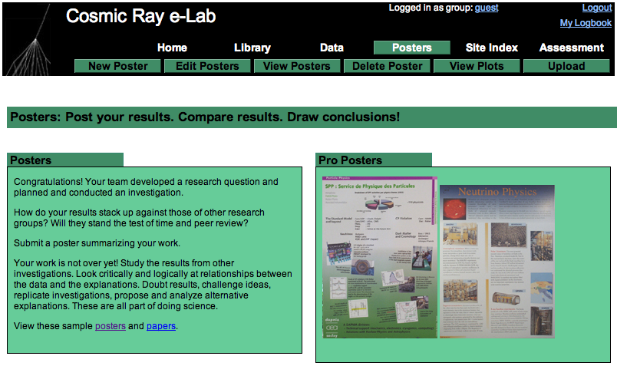

Teaching and Learning
with the Cosmic Ray e-Lab
Notes:
Show “View POSTERS” and select: all.
Good place for study ideas.

Slide 14
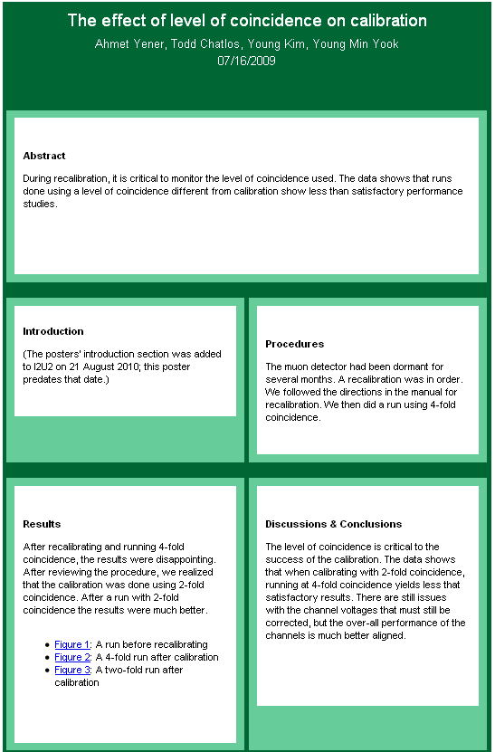
Teaching and Learning
with the Cosmic Ray e-Lab
Notes:
Show “View POSTERS” and select: all.
Good place for study ideas.

Slide 15
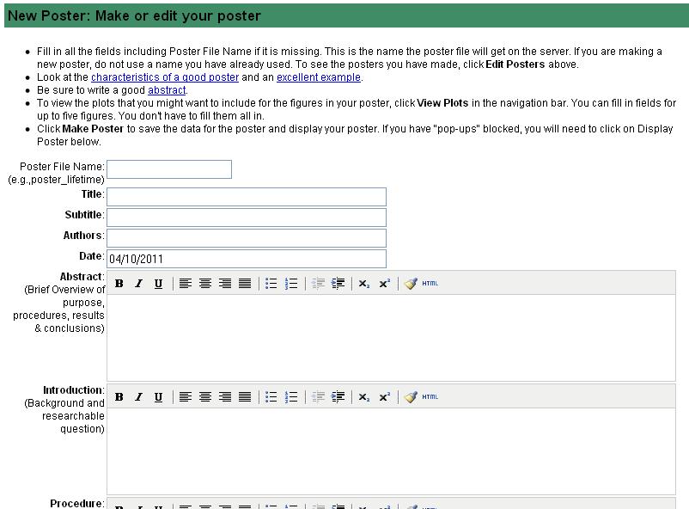
Teaching and Learning
with the Cosmic Ray e-Lab
Notes:
Show “View POSTERS” and select: all.
Good place for study ideas.

Slide 16
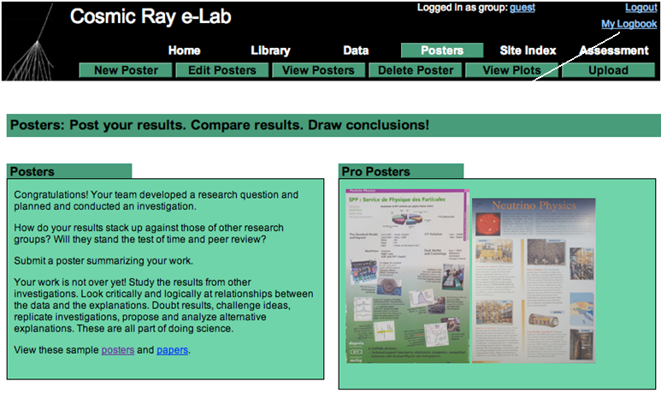
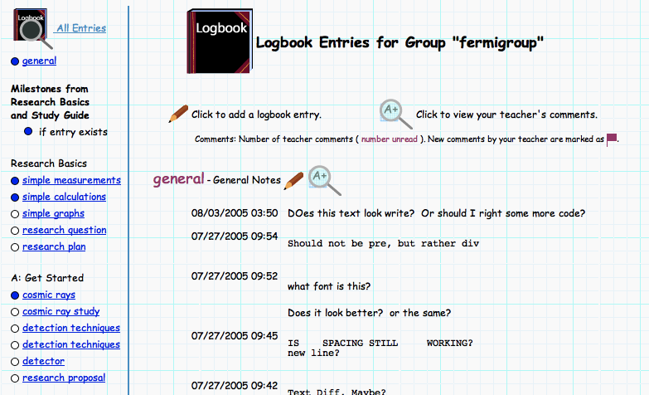
Teaching and Learning
with the Cosmic Ray e-Lab
Notes:
Show “View POSTERS” and select: all.
Good place for study ideas.

