Slide 1

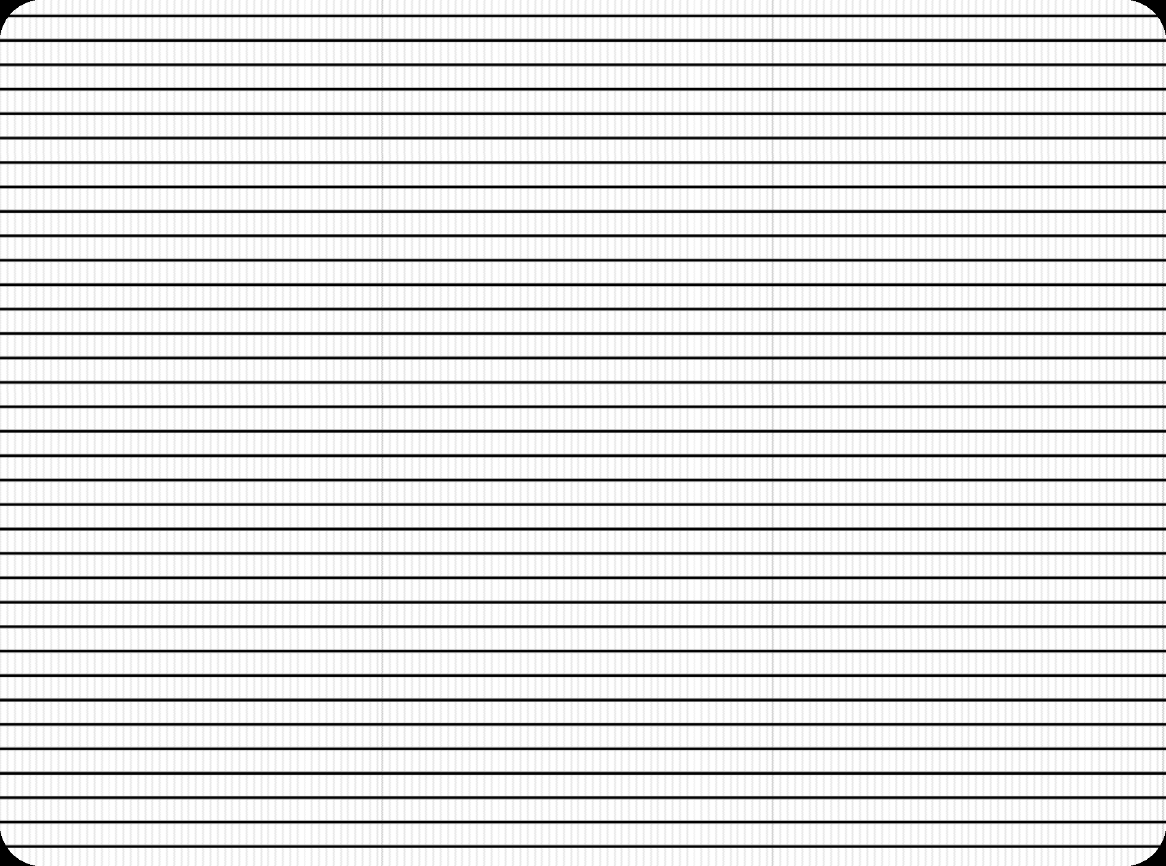

SRM INSTITUTE OF SCIENCE AND TECHNOLOGY, CHENNAI.
18CSS101J – Programming for Problem Solving Unit IV

Slide 2
SRM INSTITUTE OF SCIENCE AND TECHNOLOGY, CHENNAI
UNIT IV INTRODUCTION
Passing Array Element to Function-Formal and Actual Parameters- Advantages of using Functions-Processor Directives and #define Directives-Nested Preprocessor Macro-Advantages of using Functions- Functions-Pointers and address operator-Size of Pointer Variable and Pointer-Operator-Pointer Declaration and dereferencing-pointers-Void Pointers and size of Void Pointers-Arithmetic Operations-Incrementing Pointers-Pointers-Constant Pointers-Pointers to array elements and strings-Function Pointers-Array of Function Pointers-Accessing Array of Function Pointers-Null Pointers-Pointers

Slide 3
INTRODUCTION
SRM INSTITUTE OF SCIENCE AND TECHNOLOGY, CHENNAI
Arrays can be passed as a parameter to a function.
When it is being passed, the name of the array is enough as an argument instead passing it as an entire array.
Since the name of the array itself holds the address, no need to include & in the function call.
Since it passes address , in case of any modification occurs in called function automatically reflects back in the calling function.

Slide 4
Introduction
Multidimensional arrays are also allowed to be passed as arguments to functions.
The first dimension is omitted when a multidimensional array is used as a formal parameter in a function.

Slide 5
Formal and Actual Parameters One-Dimensional Array
Actual Parameters:
int a[10];
Function call:
add(a);
here,
a is the base address of the array add is the function

Slide 6
Formal and Actual Parameters One-Dimensional Array
Formal Parameters: within the function body void add(int a[])
{
....
}
int a[] - is a formal parameter, since it is a on dimensional
array size doesn’t matter.

Slide 7
Formal and Actual Parameters Two-Dimensional Array
Actual Parameters:
int a[10][10];
Function call:
add(a);
here,
a is the base address of the array ‘a’ b is the base address of the array ‘b’ add is the function

Slide 8
Formal and Actual Parameters One-Dimensional Array
Formal Parameters: within the function body void add(int a[][10])
{
....
}
int a[][10] - is a formal parameter, the first dimension is omitted only column value is taken into the account.

Slide 9
Passing Single element
Example
int a[5]={0,1,2,3,4};
Function call:
add(a[1]); Here,
add is the function name,
a[1] is the second element of the array, value 1 is passed to the array.

Slide 10
Adding Constant five to the given array using functions(One-Dimensional)
Main Function
int main()
{
int a[50],i,n;
scanf(“%d”,&n);
for(i=1;i<=n;i++)
scanf(“%d”,&a[i]);
add(a,n);
for(i=1;i<=n;i++)
printf(“%d\n”,a[i]);
return 0;
}

Slide 11
Adding Constant five to the given array using functions(One-Dimensional)
Add Function:
void add(int a[],int n)
{
int r; for(r=1;r<=n;r++)
{
a[r]=a[r]+5;
}
}

Slide 12
Output
Input:
5
2 4 6 8 10
Output:
7
9
11
13
15

Slide 13
Main Function
int main()
{
int num[2][2], i, j; printf("Enter 4 numbers:\n"); for (i = 0; i < 2; ++i)
{
for (j = 0; j < 2; ++j)
{
scanf("%d", &num[i][j]);
}
}
// passing multi-dimensional array to displayNumbers function
displayNumbers(num);
return 0;
}

Slide 14
Display Numbers Function
void displayNumbers(int num[2][2])
{
// Instead of the above line,
// void displayNumbers(int num[][2]) is also valid int i, j;
printf("Displaying:\n");
for (i = 0; i < 2; ++i)
{
for (j = 0; j < 2; ++j)
{
printf("%d\n", num[i][j]);
}
}
}

Slide 15
The advantages of using functions are:
Divide and conquer
Manageable program development
Software reusability
Use existing functions as building blocks for new programs
Abstraction - hide internal details (library functions)
Avoid code repetition

Slide 16
Preprocessor Directives MACROS
The C preprocessor is a macro processor that is used automatically by the C compiler to transform your program before actual compilation.
A macro is a segment of code which is replaced by the value of
macro.
Macro is defined by #define directive.
Preprocessing directives are lines in your program that start with #.
The # is followed by an identifier that is the directive name.
For example, #define is the directive that defines a macro.
Whitespace is also allowed before and after the #.

Slide 17

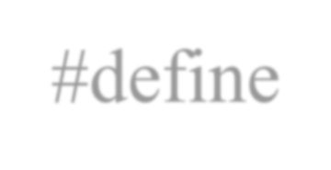

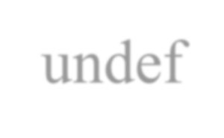
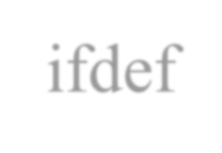
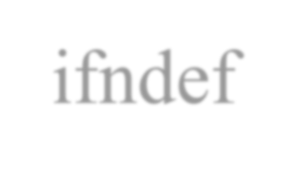
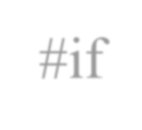
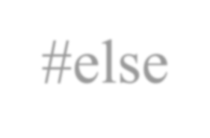
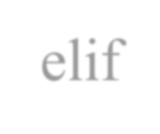
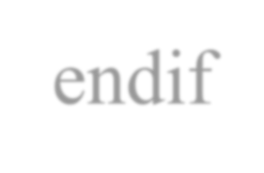
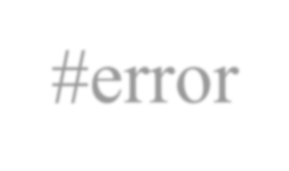

List of preprocessor directives
#include #define #undef #ifdef #ifndef #if
#else #elif #endif #error #pragma

Slide 18
#include
The #include preprocessor directive is used to paste code of given file into current file.
It is used include system-defined and user-defined header files.
If included file is not found, compiler renders error. It has three variants:
#include <file>
This variant is used for system header files.
It searches for a file named file in a list of directories specified by us, then in a standard list of system directories.

Slide 19
#include "file"
This variant is used for header files of your own program.
It searches for a file named file first in the current directory, then in the same directories used for system header files.
The current directory is the directory of the current input file. #include anything else
This variant is called a computed #include.
Any #include directive whose argument does not fit the above two forms is a computed include.

Slide 20
Macro's (#define)
#define token value There are two types of macros:
Object-like Macros
Function-like Macros
Object-like Macros
The object-like macro is an identifier that is replaced by value.
It is widely used to represent numeric constants.
For example: #include <stdio.h> #define PI 3.1415 main()
{
printf("%f",PI);
}
Output: 3.14000

Slide 21
Function-like Macros
The function-like macro looks like function call.
For example:#define MIN(a,b) ((a)<(b)?(a):(b))
Here, MIN is the macro name. #include <stdio.h>
#define MIN(a,b) ((a)<(b)?(a):(b))
void main()
{
printf("Minimum between 5 and 15 is: %d\n", MIN(5,15));
}
Output:
Minimum between 5 and 15 is: 5

Slide 22
#undef
To undefine a macro means to cancel its definition. This is done with the #undef directive.
Syntax:
#undef token
define and undefine example #include <stdio.h>
#define PI 3.1415 #undef PI
main()
{ printf("%f",PI); }
Output
Compile Time Error: 'PI' undeclared

Slide 23
#ifdef
The #ifdef preprocessor directive checks if macro is defined by #define.
If yes, it executes the code.
Syntax:
#ifdef MACRO //code #endif
#ifndef
The #ifndef preprocessor directive checks if macro is not defined by #define. If yes, it executes the code.
Syntax:
#ifndef MACRO //code #endif

Slide 24
#if
The #if preprocessor directive evaluates the expression or condition. If condition is true, it executes the code.
Syntax:
#if expression //code #endif
#else
The #else preprocessor directive evaluates the expression or condition if condition of #if is false. It can be used
with #if, #elif, #ifdef and #ifndef
directives.
Syntax:
#if expression //if code #else //else code #endif
Syntax with #elif
#if expression //if code #elif expression //elif code #else
//else code #endif

Slide 25
Example
#include <stdio.h> #include <conio.h> #define NUMBER 1 void main()
{
#if NUMBER==0
printf("Value of Number is: %d",NUMBER); #else print("Value of Number is non-zero"); #endif getch();
}
Output
Value of Number is non-zero

Slide 26
#error
The #error preprocessor directive indicates error.
The compiler gives fatal error if #error directive is found and skips further compilation process.
C #error example #include<stdio.h> #ifndef MATH_H
#error First include then compile #else
void main(){
float a; a=sqrt(7); printf("%f",a);
}
#endif

Slide 27
Nested Preprocessor Macros
These are Macros having Arguments
Every time whenever the macro name is encountered , the arguments are replaced by the actual arguments from the program.
Macro name within another macro is called Nesting of Macro.

Slide 28
Nested Preprocessor Macros -Example
#include<stdio.h>
#define SQU(x)((x)*x)
#define CUBE(x)(SQU(x)*x)
int main()
{
int x; int y; x = SQU(3); // Argumented Macro
y = CUBE(3); // Nested Macro
printf("\nSquare of 3 : %d",x);
printf("\nCube of 3 : %d",y);
return(0);
}
Output :
Square of 3 : 9
CUBE of 3 : 27

Slide 29
Advantages of Macros
Time efficiency.
Not need to pass arguments like function.
It's preprocessed.
Easier to Read
Disadvantages of Macros
Very hard to debug in large code.
Take more memory compare to function

Slide 30
POINTERS
Definition
A pointer is a variable whose value is the address of another variable, i.e., direct address of the memory location. This is done by using unary operator * that returns the value of the variable located at the address specified by its operand.

Slide 31
int *p1,a,b;
float x,*p2;
a=50; a – value 50 stored in location 500
b=100;
x=5.4;
p2=&x; correct
p1=&a; correct
p1= &b; correct
p1=&x; this statement is wrong;
P1 is a pointer variable. It can store address of a integer variable.
p1 content is 500
variable content is 50

Slide 32
POINTERS
Syntax
Datatype *pointervariable;
Syntax Example
1. int *ip; /* pointer to an integer */
double *dp;
float *fp;
char *ch
/* pointer to a double */
/* pointer to a float */
/* pointer to a character */

Slide 33
POINTERS
Example
int var = 20;
/* actual variable declaration */
int *ip;
/* pointer variable declaration */
ip = &var;
/* store address of var in pointer variable*/

Slide 34
POINTERS
Reference operator (&) and Dereference operator (*)
& is called reference operator. It gives the address of a variable.
* is called dereference operator. It gives the value from the address

Slide 35

Pointer to Pointer
Double (**) is used to denote the double pointer. Double Pointer Stores the address of the Pointer
Variable. Conceptually we can have Triple ….. n pointers.

Slide 36
Example 1
int main()
{
int num = 45 , *ptr , **ptr2ptr ; ptr = &num; //3000
ptr2ptr = &ptr; //4000
printf("%d",**ptr2ptr); return(0);
}
Output 45

Slide 37
Pointer to Constant Objects
These type of pointers are the one which cannot change the value they are pointing to. This means they cannot change the value of the variable whose address they are holding.
const datatype *pointername;
(or) datatype const *pointername;

Slide 38
Example
The pointer variable is declared as a const. We can change address of such pointer so that it will point to new memory location, but pointer to such object cannot be modified (*ptr).

Slide 39
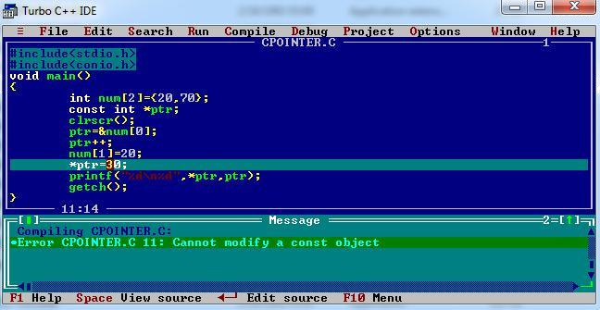
Example

Slide 40
Constant Pointers
Constant pointers are the one which cannot change address they are pointing to. This means that suppose there is a pointer which points to a variable (or stores the address of that variable). If we try to point the pointer to some other variable, then it is not possible.
int* const ptr=&variable; (or)
int *const ptr=&variable // ptr is a constant pointer to int

Slide 41
Null pointer
NULL Pointer is a pointer which is pointing to nothing.
Pointer which is initialized with NULL value is considered as NULL pointer.
datatype *pointer_variable=0; datatype *pointer_variable=NULL;

Slide 42
size of pointer
Any type of pointer variable takes the same memory bytes in the memory, because they are used to store the memory addresses on other type of variables.
/*C program to print size of different types of pointer variables.*/
#include <stdio.h>
int main()
{
printf("\nsize of char pointer: %d" ,sizeof(char*));
printf("\nsize of int pointer: %d" ,sizeof(int*));
printf("\nsize of float pointer: %d" ,sizeof(float*));
printf("\nsize of long int pointer: %d" ,sizeof(long int*));
printf("\nsize of double pointer: %d\n" ,sizeof(double*));
return 0;
}
Output
size of char pointer: 4
size of int pointer: 4
size of float pointer: 4
size of long int pointer: 4
size of double pointer: 4

Slide 43
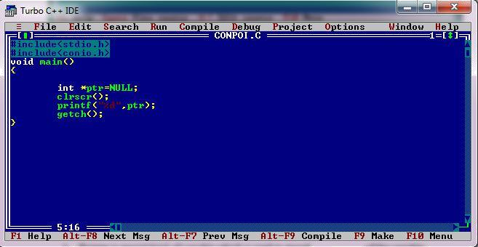
Example

Slide 44
Pointer Arithmetic
C allows you to perform some arithmetic operations on pointers.
Incrementing a pointer
Incrementing a pointer is one which increases the number of bytes of its data type.
int *ptr;
int a[]={1,2,3};
ptr=&a;
ptr++;
ptr=&a;
ptr=ptr+1;

Slide 45
Pointer Arithmetic
Decrementing a Pointer
Decrementing a pointer is one which decreases the number of bytes of its data type.
Using Unary Operator
int *ptr;
int a[]={1,2,3};
ptr=&a;
ptr--;

Slide 46
Limitations of Pointer Arithmetic
Addition of 2 pointers is not allowed
Addition of a pointer and an integer is commutative ptr+5ó 5+ptr
Subtraction of 2 pointers is applicable.
subtraction of a pointer and an integer is not commutative ptr-5≠ 5-ptr.
Only integers can be added to pointer. It is not valid to add a float or double value to a pointer.
A pointer variable cannot be assigned a non address value except zero.
Multiplication and division Operators cannot be applied on pointers.
Bitwise operators cannot be applied on pointers.
A pointer and an integer can be subtracted.
A pointer and an integer can be added.

Slide 47
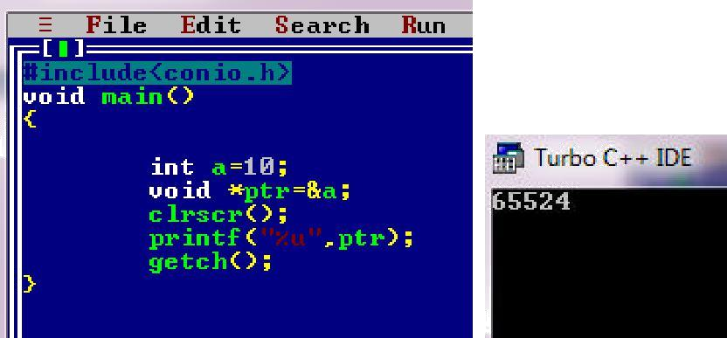
Void pointer
1.Void pointer is a generic pointer and can point to any type of object. The type of object can be char, int, float or any other type.
Example

Slide 48
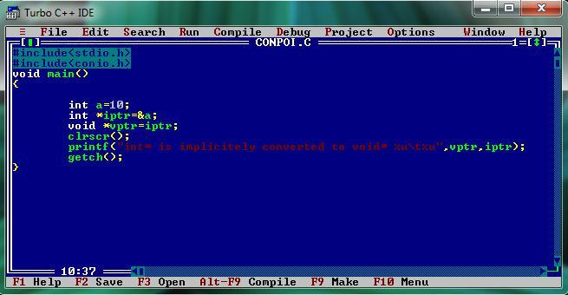
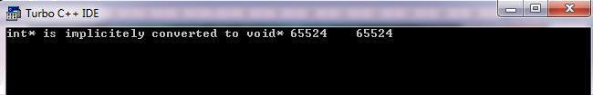
2.A pointer to any type of object can be assigned to a void pointer.
OUTPUT

Slide 49
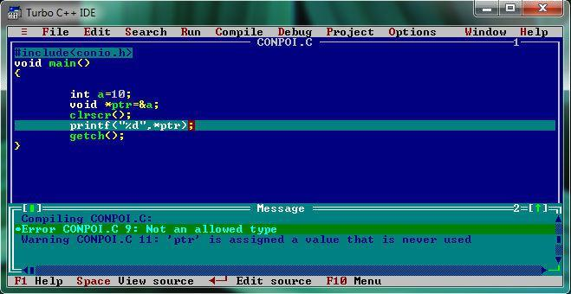
3. A void pointer cannot be dereferenced

Slide 50
Relational operations
A pointer can be compared with a pointer of same type or zero.
Various relational operators are ==.,!=,<,<=,>,>=
Ex: float a=1.0,b=2.0,*fptr1,*fptr2;
fptr1=&a;fptr2=&b;
int result;
result=fptr1!=fptr2;

Slide 51
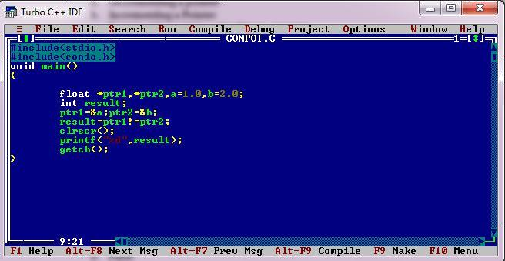
Example

Slide 52
Pointers and Arrays
Pointers and arrays are closely related , An array variable is actually just a pointer to the first element in the array.
Accessing array elements using pointers is efficient way than using array notation.
When an array is declared, compiler allocates sufficient amount of memory to contain all the elements of the array.
Base address i.e address of the first element of the array is also allocated by the compiler.

Slide 53
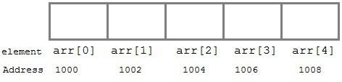
Pointers and Arrays Cont…
Suppose we declare an array arr,
int arr[5]={ 1, 2, 3, 4, 5 };Assuming that the base address of arr is 1000 and each integer requires two bytes, the five elements will be stored as follows

Slide 54
Pointers and Arrays Cont…
Here variable arr will give the base address, which is a constant pointer pointing to the element, arr[0].
Therefore arr is containing the address of arr[0] i.e 1000. In short, arr has two purpose- it is the name of an array and it acts as a pointer pointing towards the first element in the array.

Slide 55
Pointers and Arrays Cont…
int *p; p = arr; or
p = &arr[0];
Now we can access every element of array arr using p++ to move from one element to another.

Slide 56
Pointers and Arrays Cont…
a[0] is the same as *a
a[1] is the same as *(a + 1)
a[2] is the same as *(a + 2)
If pa points to a particular element of an array, (pa + 1) always points to the next element, (pa + i) points i elements after pa and (pa - i) points i elements before.

Slide 57
Example 1
#include<stdio.h> void main()
{
int a[10],i,n; printf("Enter n"); scanf("%d",&n);
for(i=0;i<n;i++) scanf("%d",&a[i]); for(i=0;i<n;i++) printf("a[%d]=%d\n",i,*(a+i));
}

Slide 58
Output
Enter n 5
1 2 3 4 5 a[0]=1
a[1]=2
a[2]=3
a[3]=4
a[4]=5

Slide 59
Pointer to Multidimensional Array
A multidimensional array is of form, a[i][j]. Lets see how we can make a pointer point to such an array.
As we know now, name of the array gives its base address. In a[i][j], a will give the base address of this array, even a+0+0 will also give the base address, that is the address of a[0][0] element.
Here is the generalized form for using pointer with multidimensional arrays.
*(*(a + i) + j) is same as a[i][j].

Slide 60
Example 2
#include <stdio.h> #define ROWS 4
#define COLS 3 int main ()
{
int i,j;
// declare 4x3 array
int matrix[ROWS][COLS] = {{1, 2, 3},
{4, 5, 6},
{7, 8, 9},
{10, 11, 12}};
for (i = 0; i < ROWS; i++)
{
for (j = 0; j < COLS; j++)
{
printf("%d\t", matrix[i][j]);
}
printf("\n");
}
return 0;
}

Slide 61
Output
1 | 2 | 3
4 | 5 | 6
7 | 8 | 9
10 | 11 |  | 12

Slide 62
matrix[0][0] = *(*(matrix))
matrix[i][j] = *((*(matrix)) + (i * COLS + j)) matrix[i][j] = *(*(matrix + i) + j)
matrix[i][j] = *(matrix[i] + j) matrix[i][j] = (*(matrix + i))[j]
&matrix[i][j] = ((*(matrix)) + (i * COLS + j))

Slide 63
Example 3
void array_of_arrays_ver(int arr[][COLS])
{
int i, j;
for (i = 0; i < ROWS; i++)
{
for (j = 0; j < COLS; j++)
{
printf("%d\t", arr[i][j]);
}
printf("\n");
}
}
void ptr_to_array_ver(int (*arr)[COLS])
{
int i, j;
for (i = 0; i < ROWS; i++)
{
for (j = 0; j < COLS; j++)
{
printf("%d\t", (*arr)[j]);
}
arr++; printf("\n");
}
}

Slide 64
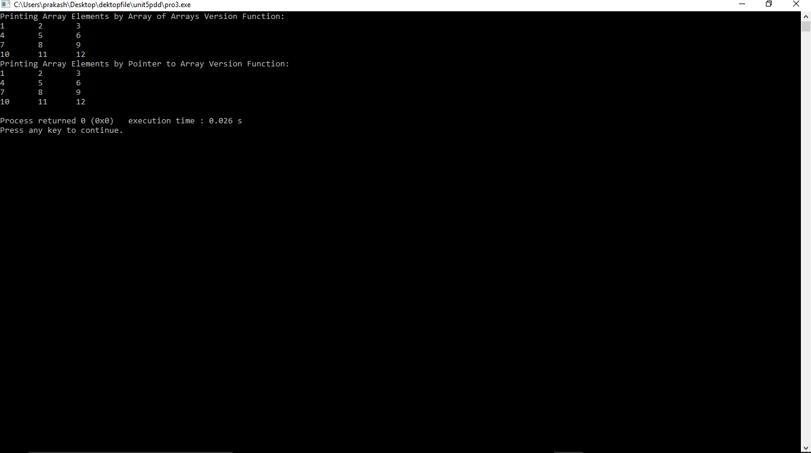
Output

Slide 65
Double Pointer
#include <stdio.h> #define ROWS 4
#define COLS 3
int main ()
{
// matrix of 4 rows and 3 columns
int matrix[ROWS][COLS] = {{1, 2, 3},
{4, 5, 6},
{7, 8, 9},
{10, 11, 12}};
int** pmat = (int **)matrix;
printf("&matrix[0][0] = %u\n", &matrix[0][0]);
printf("&pmat[0][0] = %u\n", &pmat[0][0]); return 0;
}

Slide 66
Output
&matrix[0][0] = 2675498000
&pmat[0][0] = 1

Slide 67
Passing an array to a function
Single element of an array can be passed in similar manner as passing variable to a function
C program to pass a single element of an array to
function
#include <stdio.h> void display(int age)
{
printf("%d", age);
}
int main()
{
int ageArray[] = { 2, 3, 4 };
display(ageArray[2]); //Passing array element ageArray[2] only.
return 0;
}
OUTPUT
4

Slide 68
Passing an entire one-dimensional array to a function
#include<stdio.h>
int total(int[],int);
void main()
{
int a[10],n,sum,i; printf("Enter n\n"); scanf("%d",&n); for(i=0;i<n;i++)
scanf("%d",&a[i]); sum=total(a,n); printf("Sum=%d",sum);
}
int total(int a[],int n)
{
int sum=0,i;
for(i=0;i<n;i++)
sum=sum+a[i]; return sum;
}

Slide 69
Output
Enter n
5
1
2
3
4
5
Sum=15

Slide 70
Passing Multi-dimensional Arrays to Function
To pass two-dimensional array to a function as an argument, starting address of memory area reserved is passed as in one dimensional array

Slide 71
Example 4
#include <stdio.h>
void displayNumbers(int num[2][2]); int main()
{
int num[2][2], i, j; printf("Enter 4 numbers:\n"); for (i = 0; i < 2; ++i)
for (j = 0; j < 2; ++j)
scanf("%d", &num[i][j]);
// passing multi-dimensional array to displayNumbers function
displayNumbers(num); return 0;
}
void displayNumbers(int num[2][2])
{
// Instead of the above line,
// void displayNumbers(int num[][2]) is also valid
int i, j; printf("Displaying:\n"); for (i = 0; i < 2; ++i)
for (j = 0; j < 2; ++j) printf("%d\n", num[i][j]);
}

Slide 72
Output
Enter 4 numbers:
1
2
3
4
Displaying: 1
2
3
4

Slide 73
Pointers and Strings
Strings as arrays:In C, the abstract idea of a string is implemented with just an array of characters. For example, here is a string:
char label[] = "Single";What this array looks like in memory is the following:
S | i | n | g | l | e | \0

Slide 74
Pointers and Strings cont...
where the beginning of the array is at some location in computer memory, for example, location 1000.
A character array can have more characters than the
abstract string held in it, as below:
char label[10] = "Single"; giving an array that looks like:
S i n g l e \0
we can access each character in the array using subscript notation, as in:
printf("Third char is: %c\n", label[2]);
which prints out the third character, n.

Slide 75
Disadvantage Of Creating Strings Using The Character Array
A disadvantage of creating strings using the character array syntax is that you must say ahead of time how many characters the array may hold. For example, in the following array definitions, we state the number of characters (either implicitly or explicitly) to be allocated for the array.
char label[] = "Single"; /* 7 characters */ char label[10] = "Single";
Thus, you must specify the maximum number of characters you will ever need to store in an array.
This type of array allocation, where the size of the array is determined at compile-time, is called static allocation.

Slide 76
String as Pointers
Another way of accessing a contiguous chunk of memory, instead of with an array, is with a pointer.
However, pointers only hold an address, they cannot hold all the characters in a character array.
This means that when we use a char * to keep track of a string, the character array containing the string must already exist (having been either statically- or dynamically-allocated).
char label[] = "Single";
char label2[10] = "Married"; char *labelPtr;
labelPtr = label;

Slide 77
Example1
#include <stdio.h> int main()
{
char *sample = "From whence cometh my help?n"; while(putchar(*sample++))
;
return(0);
}
Output:
From whence cometh my help?n

Slide 78
Passing Strings
Below is the definition of a function that prints a label and a call to that function:
void PrintLabel(char the_label[])
{
printf("Label: %s\n", the_label);
}
...
int main(void)
{
char label[] = "Single";
...
PrintLabel(label);
...
}

Slide 79
Passing Strings Cont...
Since label is a character array, and the function PrintLabel() expects a character array, the above makes sense.
However, if we have a pointer to the character array label, as in:
char *labelPtr = label;
then we can also pass the pointer to the function, as in:
PrintLabel(labelPtr);

Slide 80
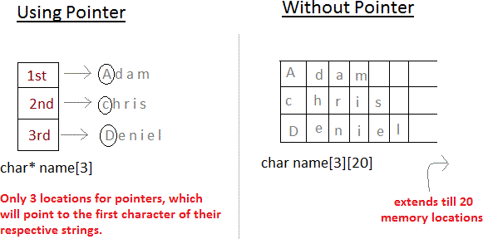
Array of Pointers
Pointers are very helpful in handling character array with rows of varying length.
char *name[3]={ "Adam", "chris", "Deniel" }; //Now see same array without using pointer char name[3][20]= { "Adam", "chris", "Deniel" };

Slide 81
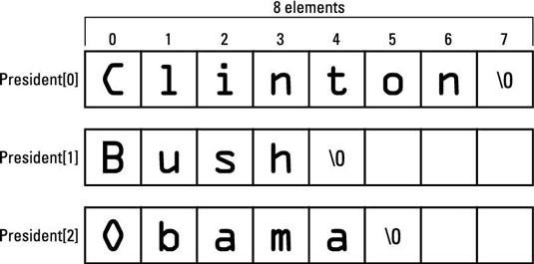
Example1
#include <stdio.h> #define SIZE 3
int main()
{
char president[SIZE][8] = { "Clinton",
"Bush", "Obama"
};
int x,index; for(x=0;x<SIZE;x++)
{
index = 0; while(president[x][index] != '\0')
{
putchar(president[x][index]);
index++;
}
putchar('n');
}
return(0);
}
Output:
ClintonnBushnObaman

Slide 82
Function Pointers
In C, like normal data pointers (int *, char *, etc), we can have pointers to functions.
Initialization
return_type function_pointer(argu)=&function_name void (*fun_ptr)(int) = &fun;
Function Definition
void fun(int a)
{
printf("Value of a is %d\n", a);
}

Slide 83
Example1
#include<stdio.h> void fun(int a)
{
printf("a=%d\n",a);
}
void main()
{
void (*fun1)(int)=&fun; (*fun1)(15);
}
Output:
a=15

Slide 84
Function Pointers Cont...
If we remove bracket, then the expression
“void (*fun_ptr)(int)”
becomes
“void *fun_ptr(int)”
which is declaration of a function that returns void pointer.
Interesting facts
Unlike normal pointers, a function pointer points to code, not data. Typically a function pointer stores the start of executable code.
Unlike normal pointers, we do not allocate de-allocate memory using function pointers.
A function’s name can also be used to get functions’ address.

Slide 85
Passing Function Pointer as an argument
#include<stdio.h>
void fun1(void(*test)())
{
int a=20; test(a);
}
void test(int a)
{
printf("a=%d\n",a);
}
void main()
{
fun1(&test);
}
Output:
a=20

Slide 86
Array of Function Pointer
#include<stdio.h> void add(int a,int b)
{
printf("add=%d\n",a+b);
}
void sub(int a,int b)
{
printf("sub=%d\n",a-b);
}
void mul(int a,int b)
{
printf("mul=%d\n",a*b);
}
void main()
{
void (*fun[])(int,int)={add,sub,mul};
int ch;
int a,b;
printf("Enter a and b\n"); scanf("%d%d",&a,&b); printf("Enter the
operation\n");
scanf("%d",&ch); if(ch>2)
printf("Wrong Input\n"); else
(*fun[ch])(a,b);
}

Slide 87
Output
Enter a and b 4 5
Enter the operation 2
mul=20

Slide 88
Structures created and accessed using pointers
Structures can be created and accessed using pointers. A pointer variable of a structure can be created as below:
struct name
{
member1;
member2;
. .
};
int main()
{
struct name *ptr;
}
Here, the pointer variable of type struct name is created.

Slide 89
Accessing structure's member through pointer
A structure's member can be accessed through pointer in two ways:
Referencing pointer to another address to access memory
Using dynamic memory allocation

Slide 90
Referencing pointer to another address to access the memory
Consider an example to access structure's member through pointer.
#include <stdio.h>
typedef struct person
{ int age; float weight;
};
int main()
{
struct person *personPtr, person1;
personPtr = &person1; // Referencing pointer to memory address of person1 printf("Enter integer: ");
scanf("%d",&(*personPtr).age); printf("Enter number: "); scanf("%f",&(*personPtr).weight); printf("Displaying:\n");
printf("age=%d\nweight=%f",(*personPtr).age,(*personPtr).weight); return 0;
}

Slide 91
Output
Enter integer: 3
Enter number: 6 Displaying:
age=3 weight=6.000000

Slide 92
->
Using -> operator to access structure pointer member.
Structure pointer member can also be accessed using -> operator.
(*personPtr).age is same as personPtr->age
(*personPtr).weight is same as personPtr->weight

Slide 93
Accessing structure member through pointer using dynamic memory allocation
To access structure member using pointers, memory can be allocated dynamically using malloc() function defined under "stdlib.h" header file.
Syntax to use malloc()
ptr = (cast-type*) malloc(byte-size)

Slide 94
Example1
#include <stdio.h> #include <stdlib.h> struct person {
int age;
float weight; char name[30];
};
int main()
{
struct person *ptr; int i, num;
printf("Enter number of persons: ");
scanf("%d", &num);
ptr = (struct person*) malloc(num * sizeof(struct person));
// Above statement allocates the memory for n structures with pointer personPtr pointing to base address */
for(i = 0; i < num; ++i)
{
printf("Enter name, age and weight of the person respectively:\n"); scanf("%s%d%f", &(ptr+i)->name, &(ptr+i)->age, &(ptr+i)->weight);
}
printf("Displaying Infromation:\n"); for(i = 0; i < num; ++i)
printf("%s\t%d\t%.2f\n", (ptr+i)->name, (ptr+i)->age, (ptr+i)->weight);
return 0;
}

Slide 95
Output
Enter number of persons: 2
Enter name, age and weight of the person respectively:
aaa 12
45
Enter name, age and weight of the person respectively: bbb
87
65
Displaying Infromation:
aaa | 12 | 45.00
bbb | 87 | 65.00

Slide 96
Self-Referential Structure
A self referential structure is used to create data structures like linked lists, stacks, etc. Following is an example of this kind of structure:
struct struct_name
{
datatype datatypename; struct_name * pointer_name;
};

Slide 97
Self-Referential Structure Cont...
A self-referential structure is one of the data structures which refer to the pointer to (points) to another structure of the same type.
For example, a linked list is supposed to be a self-referential data structure. The next node of a node is being pointed, which is of the same struct type. For example,
typedef struct listnode { void *data;
struct listnode *next;
} linked_list;
In the above example, the listnode is a self-referential structure
– because the *next is of the type struct listnode.

Slide 98

Self-Referential Structure Cont...
typedef struct listnode { void *data;
struct listnode *next;
} linked_list;
Data
Data
Data

Slide 99


