Slide 1



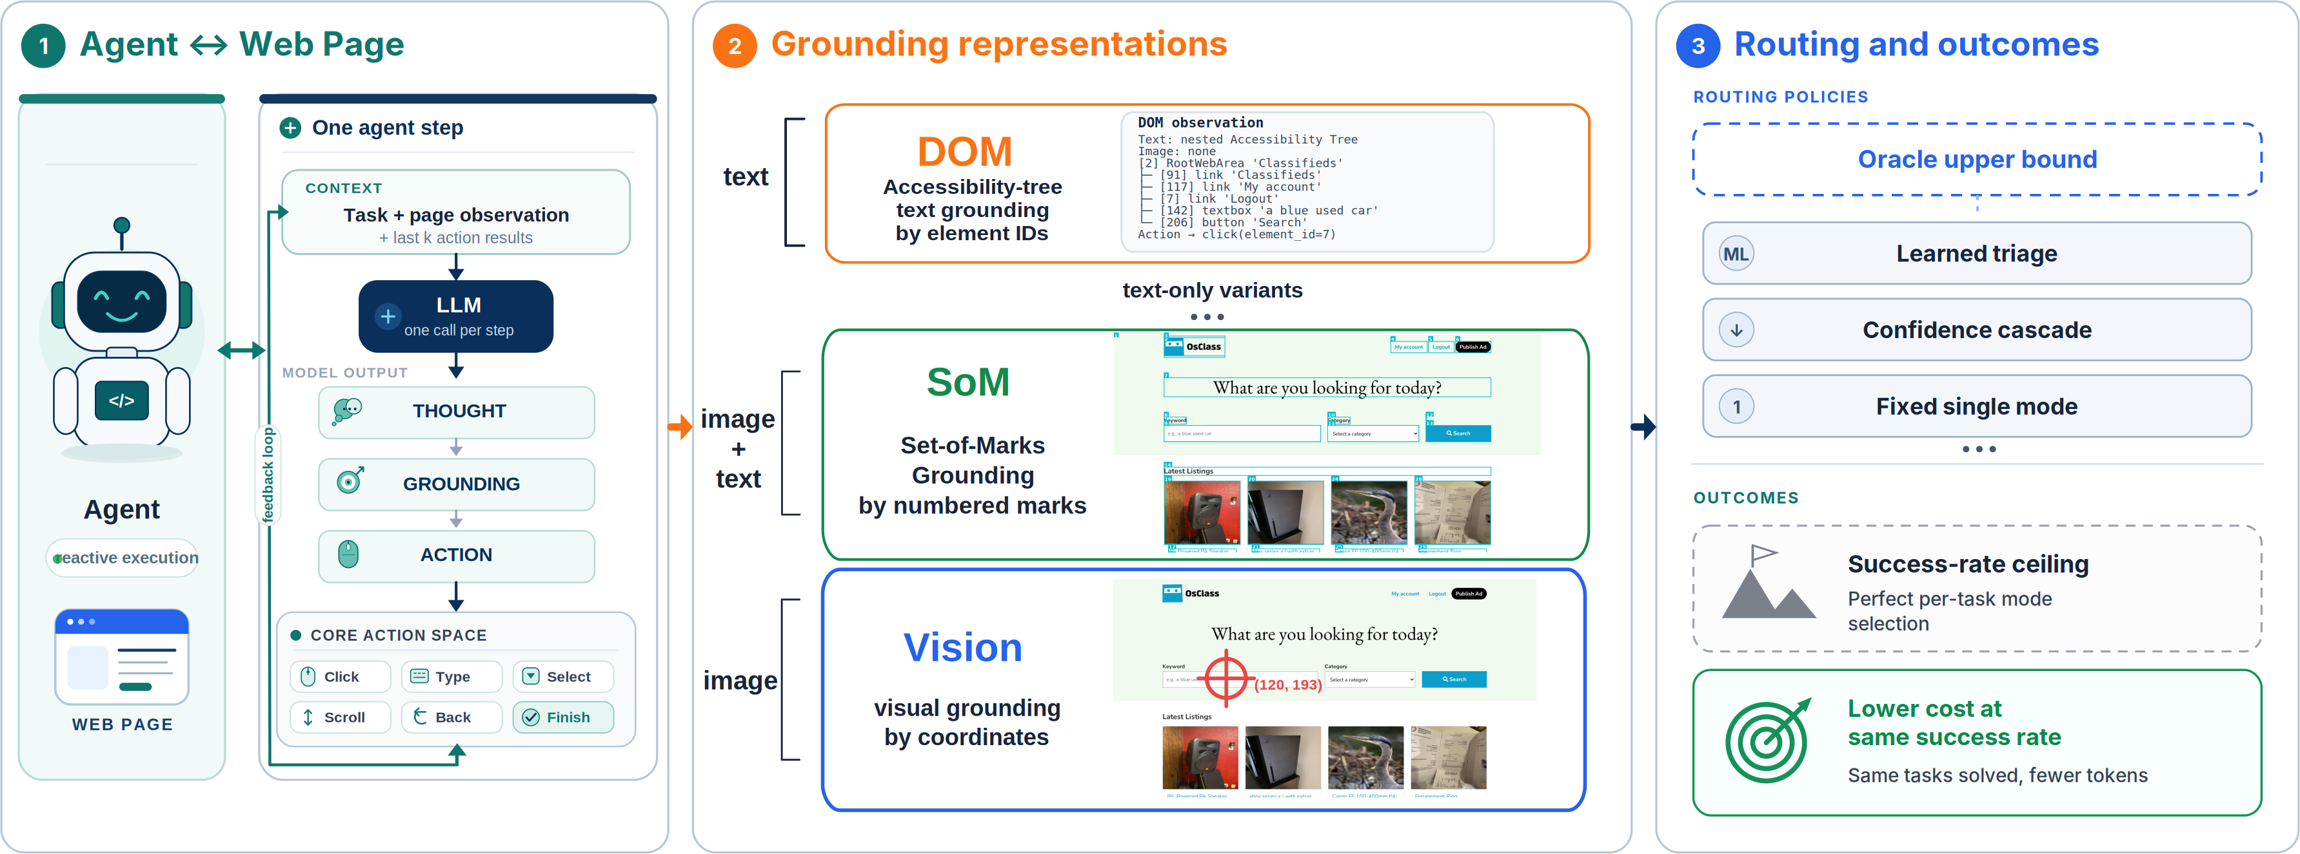


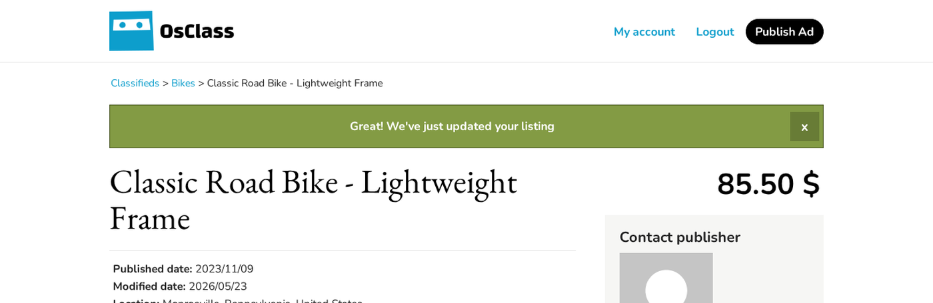

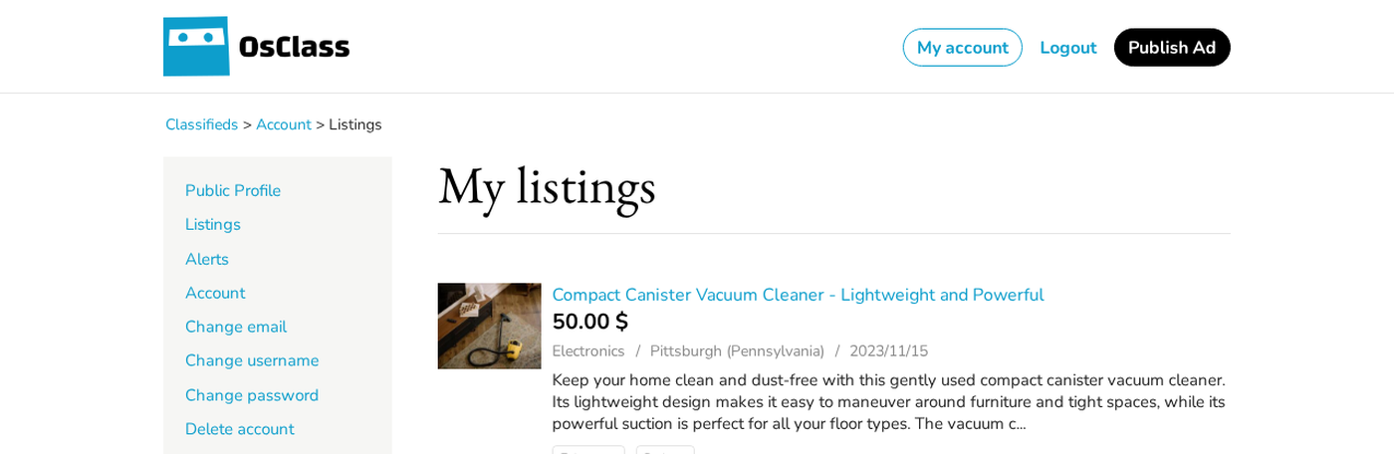
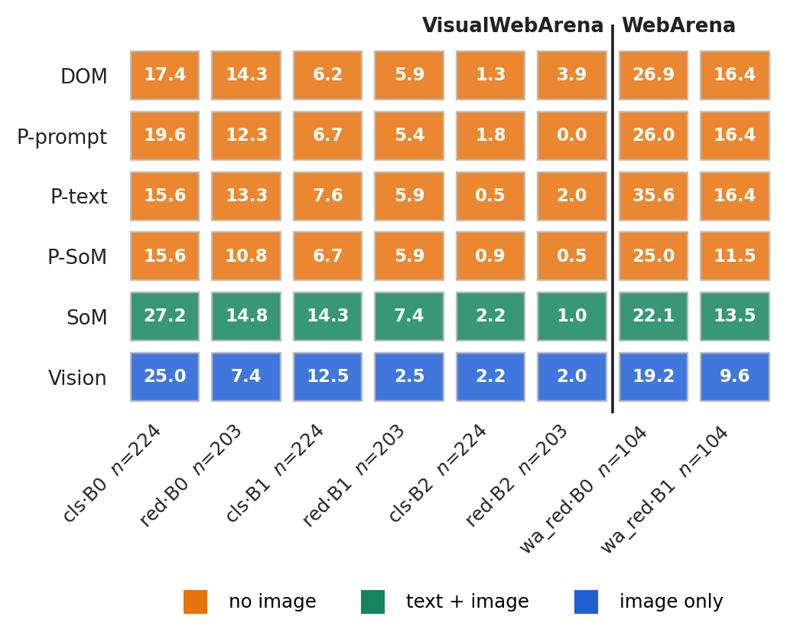
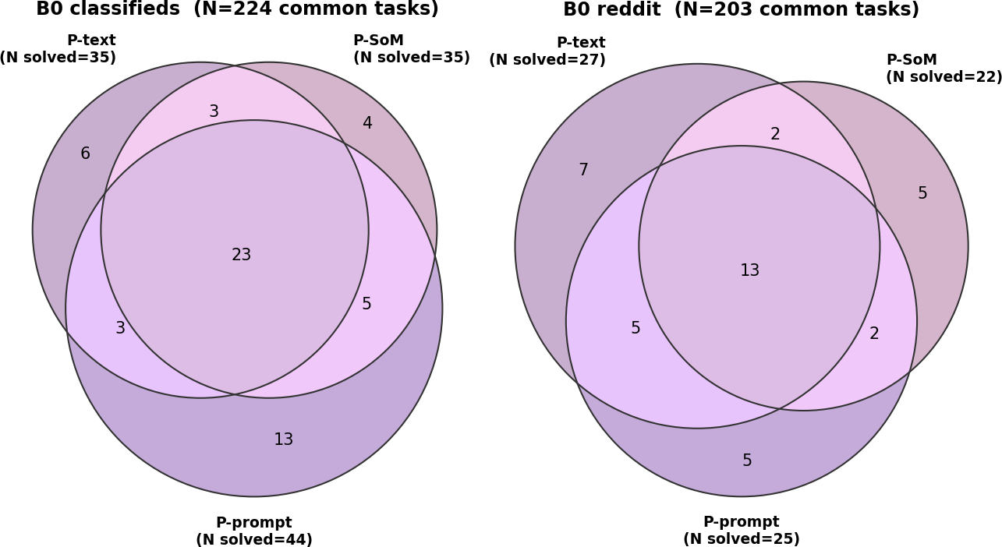
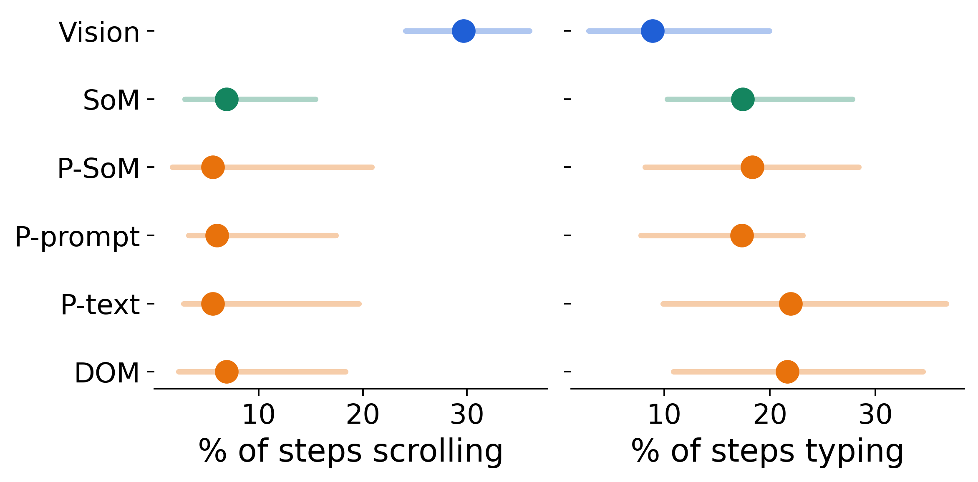
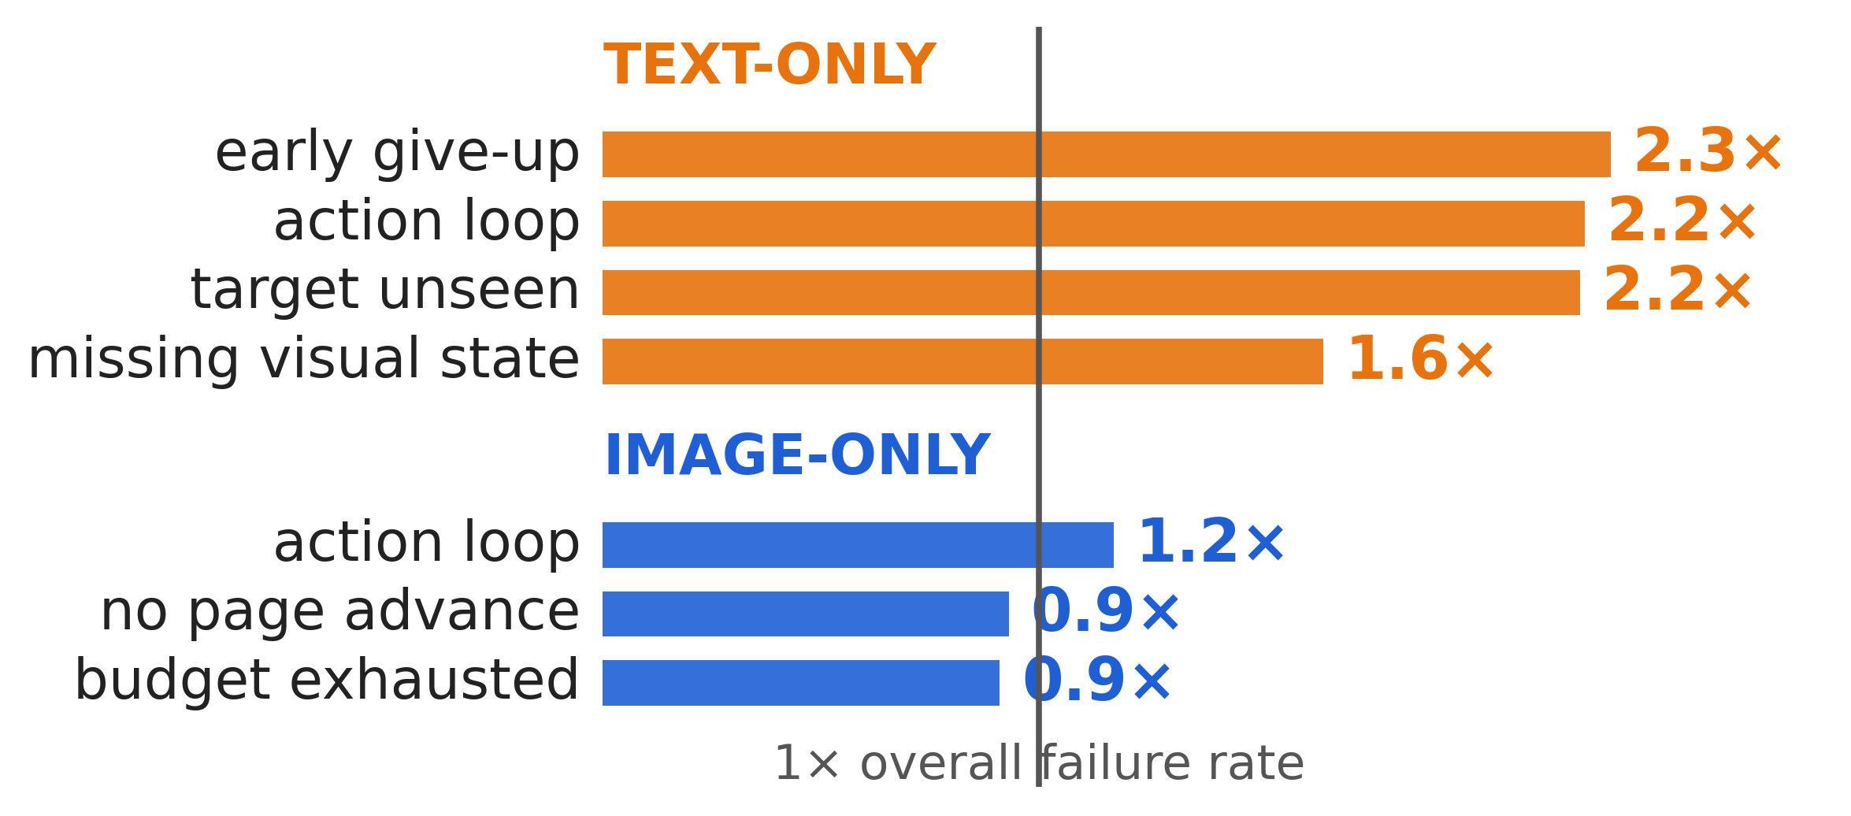
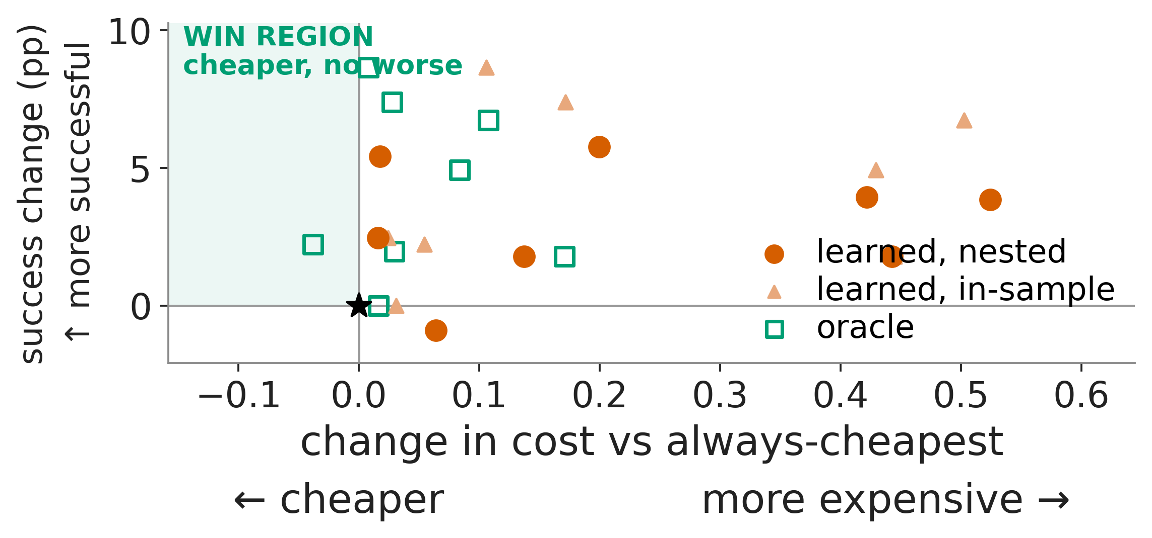
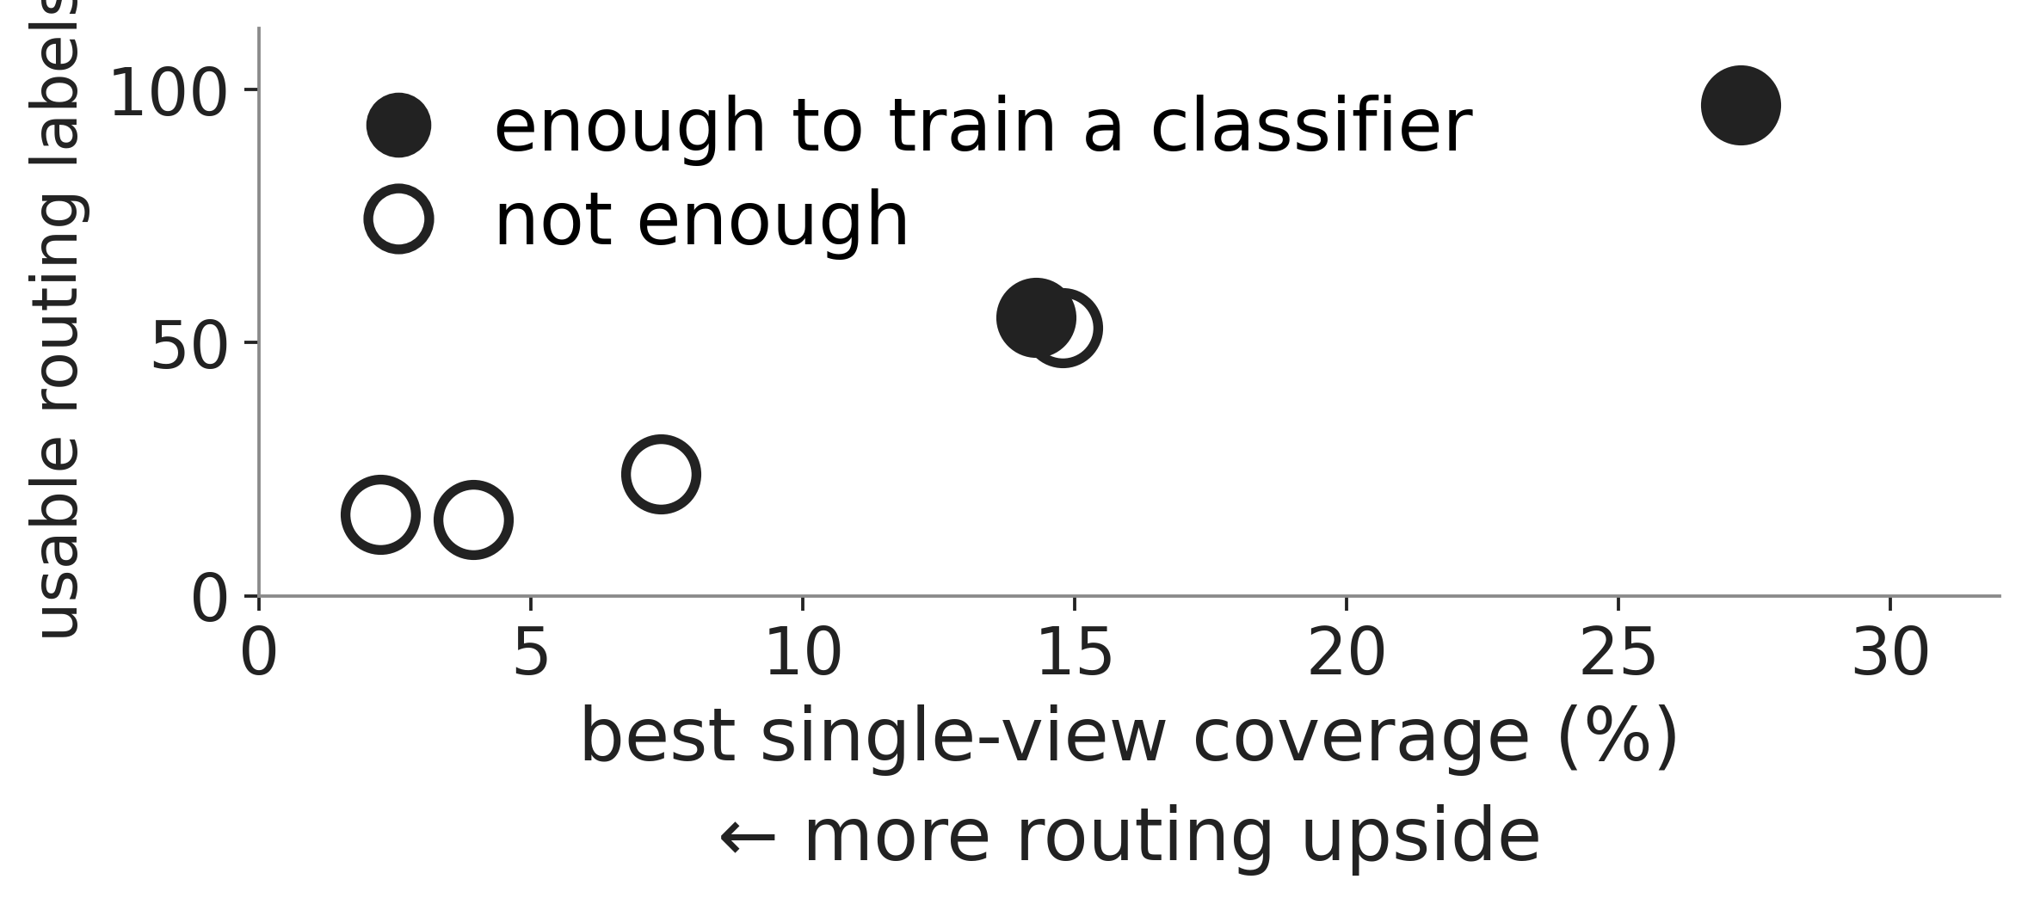

When Is Expensive Perception Worth Paying For?
Jiaming Wei Supervisors: Prof. María Pérez-Ortiz · Zekun Wu
UCL Centre for Artificial Intelligence Holistic AI
Testing when richer web-agent representations help — and whether their value can be predicted cheaply
WHAT AN AGENT SEES, AND WHO CHOOSES
THE SAME TASK, SEEN TWO WAYS
“Go to my listing of the blue bike and change the price to $85.50 — and say so in the description.”
READ
page text only
12 steps
8 pages seen
$0.09
solved
step 4 · type →
step 8 · type →
step 10 · click →
LOOK
$0.020 spent
$0.050 spent
$0.086 spent
screenshot only
26 steps
9 pages seen
$0.10
gave up
step 2 · click →
step 17 · click →
step 19 · click →
$0.011 spent
$0.071 · left the form
$0.079 · back on frame 1
Same start. READ finishes; LOOK loops back. Both outcomes repeat on an independent rerun.
1 · NO VIEW WINS EVERYWHERE
2 · THEY SOLVE DIFFERENT TASKS
3 · THEY BEHAVE DIFFERENTLY
The sets overlap — but do not coincide.
Vision scrolls ~4× more.
4 · AND THEY FAIL DIFFERENTLY
5 · SO BUILD A ROUTER? NOT SO FAST.
6 · AND THIS IS WHY
Text-only skews toward early give-up; image-only toward stalled progress.
Learned routers buy success only by spending more; only the hindsight oracle reaches the win region.
More routing upside, less usable training signal.
jiaming.wei.25@ucl.ac.uk
Paper, code & full results: github.com/Quarkgluonmixture/Cost-Aware-Routing-for-Web-Usage-Agents
Explore all 8 settings →
Holistic AI × UCL CDI · 16 September 2026

