Slide 1



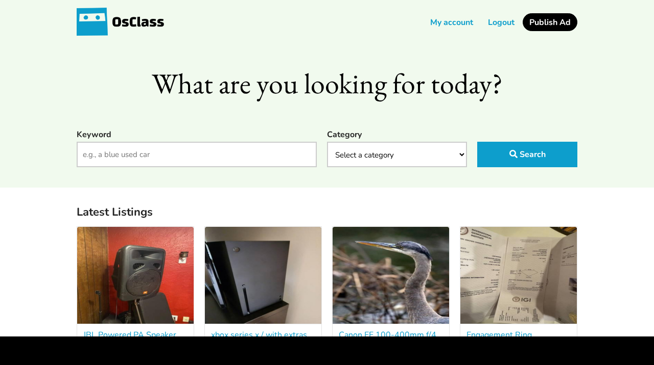
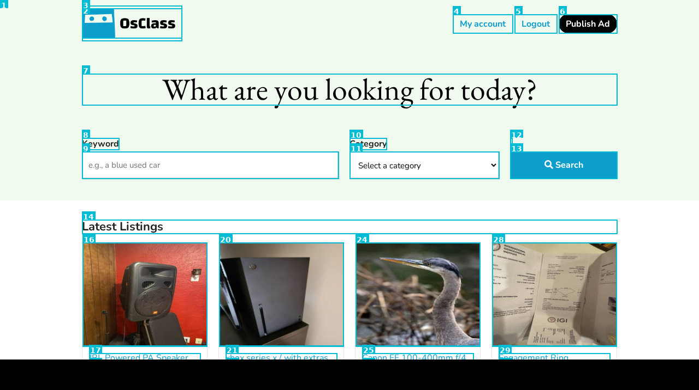
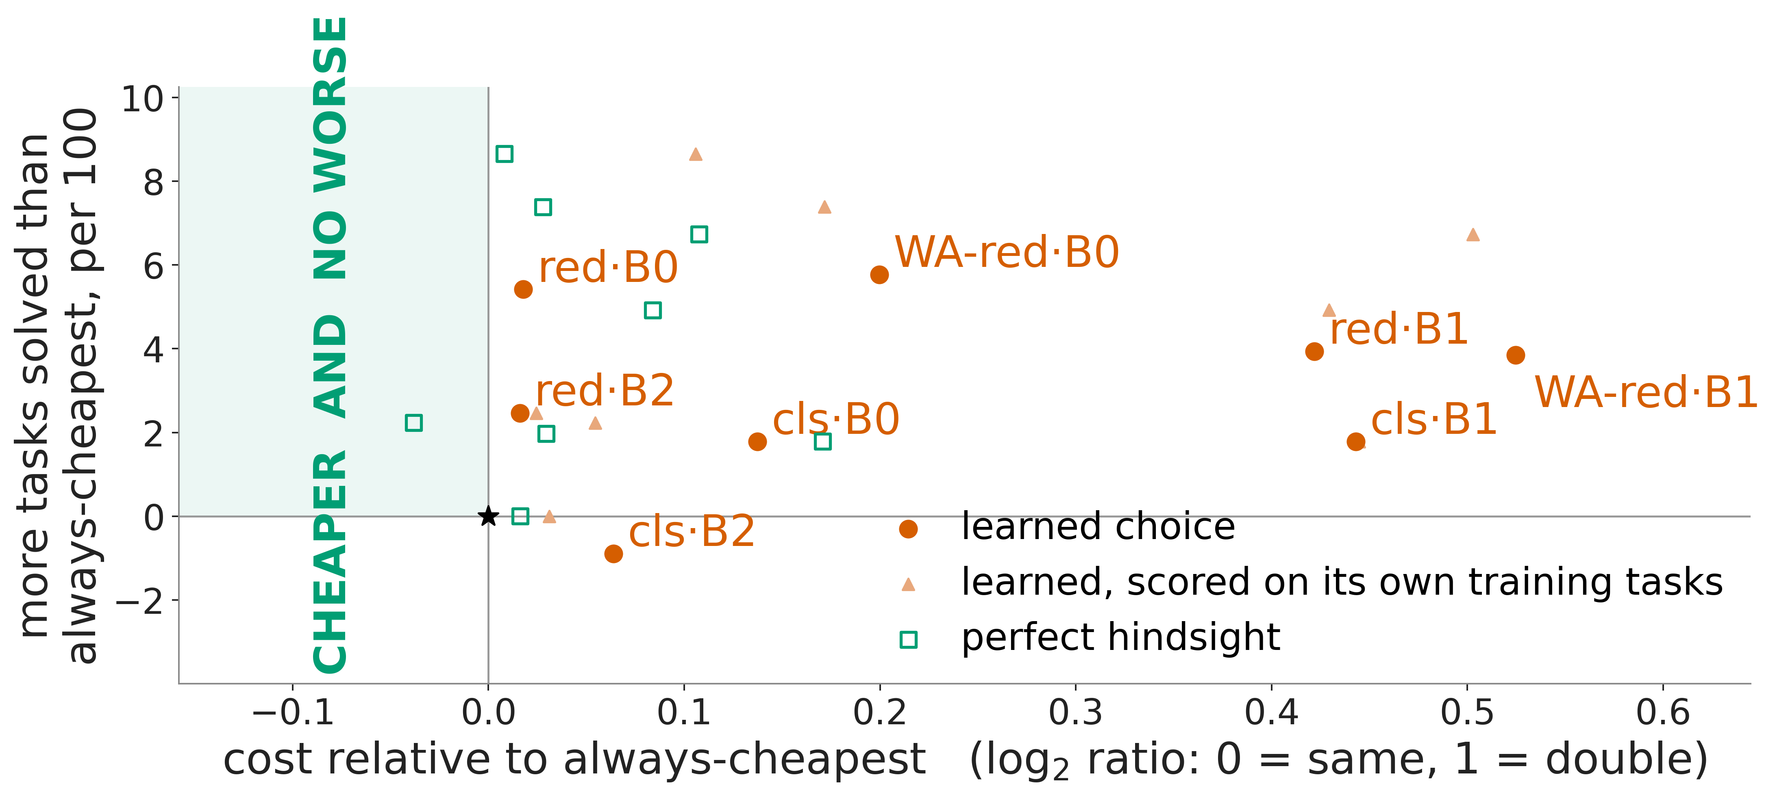
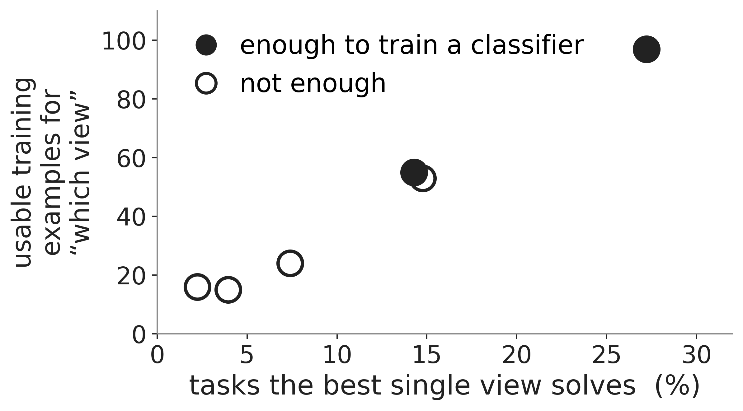
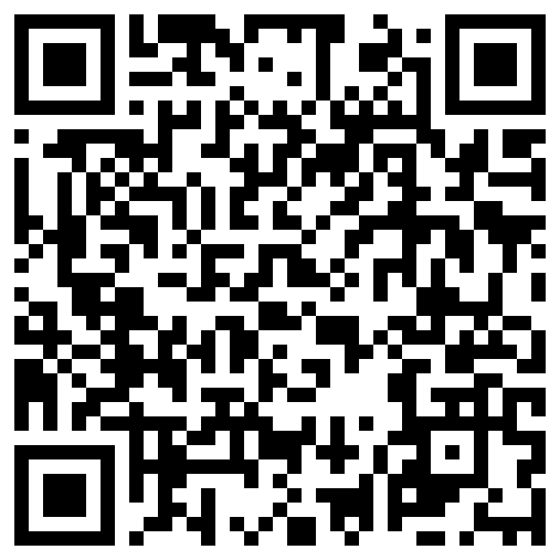
Look, read, or both?
Today's web agents can't yet learn how to see a page
Jiaming Wei Supervisors: Prof. María Pérez-Ortiz · Zekun Wu
UCL Centre for Artificial Intelligence Holistic AI
Perfect hindsight would solve up to 16 more tasks in 100 than the best single view. None of 8 learned choices beat always using the cheapest view on both success and cost.
THE AGENT LOOP, AND WHERE THE DECISION SITS
THE TASK + THE PAGE
WHO DECIDES HOW TO SEE IT?
LOOK
3,123 tokens
THE AGENT · EACH STEP
WHEN IT STOPS
“Show me the cheapest bike with red handlebars between $900–950.”
One fixed view
screenshot only
think → act
✓ solved / ✗ not
$ for the attempt
the same view on every task
click · type · scroll · go back · finish
8 website × model combinations · two public benchmarks · 6 views · 8,934 attempts
Perfect hindsight
READ
3,314 tokens
[2] RootWebArea 'Classifieds'
[89] link 'Classifieds'
[90] image 'Classifieds'
[115] link 'My account'
[5] link 'Logout'
[118] link 'Publish Ad'
Only the page view changes; model, prompt, step budget and cost accounting stay fixed.
Part of the intent is in the pictures, part in the text.
afterwards: which view solved it
page elements and labels as text, plus 3 more text-only views
A learned choice
BOTH
4,335 tokens
beforehand: predicted from the page
numbered screenshot + page text
this box is what we measure
the action changes the page → next step · up to 30 steps per task · the bill grows with every step
Fig 1. Only the page view changes. The dashed box is what we measure: one fixed view, perfect hindsight, or a learned choice, each judged on both success and cost.
RESULTS ACROSS 8,934 TASK ATTEMPTS
+16.35 in 100
0 of 8
1 of 8
PERFECT HINDSIGHT · SUCCESS ONLY · VS ONE FIXED VIEW
LEARNED CHOICES THAT WON ON SUCCESS AND COST
HINDSIGHT CHOICES THAT WON ON SUCCESS AND COST
ONE FIXED VIEW — the highest-success view in a setting, used for every task.
ALWAYS-CHEAPEST — the lowest-average-cost view in a setting, used for every task. “Won” = beat it on both success and cost.
PERFECT HINDSIGHT — after each task, select a view that solved it. Optimistic: rerunning one unchanged view flips 10–14% of outcomes and gains 2.0–7.6 tasks in 100 by itself.
THE CATCH
The agents that gain most from choosing a view solve the fewest tasks — so they produce the fewest examples to learn from.
WHY LEARNING THE CHOICE FAILS HERE
A “which view?” label exists only after a solved task. The best fixed view solves just 2–36%, leaving 15–97 usable labels per setting. Only 2 of 6 VisualWebArena settings have enough to train a classifier.
Fig 2. Every choice is compared with always use the cheapest view (★). A win lands in the shaded region: cheaper and no worse. Cheapest means lowest average cost, so some points sit left of ★. Learned choices use held-out tasks.
Perfect hindsight would pay. After-the-fact selection solves 3.45–16.35 more tasks in 100 than the best fixed view and spends 1.6–35.3% less, in all 8 settings.
Nothing we trained could do it. In 0 of 8 settings did a learned choice beat always-cheapest on both success and cost. Hindsight does so in only 1 of 8.
What survives is a bound, not a method. Sending never-solved tasks to the cheapest view saves 9.5–30.6% at equal success in 8 of 8, but needs hindsight; plain always-cheapest usually saves more.
Fig 3. Usable “which view?” labels against best-fixed-view success, one point per VisualWebArena setting.
Deliberately shrinking the training data points to scarcity: failing settings need at least 2.1–4.2× more tasks than the benchmarks contain.
WATCH THE LAPTOP BESIDE THIS POSTER
TAKEAWAY
Same task, three views, different behaviour and bills — step by step. Each view wins one illustrative task; this is not how often each wins.
Learning how to see is not only a modelling problem. It depends on how good the agent producing the examples already is. Improve the agent, collect reliable examples, then learn when to look.
“Navigate to the item on this page whose image is taken during a sunset.”
LOOK
READ
BOTH
✓ 2 steps · $0.007
✗ 21 steps · $0.096
✓ 3 steps · $0.014
“Navigate to my listing of the blue bike and change the price to $85.50 (including in the description).”
✗ 30 steps · $0.116
✓ 9 steps · $0.079
✗ 6 steps · $0.029
Measured in the 2–36% success regime we observed. This need not hold for stronger agents.
“Show me the cheapest bike with red handlebars between $900-950.”
✗ 19 steps · $0.075
✗ 6 steps · $0.025
✓ 7 steps · $0.037
One recorded attempt per view, B0 · classifieds. ✓ / ✗ repeated independently; steps and bill vary between runs.
jiaming.wei.25@ucl.ac.uk
Paper, code & full results: github.com/Quarkgluonmixture/Cost-Aware-Routing-for-Web-Usage-Agents
Explore all 8 settings →
Holistic AI × UCL CDI · 16 September 2026

