Slide 1
Portfolio allocation using Pead
A Data centric approach to portfolio allocation
Presentation by: Dennis (DSI 19)

Slide 2

Background
PEAD - post earnings announcement drift
Tendency for a stock’s cumulative abnormal returns to drift in the direction of an earnings surprise following an earnings announcement.

Slide 3
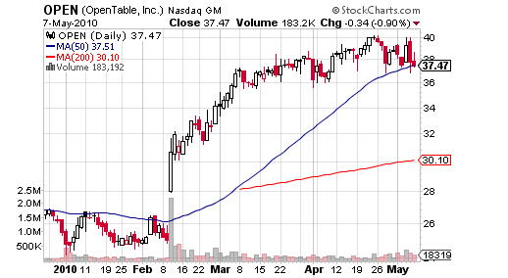
EXample
What this means is when a company reports an earnings surprise, it has a tendency to continue in the direction of the price reaction for several months.
Subsequent Drift
Earnings announcement date

Slide 4
Context
We are a team of quantitative analysts working in a multi-strategy investment fund
Tasked with back testing how a $1 million portfolio
Back test strategy - the PEAD strategy as applied on US microcap stocks over a chosen time period.
The fund utilizes a core satellite portfolio management strategy, thus if successful, this strategy will be incorporate into the main fund under the satellite portfolio as an attempt to generate alpha.

Slide 5
Project scope
Application of PEAD on US microcap stocks
Microcap – stocks with market capitalization of <300 million USD
Past academic studies suggested that the PEAD for small cap stocks tend to be larger than the PEAD of large cap stocks.
Use of SUE model to predict earnings surprises
SUE - standardised unexpected earnings (requires the prediction of EPS)
Predict EPS (earnings per share) using time series predictive models.
Backtest a strategy using PEAD strategy over a chosen time horizon
Compare PEAD strategy with simple buy and hold strategy of the S&P500 index

Slide 6
stakeholders
Primary audience:
Portfolio manager of the quantitative team as he needs to understand if the results are significant enough to be incorporate as a strategy.
Secondary audience:
Both potential and existing investors in the fund that seek to understand or predict how this would impact the overall fund performance and risk profile.

Slide 7
Exploratory data analysis (Eda)

Slide 8
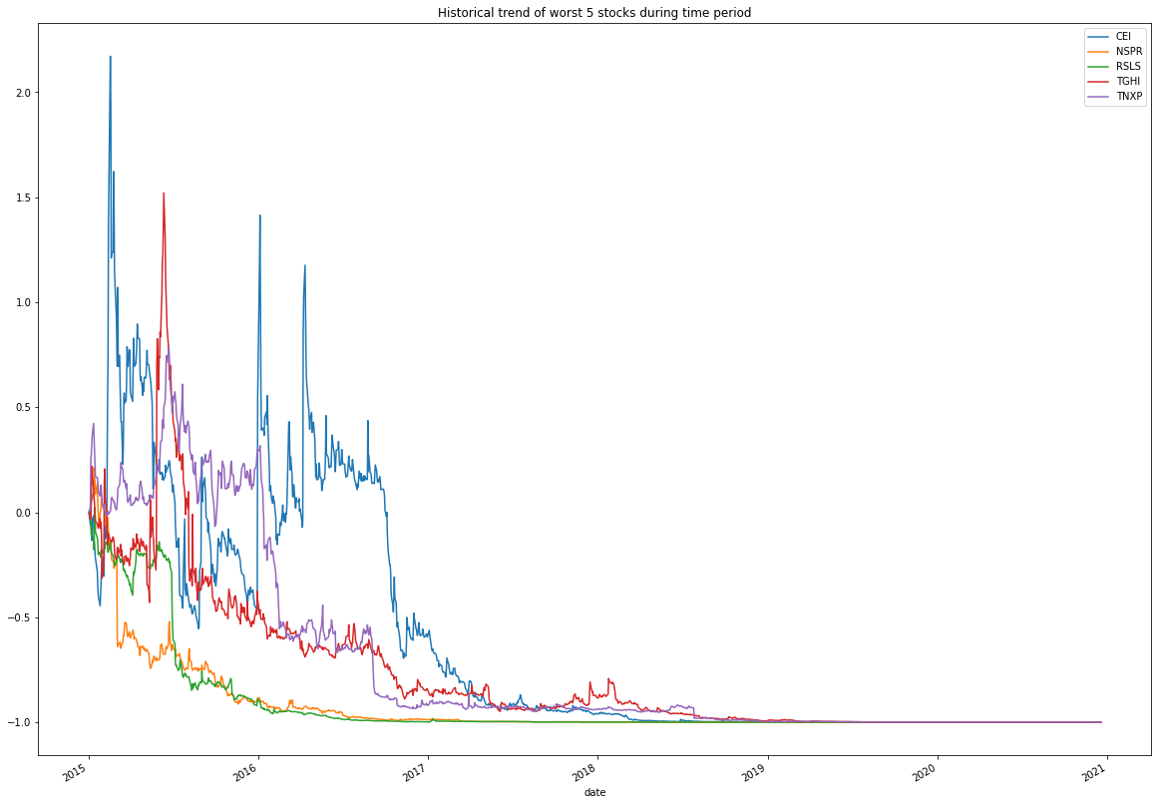
5 Worst stocks (2015 Jan and 2020 Dec)

Slide 9
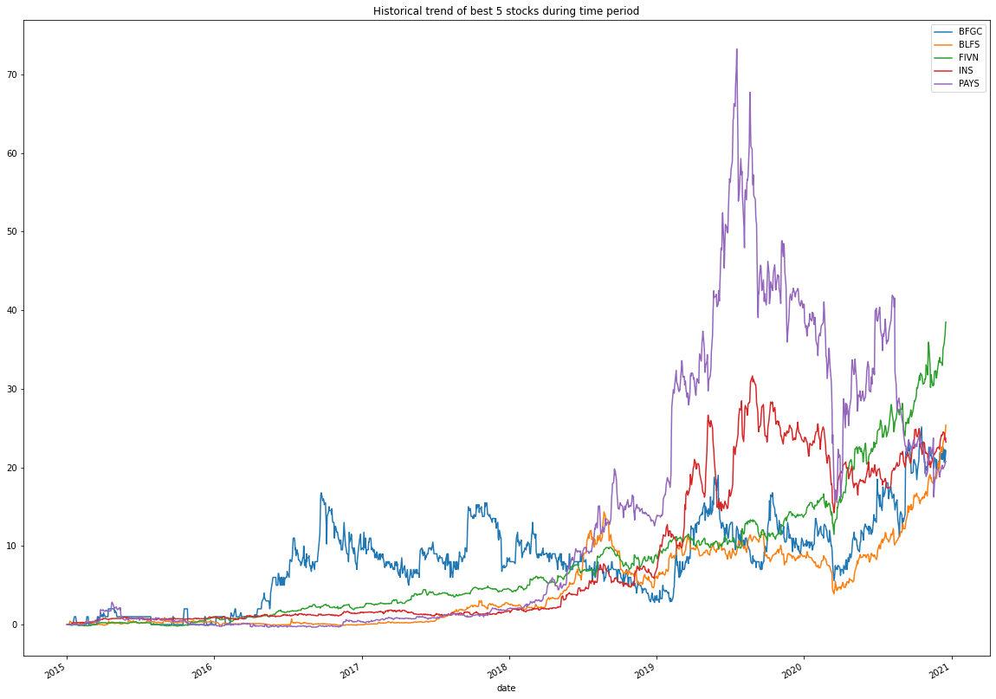
5 Best stocks (2015 Jan and 2020 Dec)

Slide 10
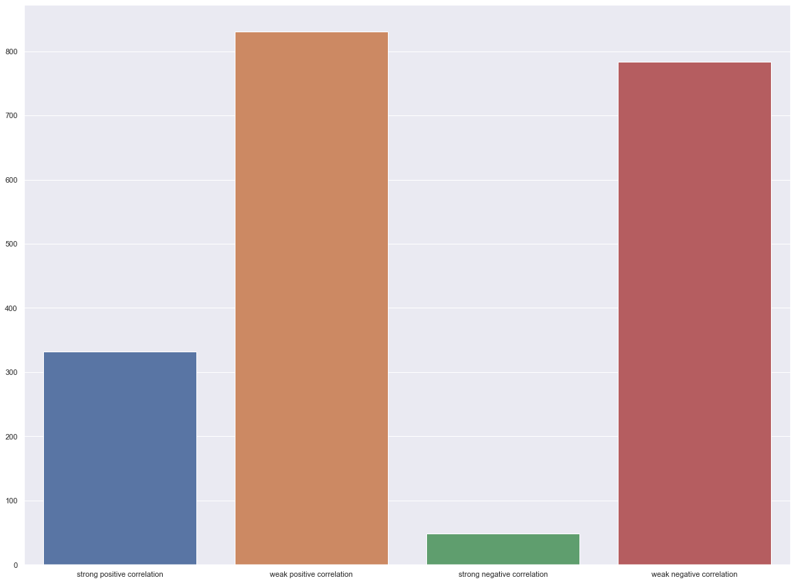
Correlation analysis
Strong Positive corelation in the stock growth of1379 stocks out of 1948 stocks,
likely because microcap stocks as an asset class is highly sensitive to liquidity flight which occurs during periods of high market stress as investors unload stocks that are deemed as more risky in search of large cap stocks that can provide ample liquidity. this is also known as Flight-to-Safety
Strong Negative corelation in the stock growth of 48 stocks
Could be because there are many micro cap stocks that have contrasting busniess models.
for example, One would expect that sustained high fuel costs would generally depress the profits of airlines, and thus their stocks' values.

Slide 11
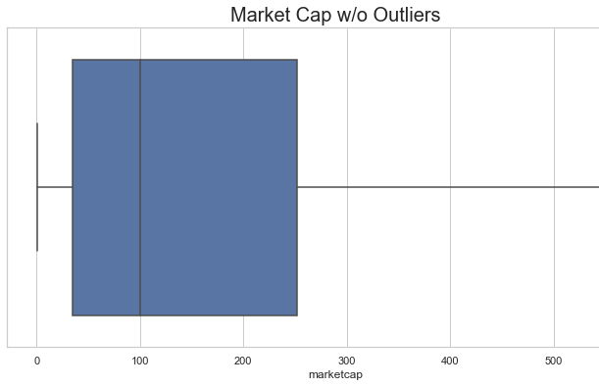
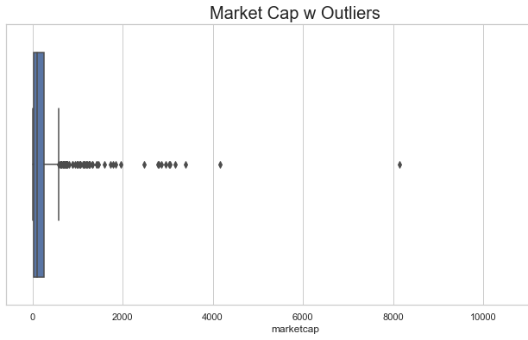
Market Capitlisation on final day (2020 Dec)
Some stocks managed to grow beyond the 300 million USD market cap
Some stocks or businesses either got delisted or went bankrupt
Most remain within the range

Slide 12
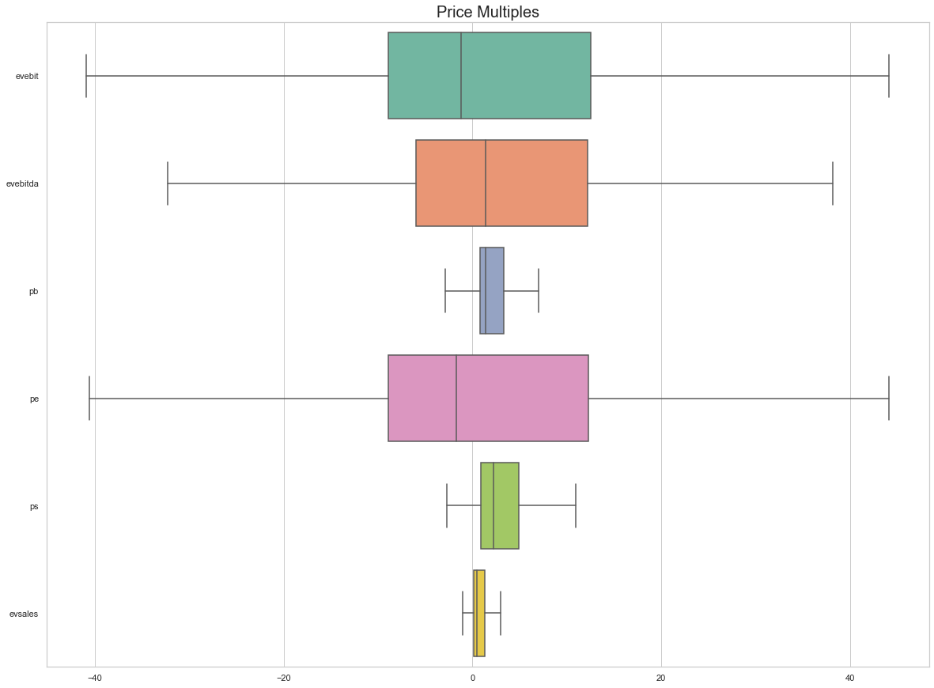
Valuation multiples
Valuation multiples seem to be within a rather tight range

Slide 13
Model selection
Forecast EPS (earnings per share) using time series prediction model
ARIMA model selected - Autoregressive integrated moving average
SMAPE loss function – A perfect SMAPE score is 0.0, and a higher score indicates a higher error rate.

Slide 14
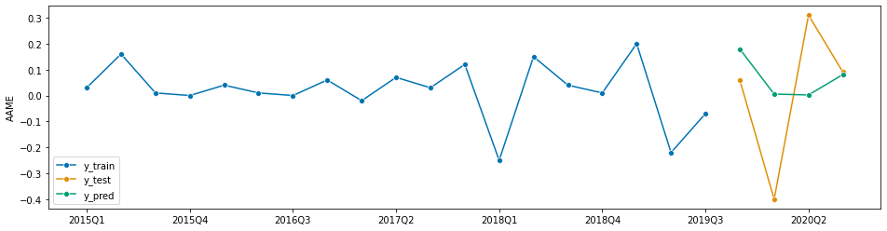
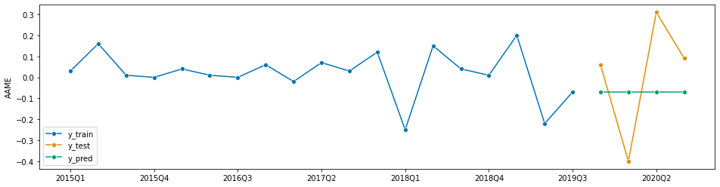
Comparing models
EPS prediction above using ARIMA
EPS prediction below using naïve model ( using final quarter EPS to predict the remaining forecasted EPS)
For this example:
SMAPE of ARIMA: 1.269
SMAPE of naïve: 1.851
The lower SMAPE, the better the result

Slide 15
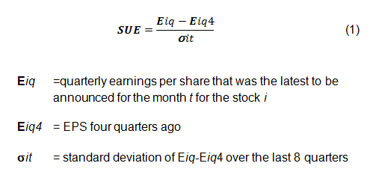
SUE (standardized unexpected earnings model)

Slide 16
Final results : comparison between 2 strategies

Slide 17
Recall
Basic buy and hold strategy using the S&P500 index as reference
PEAD strategy on microcap
Basis of comparison
Cumulative returns of a $1 million portfolio -
Rolling Sharpe ratio - the ratio of the expectation of the excess returns of the strategy to the standard deviation of those excess returns. Simply put, it captures the ratio of reward-to-risk, where risk is defined as returns volatility.

Slide 18
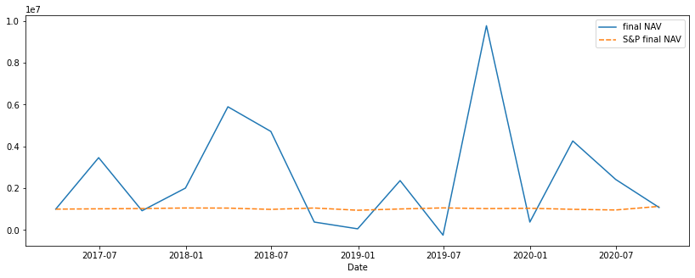
Cumulative returns
Not much distinction between the 2 for the back tested time period
S&P500 outperforms slightly

Slide 19
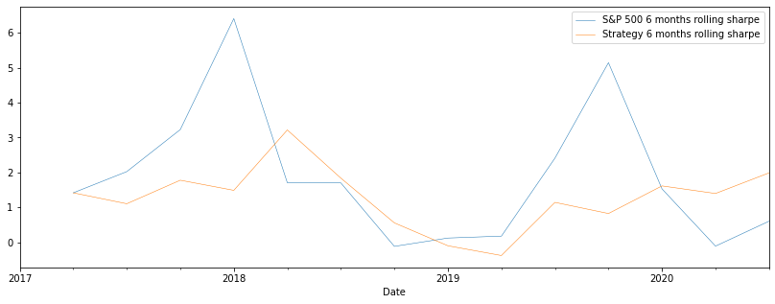
6 months Rolling sharpe ratio
S&P500 outperforms on average

Slide 20
Key takeaways & recommendations
The model is useful for predicting EPS of the subsequent quarter of each stock
However, the model is also unlikely to outperform the S&P500 index as mentioned above.
Thus, it is not recommended to include the PEAD strategy as a means of incorporating alpha into the core satellite portfokio

Slide 21
Conclusion and limitations
Prediction model:
A major area of weakness of predicting the EPS is that it is essentially a backward looking model.
Such that, the long term forecast eventually goes to be straight line and poor at predicting series with turning points
As a portfolio allocation strategy
The liquidity of various microcap stocks may be limited due to the low float and daily traded volume for many of the stocks stated above.
Thus, making this strategy infeasible for larger funds even if the strategy managed to create alpha.

Slide 22
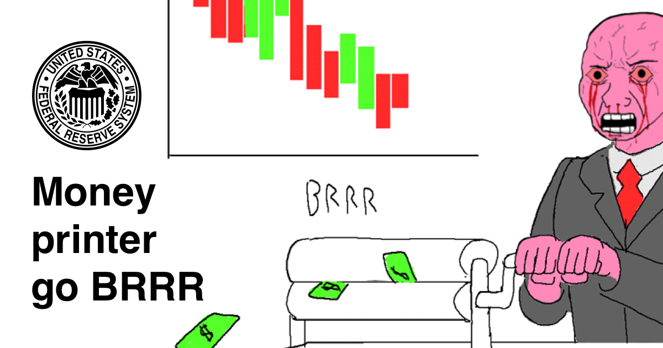
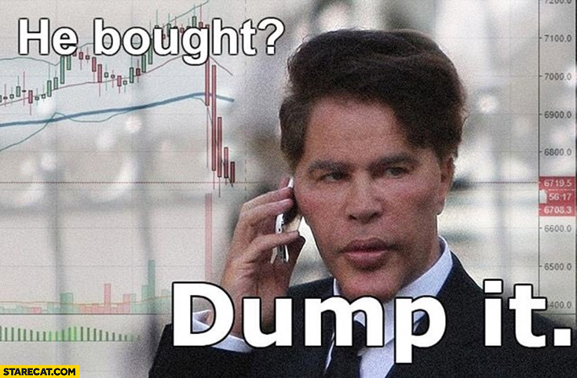

Thank you
*Buy GME

