Slide 1
Lab assignment 2
Radial basis functions, competitive learning and
self-organisation
Group 4
Chiachen Ho, Angelos Stais and Ruxue Zeng
September 29, 2021
Artificial Neural Networks and Deep Architectures, DD2437

Slide 2
RBF Networks
Batch Mode Training using Least Squares
Supervised Learning of Network Weights
Function | Error Threshold | Absolute Residual Error | Hidden Nodes
sin(2x) | 0.1 | 0.06823 | 6
sin(2x) | 0.01 | 0.0095 | 8
sin(2x) | 0.001 | 0.000914 | 11
Table 1: Absolute residual error thresholds and numbers of used hidden nodes.
Conclusions
Square(2x): Using linear activation, an absolute residual error lower than 0.1 could not be obtained.
Square(2x): Using sign activation an error of 0.0 is first achieved for 9 hidden nodes.
This kind of output from the RBF is useful for transforming the problem into classification. Another application is transforming analog values into digital, which is useful in e.g. signal processing.
Notes:
For the 1st part of the assignment, we defined the data and applied the batch learning algorihtm on our training set.
We can see the results obtained for the sin(2x) function with width σ = 1, training in batch mode on Table 1. This table shows the number of hidden nodes needed to cross each of the thresholds for the sin(2x) function.
For the square(2x) using linear activation, we couldn’t have an absolute residual error lower than 0.1. To reduce the error to 0.0, sign activation can be used instead, that is thresholding the output: a value of 1 is assigned to all outputs ≥0, and a value of -1 is assigned to all negative outputs.
Using sign activation we first achieved an error of 0.0 for 9 hidden nodes.
This kind of output from the RBF is useful for transforming the problem into classification. Another application is transforming analog values into digital, which is useful in e.g. signal processing.

Slide 3
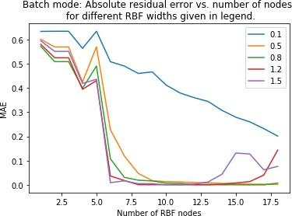
RBF Networks
Regression with Noise
Function | Hidden Nodes | Noisy data |  | Clean data
 |  | Batch mode | Online Delta Rule | Batch mode | Online Delta Rule
sin(2x) | 3 | 0.5175 | 0.5223 | 0.5683 | 0.5717
sin(2x) | 8 | 0.129 | 0.0662 | 0.04943 | 0.05293
sin(2x) | 19 | 0.195 | 0.06409 | 0.02307 | 0.03495
square(2x) | 3 | 0.6812 | 0.6679 | 0.7872 | 0.7892
square(2x) | 8 | 0.2953 | 0.3017 | 0.3107 | 0.3168
square(2x) | 19 | 0.261 | 0.30027 | 0.21309 | 0.2885
Table 2: Absolute residual error and number of hidden nodes for σ = 1.
Figure 1: The absolute residual error for a different number of RBF nodes with different widths, RBF network trained in batch mode.
Conclusions
Absolute Residual Error for σ=0.5: Online mode has a better performance than Batch mode for sin(2x)
0.1489 for batch mode with 24 hidden nodes
0.2459 for the online delta rule with 24 hidden nodes
Notes:
For this part, we used noisy data. The online learning using the delta rule was done in 10.000 epochs with a learning rate η = 0.1.
Table 2 shows the absolute residual error for different numbers of used hidden nodes with width σ = 1. The same network is applied to the clean data for comparison.We can see that the error is smaller for the online training using the delta rule for the sin(2x) function. For the square(2x) function, there isn’t a big difference (between the two methods), which makes sense as the prediction doesn’t quite capture the square shape without thresholding for the outputs. When training on noisy data but applying the network to clean data, the MAE (Mean Absolute Error) decreases.
The results in Table 2 are obtained with variance σ = 1. Changing the variance that is the width, for σ = 0.5 the absolute residual error goes down to 0.1489 for batch mode with 24 hidden nodes and down to 0.2459 for the online delta rule.
To observe the effect of different widths on the absolute residual error, from Figure 1 it can be seen that σ = 0.5 and σ = 0.8 have the lowest error when learning in batch mode,

Slide 4
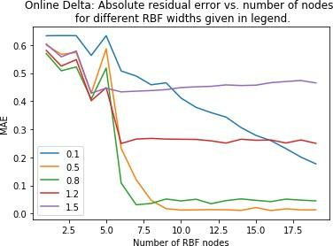
RBF Networks
Regression with Noise
Function | Absolute Residual Error RBF | Absolute Residual Error Perceptron | Hidden Nodes
sin(2x) | 0.07455 | 0.9238 | 8
sin(2x) | 0.00947 | 0.721 | 12
sin(2x) | 0.01386 | 0.698 | 20
square(2x) | 0.3448 | 11.203 | 8
square(2x) | 0.3053 | 12.654 | 12
square(2x) | 0.3781 | 15.340 | 20
Figure 2: The absolute residual error for a different number of RBF nodes with different widths, RBF network trained online with delta rule.
Table 3: Absolute Rsidual error for the sin(2x) and square(2x) data obtained by the RBF network using competitive learning and perceptron learning
Conclusions :
RBF network using competitive learning produces a smaller Absolute Rsidual Error than the perceptron network for prediction.
The performance of RBF network depends on number of hidden nodes used.
Notes:
From Figure 2, we can see that σ = 0.5 is best for online learning with delta rule. the larger learning rates (1.2 and 1.5) are not suited for the delta rule learning.
The results in Table 3 were obtained using 10 000 epochs. It shows Absolute residual error for the sin(2x) and square(2x) data obtained by the RBF network and perceptron learning, with the same number of hidden units for both algorithms for comparison.

Slide 5
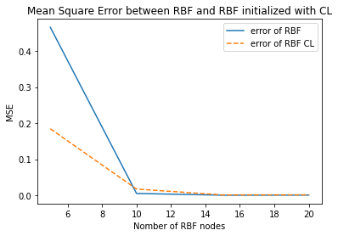
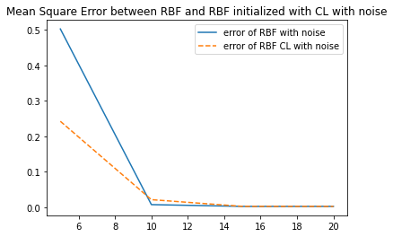
Competitive Learning for RBF unit initialisation
Automated initialisation
Conclusions :
For both noise-free and with noise datasets, the MSE of RBF initialised with CL is lower than the RBF with manually initialisation when the number of RBF units is small.
An RBF model which its units are initialised with CL has a better performance than a manually initialised model when the number of RBF units is small.
When the number of units gets bigger, both models have a similar performance.
Notes:
In the second part of assignment one, we have used a version of competitive learning for vector quantization.
The first model we have built only computes the winning unit, and this unit is updated in such a way that it gets closer to the training vector.
We combine this CL-based approach to the RBF network with delta learning, and we compare it with the one with manually initialized RBF units. We observe that for both noise-free and with noise model, the one with CL has a lower MSE, which means CL-based automated initialization improve the performance of RBF network.
(eta=0.1, epochs=100)
(eta for leaky learning = 0.01)

Slide 6
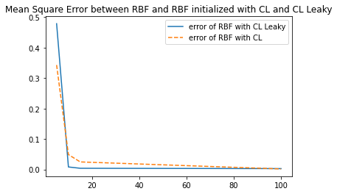
Competitive Learning for RBF unit initialisation
Dead units
Conclusions :
When the number of RBF units gets bigger than 10, the RBF with CL using leaking learning algorithm has a lower MSE then the one with a simple CL.
The CL with leaking learning algorithm has a better performance than the simple CL when the number of RBF units gets bigger, because it avoid dead units problems.
Notes:
Now, what we have done is we have introduced a strategy to avoid dead units, Leaky learning. Instead of choosing a single winner, we compute also the other units.
With a noisy dataset, we observe that with a number of RBF units superior to 10, the error of the RBF network initialized with Leaky learning-based CL, is lower than with a simple CL algorithm.
We conclude that because when we have much more RBF units, the leaky version could avoid the dead units problem, and that’s why it has a better performance.

Slide 7
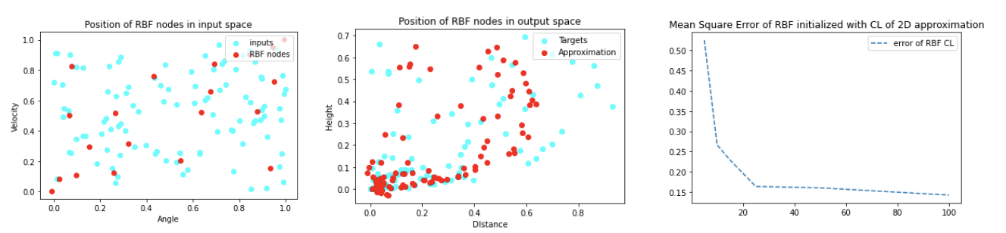
Competitive Learning for RBF unit initialisation
2D function approximation
Conclusions :
We choose 20 RBF units in order to avoid dead units problem.
When the number of RBF units gets bigger, the RBF model initialized with CL has a better performance for 2D function approximation.
We can’t attend a perfect approximation because there are still problems of overfitting if the number of RBF units gets too big.
Notes:
We have also used the RBF network to approximate a two-dimensional function. As training examples, we use noisy data from ballistical experiments.
We have chosen 20 RBF nodes and initialized those nodes with a leaky learning approach. With the first figure, we observe the distribution of RBF nodes in the input space is homogeneously distributed, and there are no dead units.
After training the RBF network, we observe in the 2nd figure that the accuracy of approximation depends on the density of nodes of each area. The approximation of an area with lots of data is satisfactory, but it gets worse when we have little data. The third figure confirms that this accuracy is affected by the number of RBF units. But we still can’t attend an error equals to zero because there still has a dead units problem and overfitting problem when the number of units gets too big.

Slide 8

Self-Organising Maps
Topological Ordering of Animal Species
Training details:
Learning rate :
0.2 for winner/neighbor nodes (setting1)
0.2 for winner node/ 0.1 for neighbor nodes (setting2)
Neighbor range : 50 - epoch*2.5
Epochs 20
Conclusion:
20 epochs gives a fairly good result.
There’s an obvious division between three groups:
Insects
Animals living both in water and on land
Four-legged mammals
Smaller learning rate for neighbor nodes does not affect results much
Notes:
In second assignment, we study self organising maps. the first task is to reorder different species of animals
For the results shown here,
learning rate is fixed to 0.2 for both winner node and neighbor nodes.
we have tried another setting where a smaller learning rate was set for neighbor nodes.
And that yields different results but the difference is subtle.
Here the results we can see an obvious division between three groups
Insects are grouped together. E.g. from beetle to spider.
And animals living in both water and on land are also grouped together. E.g. from duck to walrus.
Finally, four-legged mammals such as dogs, cats, horses, and so on are grouped together.
When the learning rate is different for neighbour nodes, the order of animals within each group is slightly different
but overall, the three groups remain the same.

Slide 9
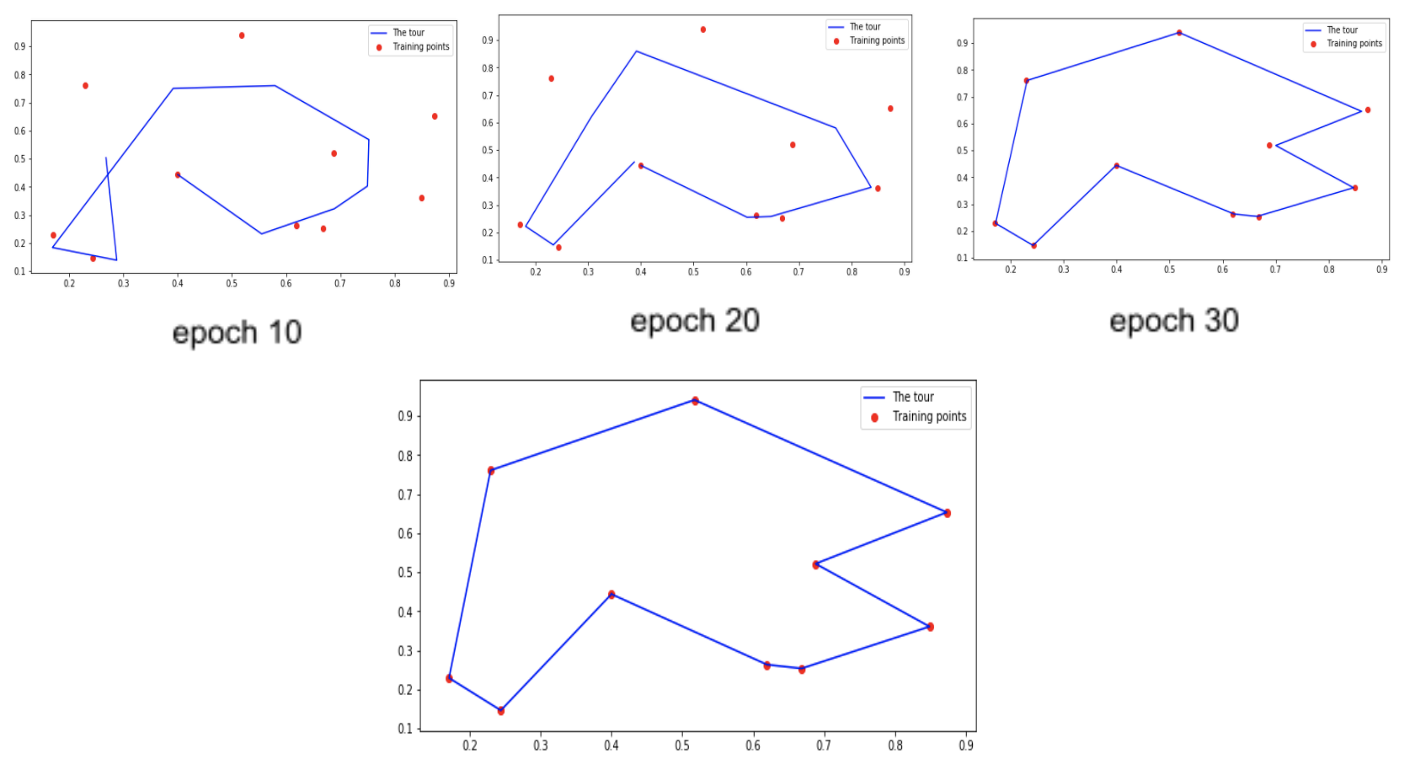
Self-Organising Maps
City Tour
Training details:
epoch: 50
learning rate: 0.2
neighbornood range : [2,1,0,0,0]
Conclusion:
Fewer data needs more updates to
find good weights
In the later part of training, focusing
on winner node is a better strategy
Notes:
In the second task, we are again using SOM to solve traveling salesman problem. Different from last task, the hidden nodes are arranged in a 2d plane. And the difference in training is how we define the neighborhood.
This time the neighbourhood is circular and the suggested range is set from 2 to 1 and finally to 0.
From 0 to 10 epoch the range is 2. From 10 to 20, the range is 1. From 30 to 50 the range is 0,meaning only update the winner node.
If we set the epoch to 20, as shown in the plot, it is still far from real data points.
Evetually we set it to 50 to get a more perfect match.
Conclusion: since we only have ten data points, it is naturally that we need to have more updates. But in the case of more complex data,more updates might lead to optimal results.
Another conclusion is that: In the later part of training, focusing on winner node is a better strategy

Slide 10
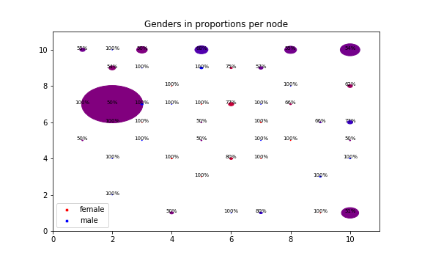
Self-Organising Maps
Data Clustering
Analysis - Gender
Conclusion:
Gender does not affect how
people votes
Notes:
Final task is to use SOM to analyze how different factors affect how parliment members votes.
In the plot,Red represents women and blue represents men. The color for each node is proportional to the percentage of a different gender. The redder, the more women. The more blue, the more men. A perfect purple shows that it has equal numbers of women and men. The diameter of the circle is proportional to the number of that particular node among 100 hidden nodes.
As shown here the biggest cluster has 50% of women which suggest gender doesn't affect how people votes.

Slide 11
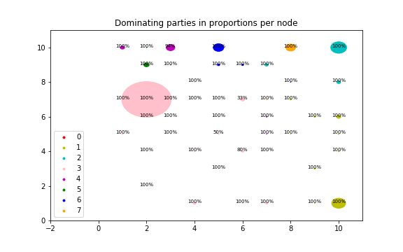
Self-Organising Maps
Data Clustering
Analysis - Party
Conclusion:
Party is the main factor which
affects how people votes
Notes:
In the plot,percentage is the dominant party’s percentage for that particular node
The diameter is also proportional to the number of that particular node among all hidden nodes
Compared with the previous plot, the data points are better clustered. Most people in the same cluster are of the same party.

Slide 12
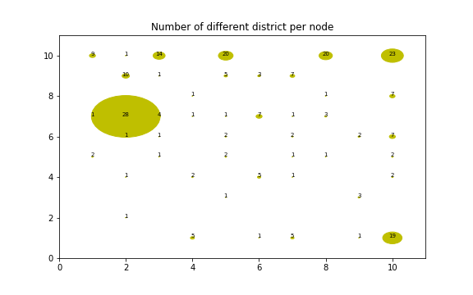
Self-Organising Maps
Data Clustering
Analysis - District
Conclusion:
District does not affect how
people votes
Notes:
As for district, due to big number of different district, we don't use different color for it
but the number for each node is how many different dictrict this node has. As shown in the plot, the biggest cluster
has 28 different districts and the total number of districts is 29 so we can conclude that district has little to do with the vote either

