Slide 1
Lab Assignment 3
Hopefield Networks
Group 4
Chiachen Ho, Angelos Stais and Ruxue Zeng
October 6, 2021
Artificial Neural Networks and Deep Architectures, DD2437

Slide 2
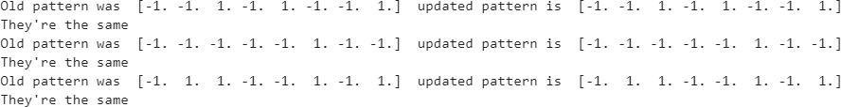
Convergence and Attractors
Stored patterns
Distorted patterns
The network is able to store all three patterns and it can recall some distorted patterns (x2d does not converge towards x2)
Very dissimilar patterns
The network cannot recall too dissimilar patterns
Notes:
In the first part we created the memory patterns, the weight matrix and the update rule. and we applied the update rule. We concluded that the network was able to store all the 3 patterns.
For the distorted inputs patterns we defined the new patterns which are distorted versions of the original ones. We applied the update rule repeatedly and we concluded that x1d and x3d converge towards stored patternsa and after 3 iterations, x2d does not converge toward x2.
So, the network is able to store all three patterns and it can recall some distorted patterns (x2d does not converge towards x2)
For very dissimilar patterns we can see that the network cannot recall them.
(The number of iterations needed to reach an attractor scales roughly as log(N) with the network size, which means there are few steps for a network this small. If you want you can train a larger network to get slower convergence).

Slide 3
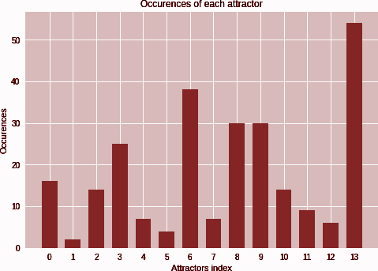
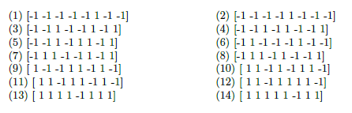
Convergence and Attractors
Number of Patterns
All 3 patterns are attractors - total of 14
If a pattern is an attractor, the opposite pattern in an attractor too.
Notes:
Regarding the number of attractors in the network (after automating the searching of the attractors) we concluded that x1,x2,x3 are attractors and also 14 attractors in this network.
In the figure we can see the occurrences for each attractor for the attractor index.
Also if a pattern is an attractor, the opposite pattern in an attractor too.

Slide 4
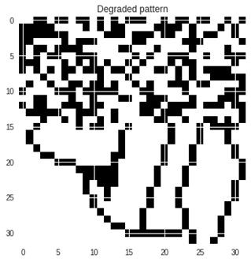
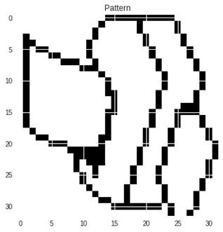
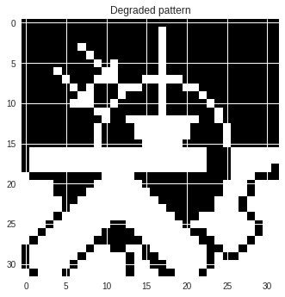
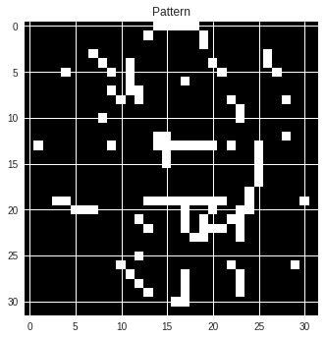
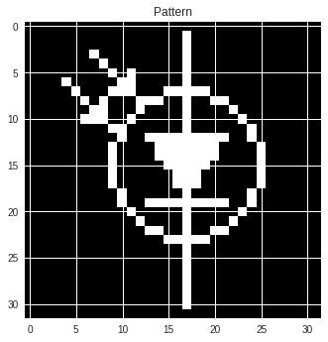
Sequential Update
The 3 patterns are stable.
In batch mode :
Figure 2 : Degraded pattern p10 Figure 3 : Restored pattern p1
The network can restore a degraded pattern in batch mode
Figure 4 : Degraded pattern p11
Figure 5 : Restored pattern
The network cannot complete a pattern that is a mixture of two learnt patterns in batch mode
With a sequential update, the pattern converges most of the time to the pattern p3 in a few iterations
Figure 6 : Degraded pattern p11
Figure 7 : Restored pattern p3
Notes:
For the second part we switched to a 1024-neuron network and picture patterns We loaded the data (which contained nine 1024-dim patterns stored one after another).We learned the first three and found out that the 3 patterns are stable and the convergence takes 1 iteration.
Regarding if the network can complete a degraded pattern we can see that trying the pattern p10, which
is a degraded version of p1 the network can restore the pattern 1 (after 2 iterations). So convergence is practically almost instantaneous here.
Trying pattern p11 which is a mixture of p2 and p3 we concluded that the network cannot complete a pattern that is a mixture of two learnt patterns in batch mode.
We can also see Pattern p11 converging to learned pattern p3 with sequential update.
So with a sequential update, the pattern converges most of the time to the pattern p3 in a few iterations

Slide 5
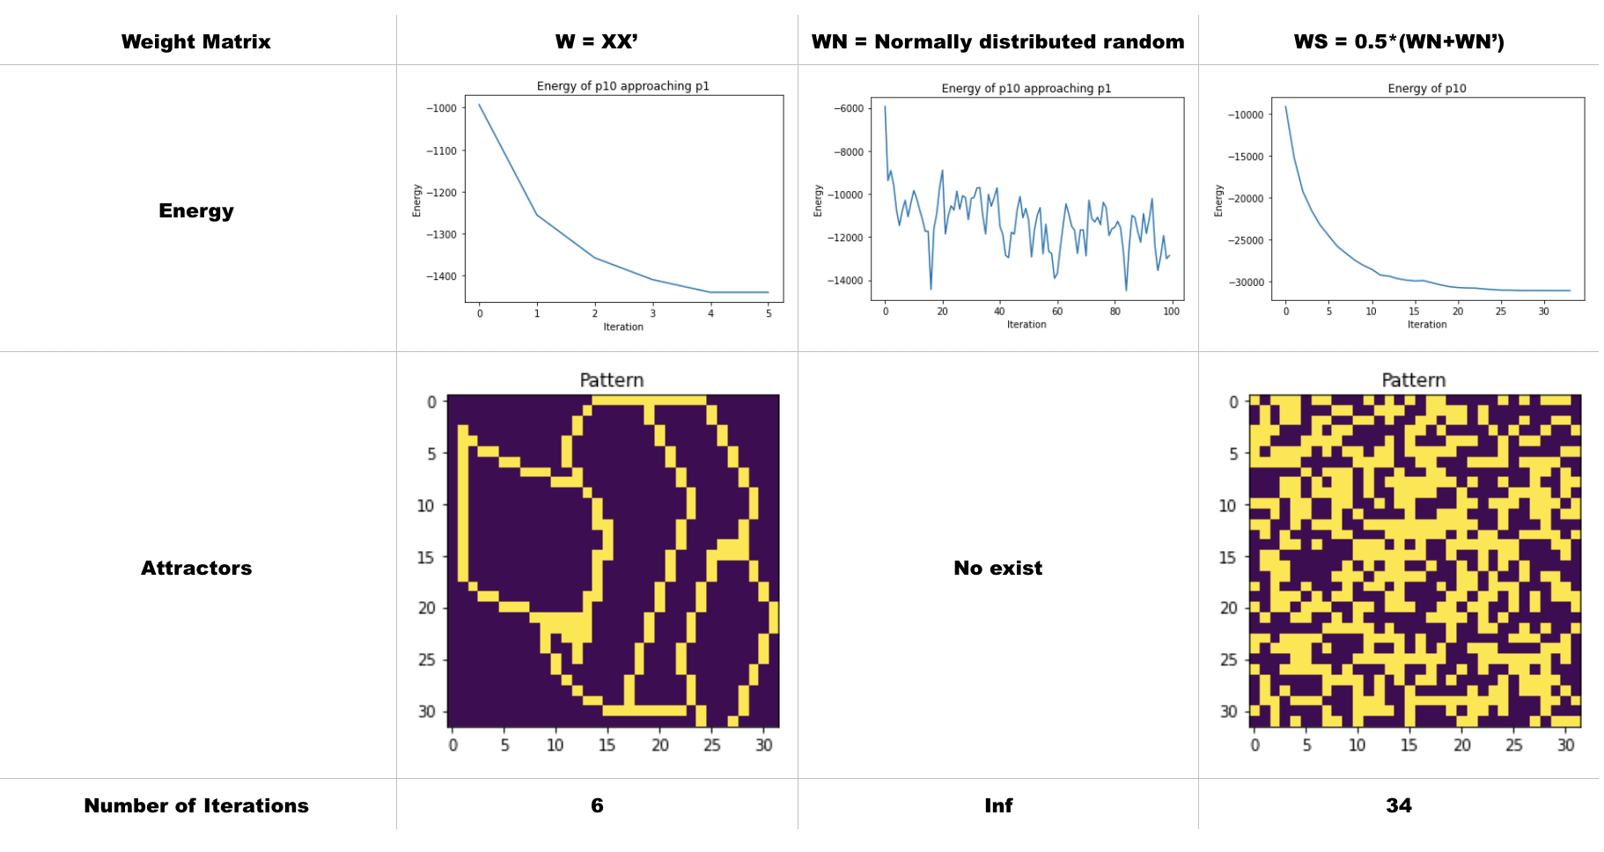
Picture patterns - Energy
Conclusions :
W=XX^{T} : Energy keeps decreasing from iteration to iteration, network converges to right attractor
W initialized with normally distributed random numbers : Energy keeps cycling, network doesn’t converge
W is random symetric : Energy keeps decreasing, network converges to wrong attractor
Notes:
In order to study the convergence of our network, since we have a symmetric connection matrix, we define an energy function, a finite-valued function of the state that always decreases as the state changes. Since it has to have a minimum at least somewhere the dynamics must end up in an attractor. We observe that the energy at the different attractors is much lower than at the points of their distorted patterns.
The figure shows the energy evolution of P10 with three different weight matrices using the sequential update rule. From iteration to iteration, when we use the weight matrix initialized depending on the patterns, the energy keeps decreasing until it attains its minimum, i.e. in an attractor. But if the weight matrix is initialized with normally distributed random numbers, then the energy doesn’t converge, it keeps cycling between different states forever. If we make this random matrix symmetric, then the energy keeps decreasing and ends up in an attractor with much more iterations then the first model, and this attractor is not the one we expected. By setting the matrix symmetrix, we obtain a symmetric connection matrix, but the numbers composed this matrix are independent from the patterns, so they are in the memory cue situated in the bassin of a different attractor, which drives it to this attractors.

Slide 6
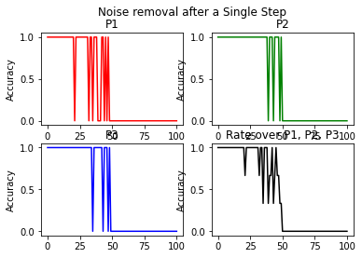
Distorsion Resistance
One Single-Step
Conclusions :
A maximum of 50% of noise can be remove
Noise tolerance varies depending on attractor
Figure 8 - Noise removal after a Single step
Notes:
Now, we want to study the resistance of the Hopfield network to noise and distortion. By randomly flipping a selected number of units, we generate noisy test stimuli. In particular, we train the network with p1, p2 and p3.
According to this Figure, using the Little model with one single-step, we observe that from 50% noise, the accuracy to recover the original clean patterns becomes zero, so only a maximum of 50% of noise can be removed. With regard to noise tolerance, it varies depending on attractors. We observe that p2 has the shortest oscillation bearing, so it has the biggest noise tolerance. On the other hand, p1 has the longest oscillation bearing, so it has the smallest noise tolerance.

Slide 7
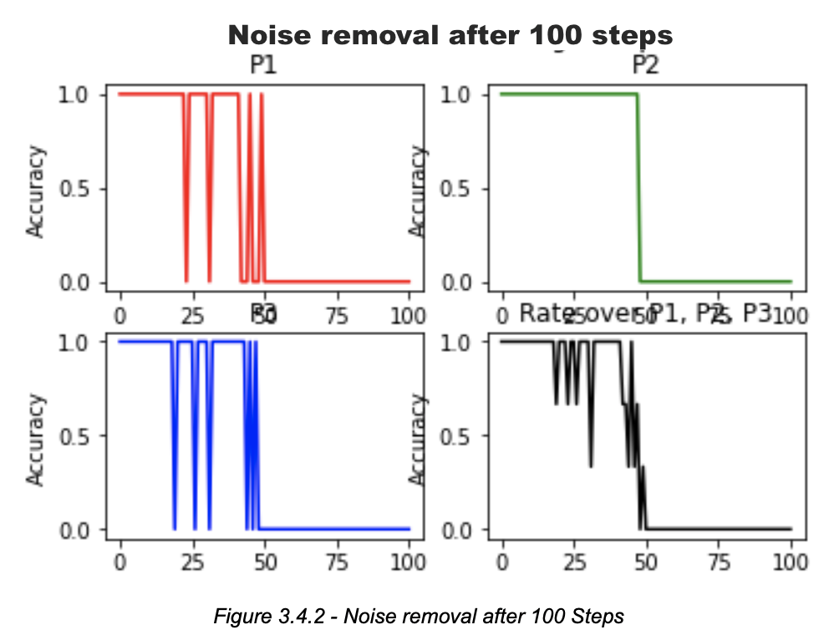
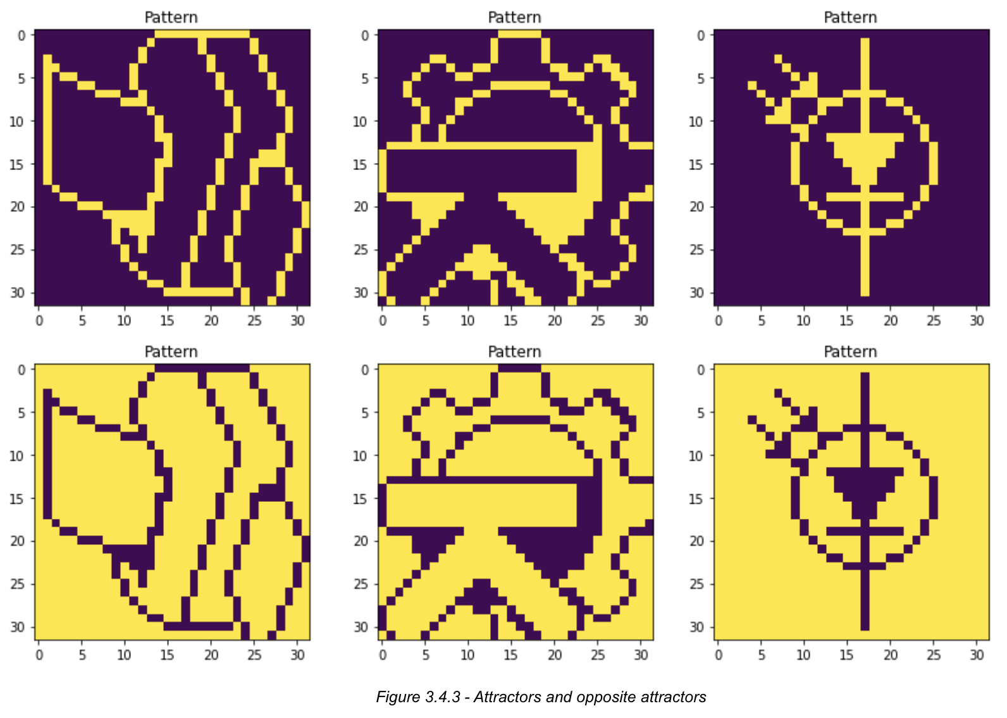
Distorsion Resistance
One Single-Step
Figure 9 - Noise removal after 100 step
Figure 10 - Attractors and its opposite
Conclusions :
Extra iterations help to improve convergence
The opposite of attactors are also attractors in the Little Model
Notes:
We observe that the network doesn’t always converge to the right attractor. The extra iterations do help to improve the convergence, there are less oscillations. Furthermore, we notice another attractor which is the opposite of the right attractor. It has the same energy than the right attractor, so with the Little model, we converge also to this opposite attractor.

Slide 8
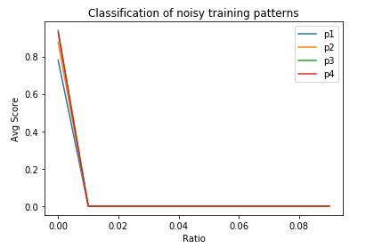
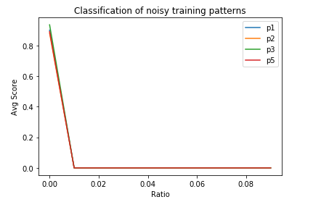
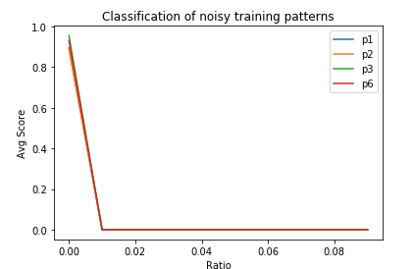
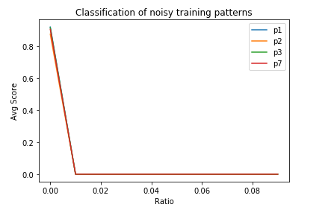
Capacity
Continue to add more patterns into weight matrix (p4,p5,p6,p7)
Conclusion:
The performance drops abruptly when the number of patterns goes from 3 to 4 and more.
Notes:
For this task, we add more patterns to the weight matrix. The value on the y-axis is the average score obtained from 10 runs. If the network is able to store this particular pattern, then we set the score to 1. We see an abrupt drop in performance when noise rate is at 1%.
We have tried different combination of patterns and found that the combination of p2,p5,p8,p9 can be better stored.
But with 5 patterns, the network can hardly store all of them.
The conclusion is that the network doesn't seem to be able to recall patterns well when the number of patterns is more than 3.

Slide 9
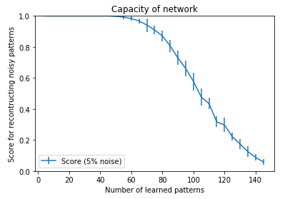
Capacity
Replace pictures with random patterns
Settings:
Number of patterns : from 0 to 0.138*1024 with an interval of 5
Repeat : 10
Conclusion:
Network performs better on random patterns than on pictures.
Notes:
Now we replace pictures with random patterns. As shown in the plot, the network performs better on random patterns than on pictures. And after the number of patterns exceeds 60, the performance starts to drop.
The reason why such difference exists is due to the similarity between pictures whereas for random patterns which are generated via uniform distribution, such similarity doesn’t exist.

Slide 10
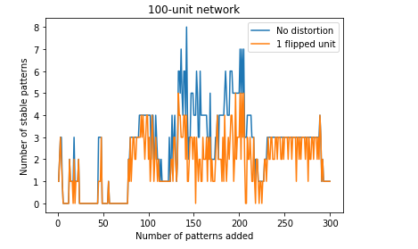
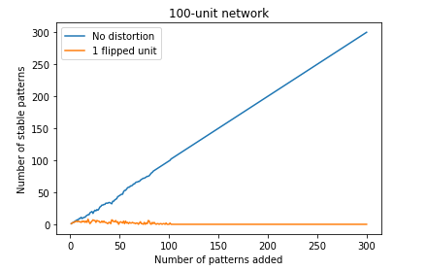
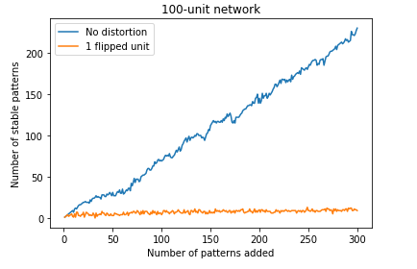
Capacity
100-unit network tested with 300 random patterns
fig1 : without self-connections fig2 : with self-connections fig3 : with self-connections & add bias to the patterns
Conclusion:
Network performs better and more stable with self-connections but is sensitive to distorted patterns
The network performs slightly worse when tested with bias patterns.
Notes:
For next task, we create a 100-unit network and test it with 300 random patterns. As shown in the plot, no distortion refers to the original patterns. 1-flipped unit refers to the noisy patterns.
We compare results with and without self-connections and self-connection with biased patterns
Without self-connection, the performance is not stable. With self-connection, the network performs perfectly on pure patterns but is sensitive to distorted patterns
Finally when bias is added to patterns, the performance is slightly worse. This is like the previous situation where network perform worse on pictures because pictures are usually dominant by 1s or 0s. And here the biased patterns are dominant by 1s.

Slide 11
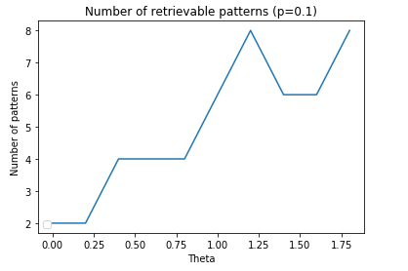
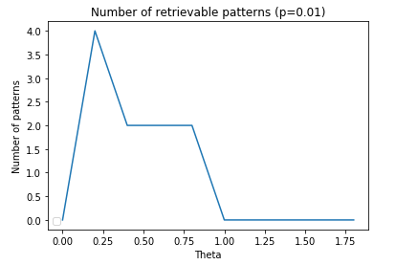
Sparse patterns
Test network with sparse patterns
Conclusion:
Bias has great influence over the capacity of the network
Sparser pattern (p=0.01) gives worse results and it needs a smaller value of 𝛉 to achieve better performance.
Notes:
The final task is to test the network with sparse patterns
in the plots,theta on x-aixs is the bias term for updating rule
We set 𝛉 from 0 to 1.8 with 0.2 interval and set the number of patterns from 2 to 12. For each number of patterns, we repeat 5 times. The value on the y-axis is the highest number of patterns the network can store among 2 to 12 patterns with 5 runs for each.
From the above two plots, we can see that bias has great influence over the capacity of the network. With 10% activity, the network can store up to 8 patterns when 𝛉 = 1.25. Overall, the sparser pattern (p=0.01) gives worse results and it needs a smaller value of 𝛉 to achieve better performance.

