Slide 1
Lab Assignment 4
Restricted Boltzmann Machines and
Deep Belief Nets
Group 4
Chiachen Ho, Angelos Stais and Ruxue Zeng
October 13, 2021
Artificial Neural Networks and Deep Architectures, DD2437

Slide 2
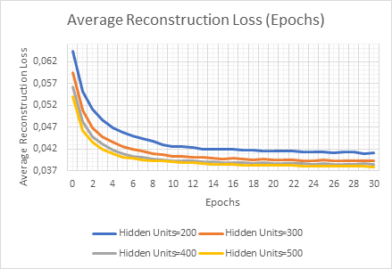
RBM for recognising MNIST images
Convergence, Average Reconstruction Loss
Conclusions
Converegence/Stability: 20-30 Epochs
Average Reconstruction Loss regarding Hidden Units: Decreasing the number of hidden units increases the average reconstruction loss.
500 Hidden Units: 0.038
200 Hidden Units: 0.041
Figure 1 - Average Reconstruction Loss for 200-500 hidden units
Notes:
Our first task is to develop an RBM with binary stochastique units and train it with a contrastive divergence algorithme CD1 to learn data representations in an unsupervised manner. In this case, to recognise MNIST images, a stantard machine learning benchmark dataset.
As recommended, firstly, we have used 500 hidden nodes, initialized the weight matrix with small random values (normally distributed: N(0,0.01)) and iterated the training process (CD) for 30-50 epochs. (The size of mini-batches is 20). To monitor convergence or stability, we stopped training when MSE between the original and reconstructed images was not larger than a threshold.
So our first conclusion is that every model converges around 20-30 epochs and we can also see from figure 1 that it doesn’t depend on the number of hidden units.
Then, we want to study how the average of thie reconstruction loss is affected by the number of hidden nodes, so we have run the model with different number of hidden nodes (200,300,400,500). From figure 1, we observe that decreasing the number of hidden units increases the average reconstruction loss. For 500 hidden units we concluded that average reconstruction loss stabilizes at around 0.038 and for 200 hidden nodes it stabilizes at around 0.041.

Slide 3
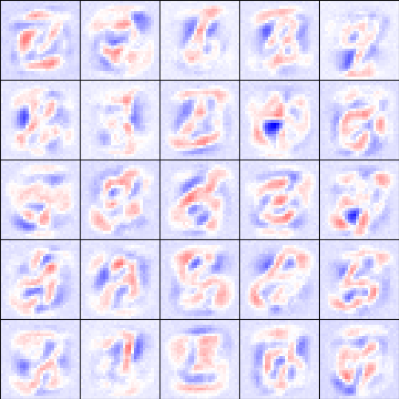
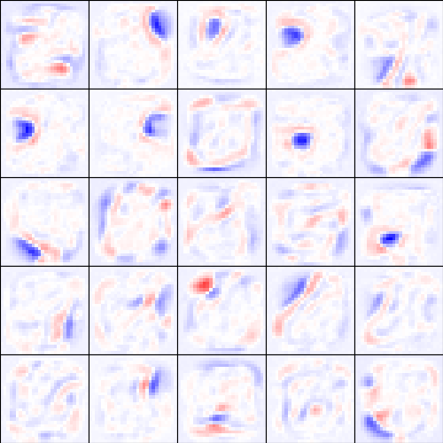
RBM for recognising MNIST images
Receptive field
Figure 2 - Image representations of the hidden weights in the RBM in 1st iteration (L) and 30th iteration (R)
Conclusions :
More we train the network, the receptive fields get more localized and show stroke-like features
Notes:
After learning, we want to examine the outcomes. We have chosen number of hidden nodes equals to 500, and number of epochs equals to 30. Since the training has been conducting without labels, the evaluation boils down to examining the fidelity of the reconstructed images as well as the nature of the receptive fields that each unit develops throughout the learning process. So we decide to plot the weights to the visible layer to be visualized for the hidden units of interest. Each square corresponds to the 784 weights of one hidden neuron to the 28 x 28 = 784 visible neurons. The squares are ordered according to the probabilities of the corresponding hidden units to be 1 given the training set in decreasing order.
When we are on the first iteration, we can even recognize digits in them, the learned filters are rather complex. When we are on the 30th iteration, the receptive fields get more localized and show stroke-like features. For example in the first square, the weight is visualized at the position of the blue and red area, where blue represents negative weight, and red represents positive weight.

Slide 4
Two RBMs in the stack
 | Reconstruction loss of First RBM | Reconstruction loss of Second RBM
First iteration | 0.0597 | 0.001
Convergence iteration | 0.0366 (50th iteration) | 0.000 (5th iteration)
Conclusions :
The 2nd generates a very small reconstruction loss, so we add more RBM in the stack.
Notes:
Now, we want to use the RBM machinery in the previous task to build a network with two RBMs with 500 hidden nodes in the stack, trained greedily one layer after another, with contrastive divergence learning, which means with the architecture 784-500-500. We obtain the reconstruction losses in the table:
We observe that the second RBM generates a very small reconstruction loss, approximately 0. That’s why we can stack more and more RBMs on top. We assume this separate learning of each RBM contributes to a globally useful representation of the true data.

Slide 5
DBN with Gibbs sampling
DBN with three RBMs
Structure : top(2000) <-> penultimate(500)+label(10) <-> hidden(500) <-> visible(784)
20 Epochs of training
Batch size | 20 | 100
Training accuracy | 83.38% | 85.5%
Test accuracy | 83.35% | 85.95%
Conclusion:
Training with larger batch size yields better results
Without the fine-funing phase, the network has limited capability of classifying images
Notes:
For the next part, we constructed a three-layer DBN to perform image recognition task. The architecture now becomes 784-500-500-2000 and the top stack can receive labels. So the number of units in the second last layer is actually 500 plus 10 which are the number of hidden units and the number of categories respectively. We train the network with different batch sizes. One with 20 another one with 100. Both were trained for 20 epochs. As shown in the table, the conclusion is that larger batch size gives better accuracy. Another thing to be noted is that a simple 3 layer neural network with back propagation can achieve an accuracy better than 90%. Here we can see the limitation of using generative models to perform classification task.

Slide 6
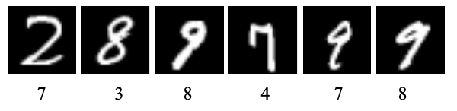
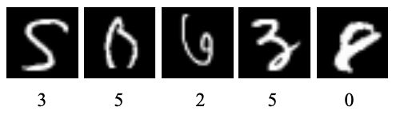
DBN with Gibbs sampling
Image classification
Misclassification on figures shared some similar features
Misclassificayion on hard cases
Notes:
Here we show some visualizations. The numbers placed below the images are the predictions made by DBN network corresponding to each image. We can see that some misclassifications are due to the similarity in some strokes shared between different numbers. For example, in the first image, 2’s curve looks like 7 without the bottom horizontal stroke. In the forth picture, 4 and 7 both have this feature where the left part is a long stroke. However, these are not so difficult cases. Other simple neural networks might be able to classify them correctly. And we also display some hard cases below. Those pictures are not so recognizable even for humans.

Slide 7
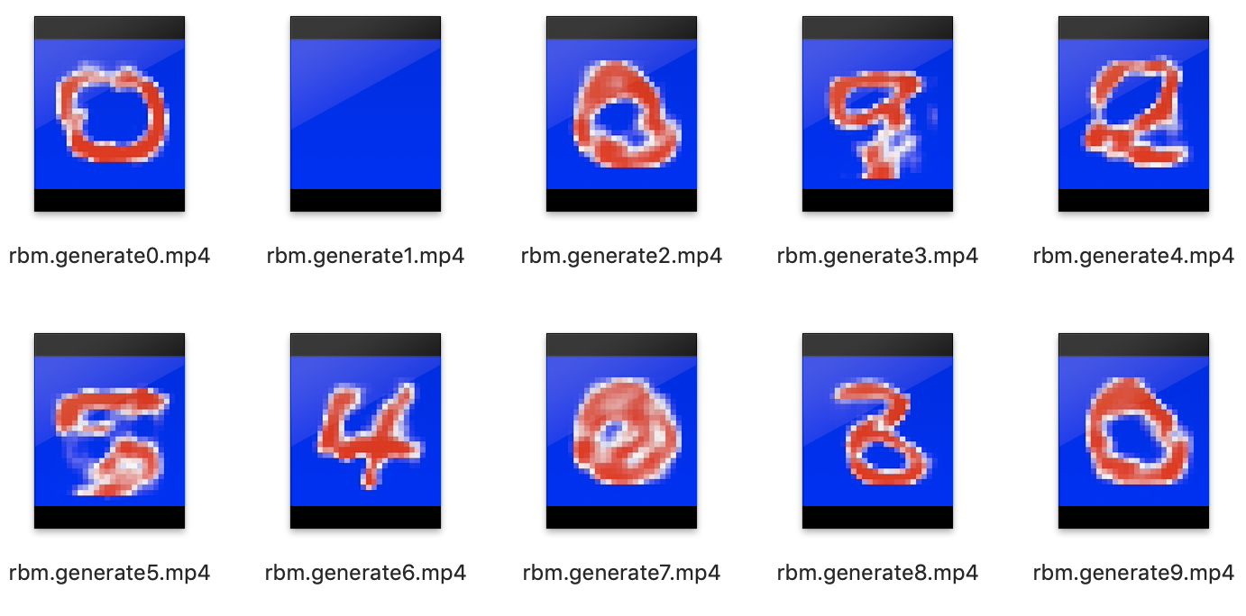
DBN in generative mode
Image generation
Conclusion:
The quality of generated images depends on the training of RBM (such as batch size and epochs) and the number of iteration for Gibbs-sampling between top and the second last layer
Less iteration gives noisier results
The poor performance could be explained by the fact that the update rule for weights is designed to maximize log(p(x)|W) instead of minimizing classification error
Notes:
For the next task, we use dbn for image generation. The results shown here is generated by the dbn trained with 20 epochs and a batch size of 100
The conclusion is that the quality of generated images depends on the training of RBM (such as batch size and epochs). Another factor is the number of iteration for Gibbs-sampling between the top and second last layer. Less interaction would yield images with more noise. As shown above, some generated images do look like their corresponding numbers such as 0,5, and 8.
As for numbers 4 and 6, the corresponding image looks completely like other numbers. This suggests that DBN does not take labels into consideration well. The reason behind this might be that the update rule for weights is designed to maximize log likelihood and it does not take classification into account when learning.

