Slide 1

Kernel Mania
Theme: Embedded System for Medical Device

Slide 2
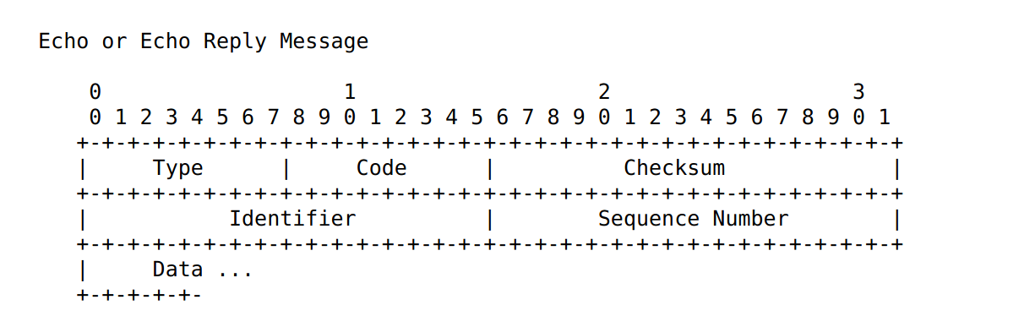
Backdoor in ICMP
RFC says this should remain 0...
I’m using it for a 1 byte checksum.
If it matches, the kernel decrypts the data section with XOR

Slide 3
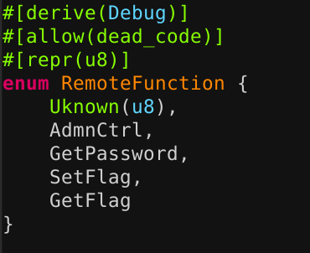
Remote function
Depending on the first byte it calls the apropriate function
Exploitable function
with hardcoded password
Functions for checker
TODO: Needs pub / priv crypto verification

Slide 4
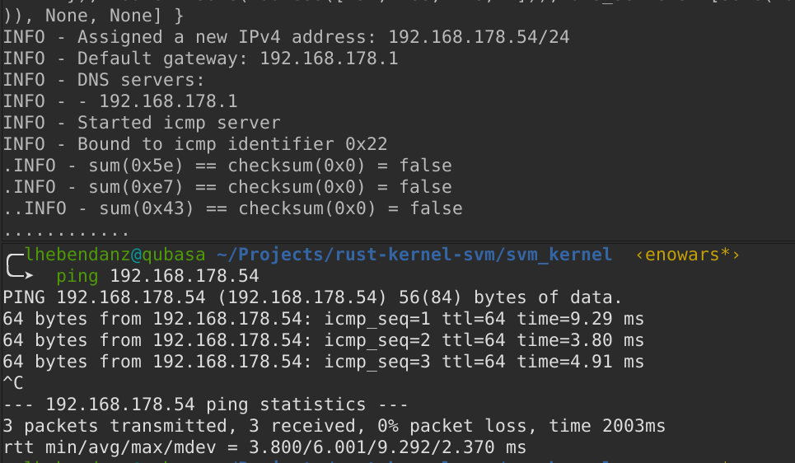
Kernel responds normally on ICMP
Kernel
Ping

Slide 5
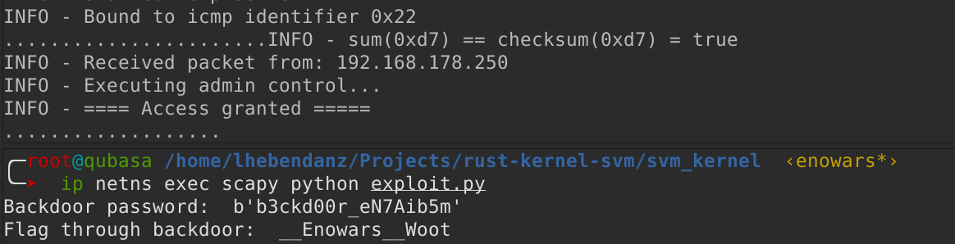
But differently if checksum correct

Slide 6
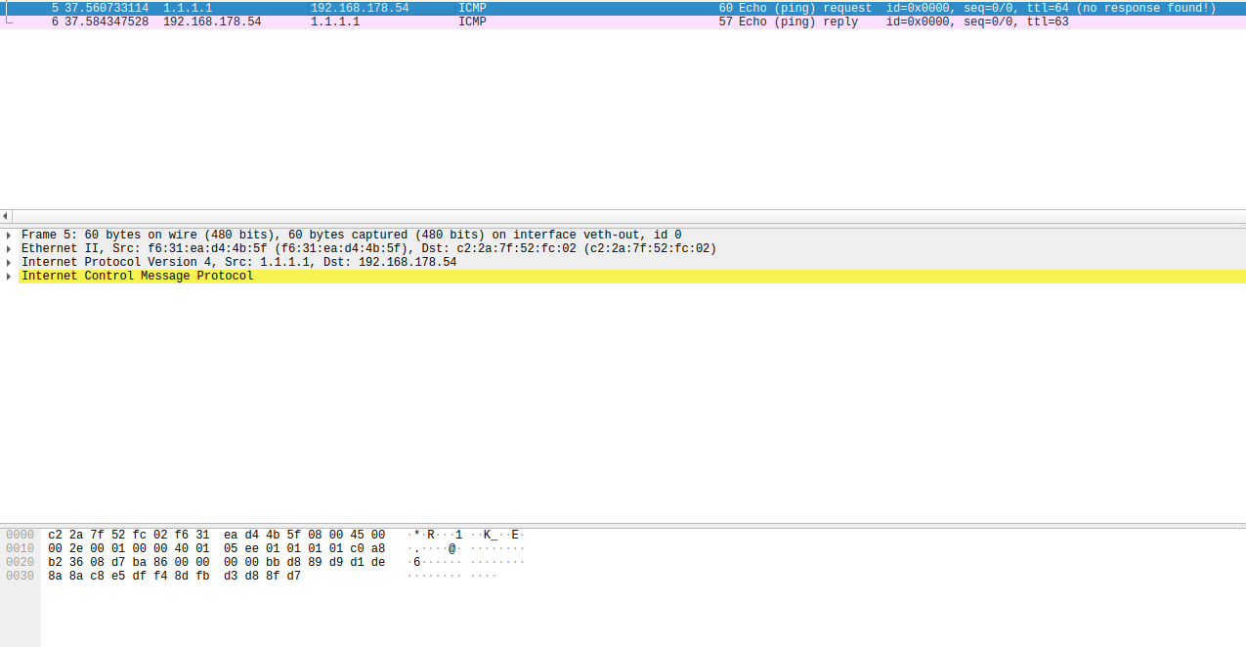
Network traffic is hidden
You do not see cleartext password because of XOR
I will add somekind of “randomness” to foil copy and paste of network traffic

Slide 7
How to defend?
Extract bootloader.elf from bootimage-svm_kernel.iso
Extract kernel.elf from bootloader.elf section called .kernel
to get debug symbols for kernel
Find hardcoded password and change it
Repackage everything and reexecute

Slide 8
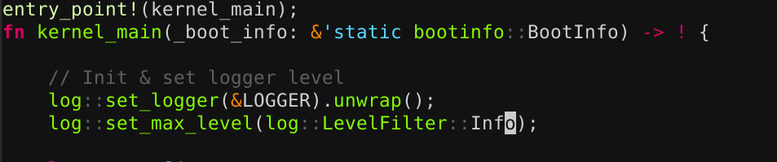
Quality of life considerations
I choose the rtl8139 network driver because it works with qemu emulation without kvm → You can copy the iso and execute it on every OS with qemu
If the player needs more information, he can patch the log level from Info to Debug.
I placed debug prints at important sections of the code

Slide 9
Problems I did encounter….
My network driver crashed… times and times again.
  → Incredibly badly documented and example code is broken. Fixed now
Creating a NATed environment to check if my protocol works through NAT.
...My protocol did not work in NAT…
Now it does ;)

Slide 10

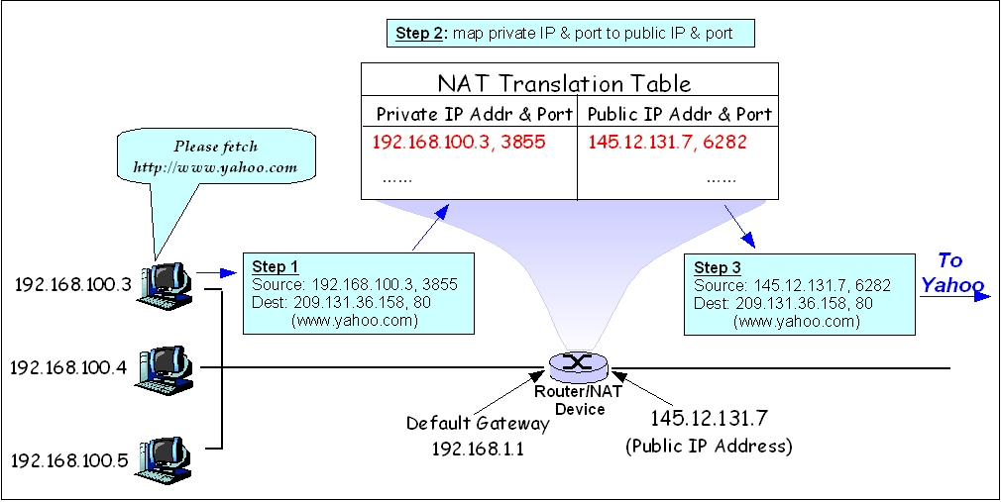
Reason it did not work in NAT

Slide 11
Current Problems
Kernel has own IP how does the checker get it?
How to display the Kernel IP to every other team?
My checker needs raw socket priviliges because of scapy, how do I do this in Docker with python?

