Slide 1

Recovery Protocol
Notes:
Hi, My name is Viktor Arato and this is my CMP202 Project presentation.

Slide 2

Incident Background
- After a hacking incident, Abertay University was contacted to help in recovering data from a website.
- Capable personnel has already been occupied, the choice to help came down to a student.
- This is how he helped humanity to solve a website scraping problem.
Notes:
In the pandemic, the number of hacking incidents rose and precious data has been deleted, that requires mitigation or recovery to function properly in the future.

Slide 3
The Incident
- In the pandemic, a hacker has deleted the sitemap of the Harvard Gazette news website.
- The website is still active, but without proper sitemap, website scrapers could wreak havoc, inflicting damage and high maintenance costs.
- The lack of a sitemap leads to too many requests.
Notes:
The problem was, that the sitemap, which stores all links has been deleted from the Harvard Gazette News website. This means that when the website is scraped, servers will need to send multiple responses instead of one.
This also makes it hard to find all news articles on the website page. The hacker however did not just delete the endpoint, but also stayed around and is actively monitoring the time one spends on the website.

Slide 4

The Requirements, Rules
The links can still be iterated through (26 years of scientific articles).
There are no request limits (~1000 requests).
It needs to finish a synchronised run in under 130 seconds. (~30 000 links).
Needs to be accessed on a shared database.
At least 3 threads, with at least 2 different thread functions.
Needs to share resources in a thread safe way.
Needs to be able to easily vary the number of threads used.
Needs to be collected in the shortest amount of time possible.
Notes:
The links from the 26 year lifespan news website are still up and running, but in order to build a sitemap, it needs to be collected to a single endpoint, but in our case, is has been tasked to upload it to an online database in a JSON like format.
The whole operation takes around 1000 requests for just getting all the number of pages, with around 28 000 links in total. This increases by the day and also need to be collected in as little time as possible, so that the hacker still around will not notice the operation.

Slide 5

The Recovery Strategy
Find an endpoint structure on the website to iterate through.
Use varying number of threads through arguments in command line.
With the use of Semaphores and thread safe Queues, achieve high Synchronization ability.
Parse structure, parse links and upload links in parallel.
Use Locks when modifying shared resources.
Use of MongoDB as online shared database.
Notes:
The recovery can be done with just one thread, but the 27 000 links and upload time would make it easy for the hacker to see what is happening, therefore parallel execution is required. The tool will also enable us, by specifying various flags, to set the amount of threads used for the recovery, while also providing an optimized scraping strategy if needed. Assessing the endpoints, scraping them and uploading however, does not need to be linear. Through the use of synchronization and a producer-consumer relationship in a pipeline pattern, we can make the threads scrape and upload while the website is still only just being assessed. The JSON like format is supported by a database called MongoDB, which is what is used for storing the links.

Slide 6

GIL and IO requests
- The Python language has a restriction, which can be surpassed.
- IO bound requests can be parallelized in Python
- What is the GIL?
- What can be done about it?
Notes:
Using CPU is required for this project, because the GPU would not be able to easily access the IO bound tasks and is not built to send or receive requests, making the CPU much more capable for the implementation. The problem is, that the Python language with the threading library does not provide full parallelization if the prebuild mutex is not surpassed. This is called the Global Interpreter Lock, which leaves a bottleneck on CPU bound processes. These are processes that spend most of their time inside the CPU. However website scraping is not CPU bound, but IO Bound. This means, that the main inherent disadvantage of the program comes from waiting on inputs, which is what Website scraping does.
With knowing this, we need to prepare with proper synchronization, to make the inputs output efficiently and most importantly, in parallel.

Slide 7

Structure and functions of scraper
The website has an endpoint, for easy navigation. The /story/<year>. A Year scraper function.
Individual years have several pages containing links, all could be accessed on endpoint /story/<year>/page/<pageNumber>. A Page number scraper function.
Iterate through them, extract links. A Link extractor function(s).
Upload to online database.
Notes:
The structure of the News page allows us to scrape it in an easier way. The main endpoint contains all years, this function then passes its output to a different function, that checks each year for the amount of pages that can be found that year. The output then inputs a function that extracts all the links, which after the links could immediately be uploaded to the database.

Slide 8
Anticipated best Efficiency
The Year scraper function can extract all 26 years in 1 request. 1 thread is the most optimal implementation. No synchronization required.
The Page number scraper function then individually scrapes for 26 links, 26 threads are most optimal. This produces a task, which could be synchronized.
Link extractor function(s). Consumes and creates tasks. Threads in amount of page numbers should be most optimal. Could be synchronized.
Upload to online database, with a Lock. Which marks the end of pipeline tasks.
Notes:
The first function only creates one request, which by itself needs to be fully parsed to continue with the next function, making this impossible for parallelization, but for safely tasking, a Queue was used. The next function however needs to parse through all 26 years to see how many pages of news there can be found there. The most optimal amount of parallel requests are the amount of years of articles on the site, which as of today from 1996 are 26. The output then can be loaded into a Queue, which is a thread-safe linear data structure. This was made more efficient with the use of semaphores, making sure that the next thread can immediately start to gather the links from each individual year's pages. When iterating through the pages, the most optimal way, which has also been implemented, but in the end partly backfired, is to start as many requests as many pages there are. The most amount of pages in a year is 54, in 2009. This then can also supply a Queue of links for the last function, immediately passing the links into a shared resource, that with the use of Locking. This data is then passed into a dictionary, that looks up the current key with an O(1) time complexity and replaces its value. These 4 functions create the pipeline pattern of the program.

Slide 9
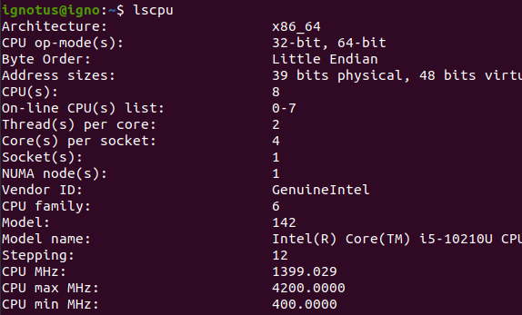

Experimenting
Slow, 1 thread for 1 task, plus the first request.
Standard, with 26 threads, one for each year.
Optimized, with 26 threads, while each year's number of pages get a thread (WARNING).
Requests and Session.
Parts of pipeline.
Measuring will be in seconds.
Varying thread numbers.
Factoring other variables in.
Notes:
When experimenting, a Linux Ubuntu 20.04 operating system was running with an Intel(R) Core(TM) i5-10210U 8 core CPU each core supports 2 threads, but due to IO bound tasks, simulating more to make requests makes it less time consuming to run. The first test, is to see how much time the year getter function takes in a parallel and non parallel way, then we can see the 2 synchronized thread functions working together with varying amount of threads in the processes. Then the full application is measured to see how long it takes with different number of treads. In the program, sessions are used instead of an individual requests. This makes it faster for scraping. Ethical considerations were made for each request made towards the service, while also seeing variable execution times based on the time the program was executed, usually faster in the evening, due to freed up broadband.

Slide 10
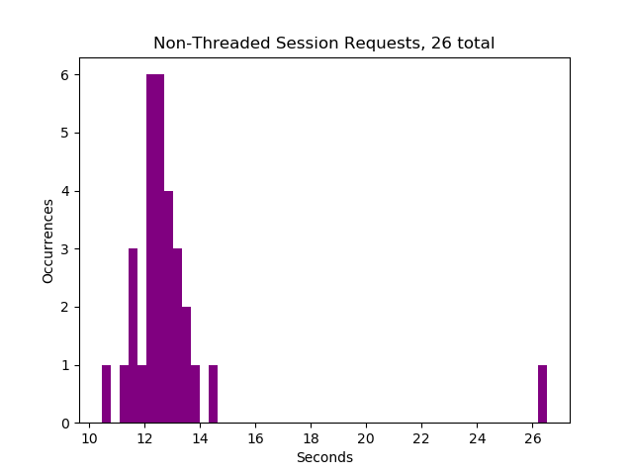
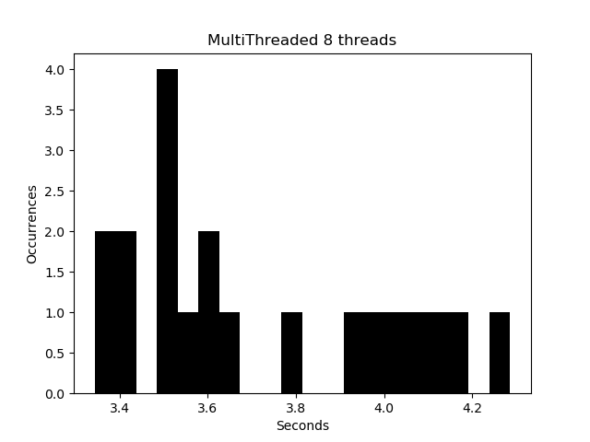
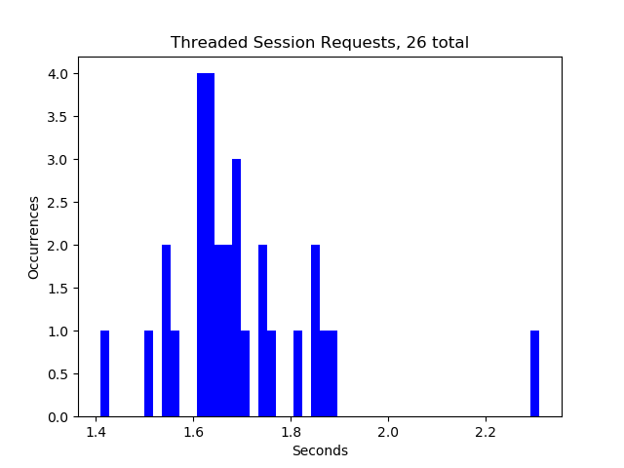
Session over Requests
Session request only, non-parallel
Average: 12.975450197855631 seconds Median: 12.45760726928711 seconds
Session requests with 8 threads
Average: 3.724008953177524 seconds
Median: 3.6156079658177624 seconds
Session requests with 26 parallel threads:
Average: 1.785995109875997 seconds
Median: 1.6741243600845337 seconds
Notes:
When testing the first function, it can be seen, that running it non-parallel takes on average more than 10 times more. Showing that the optimal is indeed 26 threads, making 1 thread execute 1 request. We can also conclude that the time taken with a smaller number of threads are almost as efficient as the optimal case, meaning that if endless amounts of resources are not available, close to peak performance can still be expected with less threads.

Slide 11
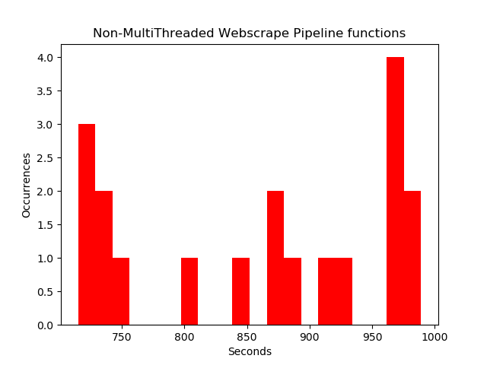
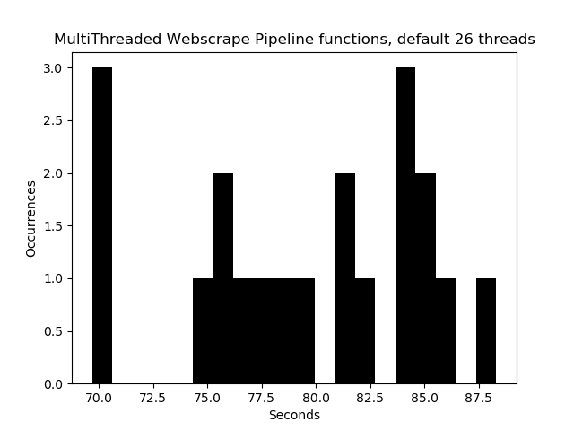
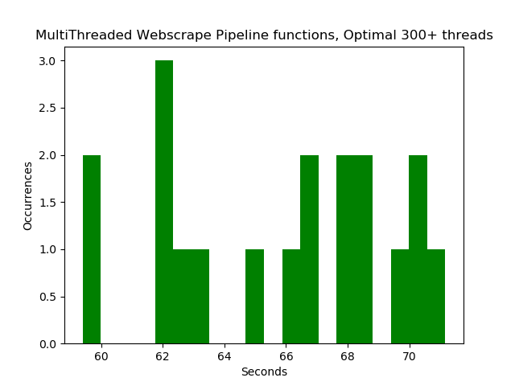
Web scraping parts of pipeline
1 Thread Web-Scraping functions Average: 860.5677591414166 seconds
Median: 875.4946679730649 seconds
Default Web-Scraping functions
Average: 79.45315009622615 seconds
Median: 80.11851621389971 seconds
Optimal Web-Scraping functions Average: 65.8431925955498 seconds Median: 66.4739441871643 seconds
Notes:
When testing the synchronized Website scraping functions on the timeline, we can see that with 1 threads per function, the performance is almost 11 times slower by average, while with 26 threads, the near perfect performance is still achievable. But when using endless amount of resources, we can still get a better result by 18%. This implementation however, will reveal a bottleneck in the design of the peak strategy implementation thought process in the full application.

Slide 12
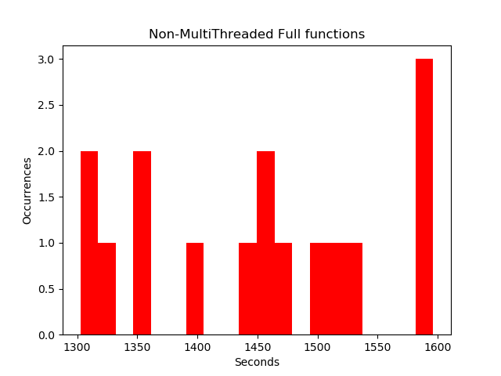
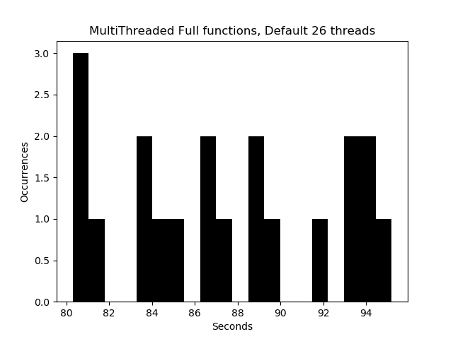
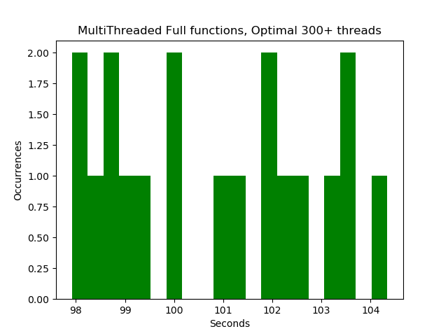
All pipeline functions
Full pipeline, 1 threaded functions
Average: 1448.121027455036 seconds
Median: 1449.7646775171445 seconds
Full pipeline, a thread for every year
Average: 87.47159079138382 seconds
Median: 87.05949537330392 seconds
Full pipeline, a thread for every year and page
Average: 100.86253020081084 seconds
Median: 101.08603882789612 seconds
Notes:
This is when the full pipeline has been run through and finishes. With using 1 thread per function, it takes a staggering 24 minutes to finish, however the most interesting result is not the 16 times difference but the relation between the peak performance and the default amount of threads. This is due to the overwhelming amount of threads running and most importantly racing concurrently and through synchronization and the lock, gives an unseen 13% cap at the performance. At worst case, the program still has not fully finished parsing the years, while the page parser already is waiting or started to parse with multiple hundred threads at the same time, while the upload threads are waiting to be executed. This can also occasionally turn the computer off.

Slide 13

Errors, Conclusion
- Difficulties in synchronization, while also having varying amount of threads
- Difficulties in locking properly while uploading
- Difficulties in proper usage of thread-safe Queues
- Enjoyment in understanding the parallel abstraction with threading groups
- How the limits of the CPU work by testing, crashing
Notes:
When implementing the project, I first thought there are no limits for IO bound threading, which through the testing of the whole application proved and showed me wrong, this made me understand that the number of threads are not meant to be played with if the crashing of the computer is a consideration. There were also difficulties in why the Semaphores did sometimes not increment properly due to improper multi-file handling, or how queues can be used to make threads run in a while loop instead of getting reassigned, for more efficiency leaving the overhead caused by making a thread out, while also leaving the possibility to vary the number of threads run by just 4 commands. When testing at night, the application also ran faster, this was concluded because all the minimum amounts of runtime gathered, were between 11pm and 1 am, this should be because the freed up broadband usage.

Slide 14
Thank You for Your attention!
Notes:
Thank You for Your attention!

