Slide 1

MBT1709313
I am Que Zi Wei, a normal student of XMU, I come from China FU Jian.

Slide 2
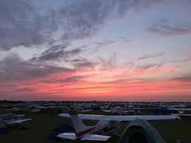
This is my first lab task, according to the slides, what I should do is insert shapes, change the color of text, example, change text effects, example, add picture and so on.
Notes:
Notes : ……

