Slide 1

Air Quality Index Analysis
Group 3
Soumya Patil
Bhavna Patadia
Kate Engard
Quecis Joshua
Michael Nosa

Slide 2
“You can have data without information, but you cannot have information without data.”
- Daniel Keys Moran

Slide 3
Problem Statement
The study is about the Air Quality Index in the United States. The data that was used is dated 2019 as it has the most recent and complete monitoring's of Air Indexes. This study is to show the quality of air that we breath and the chemicals that goes with it.
People need to breathe, and so other living creatures in this world. The flow of life wherein a process called respiration. Respiration is when a living creature breathe in oxygen and breathe out carbon dioxide for living things that needs it.
However, too much carbon dioxide plus other chemicals may be harmful especially as it reaches the atmosphere. This changes the distribution of the heat into the Earth and causing it global climate change. With that being said, we aim to show in this study the contribution of the country to the global climate change.

Slide 4
Problem Statement
Data is not collected for all 365 days by each city so an accurate picture cannot be attained with certainty. This has to be taken into consideration when looking at results.
Looked at Cities with best data coverage for evaluation (atleast 70% or higher data collected)
Looked at the Cities that has the best good days in respect to AQI
The original imported dataset for AQI does not have Latitude and Longitude for each city. In order to map it, Latitude & Longitude is pulled from google.
The dataset used includes information about the data captured for monitoring ozone and PM2.5 parameter on daily basis across counties by EPA’s Air Quality System for the year 2019. The data in these datasets is delimited with a comma ','

Slide 5
Problem Statement
What is the air quality index in the USA?
Which states has the best air quality index?
Which city in Arizona has the most hazardous days?
Which city in Arizona has the highest ground-level ozone?
What percentage of harmful chemicals in the air is harmful for sensitive groups?
Which state has the most air pollution?
Is there a correlation between population and air quality index?
Is there a significant correlation between Latitude and Ozone or PM2.5?

Slide 6


Slide 7
Milestones
Team 3 finalized the subject during the 2nd meeting and started looking for resources for the data.
During the 2nd meeting of the team the data was addressed.
The team collaborated and assigned each and everyone to manipulate the data.
The team assigned a representative to create a repository and instructed everyone to push their work in it.
The team collaborated on finalizing the codes and addressing the hypothesis.
The team assigned Joshua as the representative for team 3 to present the finish product.
Kate, Josh and Bhavna collaborated on the codes that we used in most parts of the project.
Michael volunteered to put the power point presentation together.
Bhavna proactively assisted and collaborated to finalize the power point presentation.
Everyone in the team came up with hypothesis based on their individual focuses.
Quecis Joshua combined all the codes from the team’s individual notebook into one notebook.

Slide 8
Data Analysis

Slide 9
Annual Air Quality Index
Glossary
Columns/Indicators | Description
State Code | The FIPS code of the state in which the monitor resides.
County Code | The FIPS code of the county in which the monitor resides.
Site Num | A unique number within the county identifying the site.
Parameter Code | The AQS code corresponding to the parameter measured by the monitor.
POC | This is the “Parameter Occurrence Code” used to distinguish different instruments that measure the same parameter at the same site.
Latitude | The monitoring site’s angular distance north of the equator measured in decimal degrees.
Longitude | The monitoring site’s angular distance east of the prime meridian measured in decimal degrees.
Location | Latitude and Longitude of the monitoring site
Datum | The Datum associated with the Latitude and Longitude measures.
Parameter Name | The name or description assigned in AQS to the parameter measured by the monitor. Parameters may be pollutants or non-pollutants.
Sample Duration | The length of time that air passes through the monitoring device before it is analyzed (measured). So, it represents an averaging period in the atmosphere (for example, a 24-hour sample duration draws ambient air over a collection filter for 24 straight hours). For continuous monitors, it can represent an averaging time of many samples (for example, a 1-hour value may be the average of four one-minute samples collected during each quarter of the hour).
Pollutant Standard | A description of the ambient air quality standard rules used to aggregate statistics.
Date Local | The calendar date for the summary. All daily summaries are for the local standard day (midnight to midnight) at the monitor.
Units of Measure | The unit of measure for the parameter. QAD always returns data in the standard units for the parameter. Submitters are allowed to report data in any unit and EPA converts to a standard unit so that we may use the data in calculations.
Event Type | Indicates whether data measured during exceptional events are included in the summary. A wildfire is an example of an exceptional event; it is something that affects air quality, but the local agency has no control over. No Events means no events occurred. Events Included means events occurred and the data from them is included in the summary. Events Excluded means that events occurred but data form them is excluded from the summary. Concurred Events Excluded means that events occurred but only EPA concurred exclusions are removed from the summary. If an event occurred for the parameter in question, the data will have multiple records for each monitor.
Observation Count | The number of observations (samples) taken during the day.
Observation Percent | The percent representing the number of observations taken with respect to the number scheduled to be taken during the day. This is only calculated for monitors where measurements are required (e.g., only certain parameters).
Arithmetic Mean | The average (arithmetic mean) value for the day.
1st Max Value | The highest value for the day.
1st Max Hour | The hour (on a 24-hour clock) when the highest value for the day (the previous field) was taken.
AQI | The Air Quality Index for the day for the pollutant, if applicable.
Method Code | An internal system code indicating the method (processes, equipment, and protocols) used in gathering and measuring the sample. The method name is in the next column.
Method Name | A short description of the processes, equipment, and protocols used in gathering and measuring the sample.
Local Site Name | The name of the site (if any) given by the State, local, or tribal air pollution control agency that operates it.
Address | The approximate street address of the monitoring site.
State Name | The name of the state where the monitoring site is located.
County Name | The name of the county where the monitoring site is located.
City Name | The name of the city where the monitoring site is located. This represents the legal incorporated boundaries of cities and not urban areas.
CBSA Name | The name of the core bases statistical area (metropolitan area) where the monitoring site is located.
Date of Last Change | The date the last time any numeric values in this record were updated in the AQS data system.

Slide 10
Data Analysis
CREATING DATA BY STATE
Get the Average data by State
Focused on Top 5 States with high pollutants
CREATING DATA BY CITY
Collected data percentage
Cities with best data coverage for evaluation (at least 70% or higher data collected in 365 days)
Top 5 cities with best air quality
Pulling Latitudes and Longitudes
Loop through all the cities from the imported dataset
Handle spaces in city names
Gathered city data
Acquired state from city name
Acquired lat & Lng from json response
Collected medianAQI for found cities
Collected good days for found cities
Collected hazardous days for found cities
Collected percentile AQI
Printed city data as its aquired

Slide 11
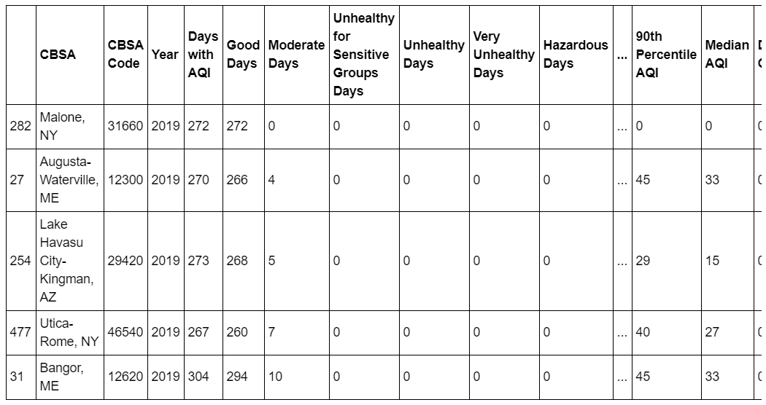
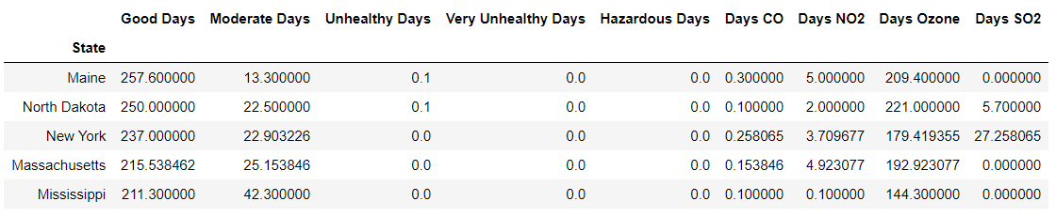
Data Analysis
CREATING DATA BY CITY
aqi_city["Year Coverage"] = aqi_city["Days with AQI"] / 365
aqi_city["Good Day Percent"] = aqi_city["Good Days"]/aqi_city["Days with AQI"]
Codes by Bhavna Patadia and Quecis Joshua

Slide 12
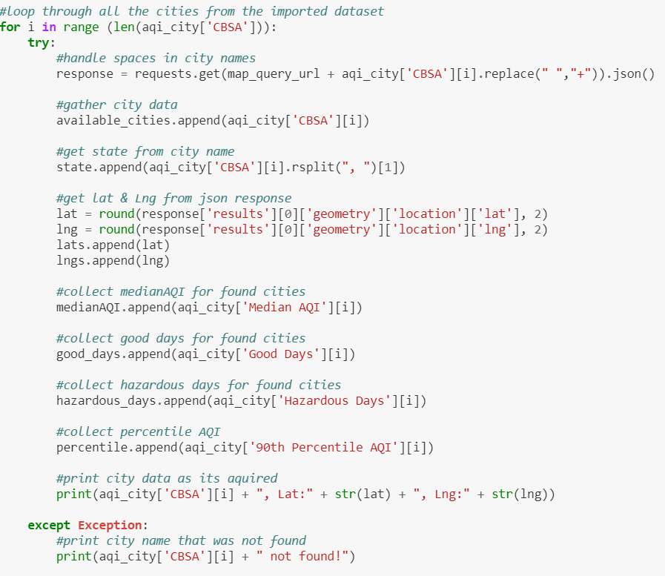
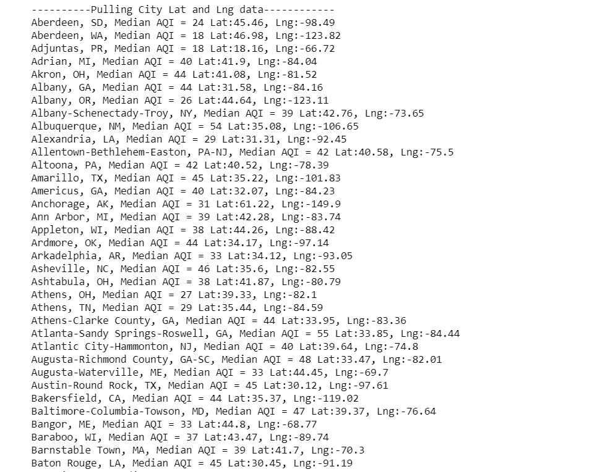
Data Analysis
Pulling Latitudes and Longitudes
Codes by Bhavna Patadia and Kate Engard

Slide 13
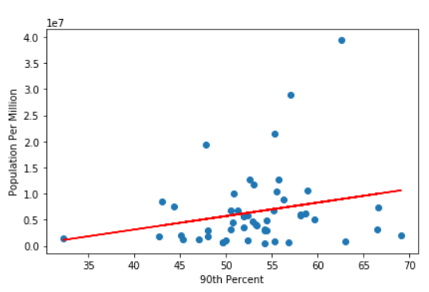
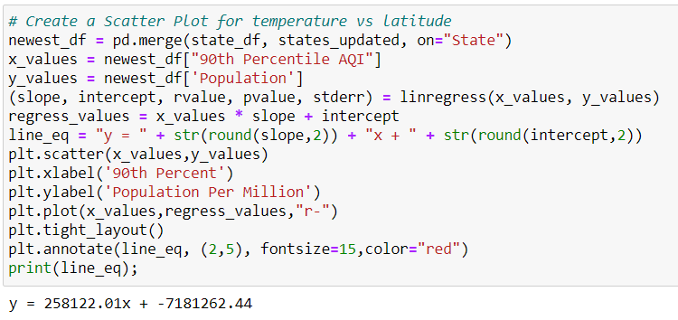
Data Analysis
Scatter Plot & Linear Regression
Codes by Quecis Joshua and Kate Engard

Slide 14
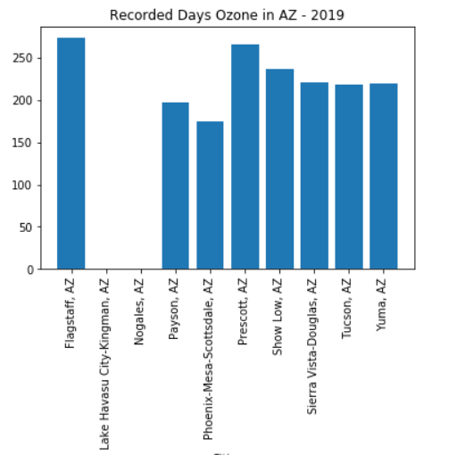
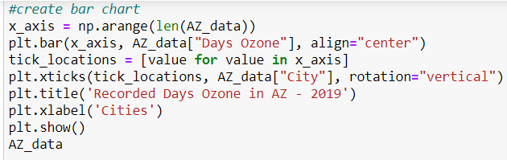
Data Analysis
Ozone Barchart for Arizona
Codes by MN

Slide 15
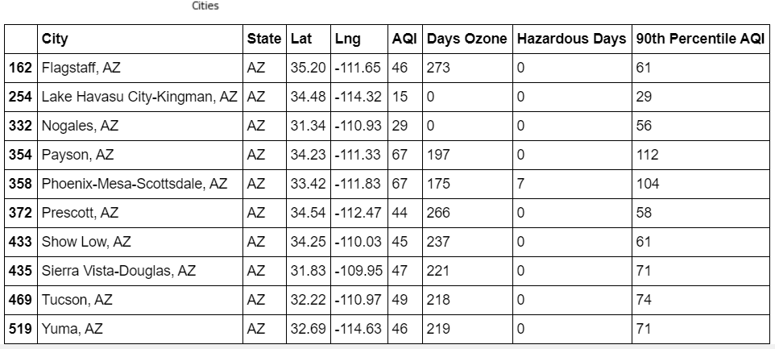
Data Analysis
Ozone Barchart for Arizona
Codes by MN

Slide 16
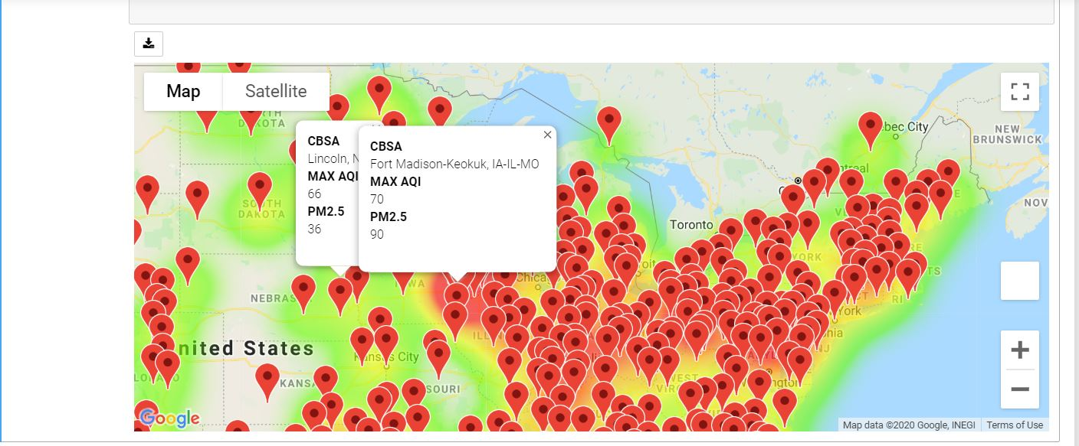
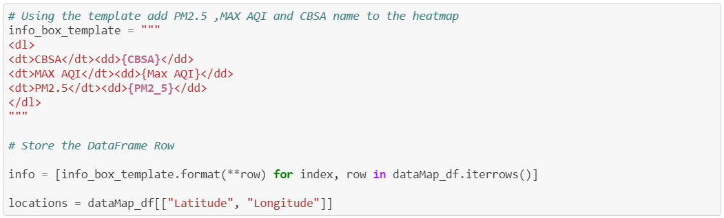
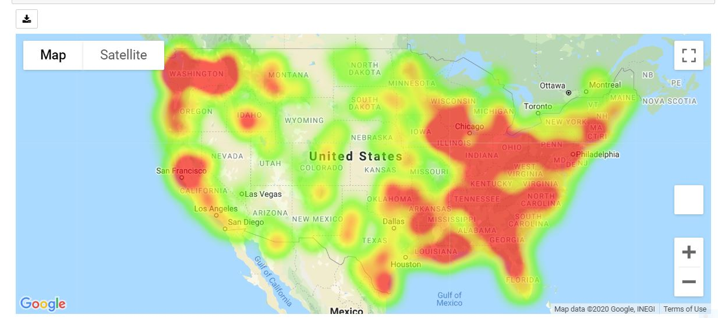
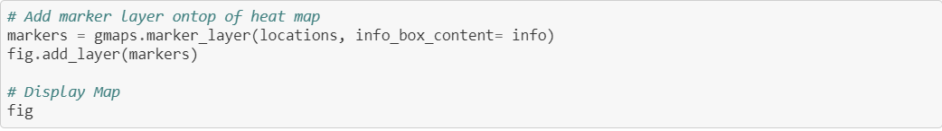
Data Analysis
Heat maps
Codes by Soumya Patil and Kate Engard

Slide 17
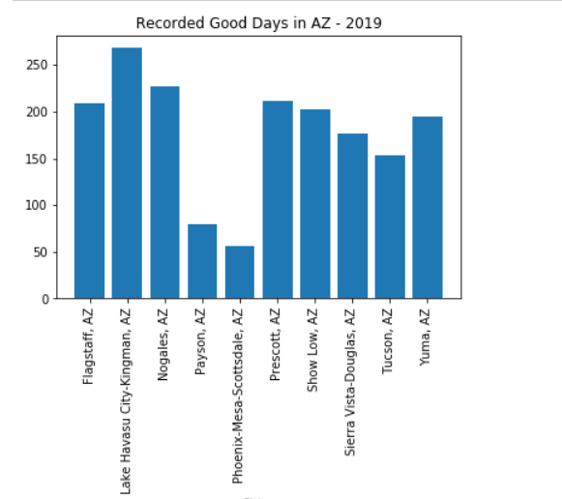
Annual Air Quality Index
Good days in found cities

Slide 18
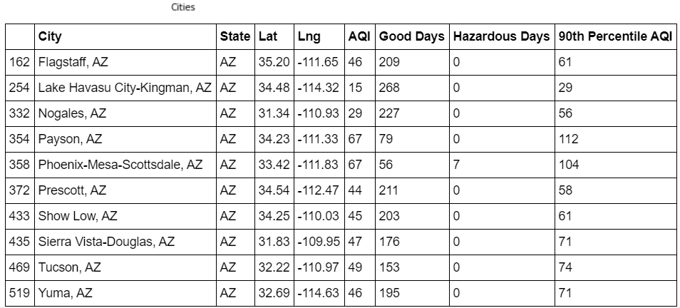
Annual Air Quality Index
Good days in found cities

Slide 19
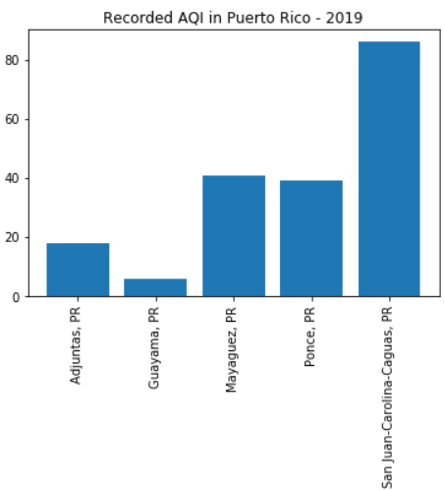
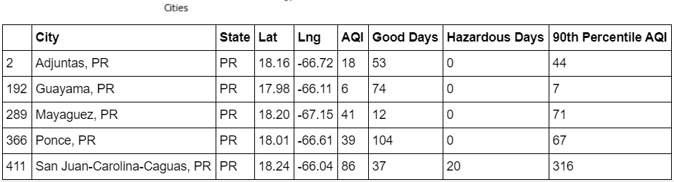
Annual Air Quality Index
Good days in found cities

Slide 20


Slide 21
Annual Air Quality Index
An assumption can be made that region with higher concentration of population & industry can reduce air quality
Congested metropolitan city like Phoenix with high traffic volume and more industries would show lower number of Good Days
(AQI between 0-50) than cities that have lower population, low traffic and no pollution creating industry
Phoenix metropolitan area does experiences lower number of Good Days. Lake Havasu City-Kingman reported
Top 5 States with Hazardous Days resulted in Puerto Rico as a territory with the highest number of Hazardous Days.
Based on the graphs shown the city that had the most Hazardous days is in Puerto Rico.
Conclusions
(an excerpt)

Slide 22
Annual Air Quality Index
“The Air Quality Index is affected by the amount of people in an area and the average temperature of the area.”
- Quecis Joshua
“Through systematically organizing the data and carefully analyzing it. It was determined that there was no significant correlation between Latitude and Ozone or PM2.5”
- Kate Engard
“The higher the pollutants and the cities with a long history of pollution in the air are most likely fatal for conditions or disease relating to pulmonary system.”.
- Soumya Patil
Hypothesis
(an excerpt)
"In general, as the concentrations of ground-level ozone increases, the number of people with pre-existing conditions are affected. This causes more people with lung diseases to visit doctors or emergency rooms, some are more likely admitted to the hospitals.“
- Bhavna Patadia
“The higher the Ozone gets, the more it’s going to affect the temperature adding to the worsening effect to global climate change.”
- Michael Nosa

Slide 23

Annual Air Quality Index
Team 3
Soumya Patil
Bhavna Patadia
Kate Engard
Quecis Joshua
Michael Nosa

Slide 24



