Slide 1

Why we split
our data
ML SOCIETY
The score your model gets on its own training data,
and the score that actually counts.
train · 80%
validation · 20%
Notes:
Welcome. Today's one question: why do we never trust a model's score on the data it trained on? Everything else today follows from that. The colour code on this slide carries through the whole deck: blue is training data, cyan is validation data. All the scores in this deck come from an illustrative example on a simulated airline-satisfaction dataset; the ideas are what matter, not the exact numbers.

Slide 2
Score: 1.00
We trained a model to predict happy airline passengers.
Then we tested it on the same passengers it learned from.
A perfect score. Should we trust it?
Illustrative example · Scores: 1.0 = perfect · 0.5 = random guessing
Notes:
Set up the score scale first: 1.0 is perfect, 0.5 is what you'd get by flipping a coin. (Technically it's ROC AUC, but you don't need that name today.) This is an illustrative example on simulated airline data, so be upfront if anyone asks. Take a show of hands: who trusts this model? Let a couple of people argue for and against before moving on.

Slide 3
It just memorised the answers
THE PROBLEM
1.00
0.64
on passengers it had already seen
on new passengers
Like a student who memorised last year's exam paper: perfect on that paper, lost on a new one. This is called overfitting.
Illustrative example: a decision tree on a simulated airline-satisfaction dataset.
Notes:
Same model, two scores. On passengers it had seen: perfect. On new passengers we hid from it: 0.64, not far above coin-flipping at 0.5. Ask: which score tells us how it'll do in real life, or on the Kaggle leaderboard? (The second one.) Introduce the word overfitting here and keep coming back to it.

Slide 4
Three kinds of data, like exam prep
KEY WORDS
Training data
Validation data
Test data
The textbook and practice questions. The model learns from these.
A mock exam. Used to check progress and pick the best model.
The real exam. Used once, at the very end.
The model must never see the mock or real exam questions while it's studying.
Notes:
This analogy carries through the rest of the session. Ask: why would it be pointless to put the real exam questions in the textbook? Because then the exam only tests memory, not understanding.

Slide 5
Hide some data from the model
THE FIX
80% training: the model learns from this
20% check
Train on the blue part. Score on the cyan part. Because the model never saw the cyan rows, that score is honest.
In Python it's one line:
train_test_split(X, y, test_size=0.2)
scikit-learn calls the hidden part "test". Today we're using it as our check set.
Notes:
Keep this one simple. 80/20 is a common choice, not a rule. If anyone asks: adding stratify=y keeps the same mix of happy and unhappy passengers in both parts, which matters when one group is rare.

Slide 6
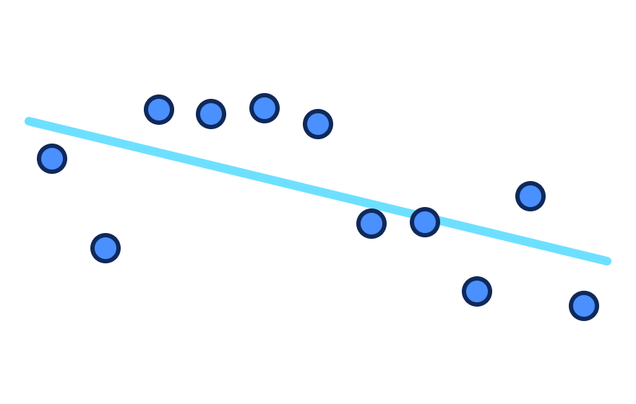
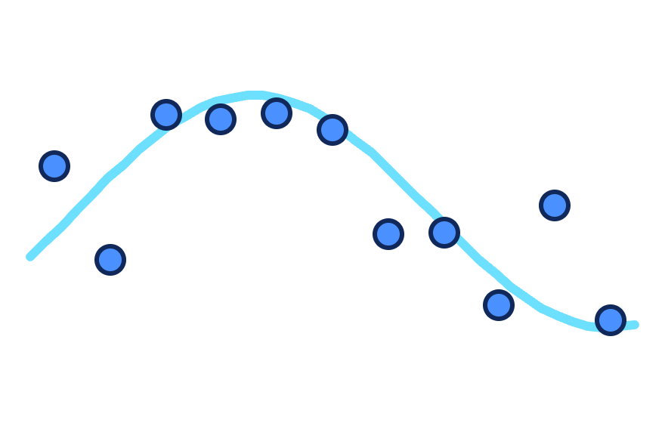
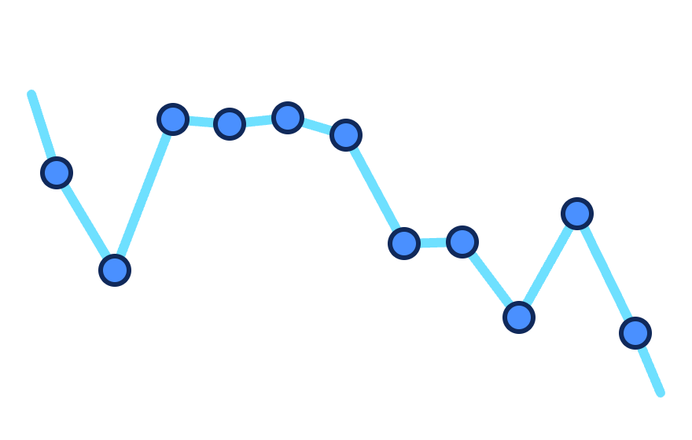
Same dots, three models
WHAT OVERFITTING LOOKS LIKE
Too simple
Just right
Memorised
A straight line. Misses the pattern.
A smooth curve. Learns the pattern.
Hits every dot, noise and all. Fails on new dots.
Notes:
Same 11 dots each time; only the model changes. Ask: which line scores best on these dots? (The zig-zag: it touches every one, so its training score is perfect.) Then ask: if a new dot arrives, which line would you trust to predict it? (The smooth one.) The zig-zag learned the noise, not the pattern. That's overfitting, and it's exactly what the next chart shows with real scores.

Slide 7
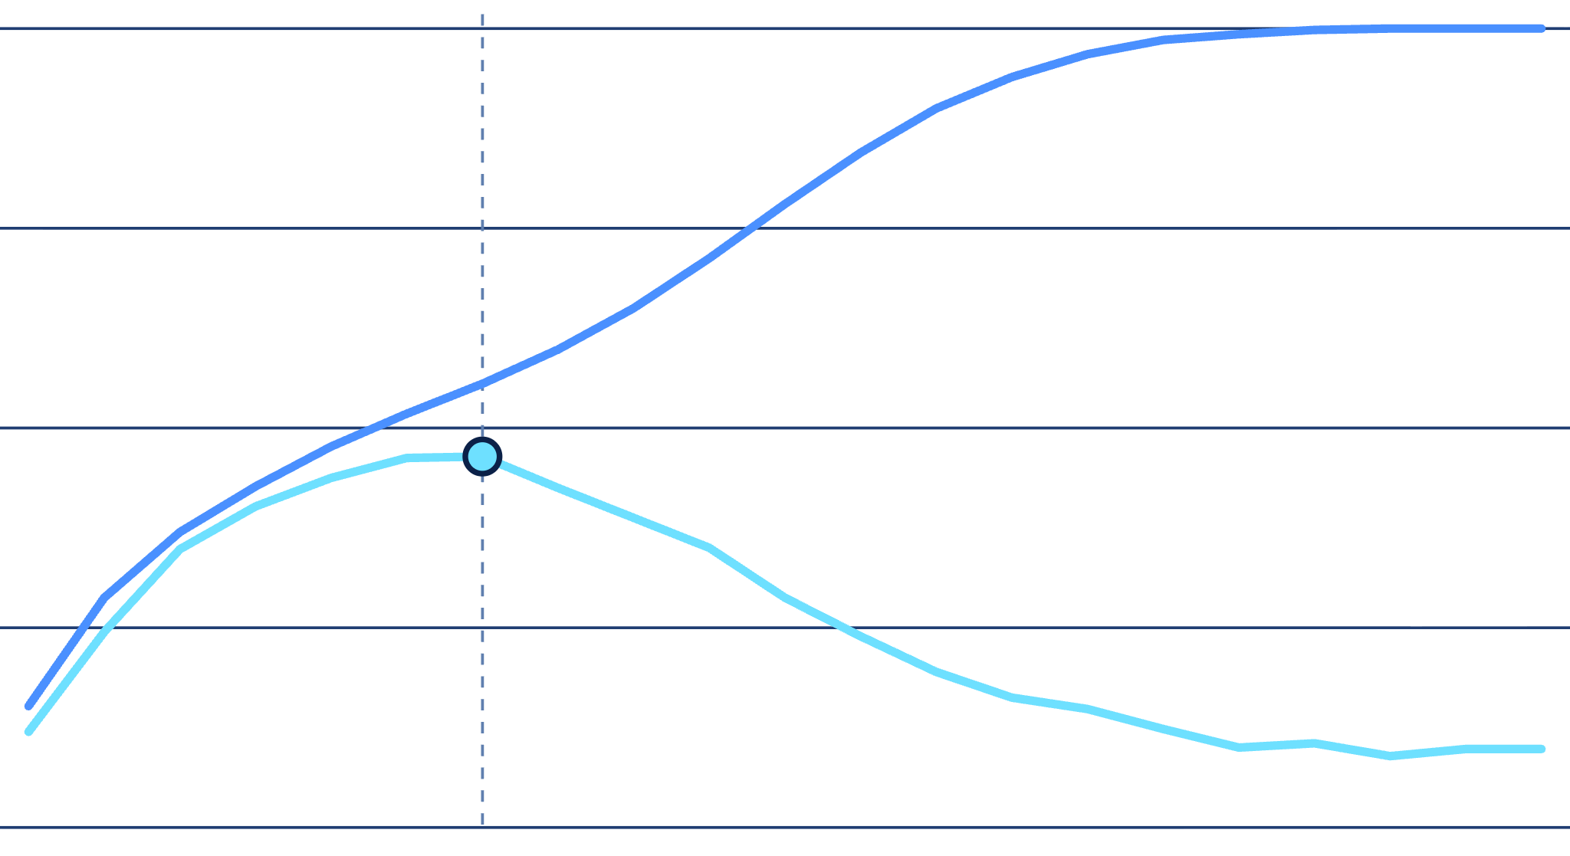
Too simple, too complex, just right
1.0
Score on data it's seen
Score on new data
0.9
Too simple: hasn't learned enough
0.8
Too complex: memorises instead of learning
just right
Only the cyan line can show you where to stop.
0.7
0.6
← simpler model
more complex →
Notes:
We trained the same kind of model 21 times, each a bit more complex than the last (a deeper decision tree), and scored each one on seen and new data. The blue line only ever goes up, so it can't tell you when to stop. The cyan line peaks, then falls: that peak is the model we want. Ask people to point at where they'd stop.

Slide 8

Kaggle uses the same idea
ON KAGGLE
Exam prep | Kaggle
Textbook and practice questions | train.csv
Mock exam | Public leaderboard
Real exam | Private leaderboard
If you only practise for the mock exam, the real one will surprise you. Trust your own check, not the public leaderboard.
Notes:
The private leaderboard is hidden until the competition ends. People who keep tweaking their model to climb the public leaderboard often drop hundreds of places when the private one is revealed. Kagglers call this a shake-up.

Slide 9
Don't let the answers leak in
LEAKAGE
We gave a model random noise: nothing real to learn.
A fair test should score about 0.5, just guessing.
LEAKY
FAIR
0.92
0.54
Prepared the data while looking at all of it, check data included. Looks brilliant. It's fake.
Prepared the data using only the training part. Correctly says: nothing here.
Notes:
Leakage means information from the check data sneaking into training. It's like seeing the mock exam answers while studying. The experiment: 5,000 columns of random numbers. Some will match the answers by pure luck. The leaky version picked the "best" columns by looking at all the data, including the check rows, so it picked the lucky ones and looked great. The fair version only looked at training rows, and correctly scored about 0.5.

Slide 10

Bundle every step into a Pipeline
HOW TO AVOID LEAKS
1. Clean
2. Choose
3. Model
Fill gaps, put numbers on the same scale
Pick the most useful columns
Learn to make predictions
A Pipeline makes sure every step learns from the training data only. The check data stays hidden until scoring.
Notes:
OPTIONAL: skip this slide if you're short on time. The leakage slide already makes the key point. Each step learns something from data: cleaning learns averages, choosing learns which columns look useful. If any step peeks at the check data, that's a leak. A Pipeline in scikit-learn chains the steps together so they're always trained together, on training rows only. Rule of thumb for anyone coding: if it has a .fit(), it goes in the pipeline.

Slide 11
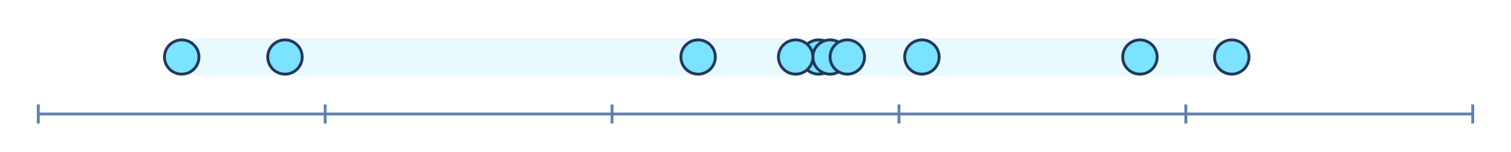
One split can get lucky
ONE MORE PROBLEM
Same model, same data. We just reshuffled which rows went into the check set, 10 times. Each dot is one score:
0.770
0.780
0.790
The score moved just from luck. One split can make a model look better or worse than it really is.
Notes:
Before revealing the dots, ask: if we only change which rows land in the check set, will the score change? Then: if your new idea improves the score by a tiny bit, is it really better, or did you just get a lucky split? From one split, you can't tell.

Slide 12
Fix: take turns, then average
CROSS-VALIDATION
Round 1
check
0.786
Round 2
check
0.781
Round 3
check
0.792
Round 4
check
0.776
Round 5
check
0.780
train
check
Average score: 0.783
Notes:
Cut the data into 5 equal parts. Each round, one part is the check set and the other four are for training. After 5 rounds every row has been checked exactly once, and we average the 5 scores. The average is much more trustworthy than one lucky or unlucky split. This is called 5-fold cross-validation, and it's what most good Kaggle notebooks use. (Scores are illustrative, from a simulated airline dataset.)

Slide 13
What would you do?
CHECK YOURSELF
1
2
3
Your model scores 0.99 on its training data. Is it a great model?
You clean all the data first, then split it. Any problem?
You're top of the public leaderboard. Will you win?
Notes:
Pairs discuss for a minute each, then take answers. 1: We can't tell yet. A training score only shows what it memorised; check it on data it hasn't seen. 2: Yes, that's a leak. The cleaning step learned from the check data too. Split first, or use a Pipeline. 3: Not necessarily. The public leaderboard is only the mock exam; the private leaderboard decides the winner. Trust your own cross-validation.

Slide 14
Five things to remember
RECAP
1
A score on training data doesn't mean much
2
Always hide some data to check the model on
3
Too complex a model memorises instead of learning
4
Don't let check data leak in: use a Pipeline
5
Take turns and average: cross-validation
Notes:
Read through them and ask the room to explain one each in their own words, using the exam analogy if they can.

Slide 15


Try it this month
WHAT'S NEXT
Join this month's Kaggle Playground competition
kaggle.com → Competitions → Playground
Run the starter notebook: split + cross-validation
Notes:
Close by pointing people to the competition and the notebook. Ask everyone to submit at least once and compare their cross-validation score with their public leaderboard score, then bring the numbers to the next session.

