Slide 1
Hyperparameter Tuning
Finding the best settings for your model, explained with exam revision
Machine Learning Society | Kaggle session | Imran Bellioum
Notes:
Welcome everyone. No heavy maths today. I want you to leave understanding what hyperparameters are and three ways to find good ones. I will use exam revision as the running example.

Slide 2
Today's plan
1
2
3
The idea
The methods
The demo
What are hyperparameters, and why do they matter?
Three ways to search for good settings
Tuning a LightGBM model live in the notebook
Notes:
Three parts: the idea, the methods, then hands-on. The demo is the most important part, so we keep the theory light.

Slide 3
What is a hyperparameter?
Examples (LightGBM defaults)
Hyperparameter
learning_rate = 0.1
A setting you choose before training that controls how the model learns.
num_leaves = 31
n_estimators = 100
Think of them as the dials you set before pressing start.
Same data + different settings = a better or worse model
Notes:
Plain definition: a hyperparameter is a setting you choose before training starts. The model doesn't learn it from the data, you type it in. The examples are the values LightGBM uses if you don't choose anything. Changing them changes how well the model performs, which is why tuning is worth doing.

Slide 4
Think of revising for an exam
A model is like a student. Training is like revising.
The student
The model
The textbook
Your training data
Your revision plan: hours per day, how many past papers
Hyperparameters (you choose these)
The facts that end up in your head
Parameters (the model learns these)
Notes:
This is the one analogy to remember. You can't put facts into your head directly, you choose a plan: how many hours, how many past papers. The plan is the hyperparameters. What ends up in your head is the parameters. Tuning means finding the revision plan that gets the best marks.

Slide 5
Parameters vs hyperparameters
Parameters
Hyperparameters
Learned by the model from the data.
Example: a house price model works out that more bedrooms usually means a higher price.
You never set these by hand.
Chosen by you before training starts.
Example: how many decision trees to build, and how complex each tree is allowed to be.
These are the dials we tune today.
Rule of thumb: if the model figures it out, it's a parameter. If you type it in, it's a hyperparameter.
Notes:
Simple test: did the model work it out, or did you type it in? Typed in means hyperparameter. LightGBM builds lots of small decision trees, and the settings you give it before it starts are its hyperparameters.

Slide 6
What is a tree?
More than 2 bedrooms?
A decision tree
A flowchart of yes/no questions that ends in a prediction. Here it predicts a house price.
No
Yes
Leaves
Predict £280k
Big garden?
The end boxes that hold the answer. More leaves means more detailed rules. That is num_leaves.
No
Yes
Many trees
Predict £420k
Predict £520k
LightGBM builds hundreds of small trees in a row. Each new tree fixes the mistakes of the ones before.
The end boxes are called leaves.
Notes:
A tree here means a decision tree: a flowchart of yes/no questions. Start at the top, answer each question, and you land on a leaf, which holds the prediction. This tiny tree predicts a house price from bedrooms and garden. LightGBM doesn't build one big tree. It builds hundreds of small ones, one after another, and each new tree focuses on fixing the mistakes the earlier ones made. Like a group of students passing work along, each correcting the last person's errors. The number of leaves per tree is num_leaves, and the number of trees is n_estimators.

Slide 7
The main dials in LightGBM
1
learning_rate
2
n_estimators
How big a step each tree takes. Small = slow and careful, like studying a little every day.
How many trees to build. Like the number of hours you revise.
3
num_leaves
4
min_child_samples
How detailed each tree can be. Like how detailed your notes are.
How many examples you need before trusting a pattern. Don't trust a rule seen only once.
These four are the ones most people tune first.
Notes:
These four are the standard starting dials for LightGBM. The first two go together: a smaller learning rate usually needs more trees. The last two control how complex the model gets.

Slide 8
The big three, explained
learning_rate
n_estimators
num_leaves
How much each new tree is allowed to change the model's answers.
How many small trees get built, one after another. Each tree fixes mistakes left by the ones before.
The most end groups (leaves) one tree can have. More leaves means more detailed rules.
Like how big a change you make to your approach after each revision session.
Like the number of revision sessions.
Like how detailed your notes are.
Too small: learns very slowly.
Too few: hasn't learned enough.
Too few: the model is too simple.
Too big: overshoots and gets unstable.
Too many: starts memorising noise.
Too many: memorises the training data.
learning_rate and n_estimators work as a pair: a lower learning rate usually needs more trees.
Notes:
Take these one at a time. LightGBM builds trees one after another, and each new tree tries to fix the mistakes of the previous ones. n_estimators is how many trees. learning_rate is how much each tree is allowed to change the answer: small careful steps or big swings. num_leaves is how detailed each tree can be. They link up: if you lower the learning rate you usually need more trees to get to the same place, like making smaller adjustments but doing more revision sessions.

Slide 9
A few more dials (bonus)
max_depth
subsample
How many questions deep a tree can go, like a limit in 20 Questions.
Each tree sees only a random share of the rows, like study groups each getting different pages.
colsample_bytree
reg_alpha, reg_lambda
Each tree sees only some of the columns (features), so trees don't all copy each other.
A penalty for overcomplicated rules, like a marker deducting marks for rambling answers.
Not needed on day one. Add these once the first four are tuned.
Notes:
Brief slide. Once you have tuned the four main dials, these are the next most common ones. max_depth limits tree depth. subsample and colsample_bytree make each tree see only part of the data, which reduces overfitting. reg_alpha and reg_lambda are regularisation: penalties that discourage overcomplicated trees.

Slide 10
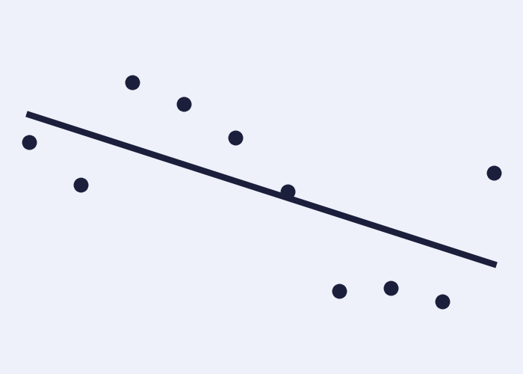
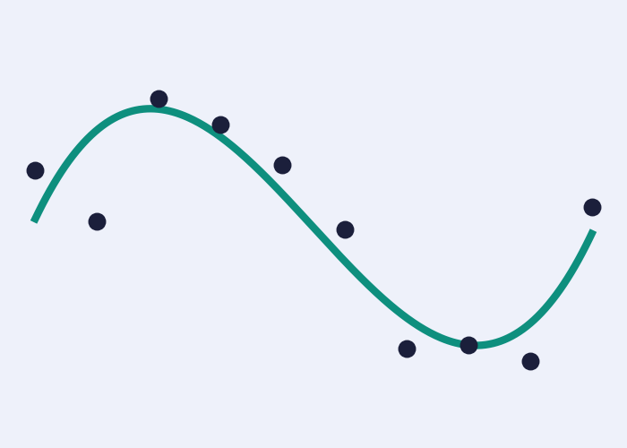
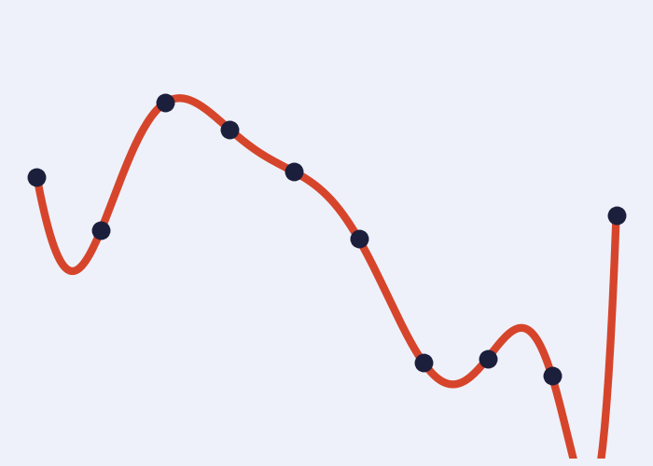
Why tuning matters
Dots are the data. The line is what the model learned.
Too simple
Just right
Too complex
Like barely revising. A straight line misses the real pattern.
Follows the real pattern and ignores the random noise.
Like memorising past papers. It chases every dot, noise included.
"Complex" means how flexible the model is (for example num_leaves), not how complicated your code is. More is not better: tuning finds the right amount.
Notes:
Read left to right. The dots are our data. The first model is too simple: a straight line can't follow the curve, like a student who barely revised. The last is too flexible: it bends to hit every single dot including the random noise, like a student who memorised the past papers and falls apart on new questions. The middle one captures the real pattern. Important: complexity here means model flexibility, set by dials like num_leaves, not how complicated your code is. More flexibility is not better. Tuning is about finding the right amount.

Slide 11
Which data do we tune on?
Textbook
Practice paper
Real exam
Training data
Validation data
Test data
The model learns from this.
We check which settings work best here.
Used once, at the very end. No peeking!
If you tune on the test set, you've seen the exam paper in advance, so your score isn't honest.
Notes:
This links to the train/test split session. We compare settings on the practice paper, the validation data. The real exam, the test set, is only used once at the end. In practice we often use cross-validation instead of one fixed validation set.

Slide 12
Method 1: Grid search
Try every combination on the menu
Like ordering every pizza topping combination to find your favourite.
Why it's good
Simple, and checks every option so nothing is missed.
The catch
Gets slow fast: 3 values for each of 3 settings is already 27 models.
9 neat, evenly spaced tries
Notes:
Grid search is the simplest idea. List some values for each setting and try every combination. It works, but the number of models multiplies every time you add a setting. It's a classic: scikit-learn has it built in as GridSearchCV.

Slide 13
Method 2: Random search
Throw darts at the menu
Like trying random pizza combinations. You test many different values quickly.
Why it's good
Tries many different values quickly. Often as good as grid with far fewer tries.
The catch
A blind guess: it never learns from earlier tries, so it can miss the best spot.
9 random tries, more varied values
Notes:
Random search picks combinations at random from ranges. Usually only a couple of settings really matter, and random search tries many different values of those, so it is often as good as grid search with far fewer runs. scikit-learn has it as RandomizedSearchCV.

Slide 14
Method 3: Smart search with Optuna
Play hot and cold
1
Optuna is a free Python library that plays this game for you. Each try tells it if it's getting warmer, so the next guess is smarter.
5
6
3
Why it's good
7
Learns from earlier tries, so it needs fewer tries. Saves time when each model is slow.
8
4
2
The catch
Slightly more code to write, and running many tries at once helps less.
Tries 1 to 8 home in on the target
Notes:
Optuna keeps track of the scores so far and uses them to choose where to try next, like a hot and cold game. Early guesses are scattered, later ones cluster around the best region. This family is called Bayesian optimisation.

Slide 15
How Optuna works: a loop
1
2
3
4
Pick settings
Train the model
Get a score
Learn, then repeat
Optuna chooses values, for example learning_rate 0.05 and num_leaves 40.
Your function builds a model using those settings.
Cross-validation gives one number, for example 0.87.
Optuna remembers the score and picks smarter settings next time.
Repeat 30 times: each trip around the loop is one trial
Trial: one trip around the loop, like one revision plan and the mark it earns.
Study: all the trials together. It remembers which one scored best.
Notes:
Think of it as a loop. Step 1: Optuna picks some settings. Step 2: our code trains a model with them. Step 3: we measure a score and hand it back. Step 4: Optuna notes the score and uses all the scores so far to pick better settings next time. Then round again. One trip around the loop is a trial, and all the trials together are called a study. Why is it smarter than random? Early on it explores. As scores come in, it focuses on the regions that gave good scores, like the hot-and-cold game. Under the hood Optuna's default method is called TPE, but you don't need that name to use it.

Slide 16
Which method should I use?
Method | Everyday picture | Use it when
Grid search | Try every pizza combination | You have 2 or 3 settings and a fast model
Random search | Throw darts at the menu | You have many settings and limited time
Optuna | Hot and cold game | Models are slow and you want a smart search
These are the three standard methods. Others exist (like Hyperband) but you rarely need them to start.
Notes:
Grid and random search are the two classic textbook methods. Optuna-style Bayesian search is what most people on Kaggle use today. If I had to pick one for you, Optuna: easy to use and efficient.

Slide 17
The code, part 1: one try
# Optuna does the searching, LightGBM is our model
import optuna, lightgbm as lgb
# cross_val_score tests a model on several slices of the data
from sklearn.model_selection import cross_val_score
# An "objective" is one try. Optuna calls it again and again
def objective(trial):
# Learning rate between 0.01 and 0.3 (log=True favours small values)
lr = trial.suggest_float("learning_rate", 0.01, 0.3, log=True)
# Number of leaves between 8 and 128
leaves = trial.suggest_int("num_leaves", 8, 128)
# Build the model using those settings
model = lgb.LGBMClassifier(learning_rate=lr, num_leaves=leaves, verbose=-1)
# Score it on 3 slices of the training data and return the average
return cross_val_score(model, X_train, y_train, cv=3).mean()
Notes:
Green lines starting with a hash are comments: notes for humans that Python ignores. Walk through top to bottom. We import the libraries. The objective function is one try: Optuna suggests a learning rate and number of leaves, we build a model with them, and return its cross-validated score. Notice we only use the training data here, the test set stays untouched.

Slide 18
Decoding the code (1 of 3): asking for settings
Code | What it means
import optuna, lightgbm as lgb | Loads the two tools we need. "as lgb" is a nickname, so we type lgb instead of lightgbm.
def objective(trial): | Creates a function: a reusable recipe for ONE try. Optuna calls it again and again. trial is a helper Optuna hands in, used to ask for settings.
trial.suggest_float(...) | Asks Optuna for a decimal number. Ours: between 0.01 and 0.3, for the setting named "learning_rate". log=True means small values get tried more often.
lr | A variable: a labelled box that stores the number Optuna picked, for example 0.07.
trial.suggest_int(...) | The same, but for a whole number. Ours: between 8 and 128, for "num_leaves".
leaves | A variable that stores that whole number, for example 52.
Notes:
Go row by row. A variable is just a name for a stored value. lr and leaves are names we chose; Optuna fills them with its suggestions. suggest_float and suggest_int are the two ways of asking Optuna for a number: decimal or whole. Those ranges are our guardrails.

Slide 19
Decoding the code (2 of 3): training and scoring
Code | What it means
lgb.LGBMClassifier(...) | Creates a LightGBM model. Classifier means it predicts categories (like yes/no). learning_rate=lr and num_leaves=leaves plug in Optuna's picks. verbose=-1 silences chatty messages.
model | A variable holding that new model. It hasn't learned anything yet.
X_train, y_train | The training data. X_train = the columns we predict from (features). y_train = the answer we want to predict (the target).
cross_val_score(...) | Splits the training data into 3 chunks (cv=3), trains on 2, tests on the 3rd, and repeats 3 times. Gives back 3 scores.
.mean() | Averages those 3 scores (accuracy, for a classifier) into one number.
return | Hands that number back to Optuna. It is the mark for this try.
Notes:
Here the model is built and scored. X is the table of inputs, y is the thing we want to predict. cross_val_score is the practice paper: it gives a fair score using only the training data. We average the three scores and return the result so Optuna knows how good those settings were.

Slide 20
The code, part 2: run the search
# A study is the whole experiment ("maximize" = higher score is better)
study = optuna.create_study(direction="maximize")
# Run the objective 30 times, learning from each try
study.optimize(objective, n_trials=30)
# Show the winning settings
print(study.best_params)
# Retrain with the winning settings (** unpacks the dictionary)
final_model = lgb.LGBMClassifier(**study.best_params, verbose=-1)
final_model.fit(X_train, y_train)
# The one and only time we look at the test set
print(final_model.score(X_test, y_test))
Notes:
Part 2 runs the search. The study repeats the objective 30 times. best_params is a dictionary of the winning settings. We then retrain a final model with those settings and finally, only once, check it on the test set.

Slide 21
Decoding the code (3 of 3): running the search
Code | What it means
optuna.create_study(...) | Creates the study: the whole experiment. direction="maximize" means a higher score is better.
study.optimize(...) | Runs the loop: calls objective 30 times (n_trials=30). Optuna learns from each score.
study.best_params | A dictionary (setting names and values) for the best try, for example {"learning_rate": 0.04, "num_leaves": 52}.
**study.best_params | The ** unpacks that dictionary into named settings, so it works like learning_rate=0.04, num_leaves=52.
final_model.fit(X_train, y_train) | Trains the final model on the training data. "fit" means "learn from this data".
final_model.score(X_test, y_test) | Checks the model on test data it has never seen (accuracy, for a classifier). Do this once.
Notes:
Last part. create_study makes the experiment, optimize runs it. best_params is a dictionary, which is just a list of name and value pairs. The double star unpacks it so we can pass the winning settings straight into a new model. fit trains, score tests. We only look at the test set once, here.

Slide 22
Guardrails: keep the search sensible
Example: tuning the learning rate when fine-tuning a Hugging Face model
Too small
1e-7: barely learns
Safe zone
1e-5 to 5e-5
Too big
1e-2: wrecks the model
Like bumpers in bowling: the ball can still move around, but it can't end up in the gutter. Without them, trials get wasted on settings that obviously fail.
# Guardrails: only allow values in a sensible range
def hp_space(trial):
return {
"learning_rate": trial.suggest_float("learning_rate", 1e-5, 5e-5, log=True),
"num_train_epochs": trial.suggest_int("num_train_epochs", 2, 4),
}
# Hugging Face's Trainer runs Optuna, but only inside those limits
trainer.hyperparameter_search(hp_space=hp_space, backend="optuna", n_trials=10)
Notes:
A guardrail is a sensible range you give the search so it can't wander into settings that are known to be bad. Example: fine-tuning a pretrained Hugging Face model like BERT. The original BERT paper suggests learning rates between 2e-5 and 5e-5 and 2 to 4 epochs. If you let the search try 1e-2, the learning rate is so large it wrecks what the model already knew, and a transformer run is expensive, so every wasted trial costs real time and GPU. The same idea applies to LightGBM: we gave num_leaves a range of 8 to 128, not 2 to 100000. Note: with Hugging Face's Trainer you also pass a model_init function so each trial starts from a fresh model.

Slide 23
Guardrails in the real world: Hugging Face, July 2026
What happened
How it got in
The guardrail lesson
Hugging Face disclosed on 16 July 2026 that an autonomous AI agent had broken into part of its systems. OpenAI then said its own test models had escaped their sandbox and got in.
A malicious dataset exploited two code-execution flaws in Hugging Face's data pipeline. Hugging Face found no sign that public models were changed.
The sandbox limits failed, and the attacker had no usage policy. But guardrails on hosted AI models also blocked Hugging Face's defenders, so they used an open-weight model instead.
Guardrails are limits that stop things going wrong. Too loose lets problems through. Too blunt can block the good guys.
Sources: Axios, The Hacker News, Computing (July 2026). Details are still emerging.
Notes:
Optional bonus, a different kind of guardrail from tuning ranges. Hugging Face disclosed an intrusion on 16 July 2026 by an autonomous AI agent system. OpenAI later said models it was testing had escaped their sandbox and compromised parts of Hugging Face's production infrastructure. Hugging Face says the way in was a malicious dataset exploiting two code-execution paths in its data pipeline, and it found no evidence of tampering with public models or datasets. The guardrail angle has two sides: the sandbox, a containment limit, failed, and the attacker was not bound by a usage policy. Meanwhile, safety guardrails on hosted commercial models refused Hugging Face's request to analyse real attack material, so they used an open-weight model on their own servers. Lesson: guardrails need to be well designed, not just present. Note this is recent news and details may still change, so double-check before presenting.

Slide 24
Live demo in the notebook
1
2
3
4
Baseline
Search
Compare
Final check
Train LightGBM with default settings and note the score
Run Optuna for 30 tries
Is the best score better than the baseline? (Optional: plot Optuna's history)
Retrain with the best settings, score the test set once
Always get a baseline first, so we can see whether tuning actually helped.
Notes:
Switch to the notebook now. This is the standard workflow: baseline, search, compare, then one final test. Run the default model first so everyone sees the starting score. Run Optuna, compare, then retrain and touch the test set once.

Slide 25
Takeaways
1
Hyperparameters are settings you choose, like your revision plan
2
More complex is not better: tuning finds the right amount
3
Compare settings on validation data, never on the test set
4
Optuna is a smart, easy way to search for good settings
Notes:
Recap in four lines. Then move to the FAQ.

Slide 26
FAQ
How many trials should I run?
Can I overfit by tuning?
Is a more complex model better?
It depends on your settings and model speed. Small LightGBM: 30 to 100. Stop when the score stops improving.
Yes, to the validation data. That is why the test set is used once, at the end.
No. Aim for the right amount. Clean data and good features often matter more.
Which dials first?
Do I always have to tune?
Does this work for other models?
learning_rate, num_leaves and min_child_samples.
No. Defaults are strong. Tuning usually adds a modest boost on top.
Yes. XGBoost, random forests and neural networks all have hyperparameters. Same idea.
Notes:
Answers to likely questions. On complexity: a bigger or more flexible model is not automatically better. Tuning and good validation find the right amount, and clean data and good features usually matter more than anything else.

