Slide 1


OpenSCAD to the Rescue!
reaking
adges?
Brad “PhearoX” Roether QCC Badge Armor Artisan
November 15, 2024

Slide 2
Agenda
Introduction
Problem Statement
Requirements
Design Process
Manufacturing Process
Final Product

Slide 3
Introduction
Current Role: Principal Security Engineer @ ServiceNow
Experience:
Cybersecurity: ~20 years
3D Printing: ~6 years
OpenSCAD: ~4 years
Cool Things in My Basement:
3D Printers: 50 (46x FDM, 4x DLP Resin)
CNC Machines: 2

Slide 4
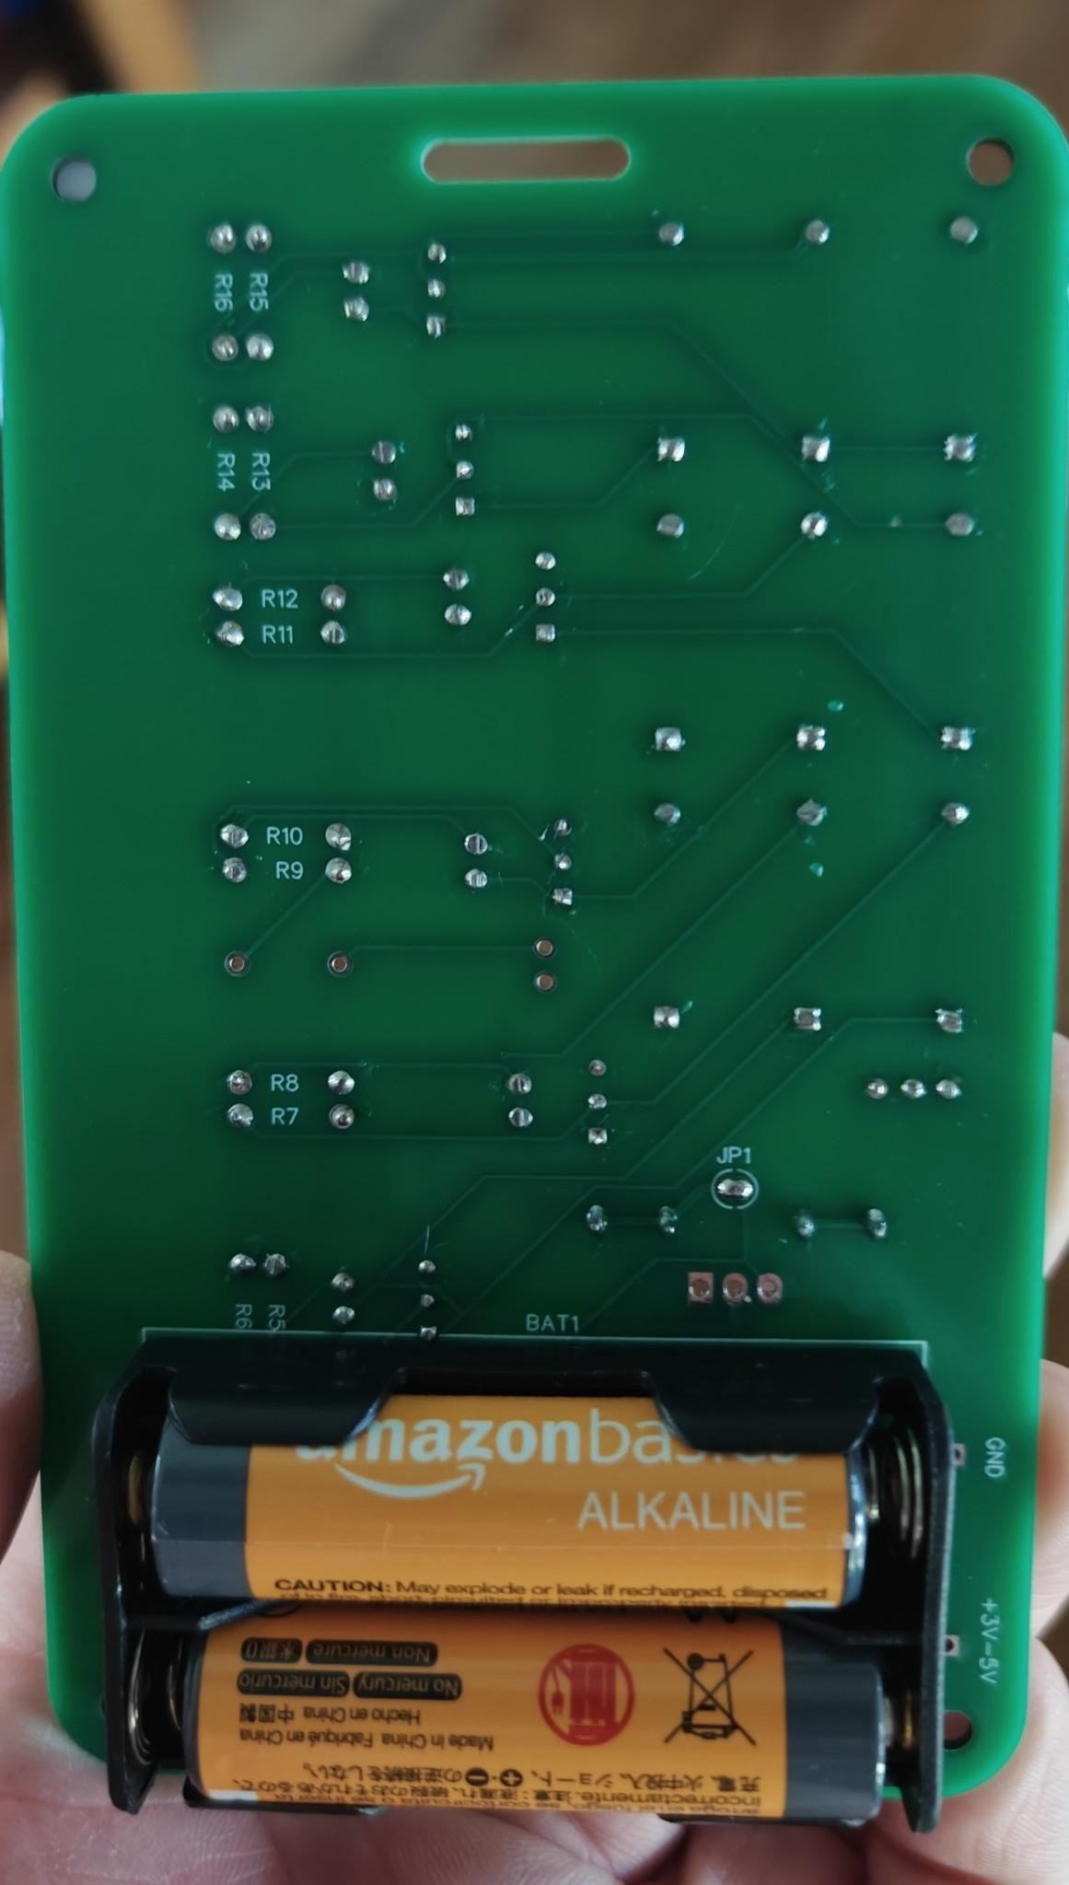
Problem Statement
The back of the badge has exposed solder joints
Attendees will be wearing the badge from a lanyard around their neck
Bridging solder joints can be problematic for electronics
Solder joints can snag clothing

Slide 5
Requirements
Sensible material
Lightweight
Inexpensive
Non-conductive
Fit badge dimensions
Toolless installation
Aesthetically pleasing design

Slide 6
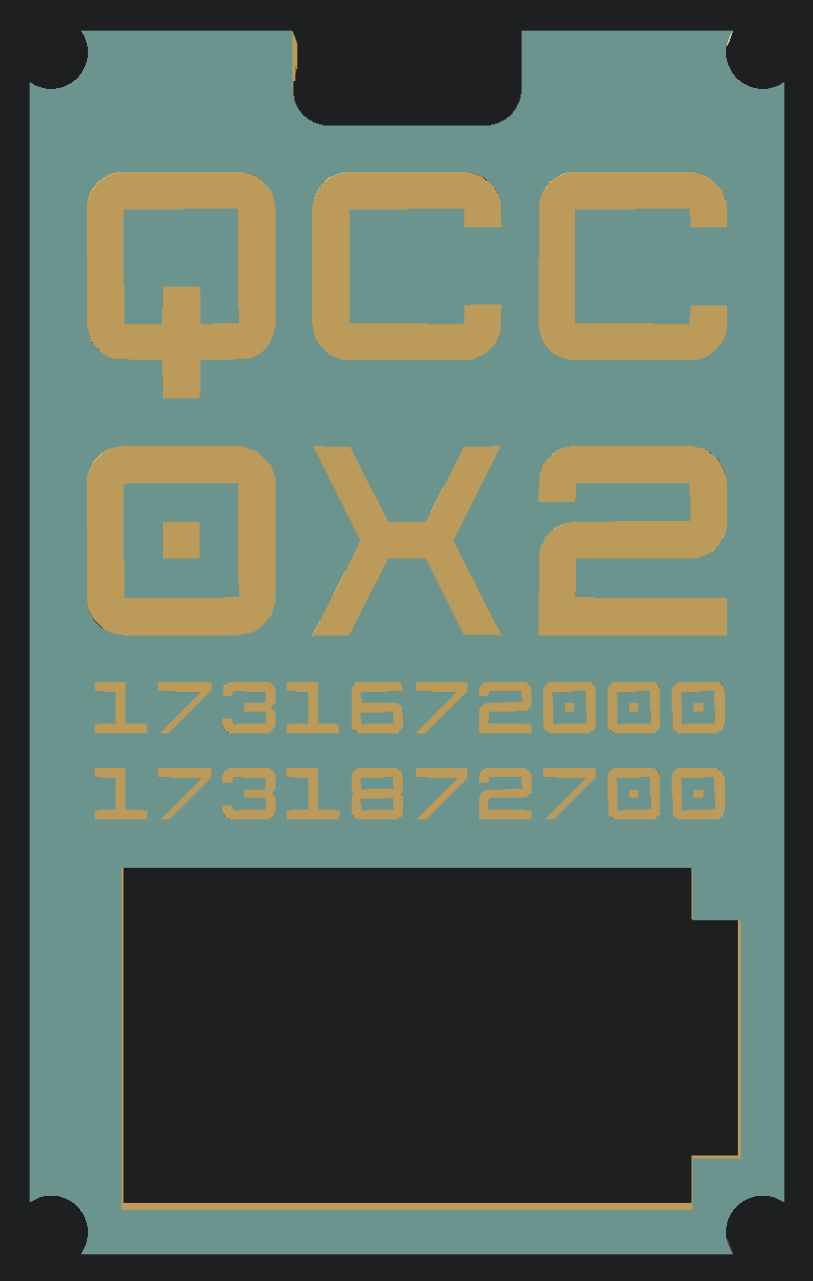
Requirements
Chosen Material: PLA (Polylactic Acid) is a biodegradable, sustainable, and food-safe polymer made from organic sources
Chosen Design:
Functional with appropriate cutout for batteries
QCC 0X2 embossed logo
Unix epoch timestamps for the opening and closing of Queen City Con 2024

Slide 7
Design Process
OpenSCAD
A script-based modeling tool that uses a simple, proprietary language to manipulate geometry
An OpenSCAD script specifies geometric primitives (such as spheres, boxes, cylinders, etc.) and defines how they are modified and combined (such as intersection, difference, envelope combination, etc.)

Slide 8
Demo

Slide 9
Design Process
My OpenSCAD Advice:
Break down your object into the simplest possible shapes
Create a module for each component
Create each component at the origin and translate() into position
Remember: Sometimes it’s easier to define what you don’t want

Slide 10
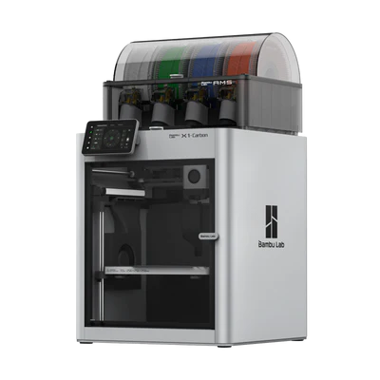
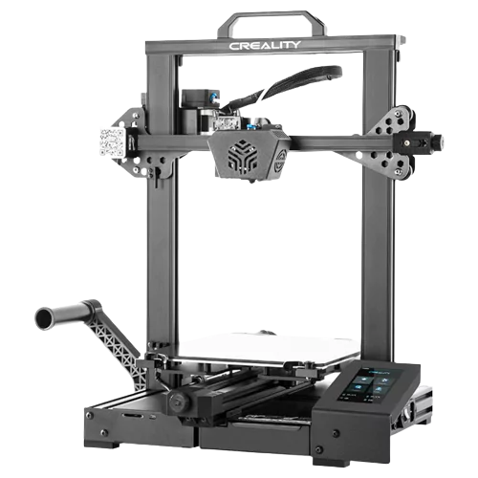
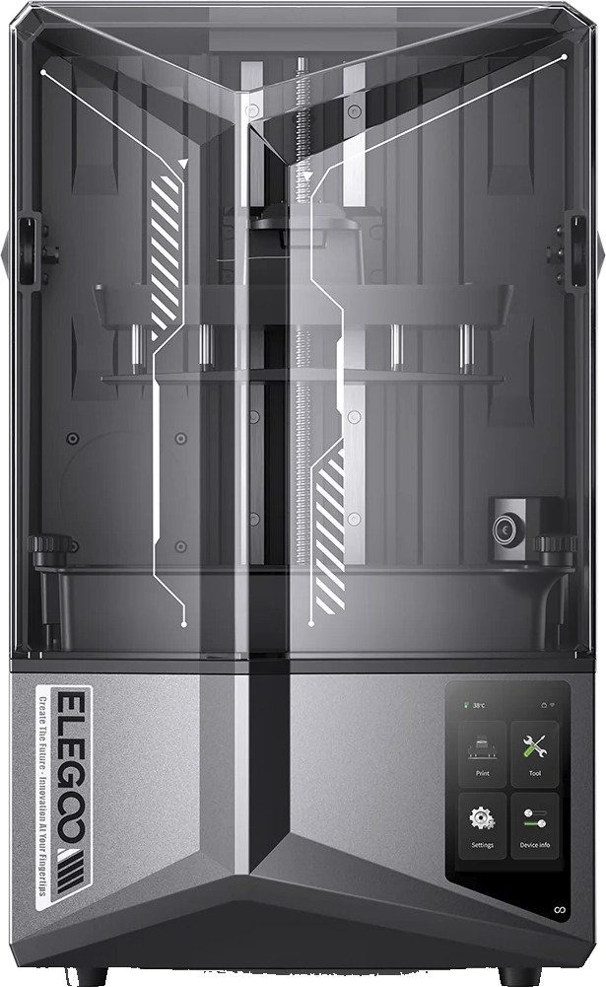
Manufacturing Process
3D Printers:
FDM
Bambu Labs X1 Carbon
Creality CR-6 SE
DLP Resin
Elegoo Saturn 4 Ultra

Slide 11
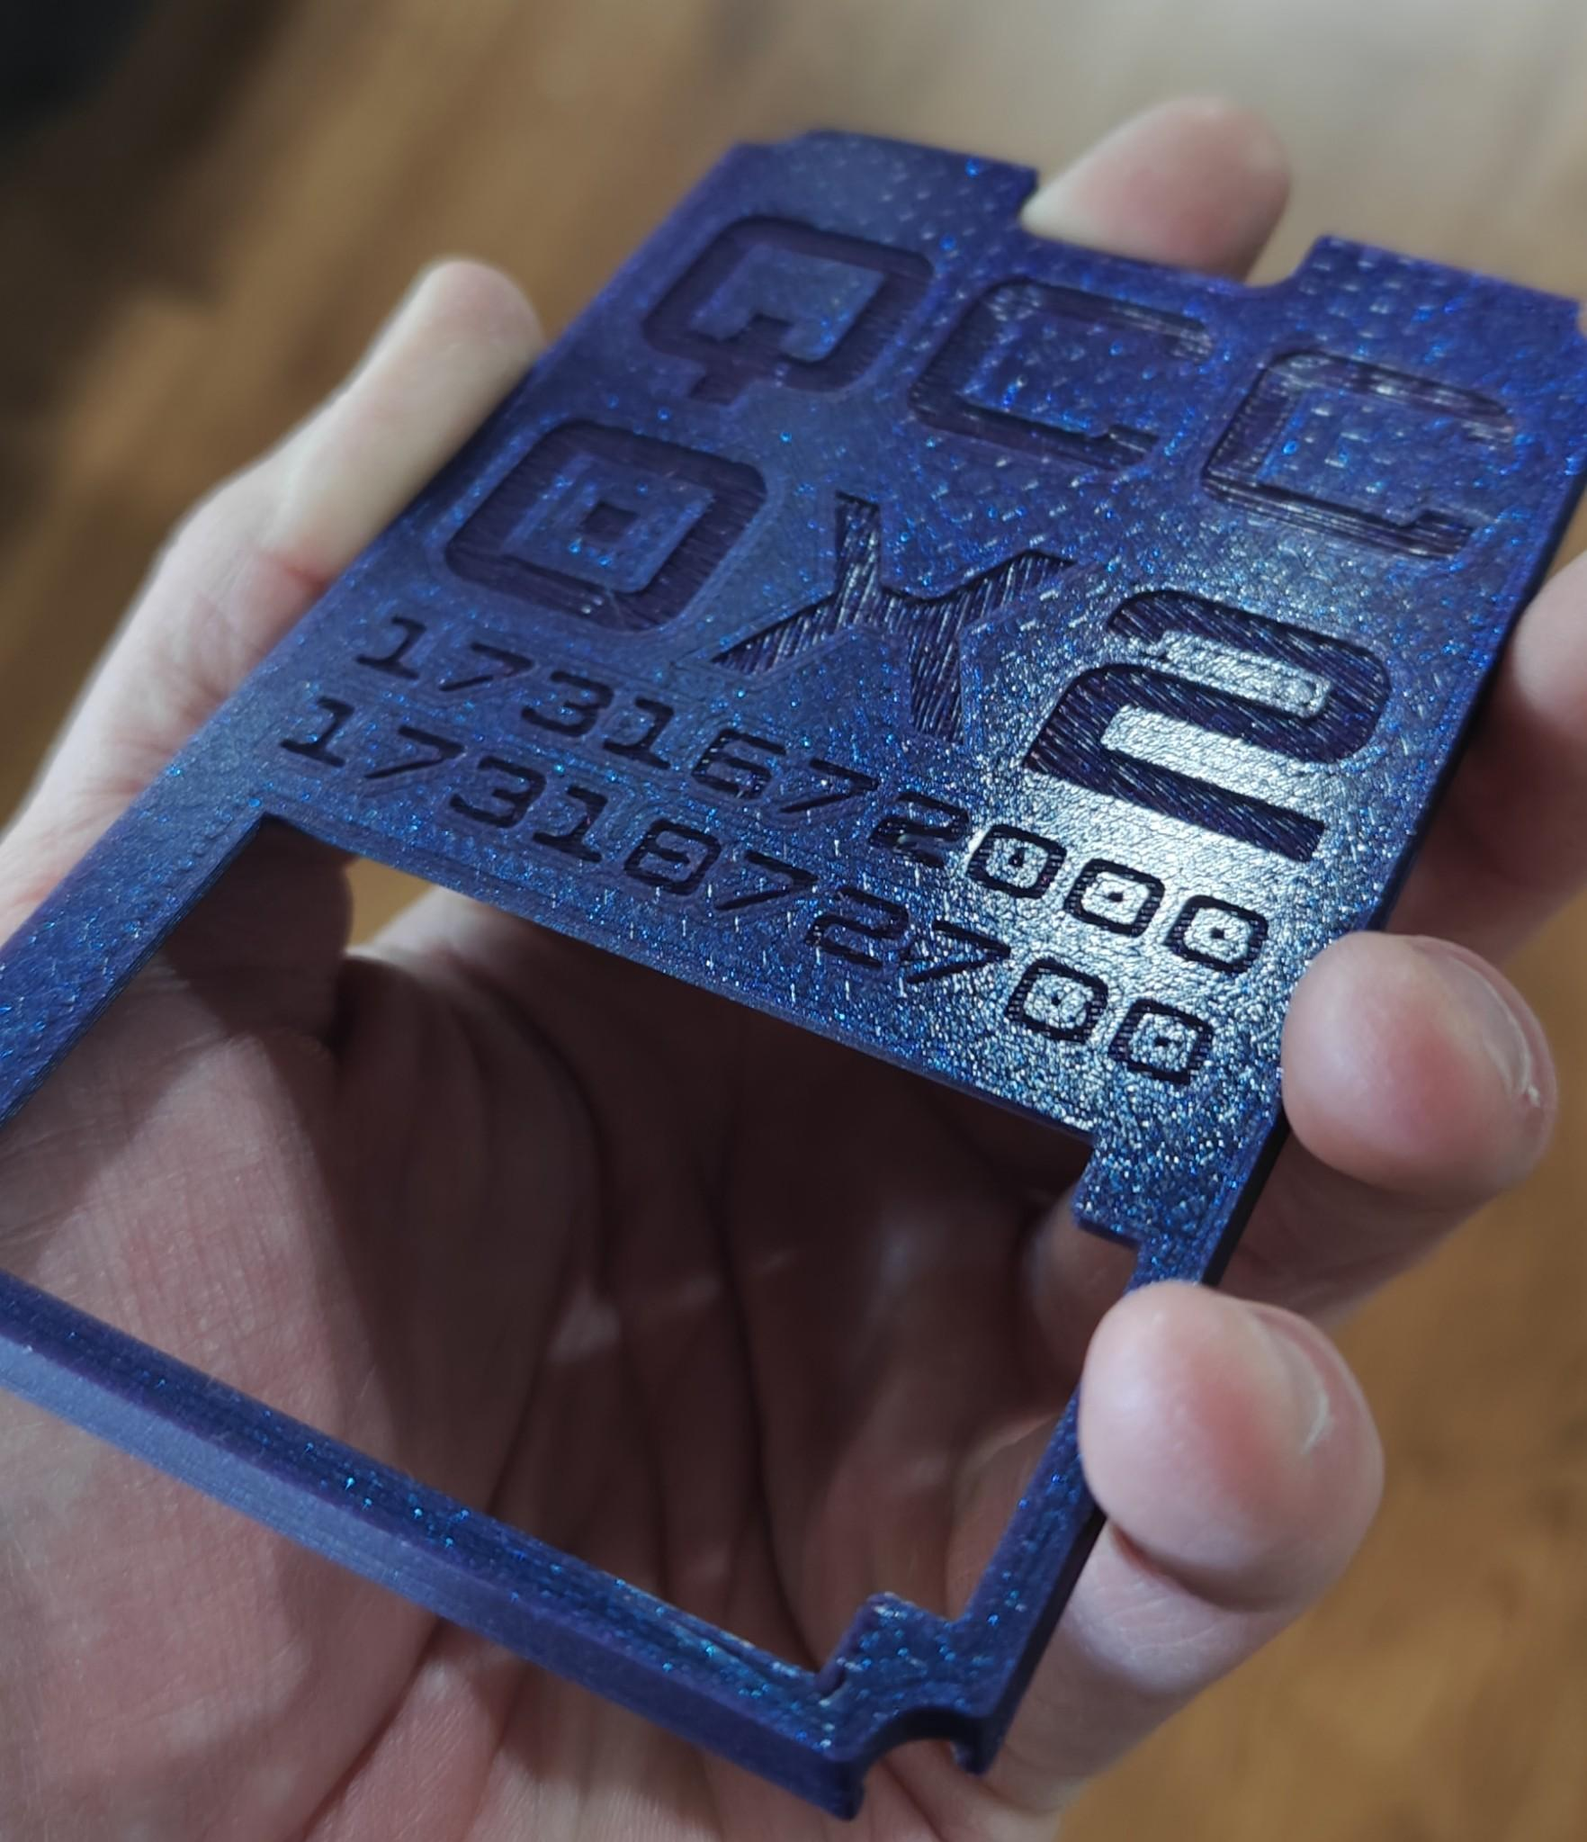
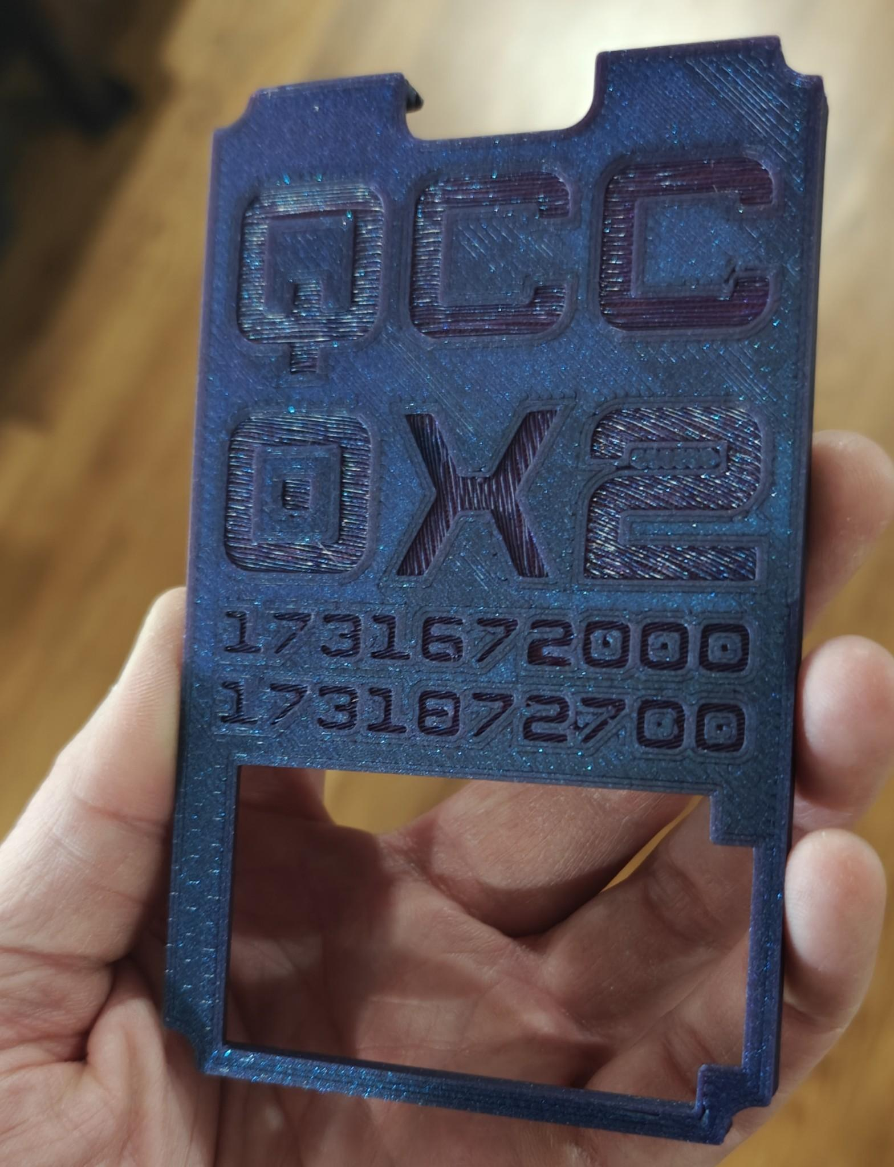
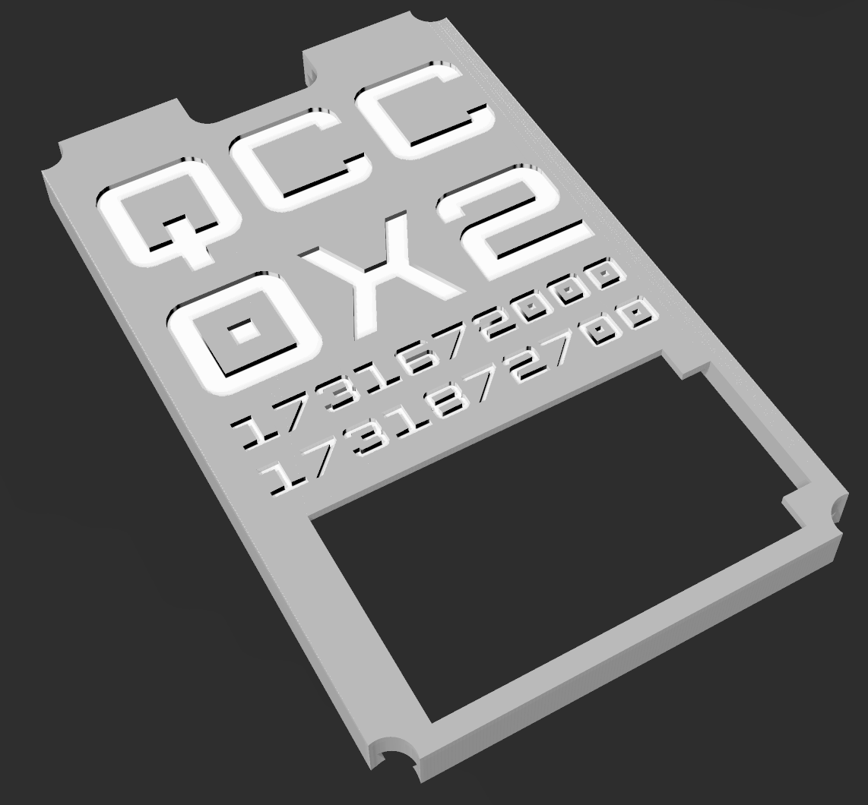
Final Product

Slide 12
Resources
GitHub
https://github.com/roetherb/QCC2024/
OpenSCAD.org
BambuLab.com

