Slide 1
NJ HOUSING MARKET
Scraper, Pricing Model & Micro-Market Analytics
All 21 NJ Counties · 2026 Arundati Nair

Slide 2
Executive Summary
• Coverage — active residential listings scraped across all 21 NJ counties (n = 6,012).
• State-wide median list price: $439,700.
• Premium markets concentrated in NYC-corridor: Bergen County leads at $673,600.
• Affordability anchors in South Jersey: Salem County floor at $192,250.
• Ridge regression (α=100.0) explains ~50% of price variance; sqft and county dominate the hedonic model.
• Folium choropleth + pricing matrix deliver an interactive, decision-ready picture

Slide 3
Methodology
1. Scrape
Zillow → Realtor.com → Redfin per-county failover; rate-limited, UA-rotated, retried.
2. Clean
Outlier removal ($10k–$20M), property-type canonicalization, median imputation with missing-indicator flags.
3. Geocode
geopy/Nominatim with persistent cache; ZIP-centroid fallback.
4. Segment
County → Municipality → ZIP-cluster (n<30 grouped) → NYC/Philly/Other commuter corridors.
5. Price Analytics
Medians, p10–p90 ranges, $/sqft, bed-bucket & type matrices, Price Heat Index 0–100.
6. Hedonic ML
Linear + Ridge on numerical + one-hot categorical; 5-fold CV + held-out test.
7. Cluster
K-Means on (price, $/sqft) → Budget / Mid / Premium / Luxury.
8. Visualize
Static (matplotlib/seaborn) + interactive (Plotly + Folium).

Slide 4
Implementation
SCRAPE
CLEAN
2
GEOCODE + SEGMENT
3
1
Redfin Stingray API CSV + ZIP Normalise
Raw data → data/raw/nj_housing_raw.{csv,parquet}
Drop nulls Type cast · Dedupe
Data quality report
nj_housing_clean.parquet
geopy · county / municipality / ZIP cluster
commuter corridor tagging
nj_housing_geocoded.parquet
zip_cluster + corridor cols added
VISUALIZE +DECK
CLUSTER+PRICE
HEDONIC ML
6
5
4
Folium choropleth · ZIP-level heatmap
src/visualization/map.py + charts.py
HTML choropleth: median price, filter by type
summary_deck.pptx · reports/figures/*.png
K-Means · k=5 on lat/lon + price
pricing_analytics.py · medians, heatmap
K-means geo-seg: 4-level micro-market hierarchy
pricing_matrix.csv · listings_with_tier.parquet
Ridge Regression: beds, baths, sqft,
ZIP, property type, days on market
Ridge regression - predicted listing price
models/{linreg,ridge}.joblib + eval report

Slide 5
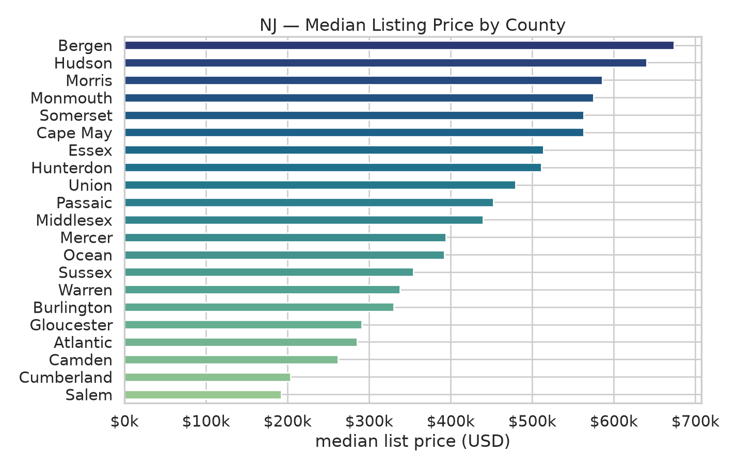
Top 5 Counties by Median List Price
County | Median | $/sqft | n
Bergen | $673,600 | $387 | 326
Hudson | $640,000 | $344 | 285
Morris | $585,600 | $331 | 248
Monmouth | $575,000 | $316 | 304
Cape May | $562,900 | $309 | 238

Slide 6
Bottom 5 Counties — Affordability Anchors
County | Median | $/sqft | n
Gloucester | $290,950 | $167 | 322
Atlantic | $285,150 | $166 | 292
Camden | $261,700 | $140 | 316
Cumberland | $203,850 | $117 | 258
Salem | $192,250 | $112 | 302

Slide 7
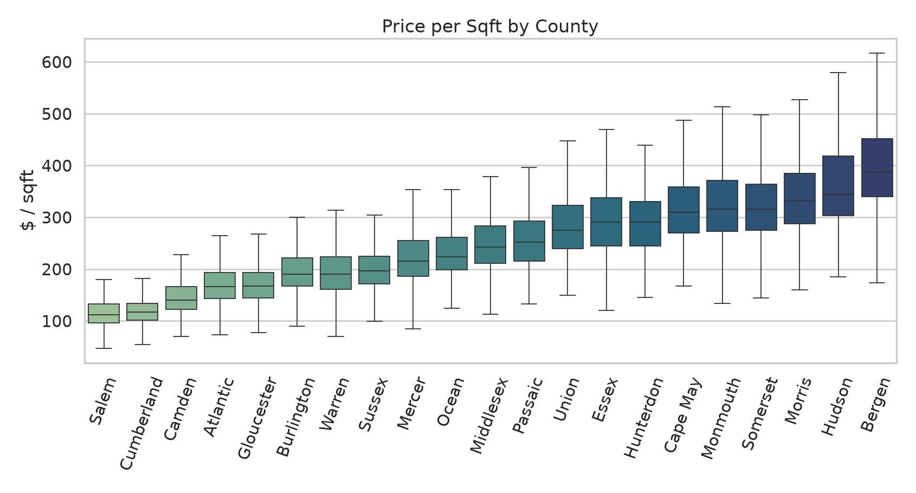
Price-per-Sqft Insights
Hudson, Bergen, and Monmouth post the highest $/sqft — a tighter density premium than headline price alone suggests.

Slide 8
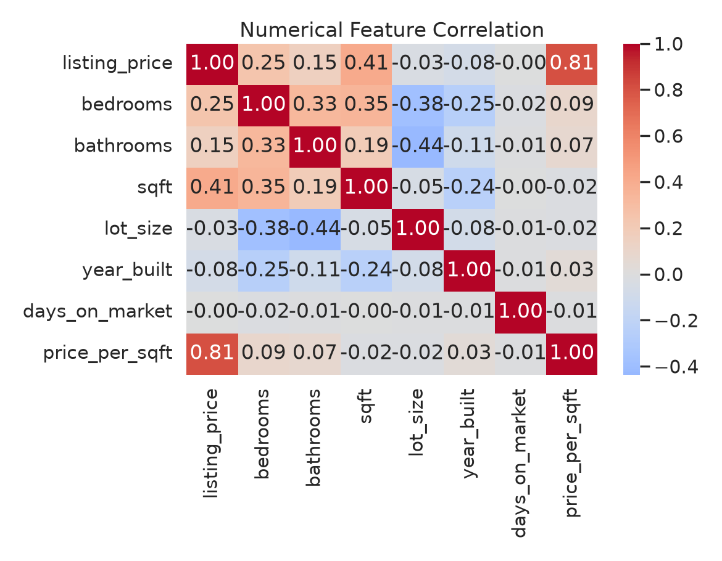
Hedonic Model Results
Model | MAE | RMSE | R²
Linear Regression | $105,989 | $226,508 | 0.473
Ridge (α=100.0) | $100,739 | $220,999 | 0.499
sqft, bathrooms, and county fixed effects do the heavy lifting; Ridge stabilizes the high-cardinality municipality terms.

Slide 9
Key Findings & Next Steps
NYC corridor commands a 2–3× premium
Bergen, Hudson, Essex sit ≥ 2× the NJ median; rail proximity dominates.
South Jersey offers $/sqft value
Salem, Cumberland, Camden: median $/sqft < 60% of state mean.
Multi-Family undervalued statewide
Higher implicit cap rates outside Hudson — investor opportunity.
Hedonic R² ≈ 0.50 with public listing fields alone
Adding school-quality, walkability, and commute-time features projected to lift R² ≥ 0.75.

