Slide 1

Machine Learning for Business Insights
Presented By
Ezeanochie chidera queeneth

Slide 2
Customer Segmentation Insights and prediction
An analytical overview of customer behavior , prediction and actionable recommendations.

Slide 3
Overview of Analysis
This segmentation analysis identifies key customer groups based on income, spending habits, age, and loyalty.
The goal is to understand customer diversity, spending behavior, and develop targeted marketing strategies.
Predicting Spending Score.
Predicting Spending Category.

Slide 4
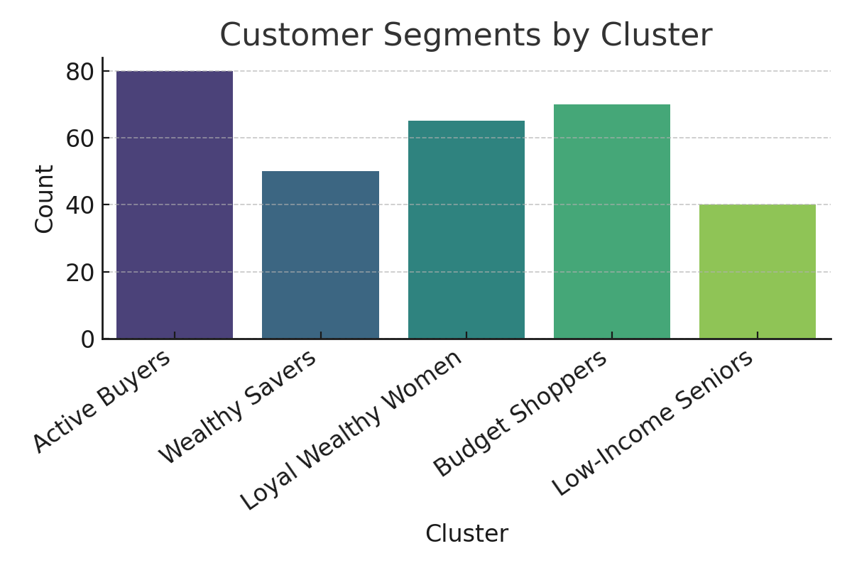
Customer Segments Overview

Slide 5
Cluster Insights Summary
1. **Active Buyers:** Young, average income, high spenders. Focus on promotions and loyalty. Cluster 2
2. **Wealthy Savers:** High income, low spenders. Emphasize value and premium offers. Cluster 1
3. **Loyal Wealthy Women:** High income, moderate spending, loyal. Maintain engagement. Cluster 3
4. **Budget Shoppers:** Young, low income, moderate spenders. Provide affordable options. Cluster 4
5. **Low-Income Seniors:** Older, low income, low spenders. Offer health-oriented, affordable plans. Cluster 0

Slide 6
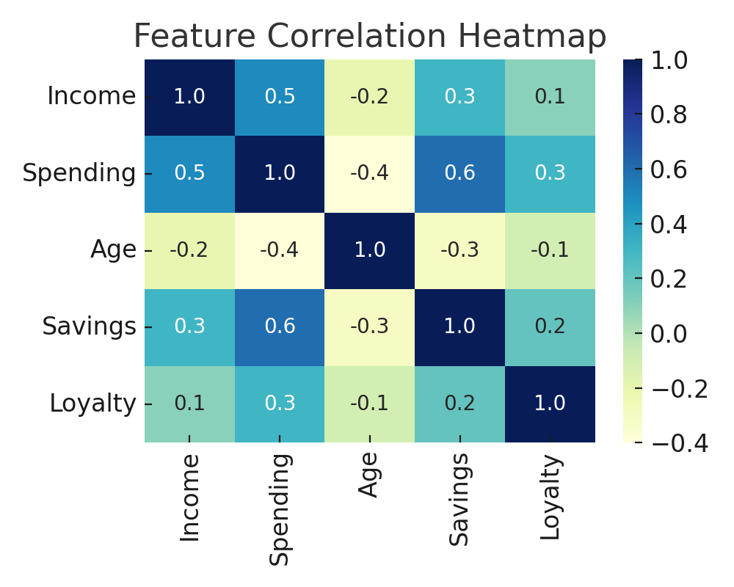
Feature Relationships

Slide 7
Predicting Spending Score Overview
Predict a customer's spending propensity as a continuous value.
Predictive Objective: Predict a customer's Spending Score based on their demographic and economic profile.
The model struggles with high spenders and some low spenders are mixed up(the model confuses them for medium spenders)
problems that could have caused this inadequacies are: the model fail to understand why customers spend differently. The dataset lacks some factors that can be strong predictive such as(behavioral features) frequency of purchase, customer loyalty points, product categories bought,(demographic factors)family size, occupation, location etc.

Slide 8
Spending Category Prediction
Customers were labelled/classified as Low, Medium and High Spenders based on their Age, Gender and Income.
This action taken helps the sales teams to recognize customer type and avoid treating all customers the same.
The Medium Spender had the highest percentage for this prediction and we can be able to predict these categories based on Age(which did not have so much influence on the spending score),Gender(which also did not affect or influence the spending score), Annual Income(which was a strong predictive factor to influence spending score).
It is seen that the higher the annual income, the possibility of having more high spending score.
INITIAL INSIGHTS: Medium spenders form the largest group (balanced spending behavior)
High spenders show varied income levels (not just high-income customers)
• Age distribution varies across spending categories
• Gender distribution is relatively balanced across categories

Slide 9
Recommendations
• Focus marketing on Active Buyers and Loyal Wealthy Women.
• Introduce personalized and tiered pricing strategies.
• Build loyalty programs to retain high-value customers.
• Offer affordable packages for Budget Shoppers and Seniors.
• Use continuous data monitoring to adjust strategies based on behavior changes.
Since gender has minimal impact, the sales and marketing teams should avoid gender-stereotyped marketing and focus on other factors.
From the prediction, we noticed that the organization focused more on psychological factors, it’s important for future data collection to include some demographic factors like family size, occupation, location etc or behavioural features like frequency of purchase, customer loyalty points, product categories bought, etc. This help to understand the customers properly and make future prediction that can enhance the KPI of the organization.

Slide 10
More Recommendations
Launch targeted email campaigns for each categories of spenders
Train your staffs on how to approach customers that falls in their various classification. For example, high spender customer should be greeted warmly, shown luxury and expensive items first before suggesting on add-ons and upgrades, medium spender customer should be shown good quality items on a fair price and suggest bundles or sets, low spenders customer should be greeted respectfully, show them value items on a great price deals and avoid pushing them with expensive items.
Items in the store should be properly arranged to suit all the categories of spenders that comes into the mall.
Apply the money rule which states on spending marketing money where you make your money(high spenders and medium spenders)

Slide 11
Thank you
Project by EZEANOCHIE CHIDERA QUEENETH

