Slide 1

Customer Segmentation Insights and prediction
An analytical overview of customer behavior , prediction and actionable recommendations.

Slide 2
Overview of Analysis
This segmentation analysis identifies key customer groups based on income, spending habits, age, and loyalty.
The goal is to understand customer diversity, spending behavior, and develop targeted marketing strategies.

Slide 3
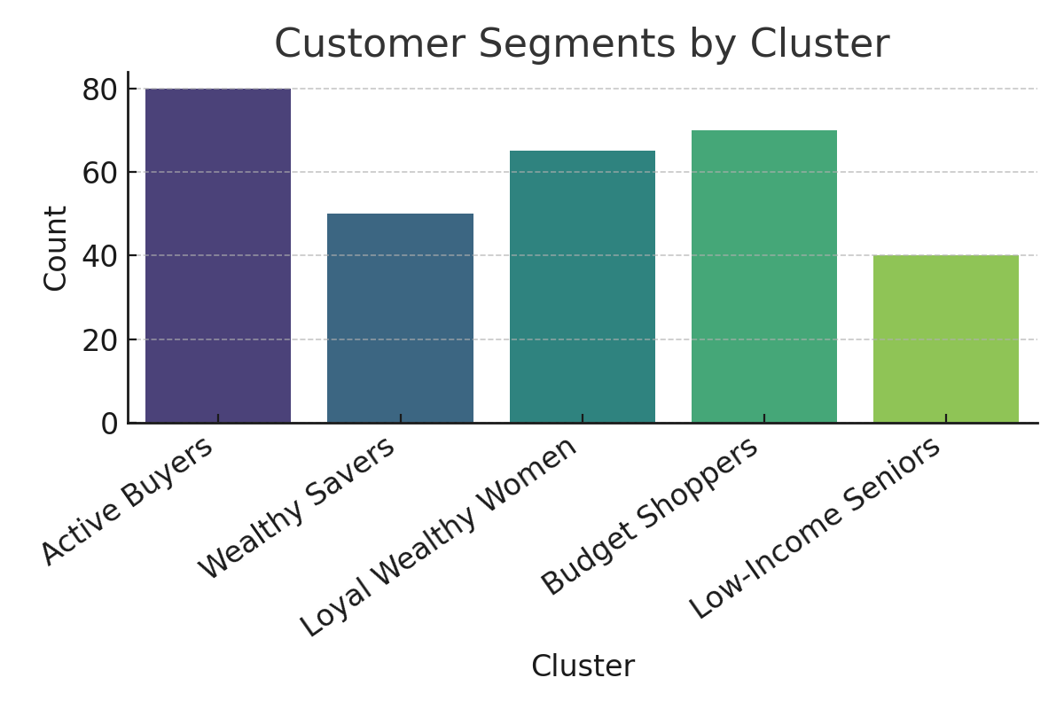
Customer Segments Overview

Slide 4
Cluster Insights Summary
1. **Active Buyers:** Young, average income, high spenders. Focus on promotions and loyalty. Cluster 2
2. **Wealthy Savers:** High income, low spenders. Emphasize value and premium offers. Cluster 1
3. **Loyal Wealthy Women:** High income, moderate spending, loyal. Maintain engagement. Cluster 3
4. **Budget Shoppers:** Young, low income, moderate spenders. Provide affordable options. Cluster 4
5. **Low-Income Seniors:** Older, low income, low spenders. Offer health-oriented, affordable plans. Cluster 0

Slide 5
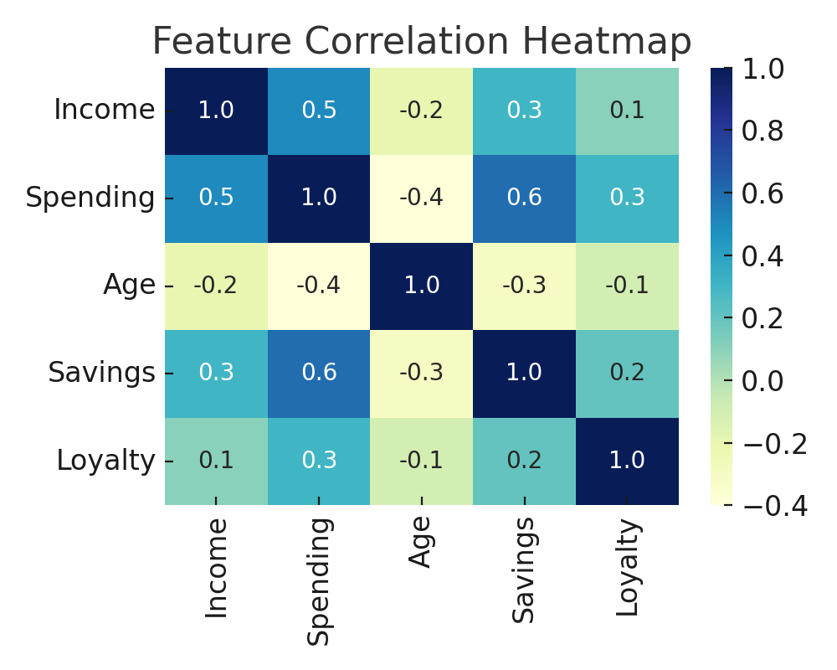
Feature Relationships

Slide 6
Recommendations
• Focus marketing on Active Buyers and Loyal Wealthy Women.
• Introduce personalized and tiered pricing strategies.
• Build loyalty programs to retain high-value customers.
• Offer affordable packages for Budget Shoppers and Seniors.
• Use continuous data monitoring to adjust strategies based on behavior changes.

Slide 7
Thank you
Project by EZEANOCHIE CHIDERA QUEENETH

