Slide 1
Active Directory
活動目錄 AD & 羽量級 LDAP

Slide 2
Table of Contents
Active Directory
Directory Service (X.500)
LDAP Client
LDAP
Feautues
Duplica & Deploy
Other Application

Slide 3
What is AD, Active Directory?
It is originated from DS, Directory Service, an organized and ACL-functional system with storage.
One directory maps itself to key/val pair, maybe the name and attribute.
And this system is aim at providing service to File System.

Slide 4
DS (Directory Service) Schema applies everywhere
Below Phone Directory, DNS, FS, and so on are Object, and the info about the Object is stored as Attribute. User with certificates will be allowed to access to the Object and to r/w the Attribute.
If we want to design a complicate directory service, the info (or called attributes hereby) may include: UserID, SSL certificate, Devices, Apps Config, those authority is setup to access the Object to R/W its Info.
Phone Directory: Name, mobile phone number
DNS: domain name, IP address
OS: printer, users accounts whitelist
FS: directory node name, child node (can be sub-directory or files)

Slide 5
How to create AD?
To create AD using ADSI, Active Directory Service Interface. Developer can create AD by connecting & accessing ADSI, we can think this interface is a DB, it has schema, and can execute CRUD operations.
By using freeware LDAP client tool software to create LDAP:
OpenDJ (cross-platform)
Active Directory Explorer (micosoft)
LDAP Admin(micosoft)
NetTools(micosoft)
OpenLDAP (cross-platform)
Apache Directory Server/Studio(cross-platform)
Links: https://en.wikipedia.org/wiki/List_of_LDAP_software

Slide 6
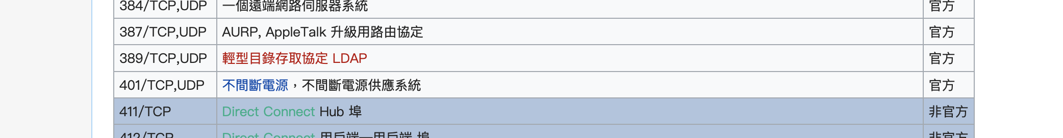
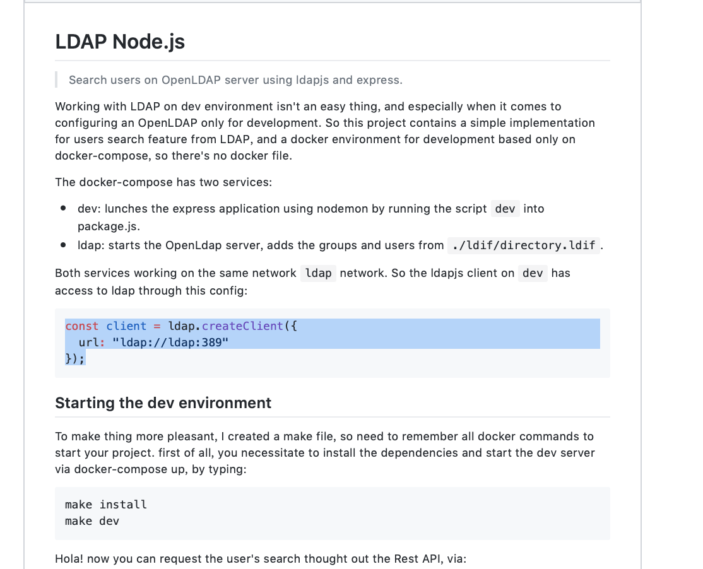
LDAP Client

Slide 7
OpenDJ

Slide 8
.ldif (LDAP filename extension)
The LDAP Data Interchange Format (LDIF) is a standard plain text data interchange format for representing LDAP (Lightweight Directory Access Protocol) directory content and update requests.
LDIF conveys directory content as a set of records, one record for each object (or entry). It also represents update requests, such as (CRUD) Add, Modify, Delete, and Rename, as a set of records, one record for each update request.

Slide 9
LDAP, Lightweight Directory Access Protocol
Key is entry, value is attribute, it consists of a k/v pair as one schema.

Slide 10
Apple Open Directory (using LDAP)
Apple Open Directory is a fork of OpenLDAP.
A lightweight DS software that store info about user and resource (ACL).
p.s.
With the release of osX 10.5, Apple chose to move away from using the Netinfo directory service which had been used by default for all local accounts and groups in every release of osX 10.0 ~ 10.4. Mac OS X 10.5.
Local accounts are now registered in the Local Plugin, which uses XML property list (plist) files stored in /var/db/dslocal/nodes/Default/ as its backing storage.

Slide 11
Features in DS
IAM
Cerificate

Slide 12
Difference between Duplica & Deployment
Duplica
Deploy
For LB-purposed.
For Decentralized-purposed.

Slide 13
Other Applications
SAP solution Manager
IBM Tivoli Directory Server
Apple Open Directory (macOS)
Apache Directory Server

