Slide 1

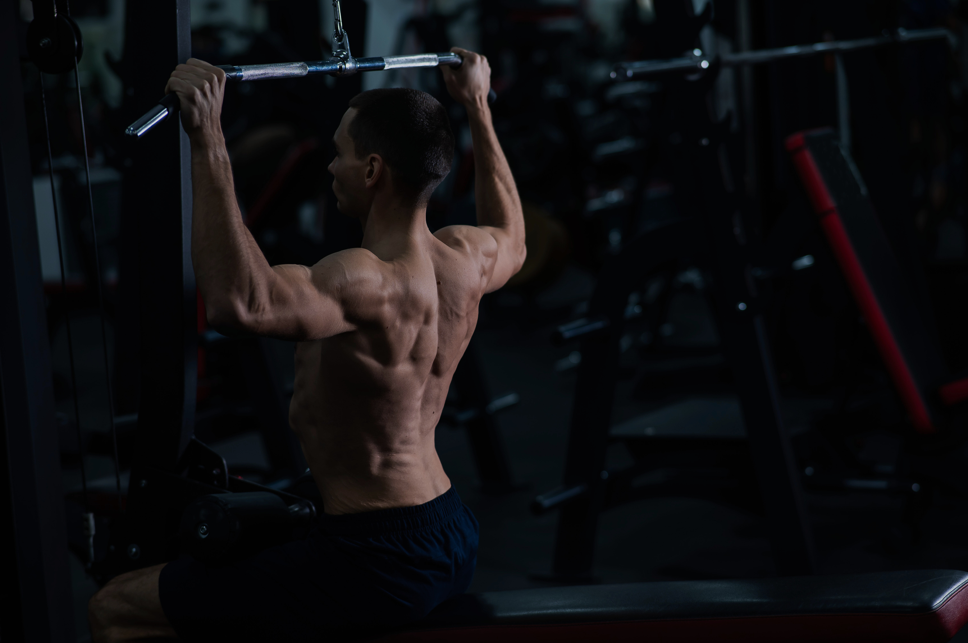
Quentin clément
ALGOSUP
Lift
GUARD

