Slide 1
Outlier Exclusion Procedures Must Be Hypothesis-Blind
Quentin André

Slide 2
Outliers?
It is common to identify (and often exclude) outliers:
Values that are « too far removed » from the rest of the data
… But from the rest of which data?

Slide 3
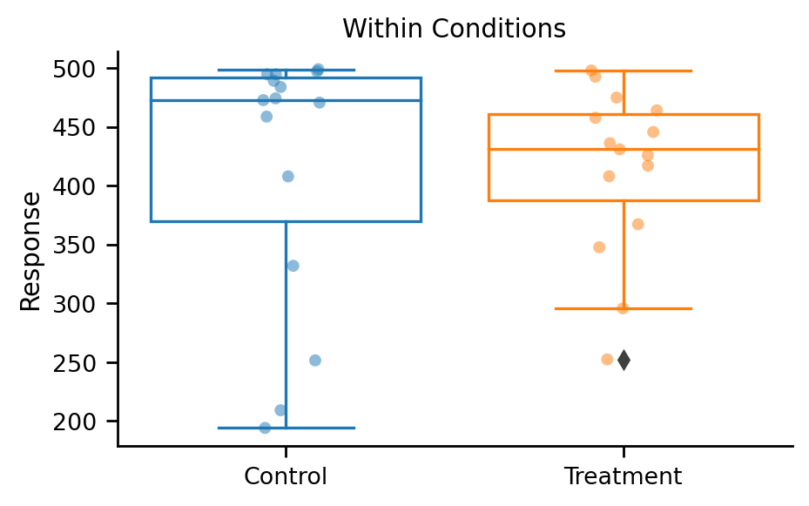
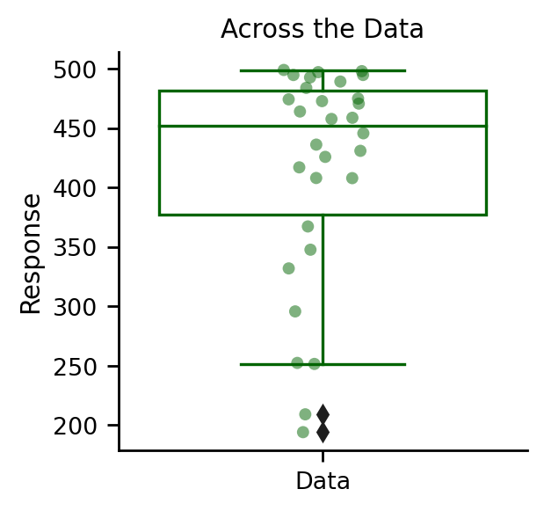
An Illustration with Boxplot

Slide 4
What Has Been Argued?
“…”
“[…] the outliers should first be searched for within condition across the participants.”
“Furthermore, the exclusion rule should be applied by condition. That is, we need to use the standard deviation and mean of the condition in which the outlier occurs.”

Slide 5
The Correct Answer?
✗
✓

Slide 6
But Why?
In the experiment, we test against the null that the responses in two conditions are drawn from a common distribution…
… But if we exclude outliers by condition, we have already rejected the null that the two conditions are drawn from a common distribution!
Worse, we are making the two conditions more dissimilar!

Slide 7
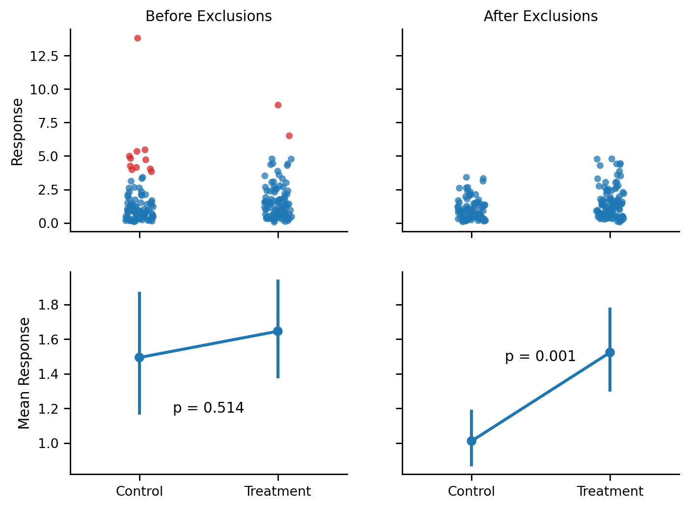
How So?

Slide 8
How So?

Slide 9
How Bad Can This Be? Simulated Experiments
243 experimental settings, varying:
Sample sizes (N = 100, 200, 500)
Data types (Normal, Normal with Outliers, Log-Normal)
Statistical test (Welsch, Mann-Whitney U, Kolmogorov-Smirnov)
Exclusion thresholds (z-score, IQR, MAD)
Exclusion methods (1.5, 2, or 3 times the z-score/IQR distance/MAD)
Run 20,000 simulated experiments in each setting, and compute p-values with:
No exclusion
Exclusions across data
Exclusions within conditions

Slide 10
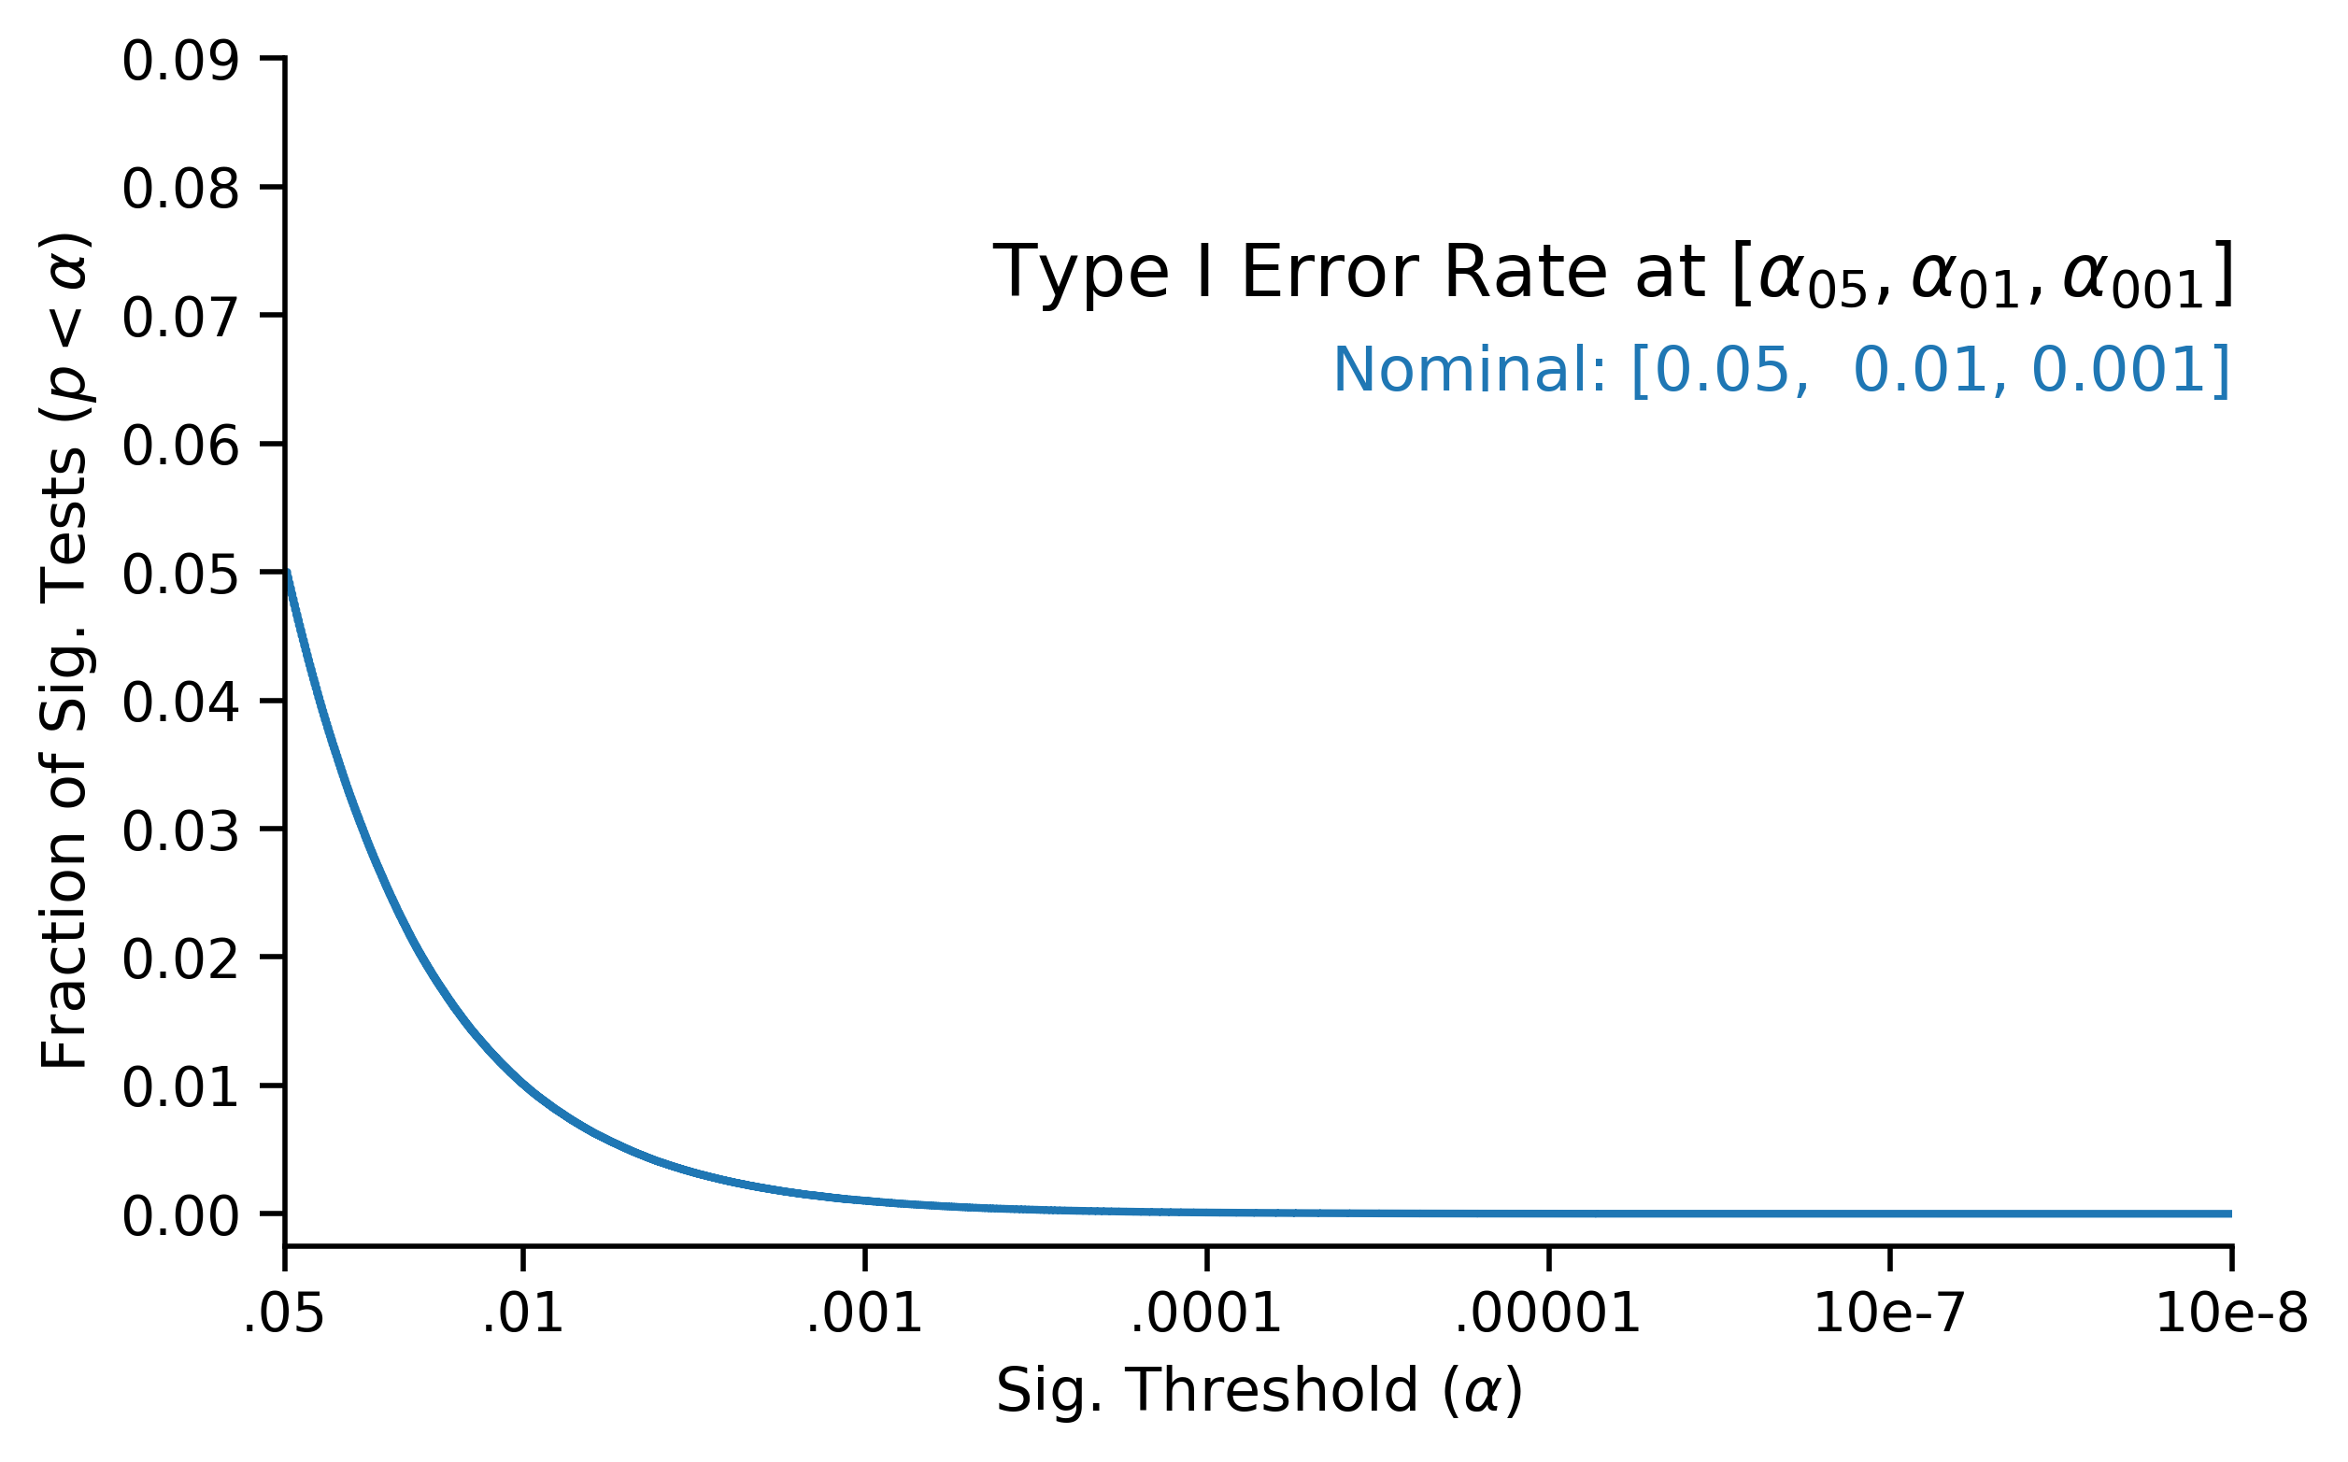
Results - Simulated Experiments

Slide 11
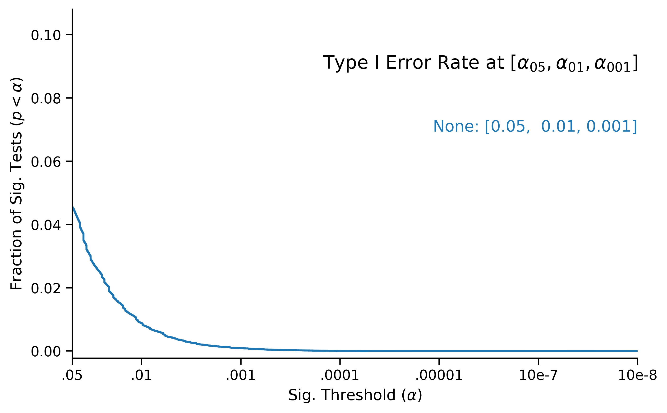
Results - Simulated Experiments

Slide 12
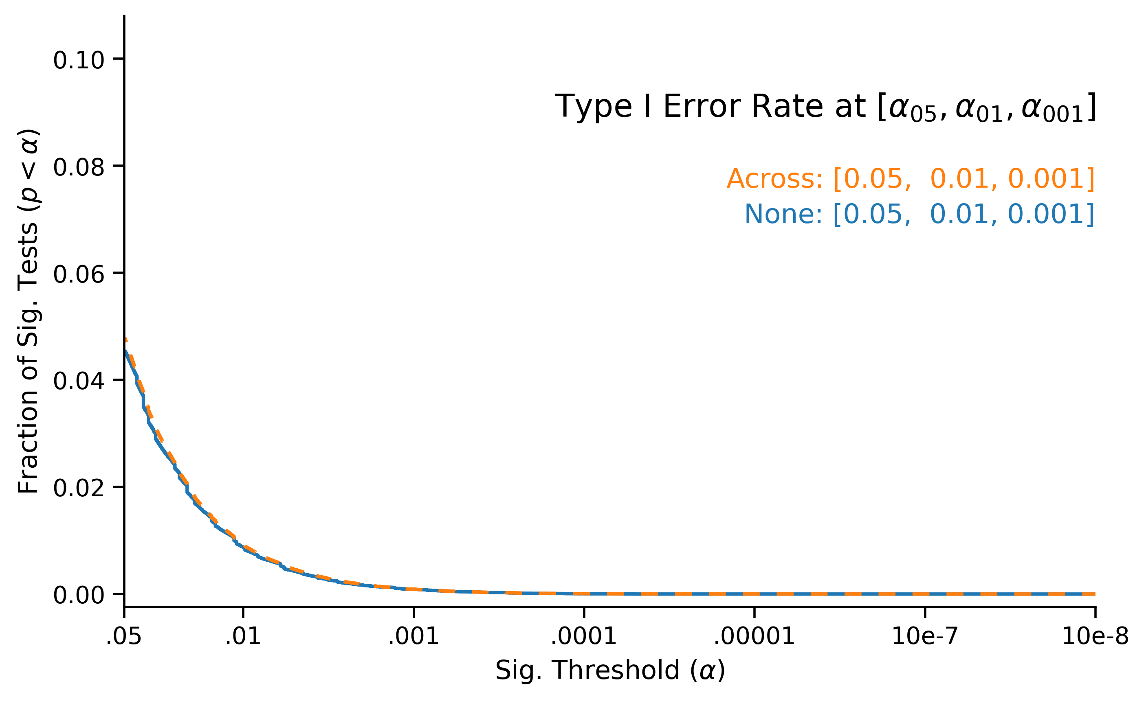
Results - Simulated Experiments

Slide 13
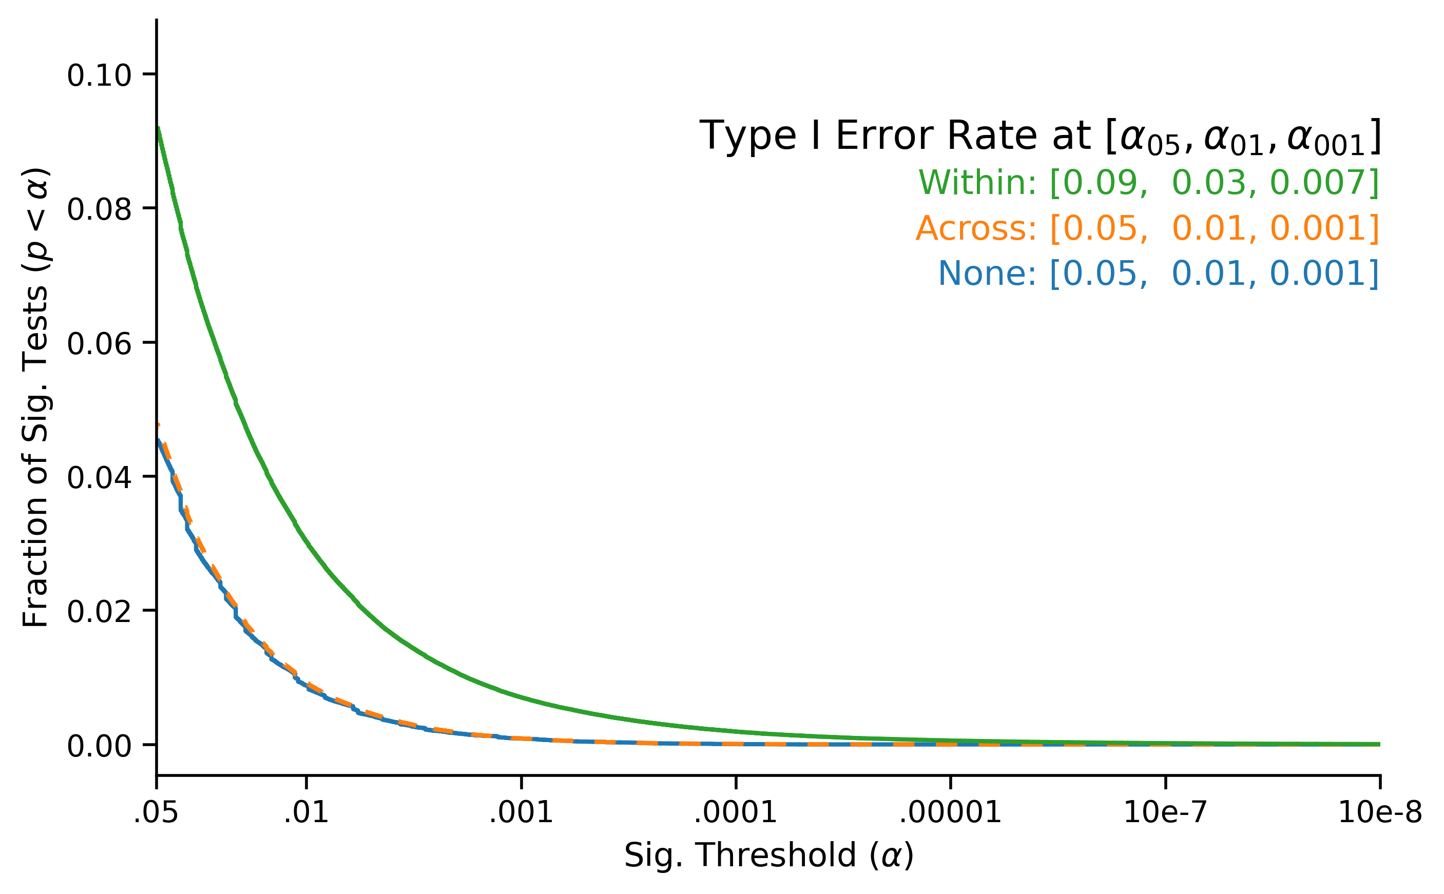
Results - Simulated Experiments

Slide 14
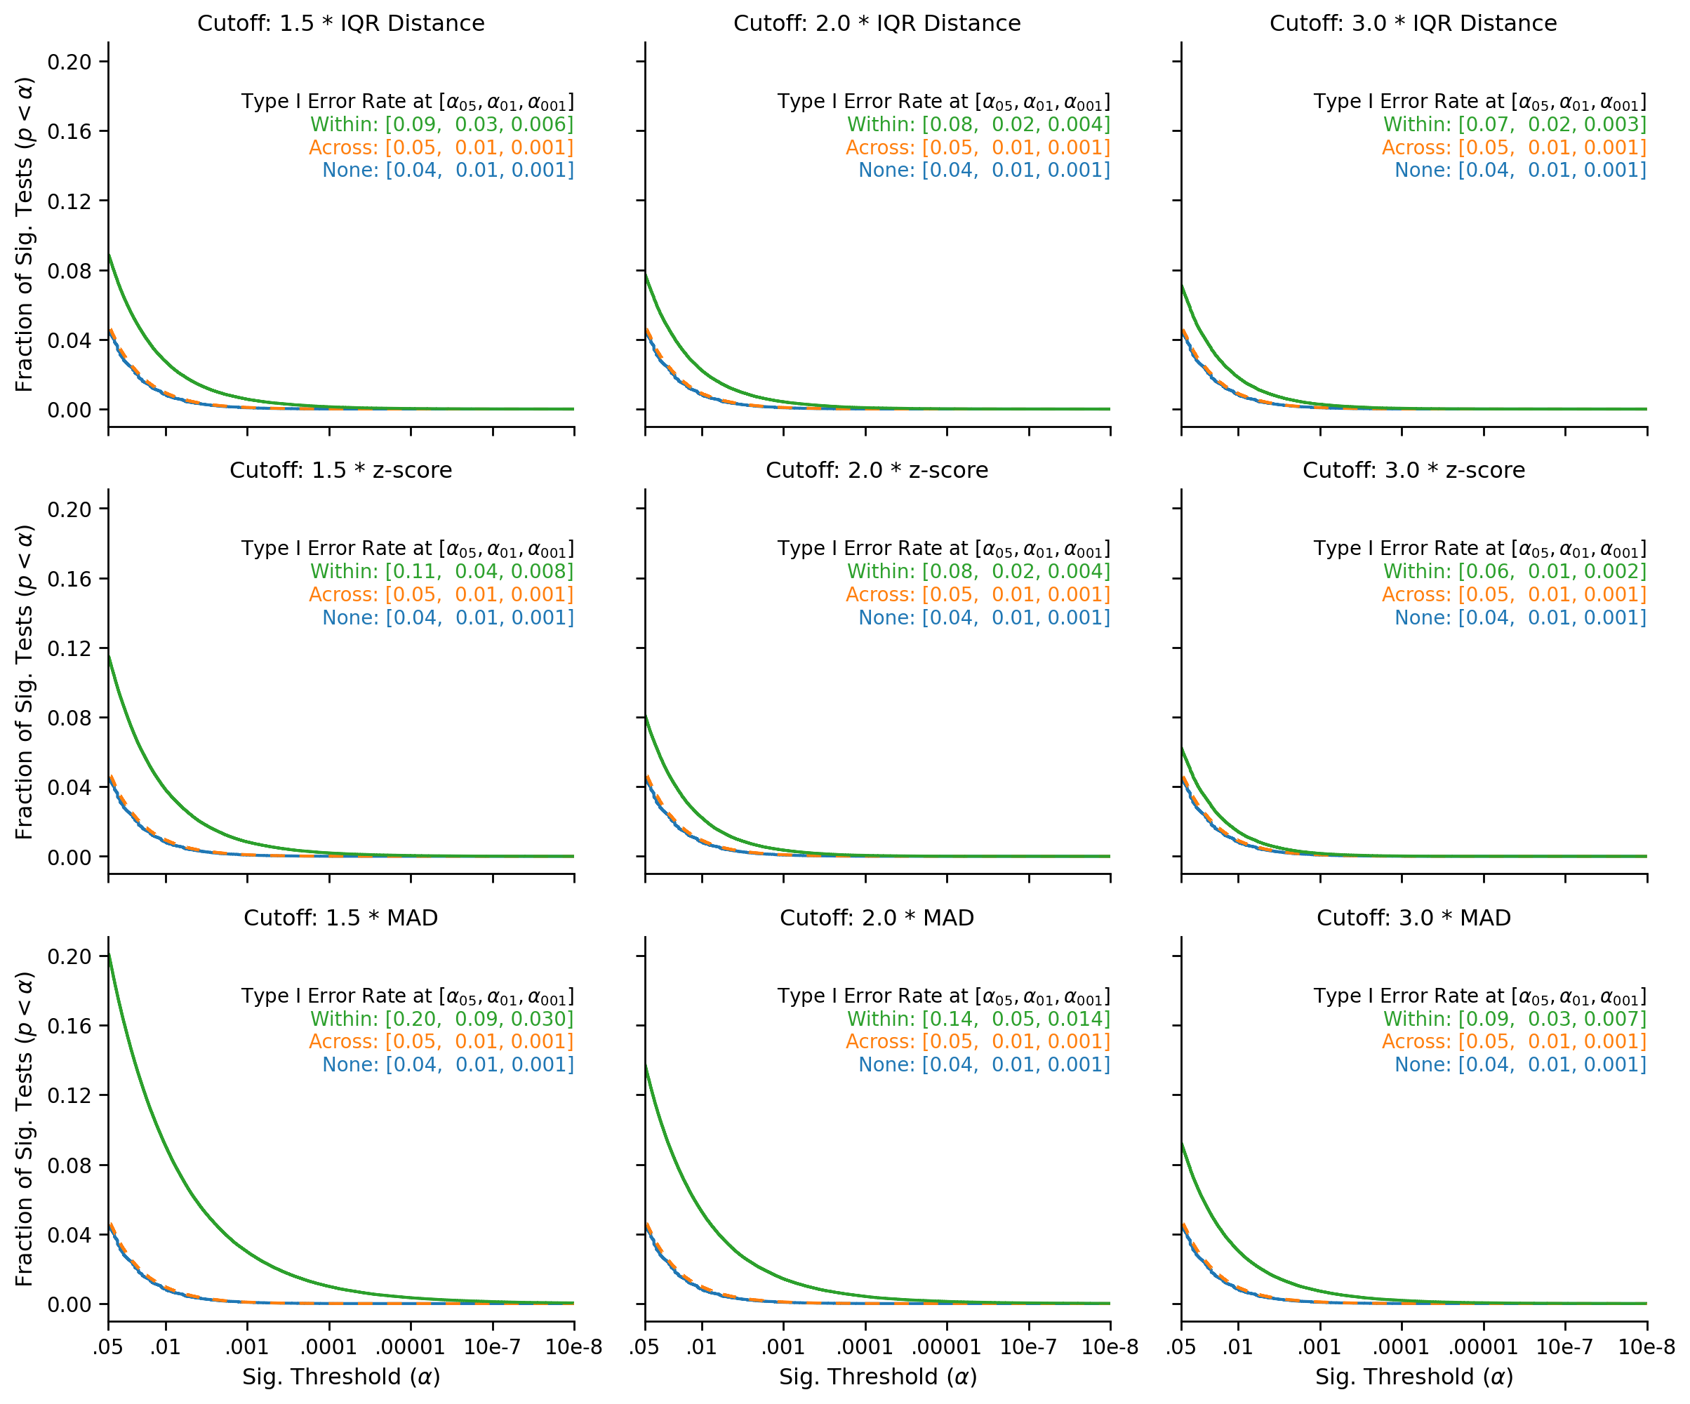

Slide 15
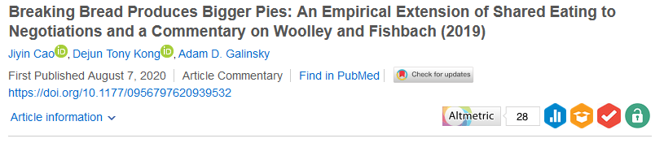
What About Real Data?
Pre-Registered + Open Data
Outliers are excluded by conditions, iteratively.

Slide 16
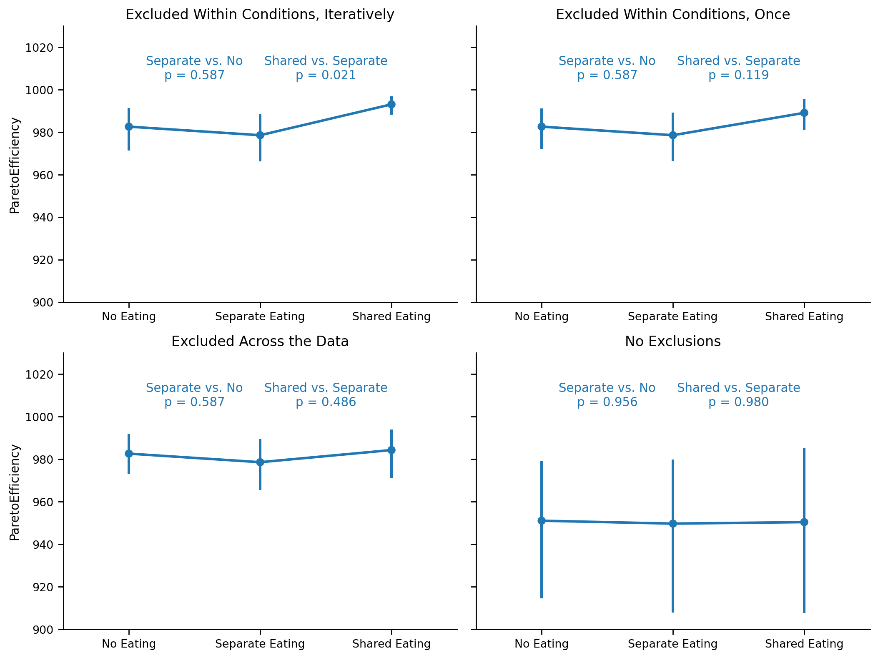
What About Real Data?

Slide 17
What About Real Data?

Slide 18
Simulation – Real Data
Simulated « null datasets », drawn from the authors’ data
Replicate the authors’ pre-registered analysis, and check how often we observe a false-positive in these datasets

Slide 19
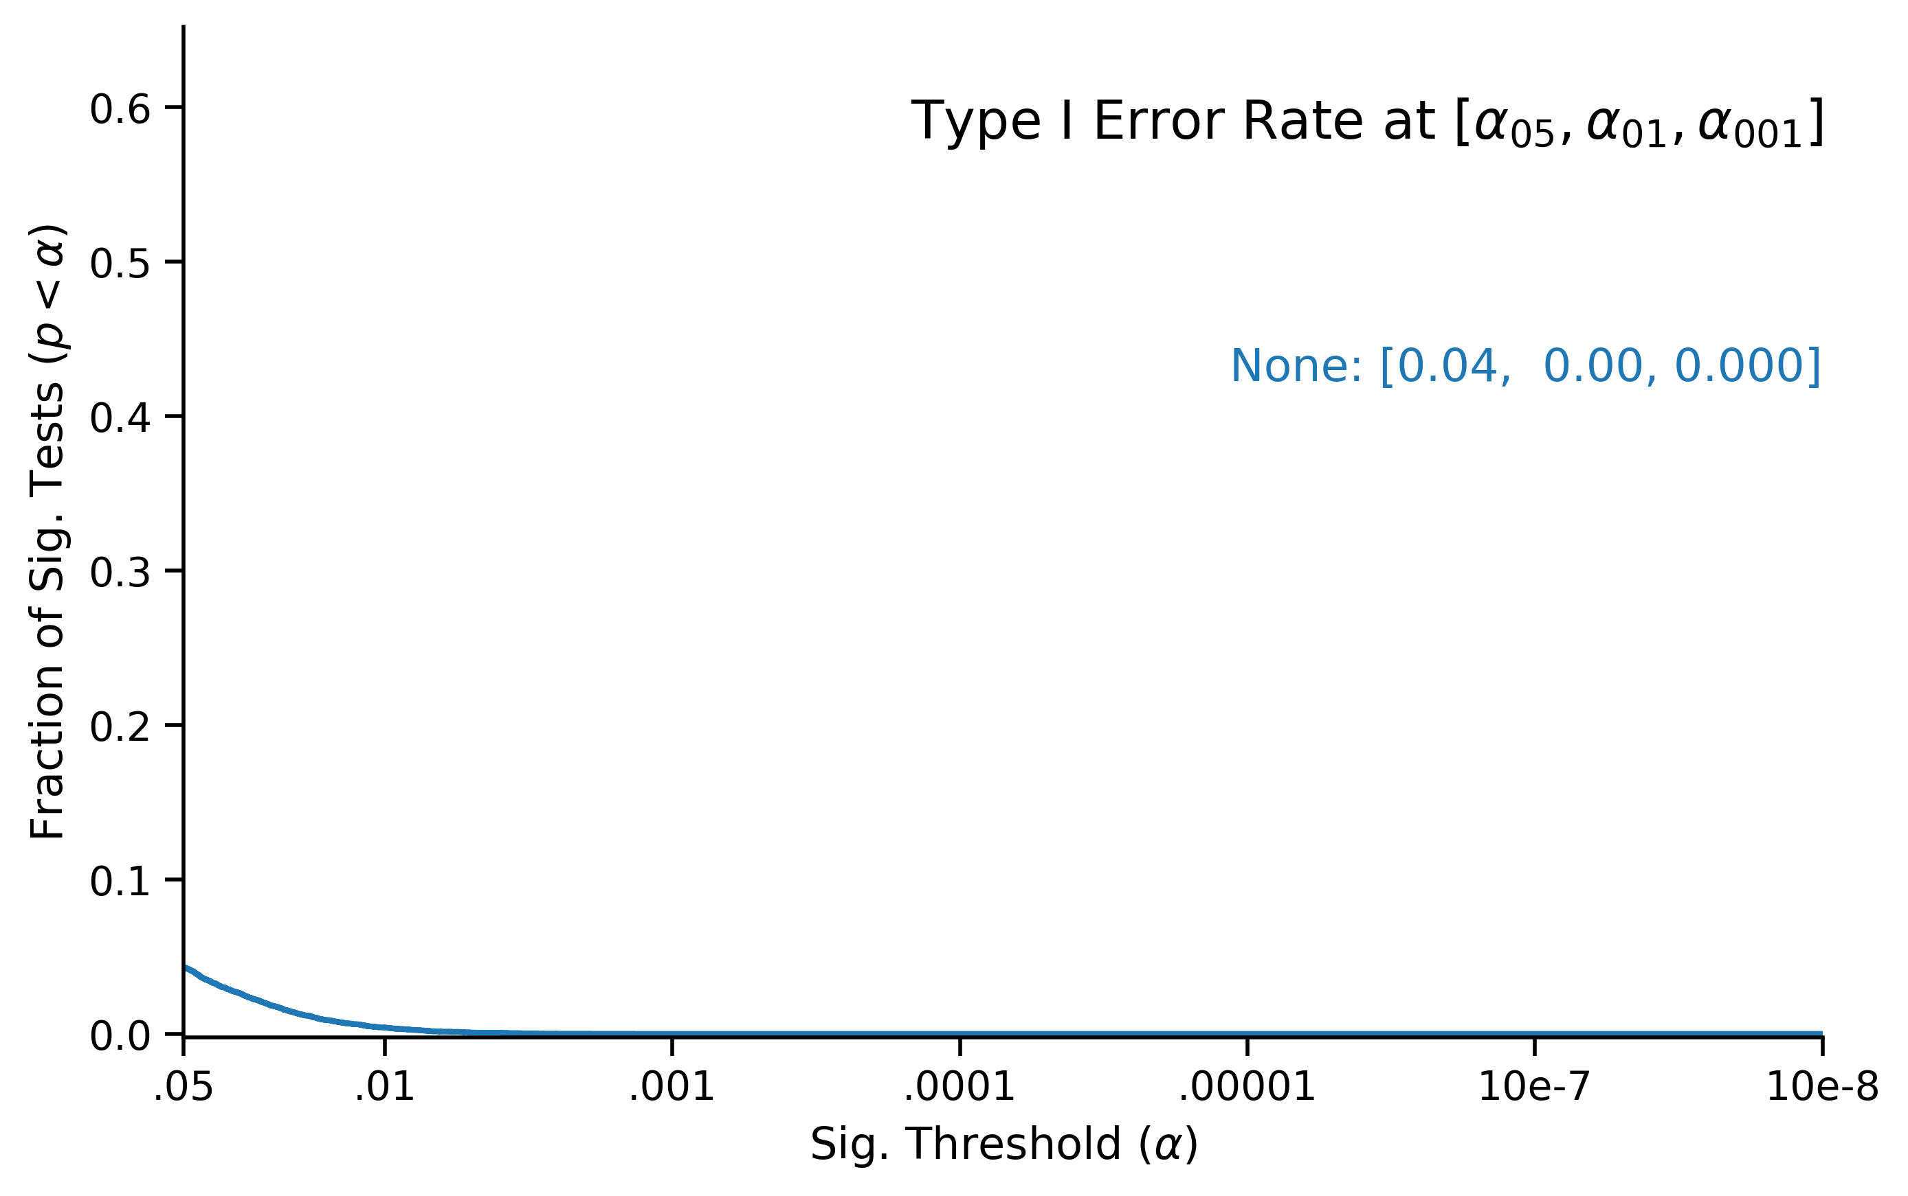
Results – Real Data

Slide 20
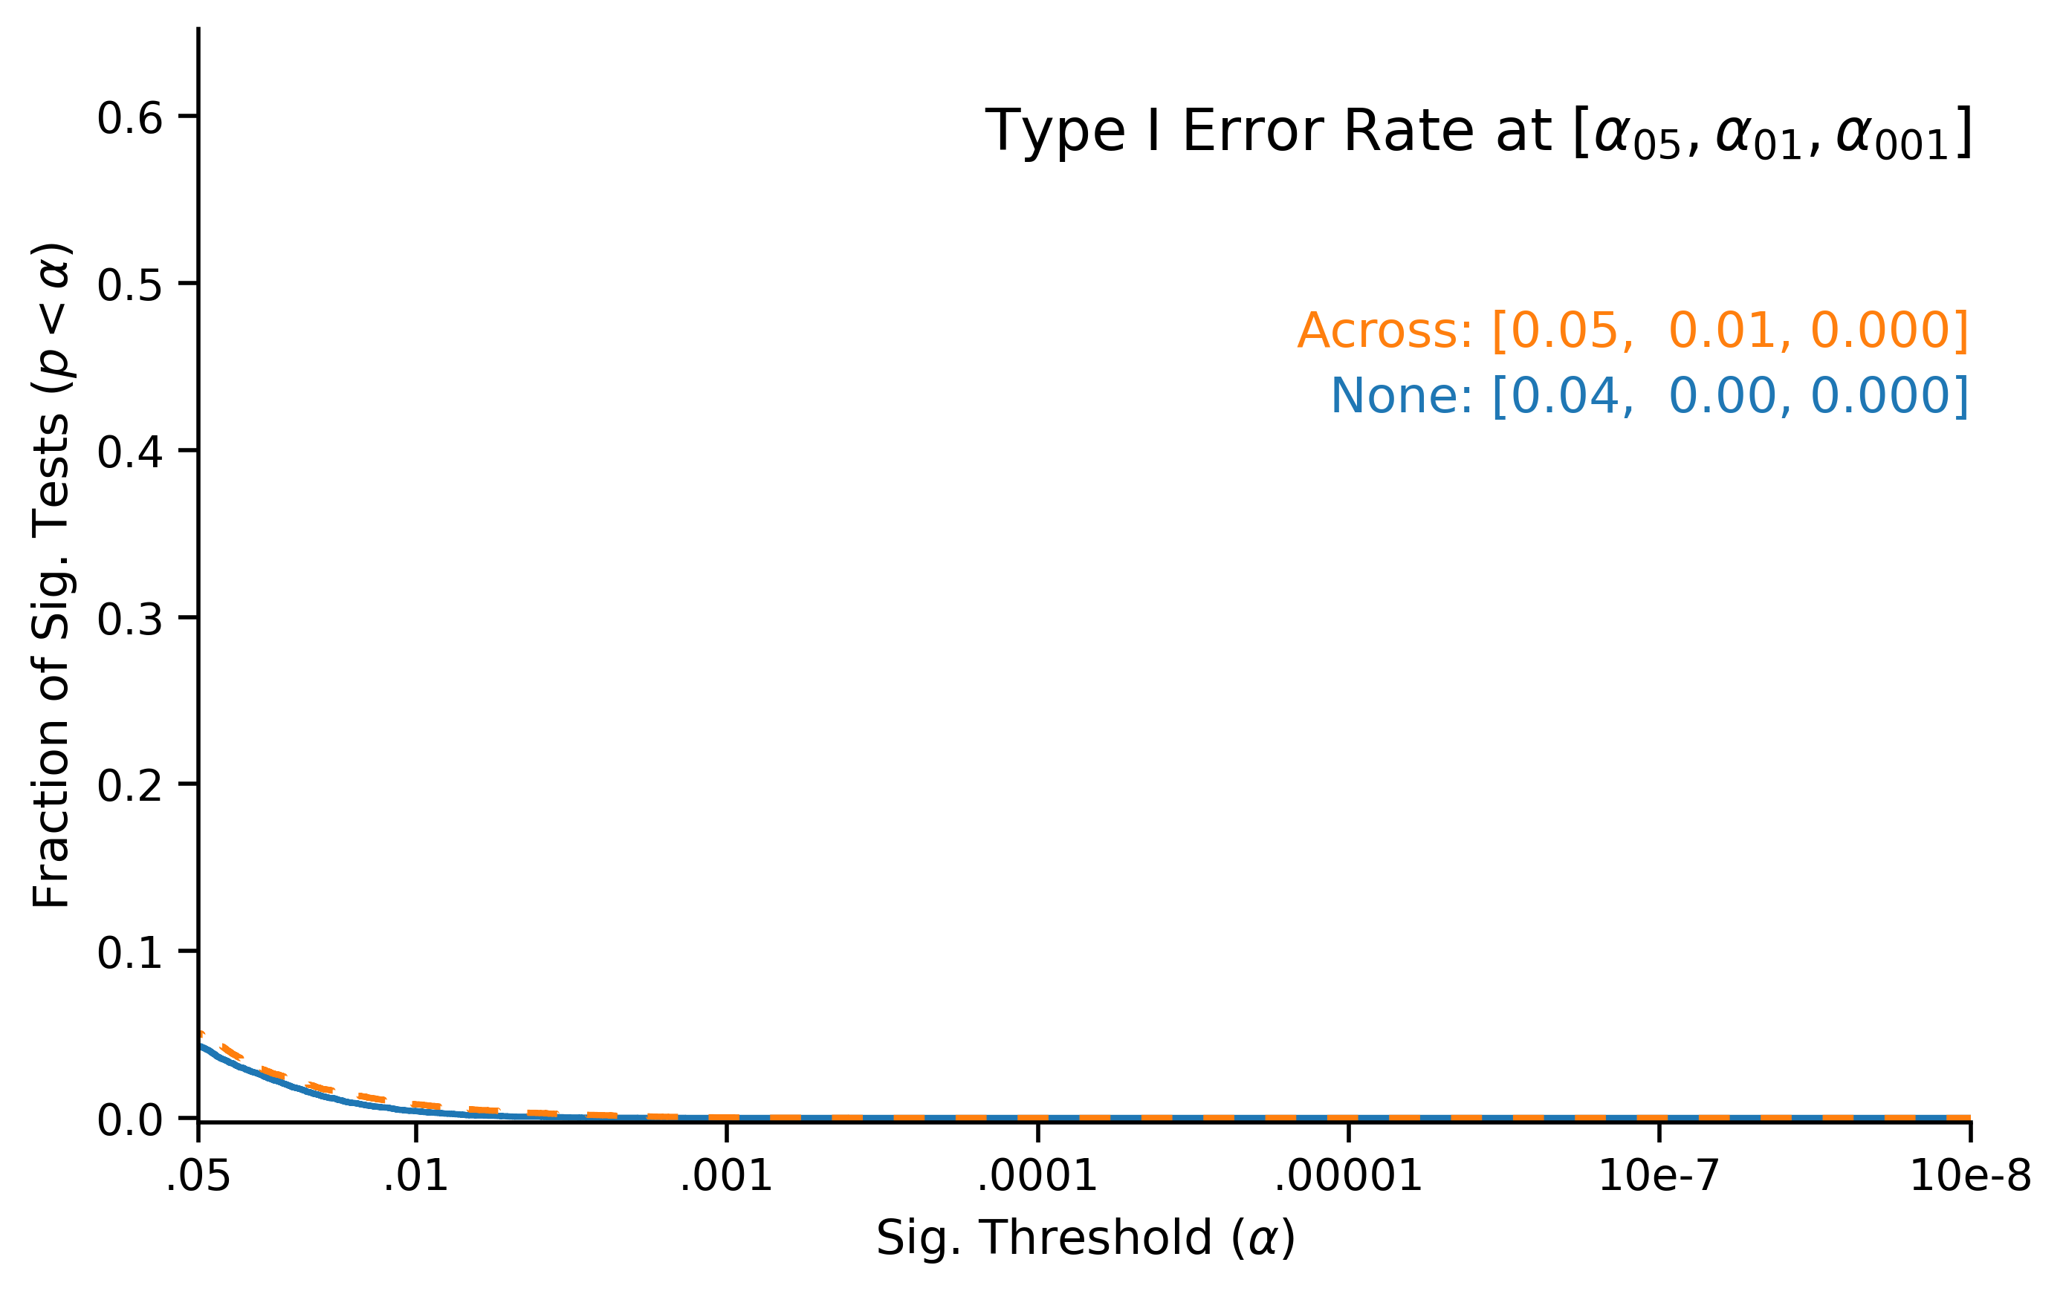
Results – Real Data

Slide 21
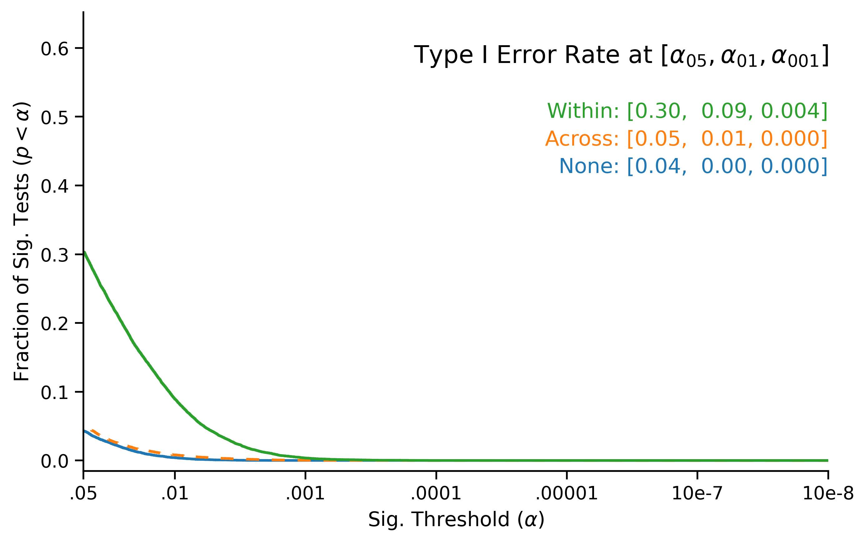
Results – Real Data

Slide 22
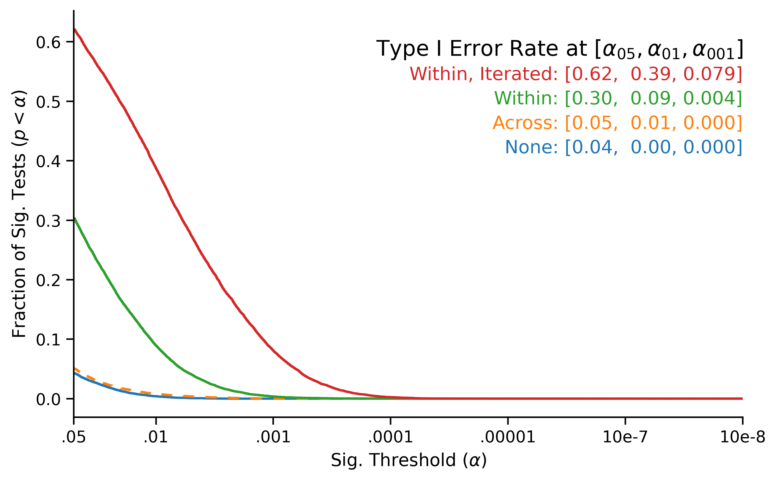
Results – Real Data

Slide 23
But What About Power?
Within-condition exclusions will give you more power to detect an effect, so can’t there be a trade-off?

Slide 24
Power Cannot Justify Within-Condition Exclusions
The tradeoff between Type I and Type II error is a fundamental property of statistical testing.
If you set 𝛼 = .20 rather than 𝛼 = .05, you will reject the null more often, both when you should and shouldn’t.

Slide 25
Power Cannot Justify Within-Condition Exclusions
… But with within-condition exclusions, you don’t know how much you are trading!
Simulations show that 𝛼 can be as low as .06, or as high as .30… So how can you determine if the trade-off is worthwhile?
And if you get a significant result, you cannot judge how likely this result is under the null!

Slide 26
Conclusions
Within-condition exclusions are common, but extremely damaging
They grossly inflate false-positive rates
They render the p-value uninterpretable
Unlike most Questionable Research Practices, they cannot be solved by pre-registration
The problem is in the method itself, not in the researchers’ degrees of freedom!
Don’t exclude outliers by condition, and flag within-condition exclusions when you review papers

Slide 27
Curious? Questions? Comments?
OSF: osf.io/3tz76/
DOI: 10.1037/xge0001069
https://quentinandre.net
Twitter: @andre_quentin

Slide 28
Residual-Based Exclusions?
Observations whose residuals are « too extreme»...
… But again, which residuals?
Notes:
Outliers are

Slide 29
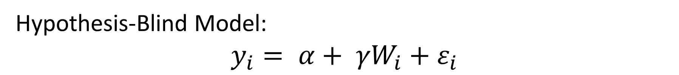
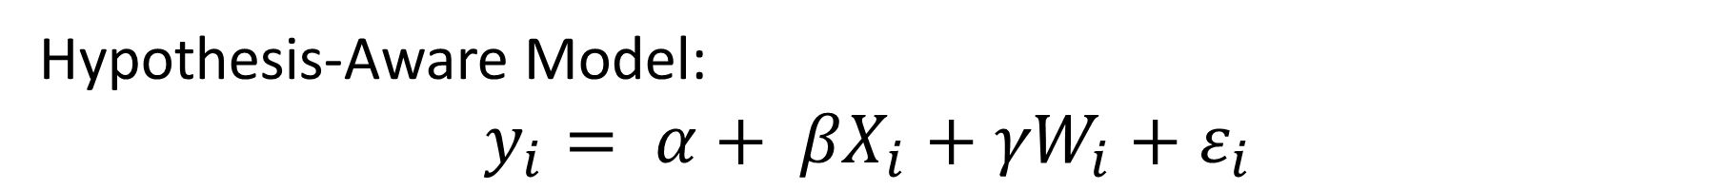
Two Types of Residuals
Key Predictor
Hypothesis-Aware Model:
$$y_{i}= α+ {{βX}_{i}+{γW}_{i}+ε}_{i}$$
Predictor-Aware
Residuals
Covariates
Hypothesis-Blind Model:
$$y_{i}= α+ {{γW}_{i}+ε}_{i}$$
Predictor-Blind
Residuals
Covariates

Slide 30
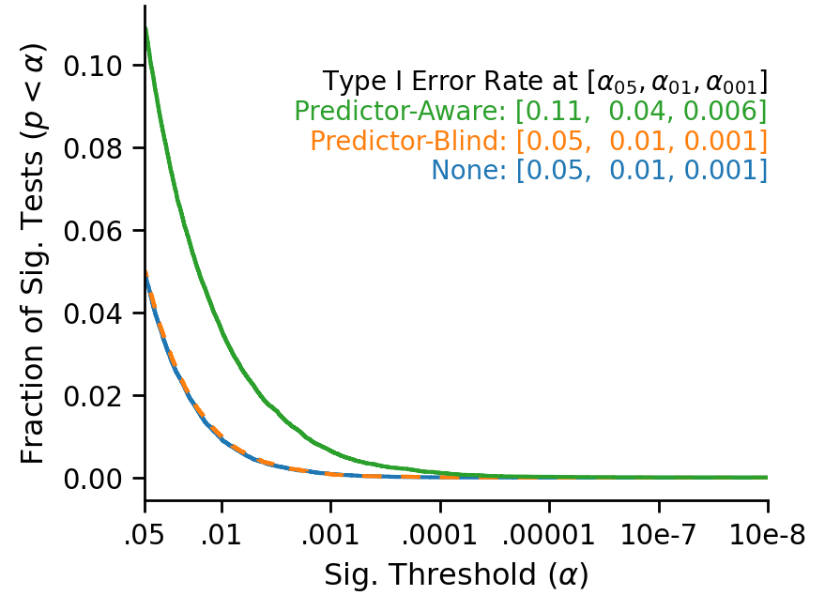
Simulated Experiments

